Slide 1
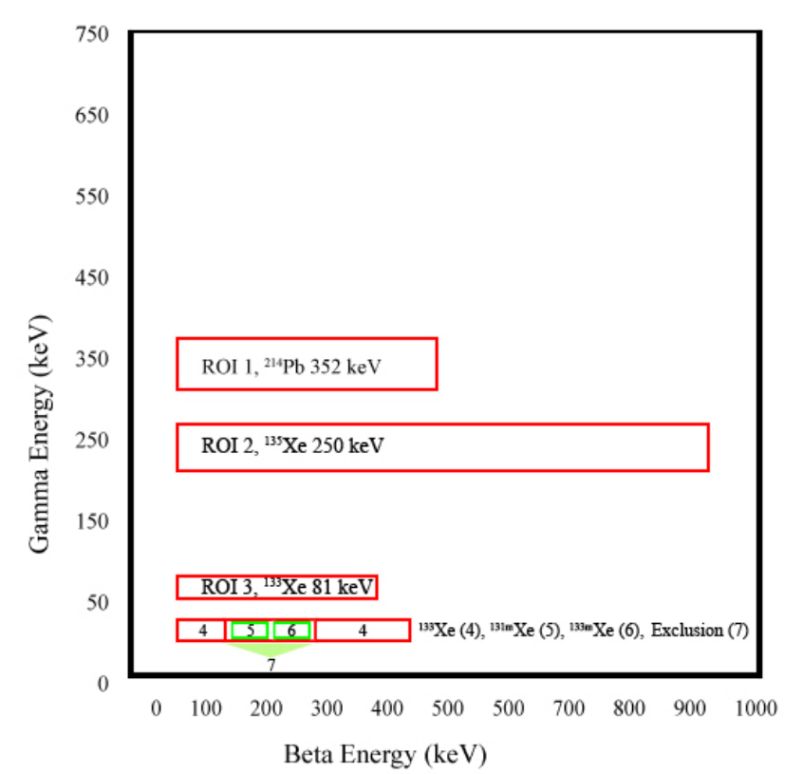
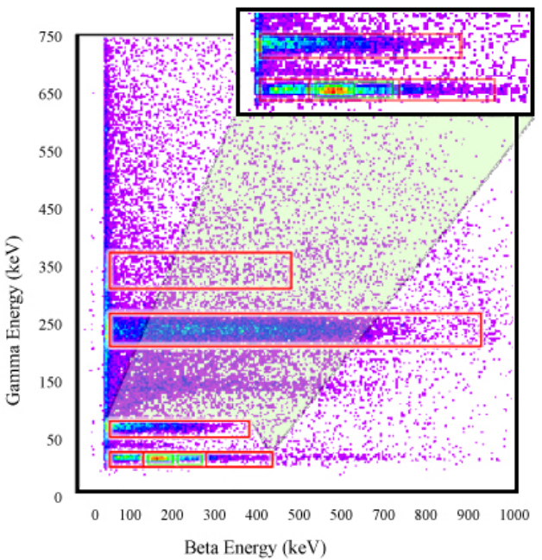
Long-Term Radioxenon Detector Background: 1st year results
Rose Perea, Matthew Cooper, Warnick Kernan, Michael Mayer, Johnathon Slack
Pacific Northwest National Laboratory
P3.6-274
Cooper, M.W., et al., https://doi.org/10.2172/1526738
The work presented here explores the environmental effects on radioxenon systems and how those might affect detector backgrounds and influence the minimum detector concentration of these systems.
While the beta and gamma rates differ between the detector systems, coincidence counts remained similar. MDA calculations are also similar between systems so far.
PNNL-SA-186263

