Slide 1
Long-Term Radioxenon Detector Background: 1st year results
Rose Perea, Matthew Cooper, Warnick Kernan, Michael Mayer, Johnathon Slack
Pacific Northwest National Laboratory
The work presented here explores the environmental effects on radioxenon systems and how those might affect detector backgrounds and influence the minimum detectable concentration and activity (MDC, MDA) of these systems.
Three different beta-gamma detection systems are currently being monitored. We have looked at day/night trends, 3-day trends, and monthly trends using time stamped data.
Beta and gamma rates vary significantly from system to system due to beta detector noise and foot traffic.
Night count rates are slightly higher than day.
Seasonal data is still being collected.
While the beta and gamma rates differ between the detector systems, coincidence counts remained similar. MDA calculations are also similar between systems so far.
Please do not use this space, a QR code will be automatically overlayed
This Ground-based Nuclear Detonation Detection (GNDD) research was funded by the National Nuclear Security Administration, Defense Nuclear Nonproliferation Research and Development (NNSA DNN R&D)
PNNL-SA-186263
P3.6-274

Slide 2
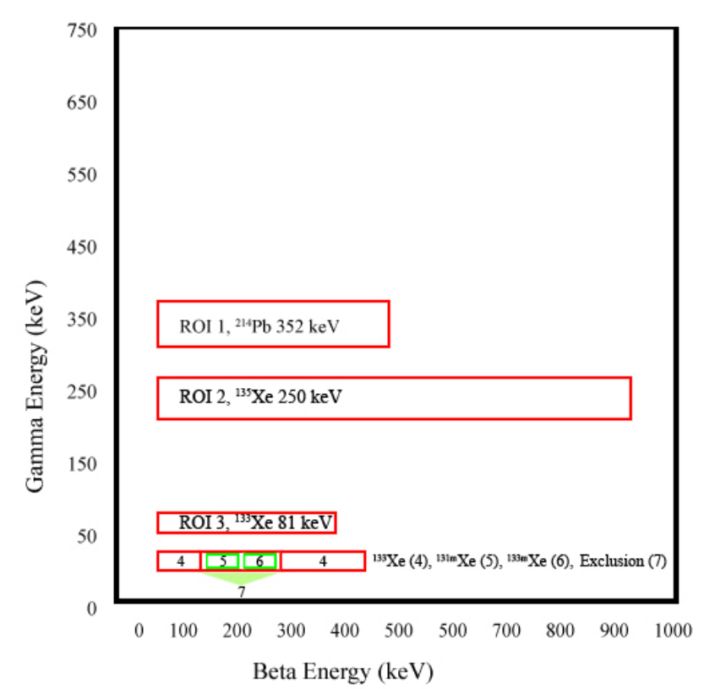
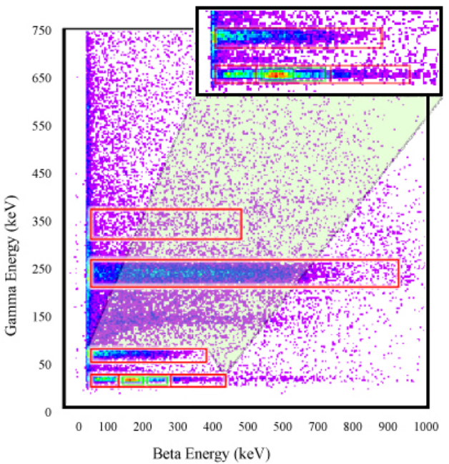
Introduction: Beta-Gamma ROIs
Cooper, M.W., et al., https://doi.org/10.2172/1526738
Beta-gamma radioxenon systems use a 7 or 10 ROI method to determine radioxenon isotope concentrations of Xe-135, Xe-133, Xe-133m, and Xe-131m.
Concentrations are determined from the Net Count Method which requires accurate detector backgrounds.
Please do not use this space, a QR code will be automatically overlayed
P3.6-274

Slide 3
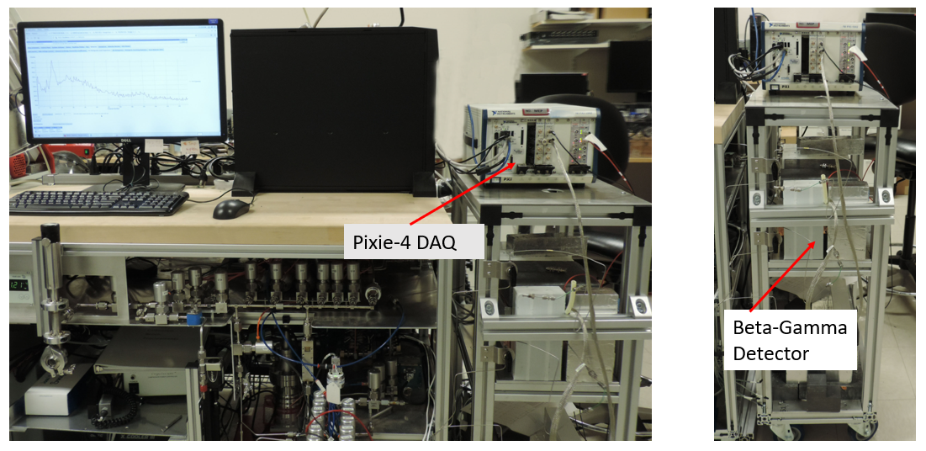
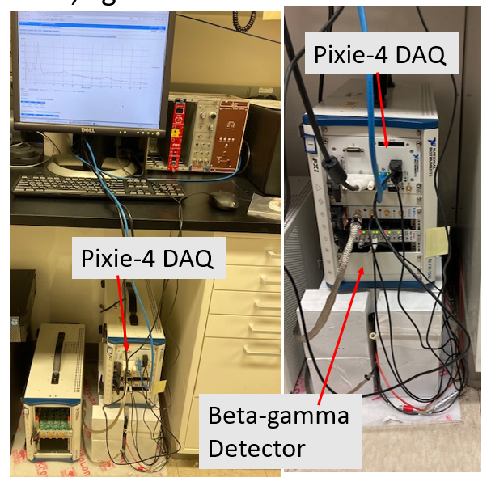
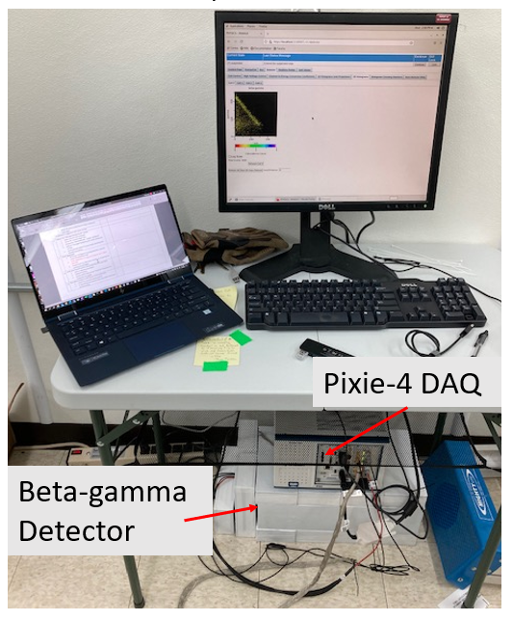
Beta-Gamma Detector Systems and Objectives
S1
S2
S3
Objective: Collect long-term detector background measurements from different beta-gamma detector systems. Look for trends in:
Day/Night Counts
Seasonal Counts
Other effects: People traffic, location, weather, room temperature, etc.
Please do not use this space, a QR code will be automatically overlayed
P3.6-274

Slide 4
Beta-Gamma Single Counts
Please do not use this space, a QR code will be automatically overlayed
Beta and gamma singles for all three systems. S1: Changes due to the system being vacuumed ~every week. S2: Increase in beta counts still being investigated. S3: Increase in beta counts due to low energy noise.
P3.6-274

Slide 5
Coincidence Counts
Please do not use this space, a QR code will be automatically overlayed
Beta and gamma coincidence counts for all three systems. Other than the variations in S1 due to the system being vacuumed, counts are similar despite the gamma and beta singles being different.
P3.6-274

Slide 6
Conclusion: Seasonal Counts and MDA So Far
Please do not use this space, a QR code will be automatically overlayed
S3 is more likely to experience seasonal variations due to its location, but that is not seen so far. MDA calculation shown is for S3 as well, but results are similar between all systems.
P3.6-274

Slide 7
References
Cooper, Matthew W., Hayes, James C., Schrom, Brian T., Ely, James H., & McIntyre, Justin I. Minimum Detectable Concentration and Concentration Calculations. United States. https://doi.org/10.2172/1526738
This Ground-based Nuclear Detonation Detection (GNDD) research was funded by the National Nuclear Security Administration, Defense Nuclear Nonproliferation Research and Development (NNSA DNN R&D)
Please do not use this space, a QR code will be automatically overlayed
PNNL-SA-186263
P3.6-274

