Slide 1
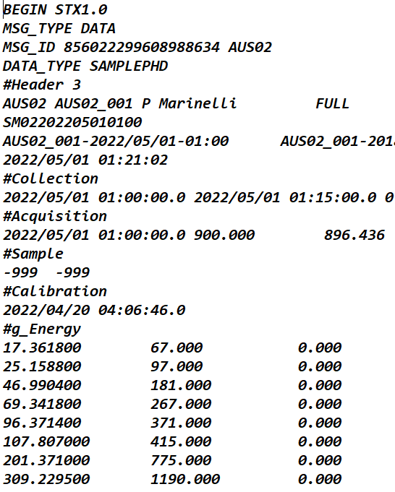
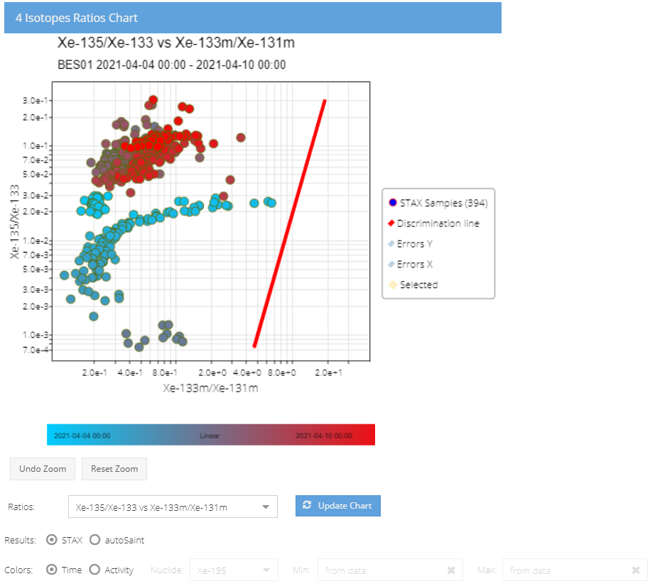
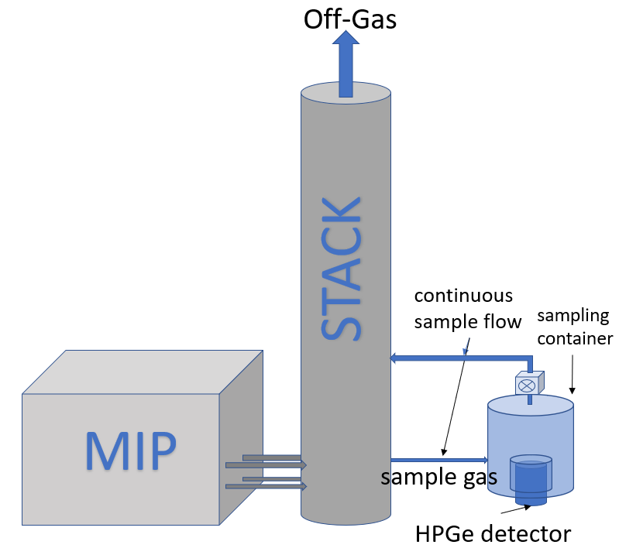
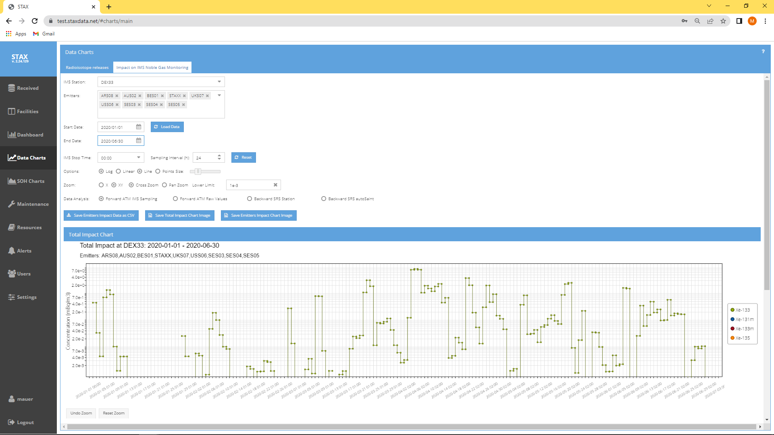
STAX (Source Term Analysis of Xenon) Data viewing software
M. Auer, K. Frechette, S. Hellman, M. Rizescu
Instrumental Software Technologies, Inc.
P3.6-658
STAX is an experimental network for measurement of emissions of xenon isotopes from Medical Isotope Production (MIP) facilities and other nuclear facilities. Using results from atmospheric transport modelling, the impact on the measured concentrations at IMS sites can be estimated
This e-poster demonstrates the processing, analysis, access and viewing of STAX data
Data retrieval and formatting
Data transmission and distribution
Data analysis and visualization
Supporting data interpretation
user 1
Impact at IMS sites
user 2
...
...
user n
Data storage,
processing
and distribution

