Slide 1

STAX (Source Term Analysis of Xenon) Data viewing software
M. Auer, K. Frechette, S. Hellman, M. Rizescu
Instrumental Software Technologies, Inc.
STAX is an experimental network to measure emissions of Xenon isotopes from medical isotope production facilities and other nuclear facilities. This poster gives an overview on access and viewing mechanisms for STAX data
The web-based STAX user interface offers a variety of data viewing perspectives such as operational status, state-of-health data, time-series and isotopic ratios charts for Xenon releases and charts on estimated impact at IMS (International Monitoring System) stations. Data can also be downloaded for further processing
Through a combination of measured Xenon releases from medical isotope facilities or nuclear reactors, and data from atmospheric transport simulations, concentrations at IMS stations caused by these emissions are estimated
Software has been developed that allows users to access and view data from STAX measurement systems and to view also the impact of emissions on IMS systems
Place your QR Code here after removing this text box!
P3.6-658

Slide 2
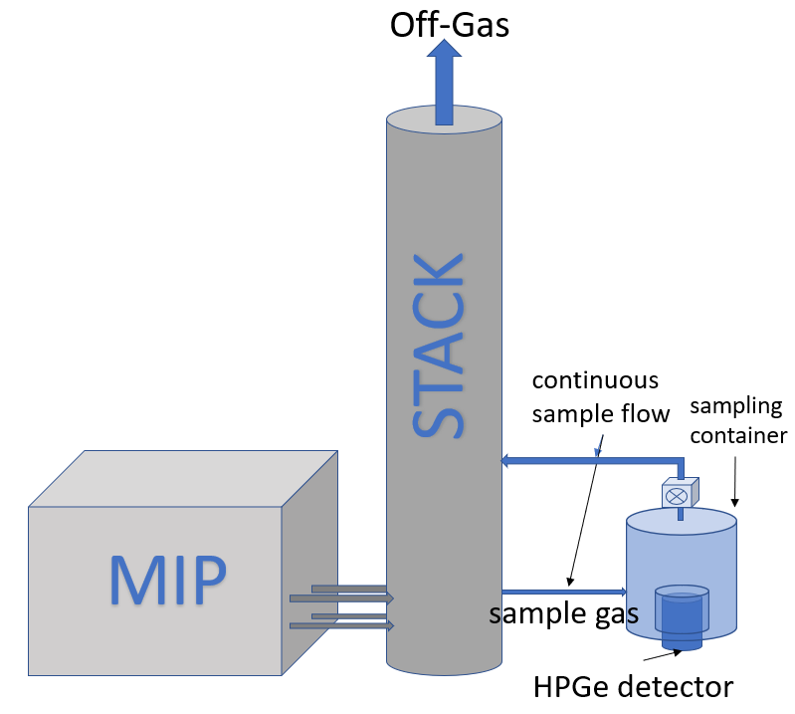




STAX network configuration
STAX (Source Term Analysis of Xenon) is an experimental network designed to detect and quantify radioxenon emissions from medical isotope production (MIP) facilities.
Measurement is performed at the stack of MIPs
using high resolution gamma spectroscopy
detection systems (HPGe detectors).
Each STAX system measures a sample every 15 minutes.
96 samples are produced daily per station and
data are transferred via secure email or https
to a central data processing server.
STAX monitoring systems architecture
STAX network architecture
STAX software
user 1
https
encrypted
e-mail
Download
Viewing
user 2
encrypted
e-mail
...
Place your QR Code here after removing this text box!
...
https
user n
Data storage,
processing
and distribution
P3.6-658

Slide 3
Objectives
Secure data transmission and controlled data access
Easy and versatile data access options for users
Provide a data viewing interface for users
Provide a first estimation of the impact of emissions at IMS stations
Data sent from monitoring facilities to data server via authenticated and encrypted e-mail messages or https
Data only accessible to authorized users and access is given per facility, so that a user only has access to their assigned facilities
Facility operators can set delays for sending of data, in order to allow for reviewing of data prior to distribution
Data are accessible via email, direct download (bash script) or can be viewed through the STAX GUI
A suite of charts is available to view emission data time series, isotopic ratios charts, impact charts, spectra and network status
Based on forward or optionally backward Atmospheric Transport Model (ATM) data, impact of emissions on concentrations at IMS stations is calculated
Place your QR Code here after removing this text box!
P3.6-658

Slide 4
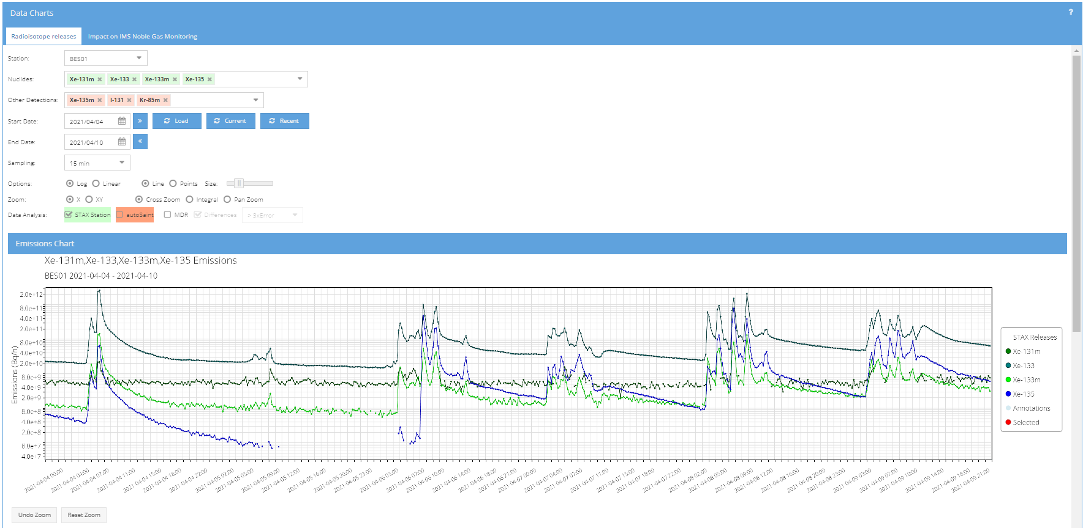
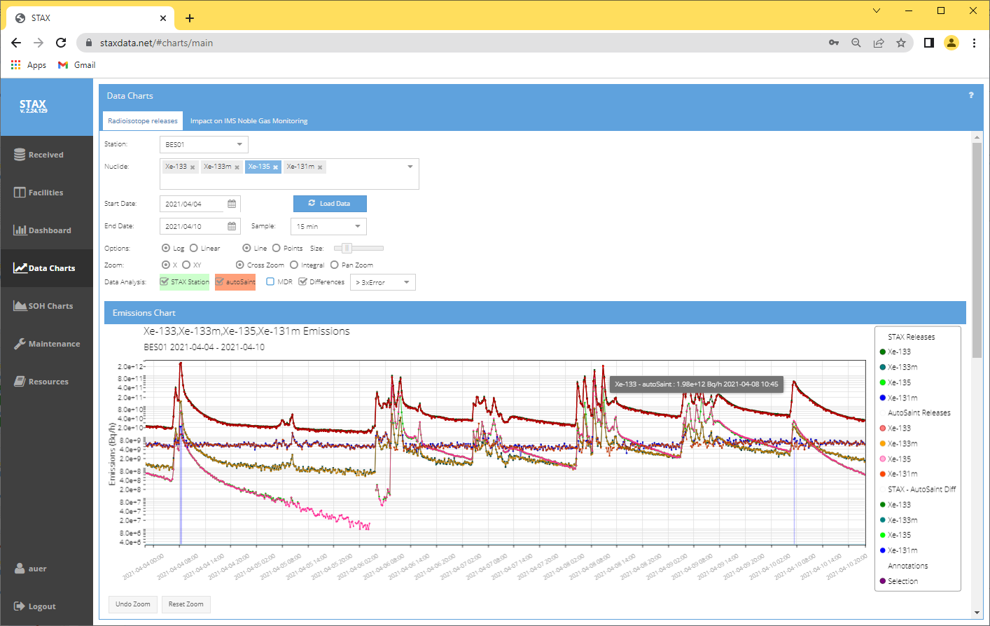
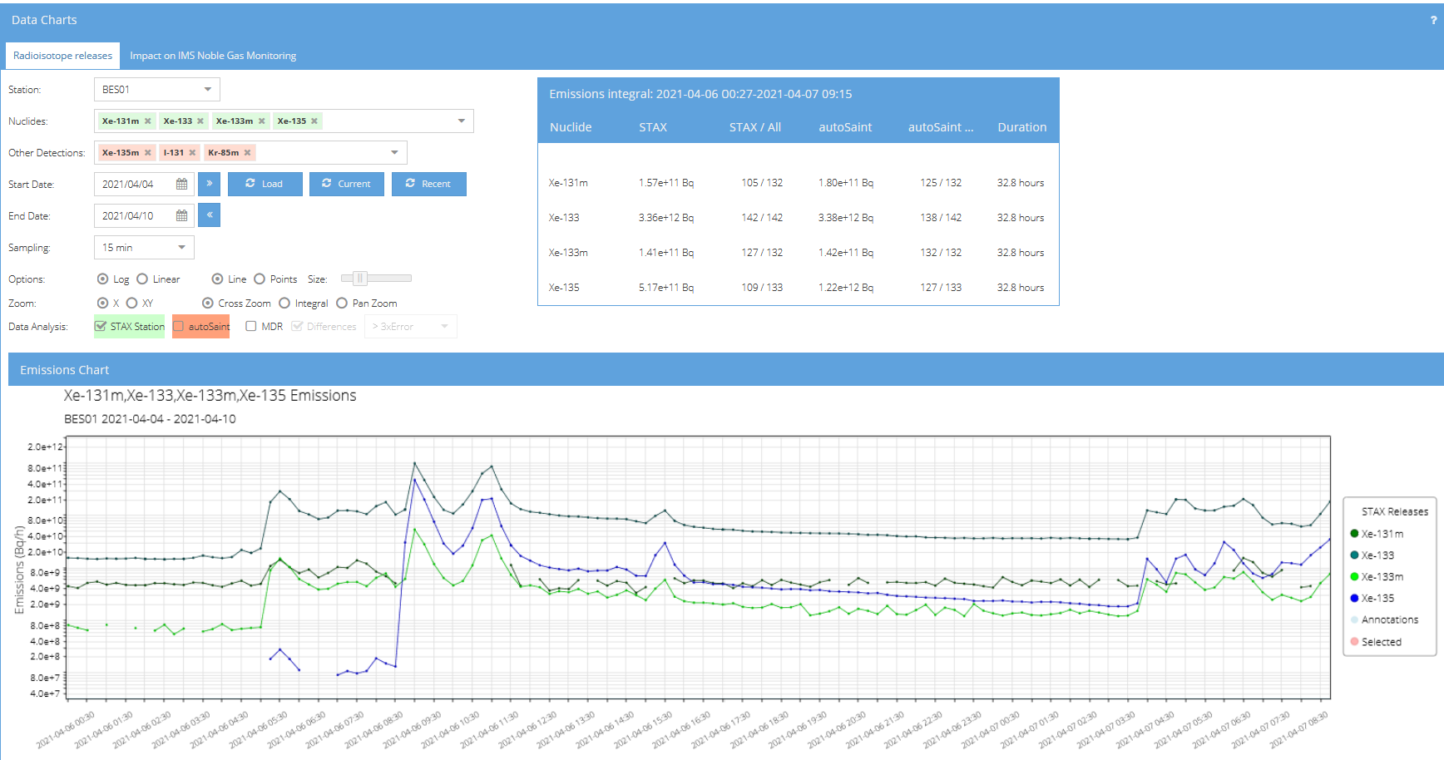
Data viewing – time series chart
Emission data can be viewed as time series of released amounts in Bq/h, in 15 minutes time resolution
Data analysis is automated. For quality control, data are analyzed twice: At the STAX system using the system‘s proprietary software and on the central STAX server using the autosaint software
Spectra can be viewed for each data point
Integral emission values for user selected time periods can be calculated
Data are initially analyzed by the STAX measurement systems
Emission values are calculated independently by the STAX measurement system and on the STAX server. Significant deviations between the results are indicated by vertical bars for quality control
Spectra can be accessed via the data points
By selecting a time interval on the data chart, integral emission values are computed
Place your QR Code here after removing this text box!
P3.6-658

Slide 5
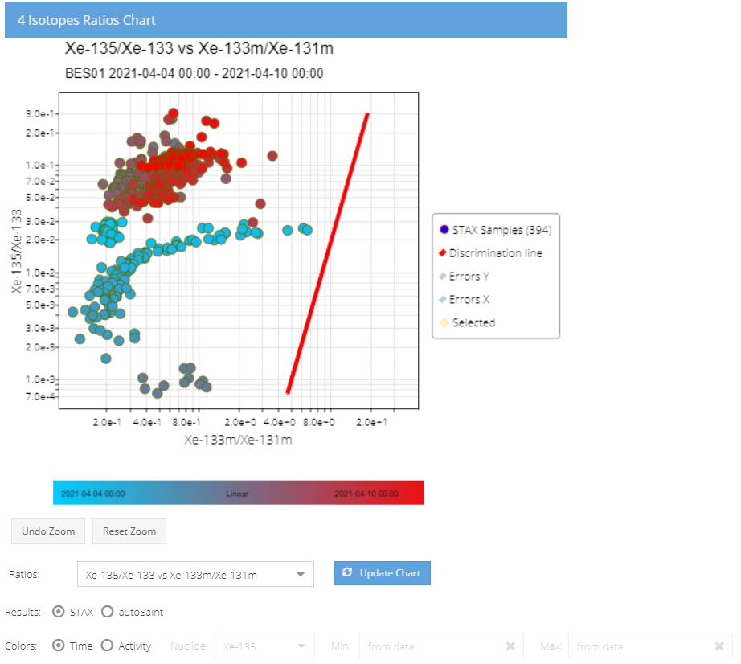
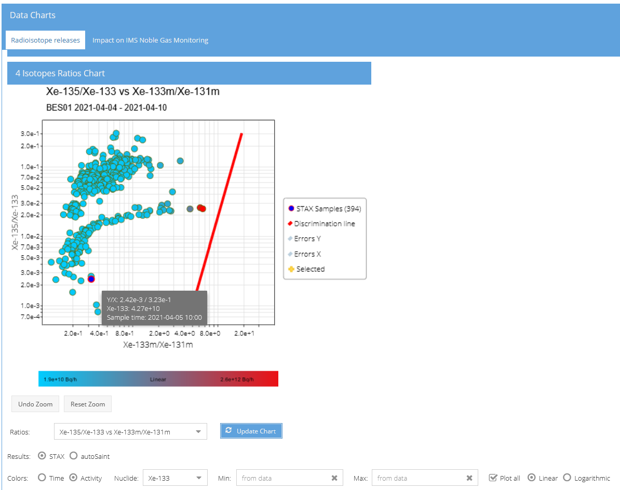
Data viewing – isotopic ratios chart
Isotopic ratios charts can be viewed with any isotope combination selected by the user
Color scheme can be selected to illustrate either temporal evolution of the ratio or to indicate the release value for a selected isotope
Display by evolution in time
Display by emission strength
Place your QR Code here after removing this text box!
P3.6-658

Slide 6
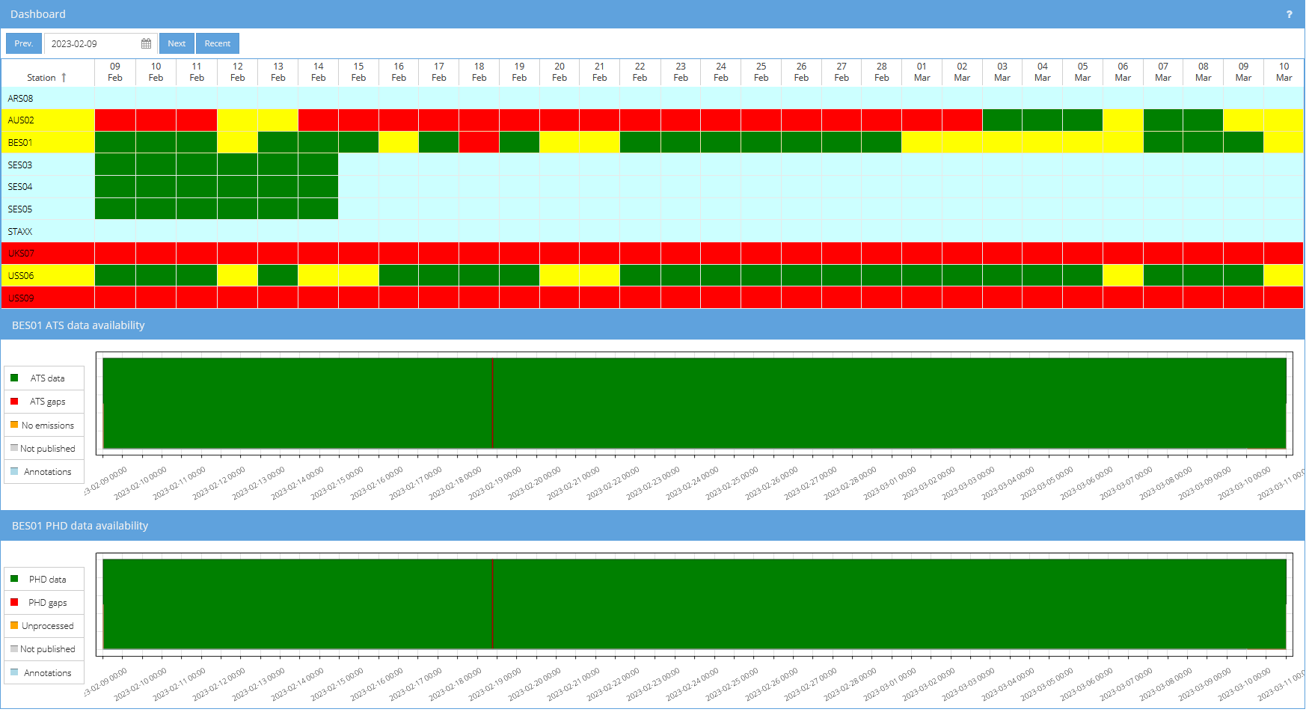
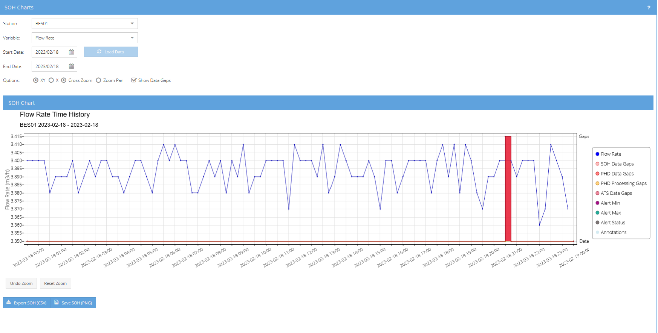
Data viewing – Facilities operational status
A dashboard view provides an overview of the operational status (data availability) for all facilities
Detailed SoH data can be viewed to diagnose issues at facilities and for data quality control
Place your QR Code here after removing this text box!
P3.6-658

Slide 7
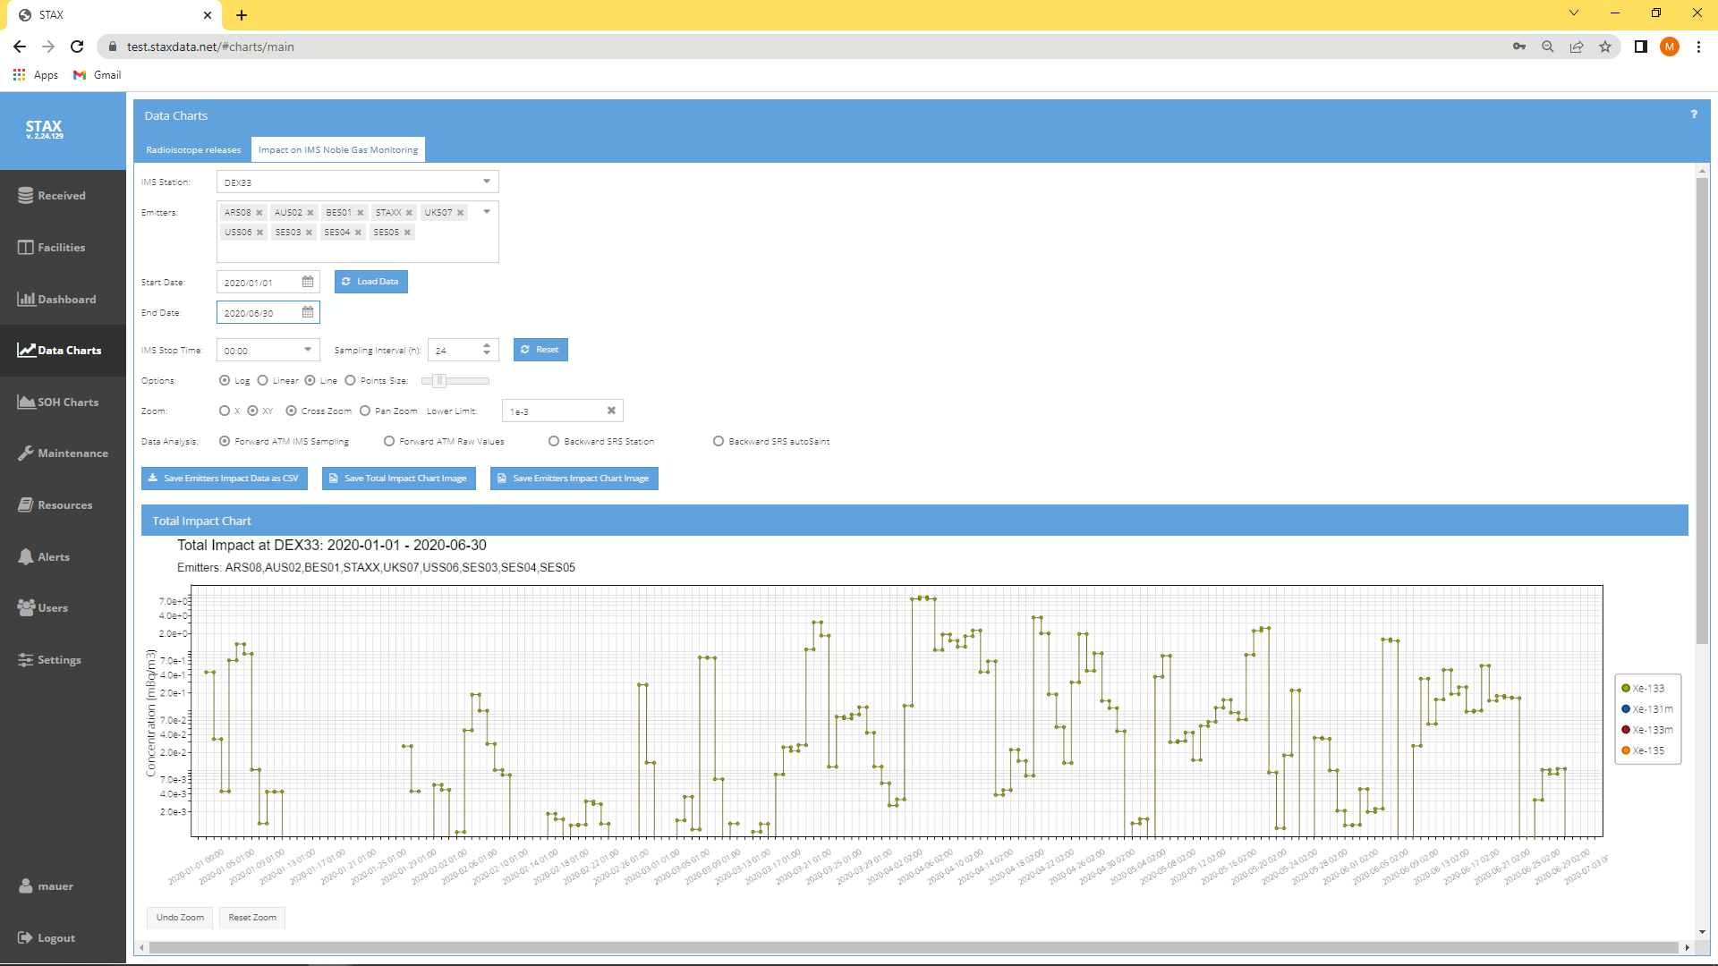
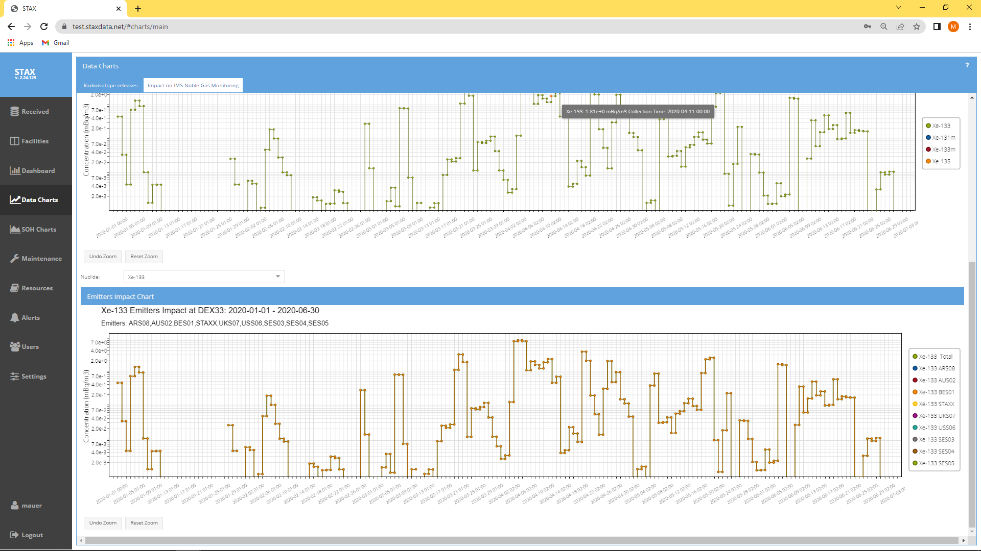
IMS Station concentration simulations
The impact of emission values on each IMS site is calculated based on atmospheric transport model (ATM) data, either in forward or backward transport mode
Forward modelling is based on hysplit calculations
For backward modelling, source receptor sensitivity (SRS) values calculated by ATM models can be used to estimate IMS concentrations
Concentrations are shown in time resolution of IMS station sampling times and are synchronized with sampling start/stop times
Total impact chart: displays the concentration based on the sum of all measured STAX emissions
Emitters impact chart: displays concentrations caused by individual emitters
Place your QR Code here after removing this text box!
P3.6-658

Slide 8
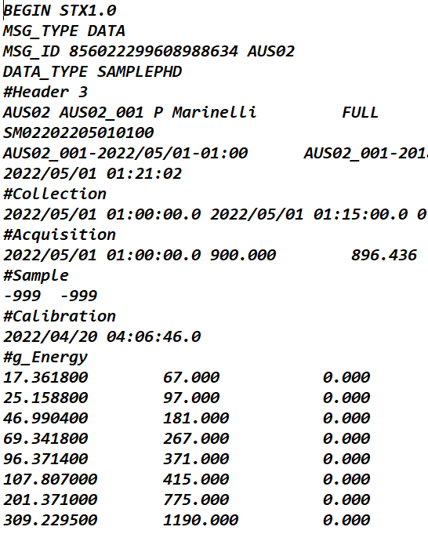
Summary
A central data server and web-based user interface has been developed to provide access to all data of the STAX network either via interactive charts for data viewing or by various download options
Web Based UI and central data server
Place your QR Code here after removing this text box!
P3.6-658

Slide 9
References
Doll, C., Auer, M., Friese, J., Bowyer, T., Burnett, J., Deconninck, B., Maurissen, N., Metz, L., Schrom, B., 2022. First STAX detector installation at the national institute for radioelements (IRE). J. Environ. Radioact. 255, 107036 https://doi.org/ 10.1016/j.jenvrad.2022.107036.
Metz, L., Bowyer, T., Burnett, J., Dion, M., Eslinger, P., Friese, J., Doll, C., McIntyre, J., Schrom, B., 2022. Source Term Analysis of Xenon (STAX): an effort focused on differentiating man-made isotope production from nuclear explosions via stack monitoring. J. Environ. Radioact. 255, 107037 https://doi.org/10.1016/j. jenvrad.2022.107037.
Place your QR Code here after removing this text box!
P3.6-658

