Slide 1

A Possible Statistical Approach to Address the Issue of Anomalous Values of Activity Concentrations
Giuseppe Ottaviano¹, Antonietta Rizzo¹, Michele Scagliarini²
¹ENEA – Italian National Agency for New Technologies, Energy and Sustainable Economic Development
²University of Bologna – Department of Statistical Sciences “Paolo Fortunati”
The main challenge for the CTBTO verification regime is to be able to discriminate anomalous radioxenon signals generated by underground nuclear explosions from those generated by other sources like medical isotope production facilities and nuclear power plants.
Several statistical inference-based parametric and non-parametric methods designed to detect significative shifts above the radioxenon natural background, have been used and compared.
The parametric approach is useful to quickly detect both large variations and unusual trends; the non-parametric approach allows to detect variations in both location and scale.
Possible statistical approaches to assess the radioxenon “anomalous values” against atmospheric background and to suppose a proper definition of anomalous activity concentrations, is suggested by the Italian NDC-RN to accomplish the purposes of the CTBTO verification regime.
Please do not use this space, a QR code will be automatically overlayed
P3.6-718

Slide 2
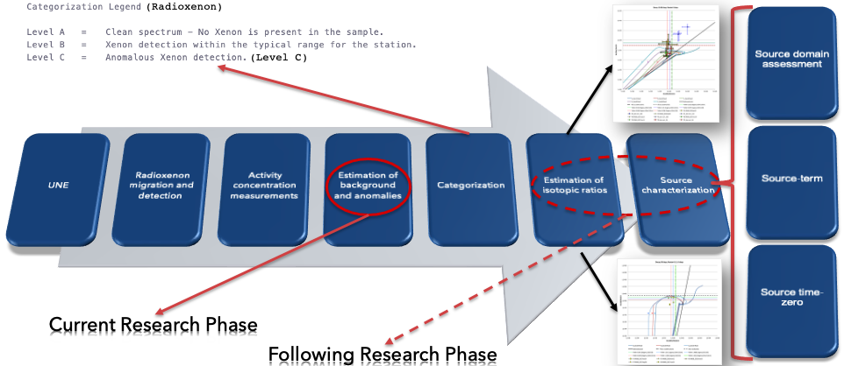
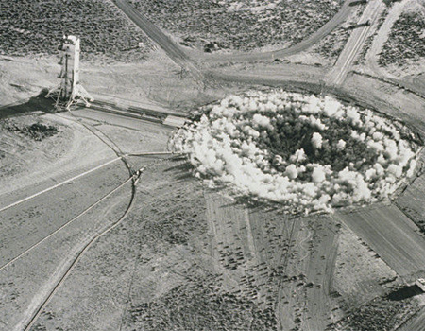
Context: Main Problem
The measurement of anomalous atmospheric activity concentrations of both radioactive noble gases and radioactive particulate by the IMS network plays a key-role in detecting underground nuclear explosions (UNEs).
The very challenging problem is to discriminate radioxenon activity concentrations generated by underground nuclear tests from those generated by other sources and the first step in achieving this goal is the correct definition and assessment of anomalous values.
Please do not use this space, a QR code will be automatically overlayed
P3.6-718

Slide 3
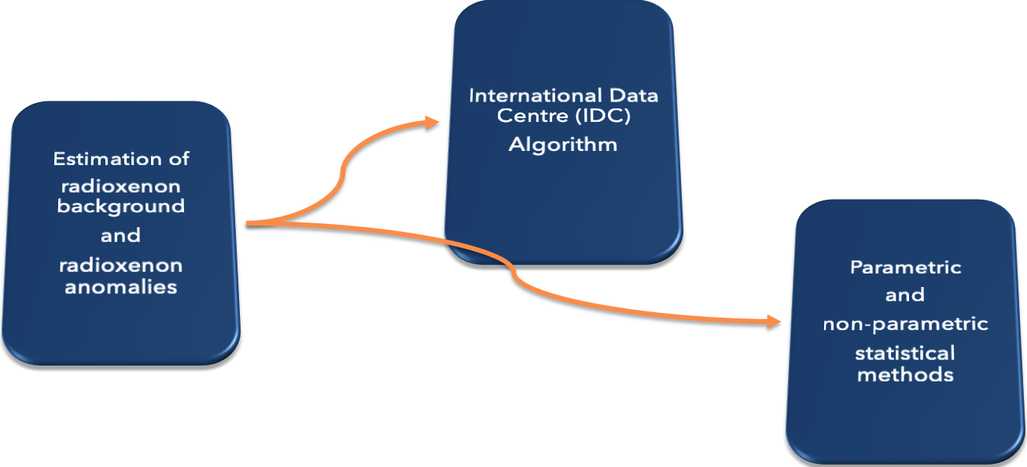

Objectives
In order to assess radioxenon anomalous values, the International Data Centre of the CTBTO uses a statistical method based on descriptive thresholds. Several statistical inference-based parametric and non-parametric methods designed to detect significative shifts above the radioxenon natural background, have been used and compared to identify radioxenon anomalous values, to support the verification activities at the Italian NDC-RN and also to integrate the interquartile filter method used by the IDC.
Please do not use this space, a QR code will be automatically overlayed
P3.6-718

Slide 4
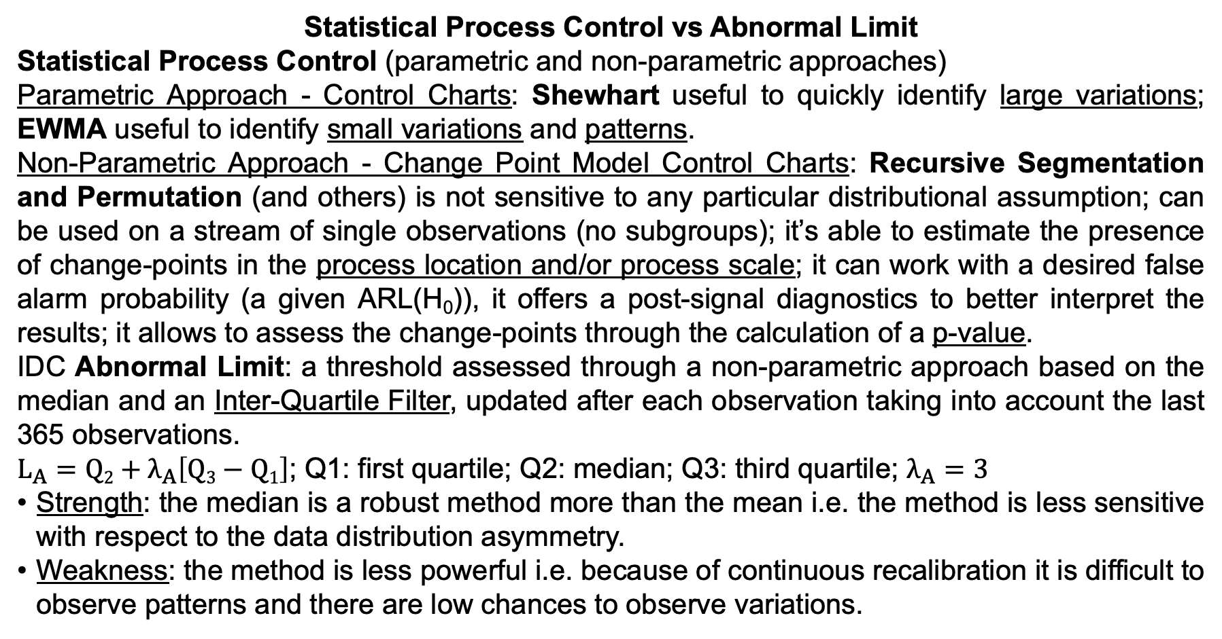
Methods/Data
Statistical Process Control vs Abnormal Limit
Statistical Process Control (parametric and non-parametric approaches)
Parametric Approach - Control Charts: Shewhart useful to quickly identify large variations; EWMA useful to identify small variations and patterns.
Non-Parametric Approach - Change Point Model Control Charts: Recursive Segmentation and Permutation (and others) is not sensitive to any particular distributional assumption; can be used on a stream of single observations (no subgroups); it’s able to estimate the presence of change-points in the process location and/or process scale; it can work with a desired false alarm probability (a given ARL(H₀)), it offers a post-signal diagnostics to better interpret the results; it allows to assess the change-points through the calculation of a p-value.
IDC Abnormal Limit: a threshold assessed through a non-parametric approach based on the median and an Inter-Quartile Filter, updated after each observation taking into account the last 365 observations.
$L_{A}=Q2+λ_{A}\left[Q3−Q1\right]$; Q1: first quartile; Q2: median; Q3: third quartile; $λ_{A}=3$
Strength: the median is a robust method more than the mean i.e. the method is less sensitive with respect to the data distribution asymmetry.
Weakness: the method is less powerful i.e. because of continuous recalibration it is difficult to observe patterns and there are low chances to observe variations.
Please do not use this space, a QR code will be automatically overlayed
P3.6-718

Slide 5
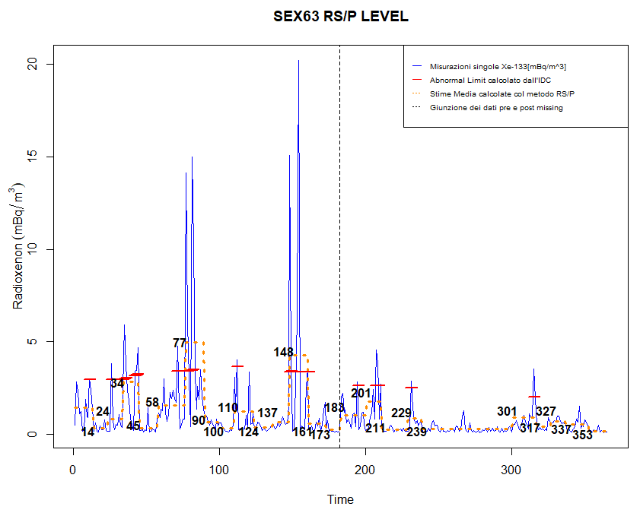
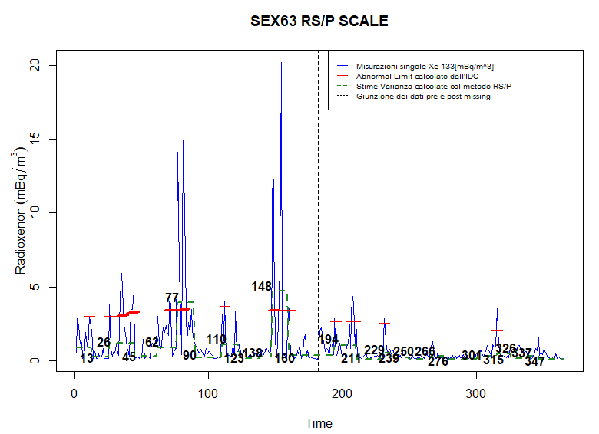
Results
Shewhart, large variations - MNX45 station - EWMA, small variations and patterns
RS/P, level - SEX63 station - RS/P, scale
Every anomalous value detected by the IDC algorithm is also detected by non-parametric algorithms (RS/P and others) both in the mean value and in the variance.
Please do not use this space, a QR code will be automatically overlayed
Abnormal Limit
P3.6-718

Slide 6
Conclusion
The Shewhart Control Chart could be extremely useful for the monitoring of IMS stations performed periodically at the Italian NDC-RN at the ENEA Research Centre in Bologna. The Control Chart, in fact, as sensitive to large variations compared to the average, could be effectively used to easily identify large variations in concentrations of radio-xenon activity. The EWMA Control Chart could be useful for conducting specific studies on the atmospheric background and radio-xenon "anomalies" and also for a better understanding of the discrimination system based on radio-xenon isotopic ratios. For the purposes of the verification regime, a reduction in the levels of attention becomes essential to correctly address further analysis and verification.
The Change-Point Model Control Charts (CPMCC) could be useful to support the activity of NDCs with an inferential approach and to integrate the IDC algorithm. CPMCC can give a valuable contribution to the activities of NDCs by strengthening the discrimination efforts because, on an inferential basis, they allow to establish priorities. Based on the outcomes of CPMCC, NDCs can give priority to anomalous values preceded by an estimated change-point. The considered control charts provide quite similar results but the RS/P method may provide a slightly better support to the NDCs, as it provides separate results for location and scale, allowing a clearer picture of the dynamics of the investigated phenomena.
Please do not use this space, a QR code will be automatically overlayed
P3.6-718

Slide 7
References
References:
- Scagliarini M., Gualdi R., Ottaviano G., Rizzo A. (2023) Detection of anomalous radioxenon concentrations: A distribution-free approach, Enivironmetrics, 1-23, DOI: 10.1002/env.2804.
- Capizzi G, Masarotto G. (2017), Phase I Distribution-Free Analysis of Multivariate Data, Technometrics, 59, 484-495.
- Crowder, S. V.; Hawkins, D. M.; Reynolds, M. R., Jr.; and Yashchin, E. (1997). Process Control and Statistical Inference, Journal of Quality Technology, 29, 134-139.
- Woodall WH, Montgomery DC. (1999), Research issues and ideas in statistical process control. Journal of Quality Technology, 31, 376-386.
- Zhou C, Zou C, Zhang Y, Wang Z. (2009), Non-parametric control chart based on change-point model. Statistical Papers, 50, 13-28.
- Ferri L, Studio statistico delle misure di radioxeno per la verifica del trattato per l’abolizione totale dei test nucleari (Comprehensive nuclear test ban treaty - CTBT), Bologna, 2019 (Bachelor Degree in Statistical Sciences).
- Coppola V, Metodi statistici non-parametrici applicati ai valori anomali di XE-133 misurati presso le stazioni dell’international monitoring system del CTBTO, Bologna 2022, (Master’s Degree in Statistical Sciences).
Please do not use this space, a QR code will be automatically overlayed
P3.6-718

