Slide 1
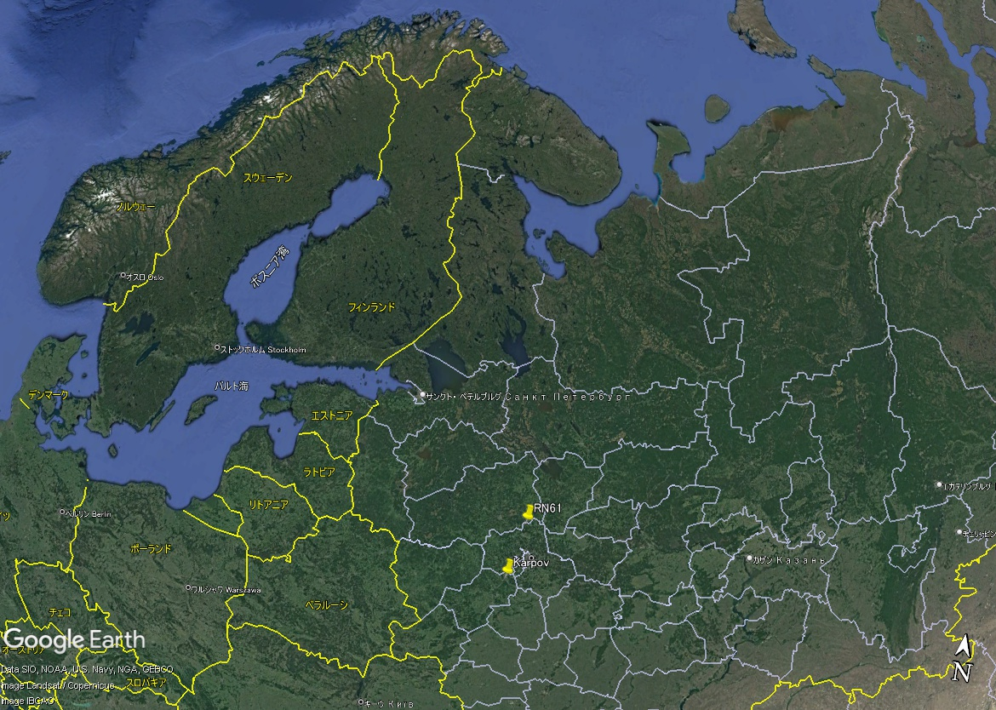
Investigating how Source Receptor Sensitivity fields can be used for identifying samples that may have received radioactivity from the same release event as a Level 5 sample
Yuichi Kijima, Robin Schoemaker, Boxue Liu, Joshua Kunkle,
Anne Tipka, Jolanta Kuśmierczyk-Michulec, Martin Kalinowski
CTBTO/IDC
P3.6-412
Samples from International Monitoring System (IMS) stations which contain multiple CTBT-relevant
radionuclides with abnormal activity concentrations (Level 5 for particulates) are sent to the IMS radionuclide
laboratories for further analysis.
Since a re-analysis of spectra at IMS radionuclide laboratories might enhance the reliability of analysis results,
it is proposed to investigate a method that can be used to identify potentially associated samples (that are
most likely not categorised as Level 5) at the same or at neighbouring stations that may have received
radioactivity from the same release event as the Level 5 sample.
We investigate methods to associate the Level 5 samples at an IMS station with the other samples at the
same or neighbouring stations using the source receptor sensitivity (SRS) fields produced routinely for each
sample by atmospheric transport modelling (ATM).
Level 5 and Level 3 samples at RUP61 (an IMS
radionuclide station in Russia) in March 2013
Sample category | Collection stop date | I-131 concentration [μBq/m³]
Level 5 | 7 March 2013 | 4.66
Level 3 | 15 March 2013 | 1.48
Are these two samples associated (that is,
originated from a same release) or not ?
RUP61
Karpov Institute

