Slide 1
Investigating how Source Receptor Sensitivity fields can be used for identifying samples that may have received radioactivity from the same release event as a Level 5 sample
Yuichi Kijima, Robin Schoemaker, Boxue Liu, Joshua Kunkle,
Anne Tipka, Jolanta Kuśmierczyk-Michulec, Martin Kalinowski
CTBTO/IDC
Since a re-analysis of spectra at International Monitoring System (IMS) radionuclide laboratories might enhance the reliability of analysis results, it is proposed to investigate a method that can be used to identify potentially associated samples at the same or at neighbouring stations that may have received radioactivity from the same release event as the Level 5 sample.
Concentration probability density function (PDF) at IMS station and source receptor sensitivity (SRS) PDF (where two SRS fields overlap in time) between IMS station and known source are combined to predict emission PDF at known source using Monte Carlo Method (MCM).
There is no statistically significant difference between distributions of Level 5 and Level 3 samples at RUP61 (an IMS radionuclide station in Russia) in November 2016. On the other hand, there is a statistically significant difference between distributions of Level 5 and Level 3 samples at RUP61 in March 2013.
This method could be one of several prospective approaches to associate the Level 5
samples at an IMS station with the other samples using the SRS fields by atmospheric transport modelling (ATM).
Please do not use this space, a QR code will be automatically overlayed
P3.6-412

Slide 2
Introduction
Samples from International Monitoring Station (IMS) stations which contain multiple
CTBT-relevant radionuclides with abnormal activity concentrations (Level 5 for
particulates) are sent to the IMS radionuclide laboratories for further analysis.
Since a re-analysis of spectra at IMS radionuclide laboratories might enhance the
reliability of analysis results, it is proposed to investigate a method that can be used to
identify potentially associated samples (that are most likely not categorised as Level 5)
at the same or at neighbouring stations that may have received radioactivity from the
same release event as the Level 5 sample.
P3.6-412
Please do not use this space, a QR code will be automatically overlayed

Slide 3
Objectives
Development of methods to associate the Level 5 samples at an IMS station with
the other samples at the same or neighbouring stations using the source receptor
sensitivity (SRS) fields produced routinely for each sample by atmospheric transport
modelling (ATM).
This investigation can help to determine a suitable method for adding associated
samples to the Standard Screened Radionuclide Event Bulletin (SSREB) of a Level 5
sample, and to determine the triggering condition for sending samples to IMS
radionuclide laboratories which may contain radionuclides from the same release event.
P3.6-412
Please do not use this space, a QR code will be automatically overlayed

Slide 4
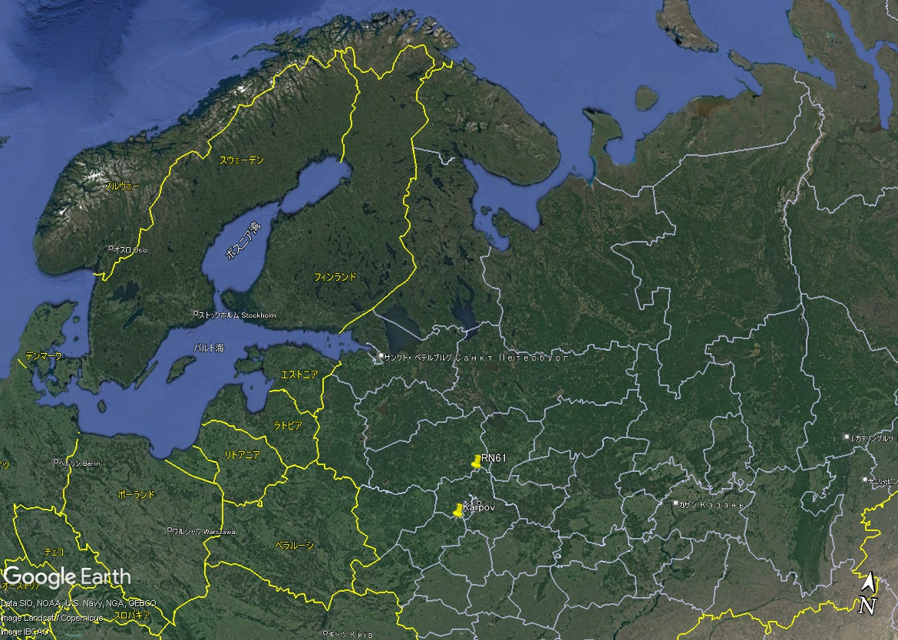
Methods/Data
Case study 1
Case study 2
RUP61 (an IMS radionuclide station in Russia)
RUP61
RUP61
Sample category | Collection stop date | I-131 concentration [μBq/m³]
Level 5 | 17 November 2016 | 23.19
Level 3 | 18 November 2016 | 5.44
Sample category | Collection stop date | I-131 concentration [μBq/m³]
Level 5 | 7 March 2013 | 4.66
Level 3 | 15 March 2013 | 1.48
Karpov Institute
Concentration PDF of
Level 5 in November 2016
SRS (source receptor
sensitivity) PDF of Level 5
Concentration PDF of
Level 5 in March 2013
SRS PDF of Level 5
P3.6-412
*Same for Level 3 sample
*Same for Level 3 sample
Please do not use this space, a QR code will be automatically overlayed
Concentration PDF (probability density function) at RUP61 and SRS PDF (where two SRS fields (for Level 5 and Level 3 samples) overlap in time) between RUP61 and known source (Karpov Institute) are combined to predict emission PDF at Karpov using Monte Carlo Method (MCM).

Slide 5
Results
Case study 1
Case study 2
Emission PDF at Karpov in November 2016
Emission PDF at Karpov in March 2013
(log)
(log)
Expectation values of Level 5 sample and Level 3 sample are 3.3E12 Bq and 1.6E12 Bq.
Expectation values of Level 5 sample and Level 3 sample are 3.1E12 Bq and 1.9E13 Bq.
There is no statistically significant difference between two emission distributions.
There is a statistically significant difference between two emission distributions.
P3.6-412
Please do not use this space, a QR code will be automatically overlayed
It might be possible that two (Level 5 and Level 3) samples are associated, that is, originated from a same release.
It might be possible that two samples are not associated and that there were two distinct releases at Karpov Institute.

Slide 6
Conclusion
This method could be one of several prospective approaches to associate the Level 5
samples at an IMS station with the other samples using the SRS fields by ATM.
P3.6-412
Please do not use this space, a QR code will be automatically overlayed

