Slide 1
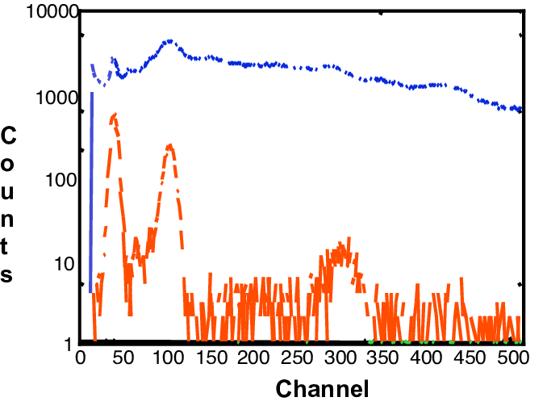
Developments toward a Radionuclide Event Computational Pipeline
Brian Schrom, Paul Eslinger, Harry Miley, Ramesh Sarathi
Pacific Northwest National Laboratory, USA
PNNL-SA-186200
P3.6-481
The top-level objective of an automated RN pipeline is to provide information to analysts to help them quickly determine if measured nuclides were released by activities not relevant to the Treaty.
The focus is on evaluating possible release events, rather than individual samples.
A goal for radionuclide monitoring is to automatically create a draft radionuclide event bulletin from multiple sample measurements across the network.
New automated sample association rules feed source-location algorithms that incorporate multiple isotopes and background information.
IMS System
Spectrum and Analysis
Sample Flagged as L5/LC
Sample Automated RN Report
Sample Reviewed RN Report
If you want to learn more about this, come see my e-poster during session 3.6 on 21 June at 11:00 or access it online on the SnT2023 Conference platform.
Sensitivity & Selectivity
IDC Algorithm and Lists
Transport Parameter Calculations
Analyst Review
Fused Event Bulletin
Waveform Fusion
Bayesian Analyses
Analyst Review
Detect Anomaly
Find Associated Samples
Estimate T₀, Release Strength, Location
EVENT Bulletin 1
EVENT Bulletin 2
Includes local BKG

