Slide 1
Developments toward a Radionuclide Event Computational Pipeline
Brian Schrom, Paul Eslinger, Harry Miley, Ramesh Sarathi
Pacific Northwest National Laboratory, USA
A goal for radionuclide monitoring is to automatically create a radionuclide event bulletin from multiple sample measurements across the network, inspired by what is done with waveform processing.
Many radionuclide samples in the IMS contain isotopes released by industrial nuclear facilities. A RN pipeline provides automated information to analysts to help them determine if the nuclides were released by activities not relevant to the Treaty.
New automated sample association rules feed source-location algorithms that incorporate multiple isotopes and background information. Seismic or other information can be included when developing the source-location attribution.
Many of the algorithms and computational tools needed to implement a radionuclide analysis pipeline have been developed. The next step is to combine them in a prototype automated pipeline.
Please do not use this space, a QR code will be automatically overlayed
PNNL-SA-186200
P3.6-481

Slide 2
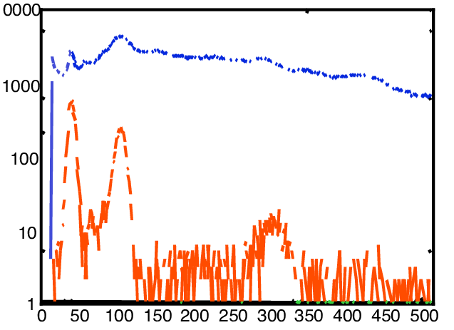
Goal: Implement a Radionuclide Data Pipeline that Focuses on Release Events rather than Samples using Data Fusion
IMS System
Spectrum and Analysis
Sample Flagged as L5/LC
Sample Automated RN Report
Sample Reviewed RN Report
Sensitivity & Selectivity
IDC Algorithm and Lists
Transport Parameter Calculations
Analyst Review
Fused Event Bulletin
Waveform Fusion
Bayesian Analyses
Analyst Review
Detect Anomaly
Find Associated Samples
Estimate T₀, Release Strength, Location
EVENT Bulletin 1
EVENT Bulletin 2
Includes local BKG
Events developed with new automated tools can bring ‘network power’ to RN
Merge ATM with RN measurements
Improve Sensitivity, Location, Screening
Please do not use this space, a QR code will be automatically overlayed
P3.6-481

Slide 3
Radionuclide Pipeline Algorithm Objectives
Many of the radionuclide samples collected every day in the IMS contain measurable levels of isotopes released to the atmosphere by industrial nuclear applications or residue from past weapons testing. The top-level objective of a RN pipeline is to provide automated information to analysts to help them quickly determine if measured nuclides were released by activities not relevant to the Treaty. Steps include:
Anomaly Detection – Do the measured samples exhibit unusual characteristics?
Consistent with historical magnitudes? Unusual isotopic mixtures? Unusual groupings of detections?
Sample Association – Do multiple samples have information about a common release event?
Would they be at the same sampling location? At other sampling locations?
Would an as-yet undetermined release event result in more measurable samples?
Source-Location Determination – What release event (location, magnitude, time) could have caused the sample measurement (or associated sample measurements)?
Source-location algorithms depend on computationally demanding atmospheric transport models.
Can fuse data from seismic, infrasound, or hydroacoustic measurements.
Event Bulletin – Preliminary evaluation of multiple hypotheses.
Are measurements consistent with releases from industrial facilities?
Are measurements consistent with historical background?
Should this suite of measurements be elevated for more detailed study?
Please do not use this space, a QR code will be automatically overlayed
P3.6-481

Slide 4
Methods and Data
Algorithm research and expanded data sets are required to finish an automated RN pipeline. Key areas of current investigation are:
Anomaly Detection
Developing rules for automatically identifying anomalies
Status of industrial nuclear facilities and their release history (with isotopic composition)
Sample Association
Computing and storing historical station affinities for quick access
Fast atmospheric transport models to replace precomputed affinities on demand
Source-Location Determination
Quick development of source-receptor matrices for every RN sample
Global network coverage for emissions in the last few days
Single-isotope and multiple-isotope source-location models that can explicitly incorporate background measurements
Event Bulletin
Initial determination of the plausibility of a comprehensive suite of hypotheses
Please do not use this space, a QR code will be automatically overlayed
P3.6-481

Slide 5
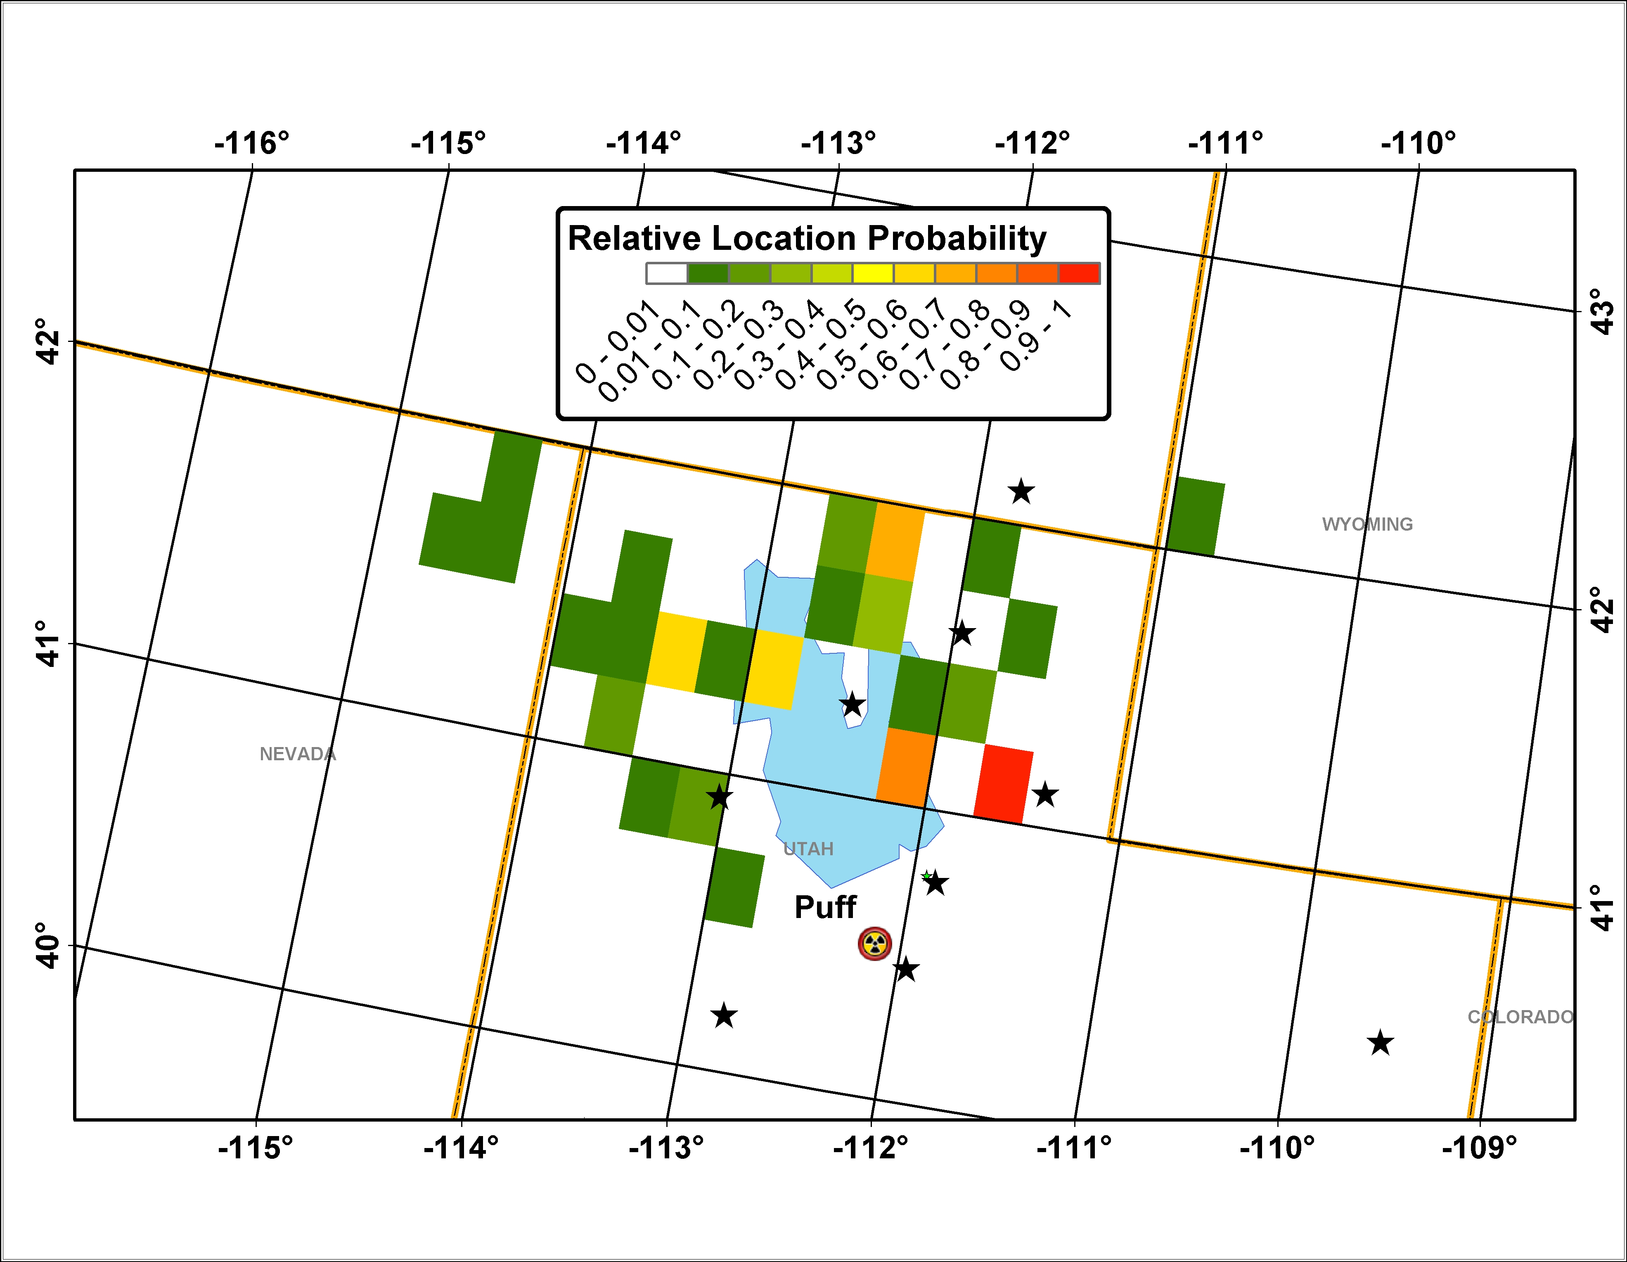
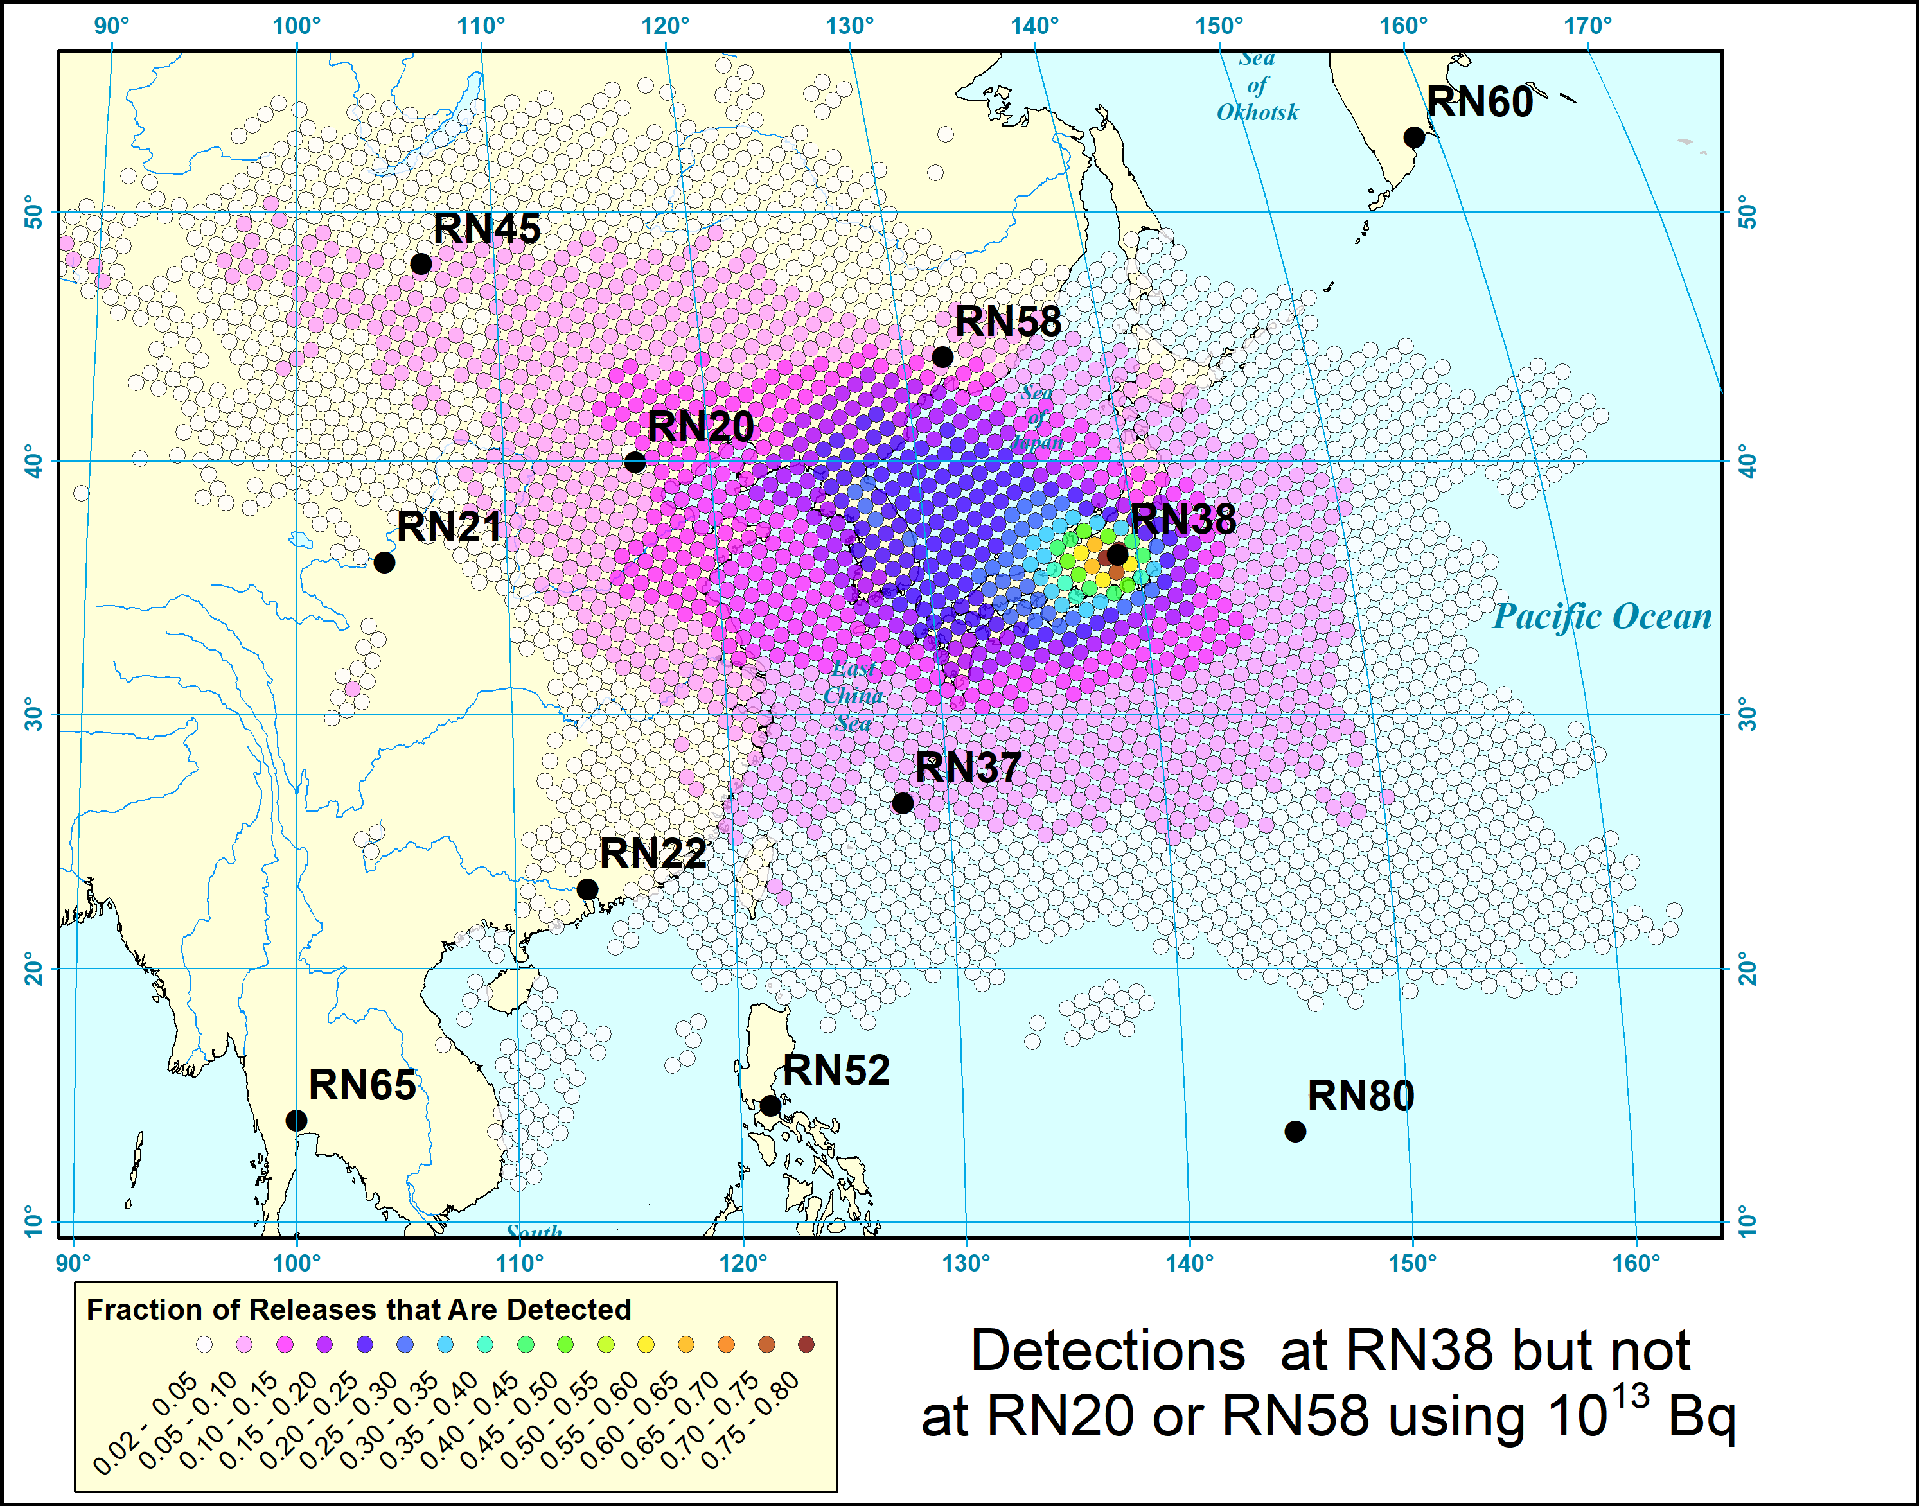
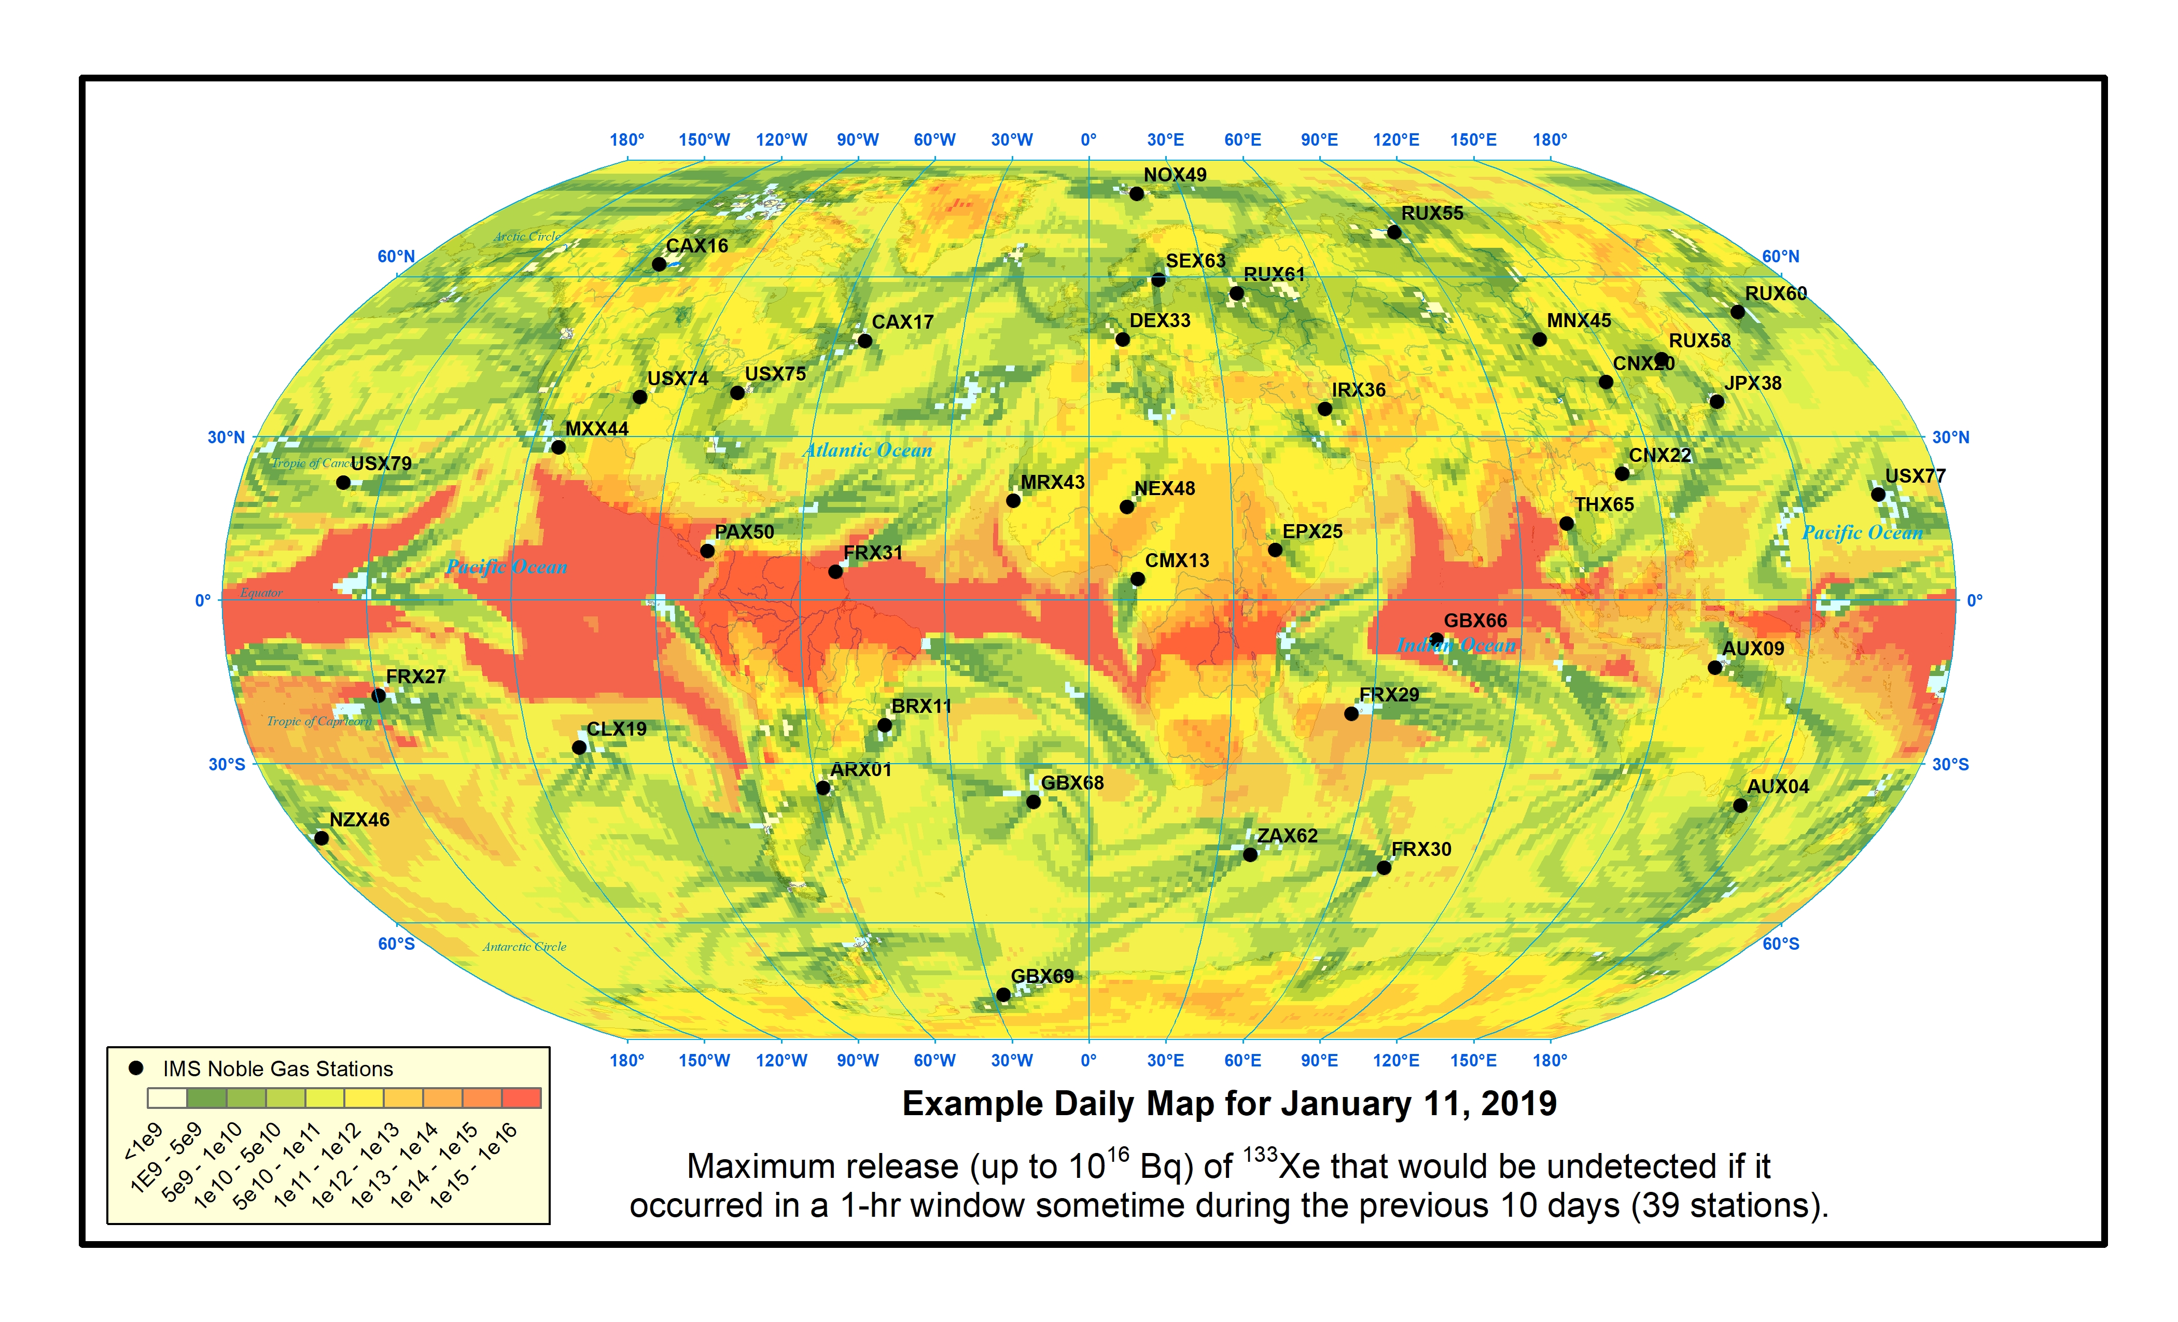
Results Using the Algorithms that would be Included in a Radionuclide Event Pipeline
Place your institution logo here after removing this tet box!
An example plot showing what magnitude of short-duration releases of ¹³³Xe should have been detected if they had been released in the last ten days. This plot is indicative of the network coverage at the time that a sample with a detection is collected. This type of plot could be updated every day.
The magnitude of detections of interest may be smaller than typical measurements caused by industrial emissions. This synthetic data set shows a new algorithm that explicitly uses industrial emissions when locating a puff release.
An example sample association result using synthetic releases showing the most plausible release locations based on historical weather patterns when stations close to JPX38 didn’t have detectable quantities of ¹³³Xe but JPX38 had a detection. These results can be precomputed and archived for different station combinations.
Please do not use this space, a QR code will be automatically overlayed
P3.6-481

Slide 6
Conclusions
As the volume of data grows and backgrounds increase, the pressure to leverage automatic data techniques across the network will also increase. An important step is to combine aerosol and xenon measurements and enable data fusion with other technologies such as seismic. Many of the analysis tools needed for a RN analysis pipeline have been developed, but have not yet implemented in an automated prototype:
Anomaly Detection: Have a draft journal article on different anomaly detection algorithms. Magnitude-only anomaly rules are insufficient.
Sample Association: Developed on an approach for automated sample association and published a journal article (doi:10.1016/j.jenvrad.2021.106777).
Continued study of industrial emissions to understand their influence on samples. (doi:10.1016/j.jenvrad.2022.107081, 10.1016/j.jenvrad.2022.107037, 10.1016/j.jenvrad.2022.106916)
Bayesian source-location algorithms. Have developed new multiple-isotope and background cognizant algorithms (doi:10.1016/j.jenvrad.2019.04.004, 10.1016/j.jenvrad.2019.03.022). Have a draft journal article comparing single-isotope algorithms with maximum correlation approaches and FREAR.
Analysis of network performance for new generation samplers. Have studied network performance for new generation noble gas and aerosol samplers (doi:10.1016/j.jenvrad.2022.106963, 10.1016/j.jenvrad.2022.107088).
Please do not use this space, a QR code will be automatically overlayed
P3.6-481

Slide 7
References
Eslinger, P.W., Miley, H.S., Schrom, B.T., 2022. Investigations of association among atmospheric radionuclide measurements. J. Environ. Radioact. 241, 106777. https://doi.org/10.1016/j.jenvrad.2021.106777
Miley, H.S., Eslinger, P.W., 2023. Impact of industrial nuclear emissions on nuclear explosion monitoring. J. Environ. Radioact. 257, 107081. https://doi.org/10.1016/j.jenvrad.2022.107081
Rosenthal, W.S., Eslinger, P.W., Schrom, B.T., Miley, H.S., Baxter, D.J., Fast, J.D., 2022. Enabling probabilistic retrospective transport modeling for accurate source detection. J. Environ. Radioact. 247, 106849. https://doi.org/10.1016/j.jenvrad.2022.106849
Miley, H.S., Eslinger, P.W., Friese, J.I., 2021. Examining Nuisance Aerosol Detections in Light of the Origin of the Screening Process, PNNL-SA-32446, Pacific Northwest National Laboratory, Richland, Washington. https://doi.org/10.2172/1843271
Eslinger, P.W., Miley, H.S., Burnett, J.L., Lidey, L.S., Mendez, J.M., Schrom, B.T., Sharma, M.K., 2023. Projected network performance for next generation aerosol monitoring systems. J. Environ. Radioact. 257, 107088. https://doi.org/10.1016/j.jenvrad.2022.107088
Eslinger, P.W., Ely, J.H., Lowrey, J.D., Miley, H.S., 2022. Projected network performance for multiple isotopes using next-generation xenon monitoring systems. J. Environ. Radioact. 251-252, 106963. https://doi.org/10.1016/j.jenvrad.2022.106963
Metz, L., Bowyer, T., Burnett, J., Dion, M., Eslinger, P., Friese, J., Doll, C., McIntyre, J., Schrom, B., 2022. Source Term Analysis of Xenon (STAX): An effort focused on differentiating man-made isotope production from nuclear explosions via stack monitoring. J. Environ. Radioact. 255, 107037. https://doi.org/10.1016/j.jenvrad.2022.107037
Eslinger, P.W., Bowyer, T.W., Doll, C.G., Friese, J.I., Metz, L.A., Schrom, B.T., 2022. Using STAX data to predict IMS radioxenon concentrations. J. Environ. Radioact. 250, 106916. https://doi.org/10.1016/j.jenvrad.2022.106916
Eslinger, P.W., Mendez, J.M., Schrom, B.T., 2019. Source term estimation in the presence of nuisance signals. J. Environ. Radioact. 203, 220-225. https://doi.org/10.1016/j.jenvrad.2019.03.022
Eslinger, P.W., Lowrey, J.D., Miley, H.S., Rosenthal, W.S., Schrom, B.T., 2019. Source term estimation using multiple xenon isotopes in atmospheric samples. J. Environ. Radioact. 204, 111-116. https://doi.org/10.1016/j.jenvrad.2019.04.004
Please do not use this space, a QR code will be automatically overlayed
P3.6-481

