Slide 1
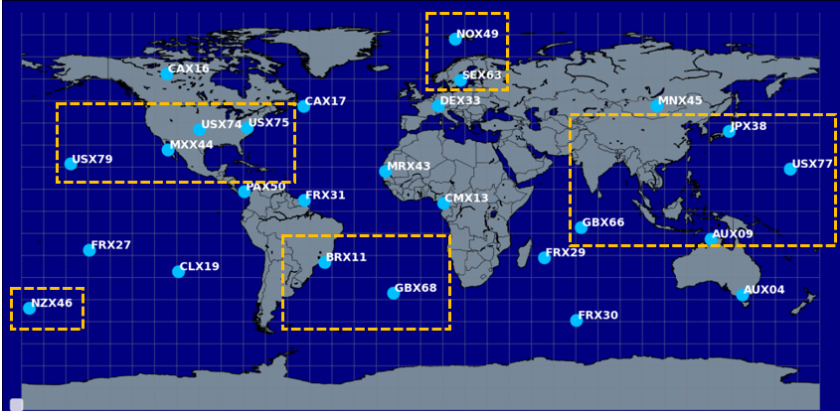
Updated 2014 radioxenon observations at IMS stations
– Comparison with the 2014 baseline
Abdelhakim Gheddou, Martin B. Kalinowski
CTBTO
P3.6_740
There is high interest among the CTBTO noble gas monitoring community for further enhancing the agreement between observed and simulated radioxenon concentrations in comparison to the 2014 baseline.
One year (2014) of spectral data from certified IMS SAUNA based noble gas systems was reprocessed in offline mode, using the modern IDC software.
New observations were compared to old results for the four CTBT relevant radioxenon isotopes.
New analysis results clearly demonstrate a significant reduction of false positive rates for Xe-131m, Xe-133m and Xe-135.
Achieved results will allow the statistical analysis of simulated vs. observed data to be repeated and compared with the 2014 baseline.
In addition, the new dataset has the potential to be used in other research areas, such as radioxenon isotopic ratio studies.

