Slide 1
Updated 2014 radioxenon observations at IMS stations – Comparison with the 2014 baseline
Abdelhakim Gheddou, Martin B. Kalinowski
CTBTO
One year (2014) of spectral data from certified IMS SAUNA based noble gas systems was reprocessed in offline mode, using the modern IDC software.
New observations were compared to old results for the four CTBT relevant radioxenon isotopes.
Achieved results will allow the statistical analysis of simulated vs. observed data to be repeated and compared with the 2014 baseline.
In addition, the new dataset has the potential to be used in other research areas, such as radioxenon isotopic ratio studies.
There is high interest among the CTBTO noble gas monitoring community for further enhancing the agreement between observed and simulated radioxenon concentrations in comparison to the 2014 baseline.
The poster compiles an update on observations.
New analysis results clearly demonstrate a significant reduction of false positive rates for Xe-131m, Xe-133m and Xe-135.
Please do not use this space, a QR code will be automatically overlayed
P3.6-740

Slide 2
Introduction
Routine operational releases of radioxenon make the discrimination between radioxenon detections from civil nuclear applications and from nuclear testing a very complex task.
The objective in the short to medium term is to develop algorithms and tools that facilitate the understanding of the background.
The longer-term vision is to eventually develop robust methodologies for determining to what extent radioxenon detections at International Monitoring System (IMS) stations can be explained based on the impact of civil sources.
Over the recent years, 2014 was used as a baseline for various scientific studies, for example (Gueibe et al., 2017), as well as ATM challenge exercises organized within the WOSMIP framework.
P3.6-740

Slide 3
Objectives
There is a high interest among the CTBTO noble gas monitoring community for further enhancing the 2014 baseline in two ways:
Updating the radioxenon emission inventory, for example (Kalinowski M., 2023);
Enhancing spectrum analysis methods for observed radioxenon activity concentrations at the IMS noble gas sites.
The current study aims at updating the observations of CTBT relevant radioxenon isotopes Xe-131m, Xe-133, Xe-133m and Xe-135 at 13 IMS locations where SAUNA noble gas systems were sending data to IDC operations in 2014.
The new analysis takes advantages of the recently developed software autoSTRADA (automatic Software Tool for Radionuclide Data Analysis), which was deployed in IDC operation and delivered to NDCs since August 2021. The software includes a new NCC analysis method (without any binary condition) as well as BGM method (Ringbom et al., 2019).
P3.6-740

Slide 4
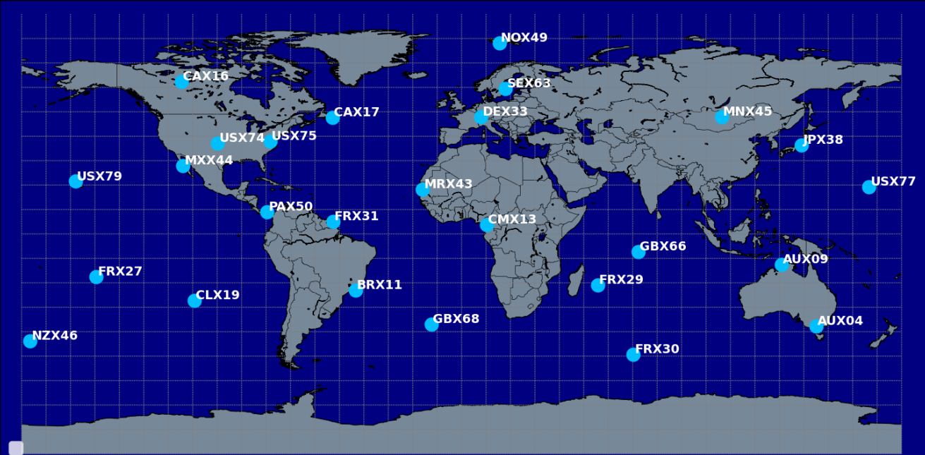
Methods/data: IMS SAUNA noble gas systems in IDC operations in 2014
Used data:
13 certified SAUNA noble gas systems of the IMS that were in IDC operation in 2014
AUX09 Darwin, NT, Australia
BRX11 Rio de Janeiro, Brazil
GBX66 Biot, Chagos Archipelago, UK
GBX68 Tristan da Cunha, UK
JPX38 Takasaki, Gunma, Japan
MXX44 Guerrero Negro,
Baja California, Mexico
NOX49 Spitsbergen, Norway
NZX46 Chatham Island, New Zealand
SEX63 Stockholm, Sweden
USX74 Ashland, KS, USA
USX75 Charlottesville, VA, USA
USX77 Wake Island, USA
USX79 Oahu, HI, USA
P3.6-740

Slide 5
Methods/data: software and environment
The data is reprocessed in a virtual machine containing the Radionuclide NDC-in-a-Box software package, including autoSTRADA software.
Spectral data from the 13 SAUNA systems over year 2014 were reprocessed in offline mode, using the new software autoSTRADA combined with BGM module.
Systematic correction for gas background
Systematic interference correction for Radon and Xenon isotopes
Beta and gamma energy calibrations are automatically checked/adjusted for gain shift, using the software tool “qcecorr”.
Test results were compared with the old results in IDC operations that were based on the old NCC (systematic gas background subtraction; conditional interference correction) as implemented in the former IDC software bg_analyze.
P3.6-740
5

Slide 6
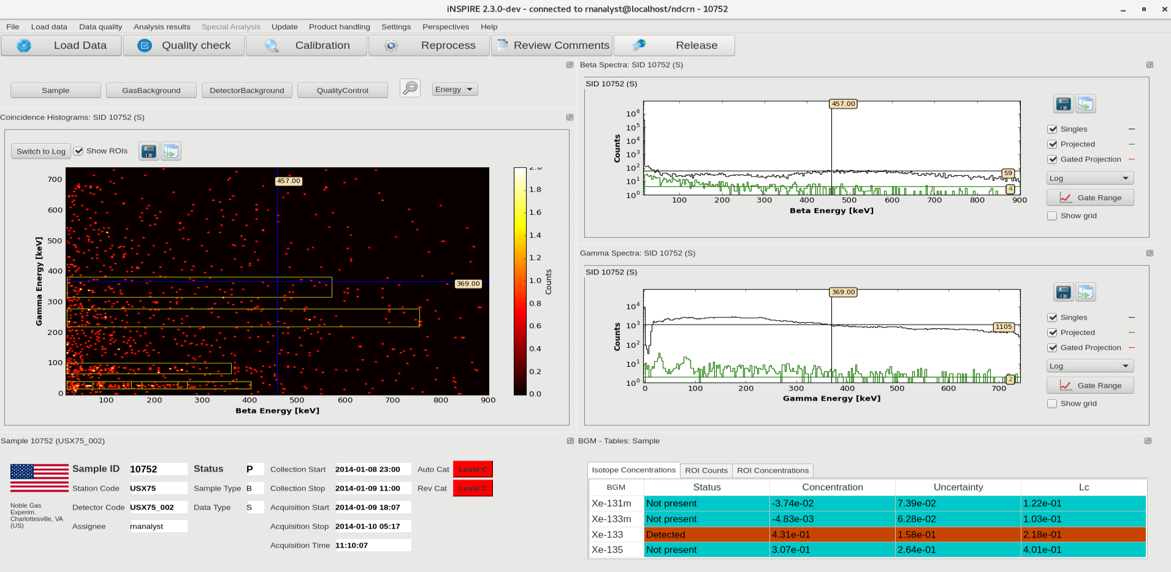
Methods/data: quality check
Data quality is spot-checked using iNSPIRE (iNtegrated Software Platform for Interactive Radionuclide rEview).
P3.6-740

Slide 7
Results: reported rate or radioxenon isotopes
The following figures compile achieved results in terms of comparison:
Old results based on old software (as in IDC operations)
New results based on new software (offline mode)
Each figure shows the results for one SAUNA system, in terms of reported detection rate of the four CTBT relevant radioxenon isotopes Xe-131m, Xe-133, Xe-133m and Xe-135.
P3.6-740

Slide 8
Results: reported rate or radioxenon isotopes
P3.6-740

Slide 9
Results: reported rate or radioxenon isotopes
P3.6-740

Slide 10
Results: reported rate or radioxenon isotopes
P3.6-740

Slide 11
Radioxenon observations from 13 certified SAUNA noble gas systems of the IMS have been reprocessed for the whole year 2014, using our modern software and algorithms.
The results based on the new software (new NCC/BGM) are compared to those of the old software (standard NCC) in IDC operation.
In general, the rate of reported detections based on the new software is lower compared to the old software.
The new analysis demonstrated a significant reduction of false positives for Xe-131m, Xe-133m and Xe-135. Achieved values are closer to the theoretical level of 5% for stations with clean background.
The new rates of Xe-133 detections are slightly lower in comparison to old results. The main reasons are:
more accurate energy calibration check/update in the new software, and which was not yet in IDC operation in 2014.
new results are based on key ROI3 (more robust against gain shift) whereas old results include X-ray ROIs as well.
P3.6-740

Slide 12
Future work
Achieved analysis results will be used to compare the new observations at IMS noble gas systems with:
the simulated concentrations used by Gueibe et al (2017);
new simulated concentrations using the updated emission inventory of Kalinowski (2023).
In addition, the new dataset has the potential to be used in other research areas, such as radioxenon isotopic ratio studies.
P3.6-740

Slide 13
References
Gueibe C., Kalinowski M., Bare J., Gheddou A., Krysta M ., Kusmierczyk-Michulec J., 2017. Setting the baseline for estimated background observations at IMS systems of four radioxenon isotopes in 2014. Journal of Environmental Radioactivity 178-179 (2017) 297-314.
Ringbom A., Axelsson A., 2019. A new method for analysis of beta-gamma radioxenon spectra. Applied Radiation and Isotopes: Including Data, Instrumentation and Methods for Use in Agriculture, Industry and Medicine 156(9):108950
Kalinowski M., 2023. Global emission inventory of 131mXe, 133Xe, 133mXe, and 135Xe from all kinds of nuclear facilities for the reference year 2014. Journal of Environmental Radioactivity 261(7):107121.
P3.6-740

