Slide 1
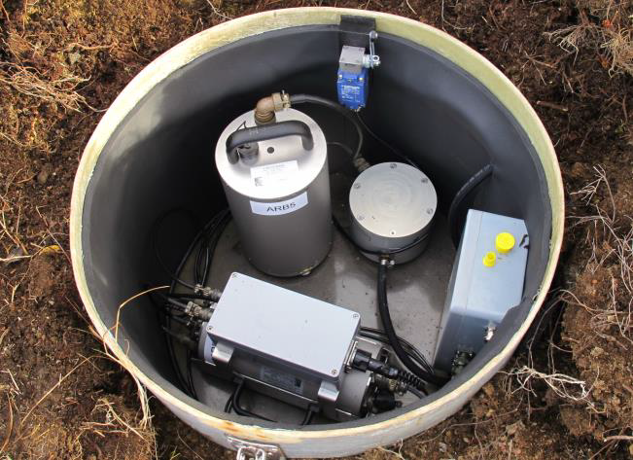
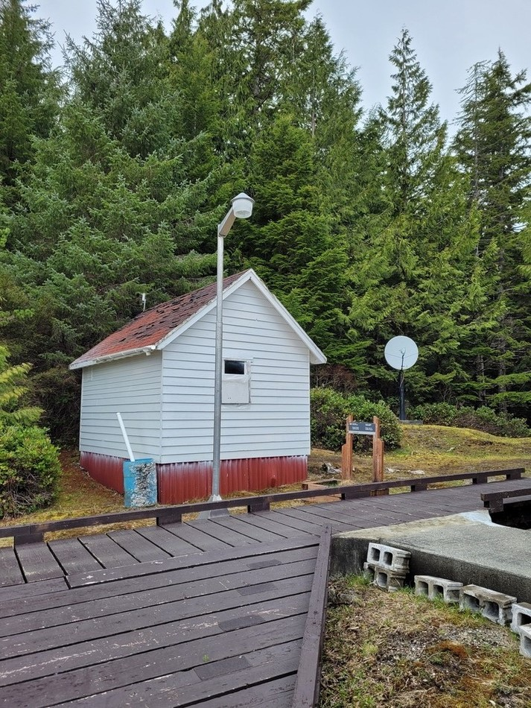
Revalidation process for IMS waveform technologies stations
S. Bazarragchaa¹, M. Jusko¹, P.Martysevich¹, A. Molero², Y.Starovoyt²
¹ CTBTO, International Monitoring System Division, ED section,
Wagramerstrasse 5, 1220 Vienna, Austria;
² Addproject, C/Conde Duque 48, bajo izda, 28015 Madrid, Spain
P4.1-798
The IMS revalidation process is undertaken if any change occurs at a station that significantly affects its system response, detection capability or data availability
The process is leaded by IMS Engineering&Development Section and carried out in cooperation with IDC, Station Operator and often with civil works contractor
The process is “two-step” approach that includes infrastructure upgrade and new equipment installation on-site.
After the process is completed the major goal is to assure the compliance of the renovated station with IMS technical requirements specified in the waveform technologies IMS Operational Manuals
Such compliance is demonstrated by detailed testing of the major hardware and software components inventoried at the site
Welcome to attend our more detailed e – poster presentation P4.1-798
PS28 sensor vault
AS015 equipment hut

