Slide 1
Revalidation process for IMS waveform technologies stations
S. Bazarragchaa¹, M. Jusko¹, P.Martysevich¹, A. Molero², Y.Starovoyt²
¹ CTBTO, International Monitoring System Division, ED section,
Wagramerstrasse 5, 1220 Vienna, Austria;
² Addproject, C/Conde Duque 48, bajo izda, 28015 Madrid, Spain
This poster describes the revalidation process for the IMS waveform technologies stations which underwent significant upgrade or change of the measurement system response, detection capability or data availability.
The revalidation process is launched by the CMB decision. It includes equipment upgrade works and “in-situ” implementation of approved methods of station testing to assure the compliance with IMS technical requirements defined in the Operational Manuals (OM)
Testing results are assessed against key metrics of the technical specification Table and key performance indicators (KPI). They are presented in the Revalidation Report and submitted for the consideration of the IMS Certification Group.
Station revalidation process is one of the Quality control tools in the IMS to secure permanent technical compliance of the station with required standards of the OMs. It confirms the required quality of the IMS data for verification purposes over the station operational cycle
Place your QR Code here after removing this text box!
P4.1-798

Slide 2
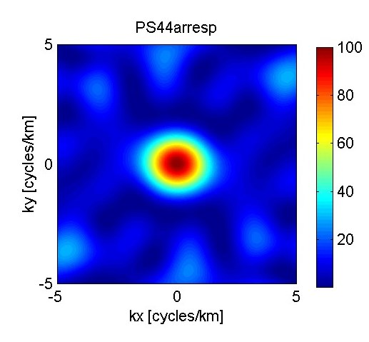
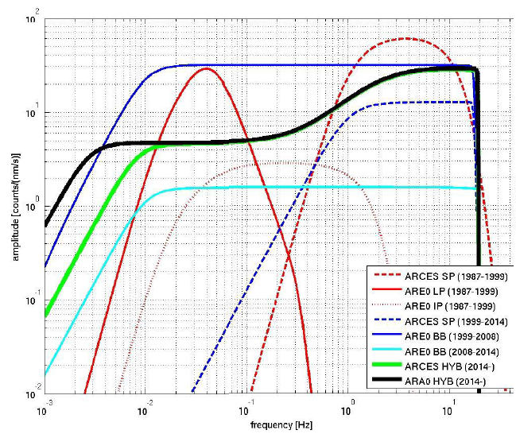
Introduction to the revalidation process
Station revalidation should be undertaken if any change occurs at a station that significantly affects its system response, detection capability or data availability.
Examples could include:
Reconstruction following partial or total destruction
Change of location or array geometry
Change of equipment or software due to repair
Engineering improvement,
Upgrade, end of life replacement
Infrastructure or equipment obsolescence
Deterioration owing to changes in the station environment
such as increased noise levels.
Place your QR Code here after removing this text box!
P4.1-798

Slide 3
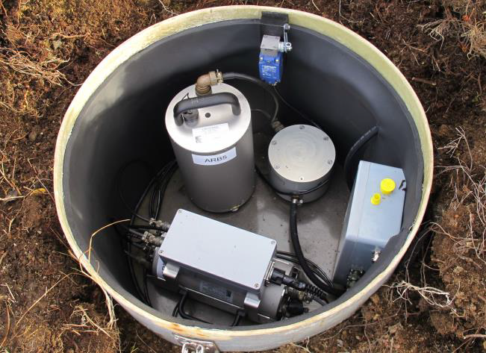
Objectives of the revalidation process
Upon completion of the modernization works the revalidation process is aimed to assure high standard of the IMS facility compliant with technical requirements of the Operational Manuals. The report is submitted for the review of the Certification Group. The content is standardized demonstrating the updated technical specification Table and testing results.
The report is emphasising the compliance demonstration in the following areas:
Noise study analysis using newly ED developed calculator for
different equipment settings;
Station calibration;
Testing of the CD1.1 status bit settings;
Compliance with CD1.1 requirements for data transmission and
data surety aspects;
Station documentation, parameters update and DOTS population.
Place your QR Code here after removing this text box!
P4.1-798
Renewed seismometer enclosure PS28,Norway

Slide 4
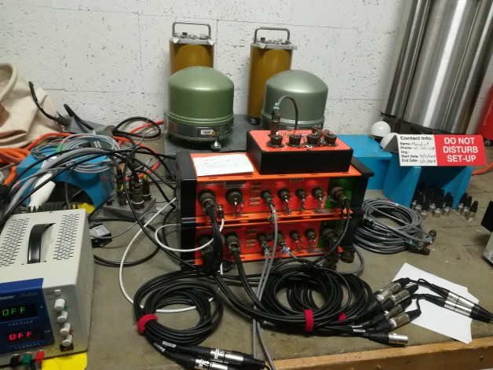
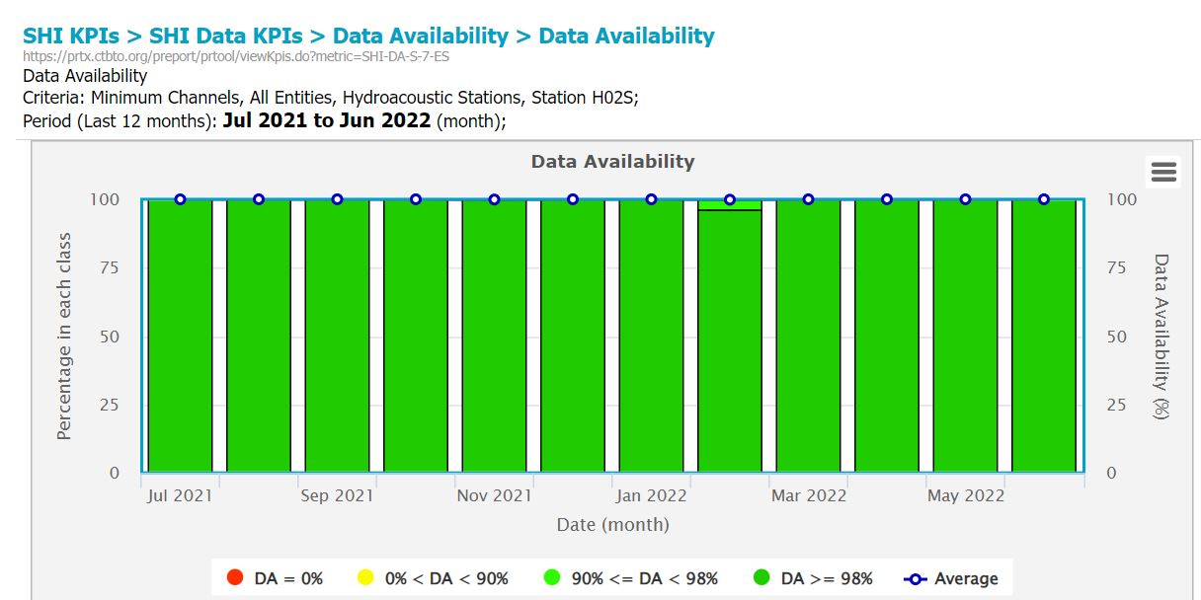
Used methods for station revalidation
Revalidation process absorbs variety of different methods to judge about station compliance with IMS Quality standards
Equipment model testing (mainly sensors and digitizers)
Factory acceptance testing results
“In-situ” testing of integrated engineering solutions
Contractor’s reporting documentation
Inspection visits
Assistance of Station Operators
Assessment of different metrics and KPIs in
IDC (PRTool, CAM, for example)
Place your QR Code here after removing this text box!
P4.1-798

Slide 5
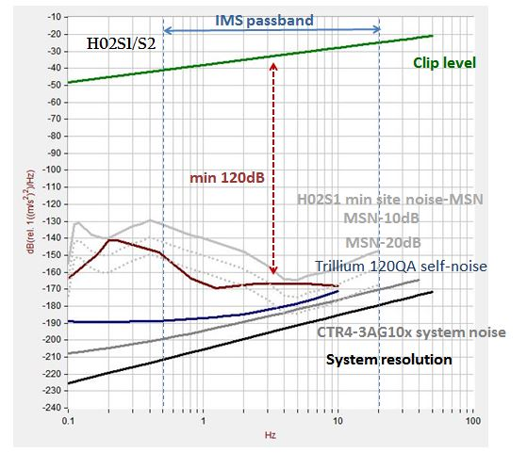
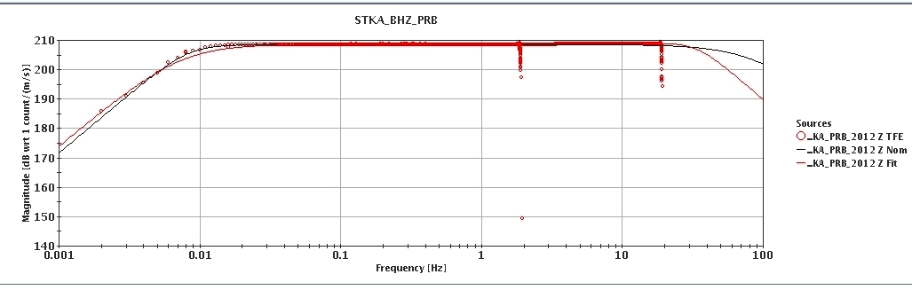
Key testing results of station integrated solution
Noise study, compliance with min requirements
Digitizer and sensor self –noise check relative min site noise (MSN), dynamic range and resolution limits
Timing system
Relative (1ms) and absolute (10ms) timing accuracy.
PTP and individual GPS/GNSS receivers
Drifting of the timing accuracy
Four timing status bits setting in CD1.1
Calibration
Single and full frequency calibration
Control of “poles and zeroes” and CALIB
Calibration status bit CD1.1
Data surety aspects
Implementation of authentication and tamper switch measures
Hardware level solution
ECDSA algorithm
Frame and sub-frame signing and CD1.1 check
Place your QR Code here after removing this text box!
P4.1-798

Slide 6

Revalidation process Conclusion
Station revalidation is an efficient tool of an IMS station sustainment process.
The process assures compliance of the station with minimum requirements of the Operational Manuals after equipment change or significant upgrade.
Revalidation process triggered by CMB uses standardized reporting presentation for consideration of the Certification Group.
The process is leaded by IMS/ED and carried out in cooperation with IDC, Station Operator and often with civil works contractor.
Revalidation results and the list of revalidated IMS facilities
are provided to State Signatories
Place your QR Code here after removing this text box!
P4.1-798

Slide 7
References
REVALIDATION OF PERFORMANCE OF INTERNATIONAL MONITORING SYSTEM FACILITIES. CTBT/PTS/INF.934 2008
OPERATIONAL MANUAL FOR SEISMOLOGICAL MONITORING AND THE INTERNATIONAL EXCHANGE OF SEISMOLOGICAL DATA .
CTBT/WGB/TL-11,17/15/Rev.7 2020
Operational Manual for Hydroacoustic Monitoring and the INTERNATIONAL EXCHANGE OF Hydroacoustic DATA. CTBT/WGB/TL-11,17/16/Rev.7 2020
Operational Manual for Infrasound Monitoring and the INTERNATIONAL EXCHANGE OF Infrasound DATA. CTBT/WGB/TL-11,17/16/Rev.7 2020
Place your QR Code here after removing this text box!
P4.1-798

