Slide 1
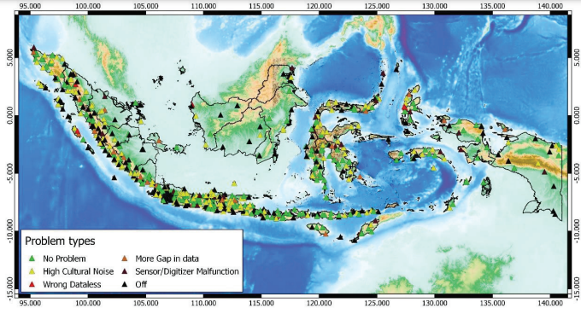
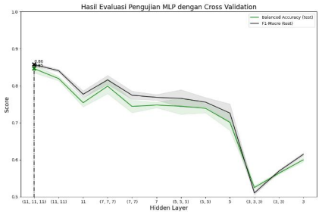
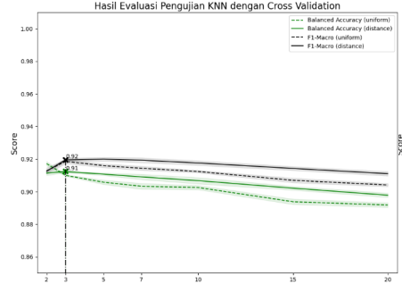
Evaluation of Accelerograph Data Quality System Based on Machine Learning on Seismic Networks in Indonesia
Kurniati Retno Dewi¹, Angga WIjaya²
Indonesia Agency for Meteorology, Climatology, and Geophysics
P4.1-249
Evaluation Result from Average Data Quality on 7 days data
Earthquake strong motion data from accelerograph equipment is crucial for determining earthquake intensity and other needs in earthquake disaster mitigation, so it is necessary to accurately evaluate the quality of accelerograph data.
Data evaluation is analyzed daily based on gap, availability, and power spectral analysis parameters. This evaluation system is designed using the results of MLP (Multi Layer Percepton) and kNN (k-Nearest Neighbor) machine learning computations.
The results of manual evaluation obtained the most frequent problems occur in electricity and communication networks and some due to equipment damage. The evaluation system with machine learning found the kNN model has an accuracy of 91.2%.
MLP (Multi Layer Percepton)
kNN (k-Nearest Neighbor)

