Slide 1
Evaluation of Accelerograph Data Quality System Based on Machine Learning on Seismic Networks in Indonesia
Kurniati Retno Dewi¹, Angga Wijaya²
Indonesian Agency for Meteorological, Climatological, and Geophysics
Earthquake strong motion data from accelerograph equipment is crucial for determining earthquake intensity and other needs in earthquake disaster mitigation, so it is necessary to accurately evaluate the quality of accelerograph data.
Data evaluation is analyzed daily based on gap, availability, and power spectral analysis parameters. This evaluation system is designed using the results of MLP (Multi Layer Percepton) and kNN (k-Nearest Neighbor) machine learning computations.
The results of manual evaluation obtained the most frequent problems occur in electricity and communication networks and some due to equipment damage. The evaluation system with machine learning found the kNN model has an accuracy of 91.2%.
From the results of system design with machine learning models MLP and kNN can classify accelerograph data quality, the average performance results are above 80% so that the model can be used for the evaluation stage of accelerograph data quality at BMKG.
Please do not use this space, a QR code will be automatically overlayed
P4.1-249

Slide 2
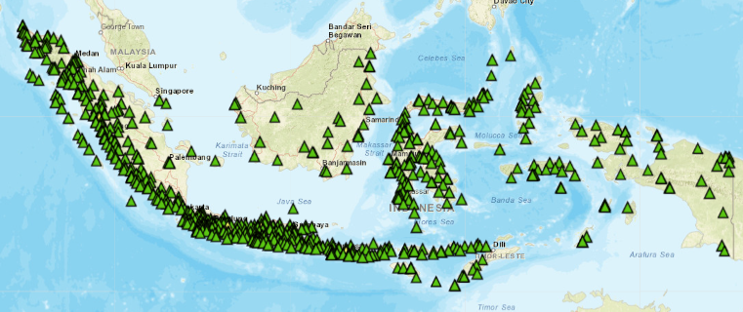
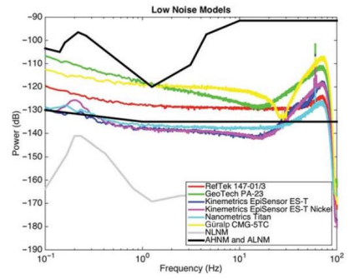
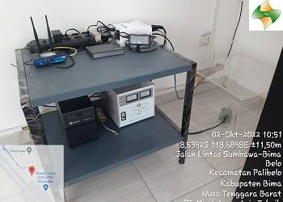
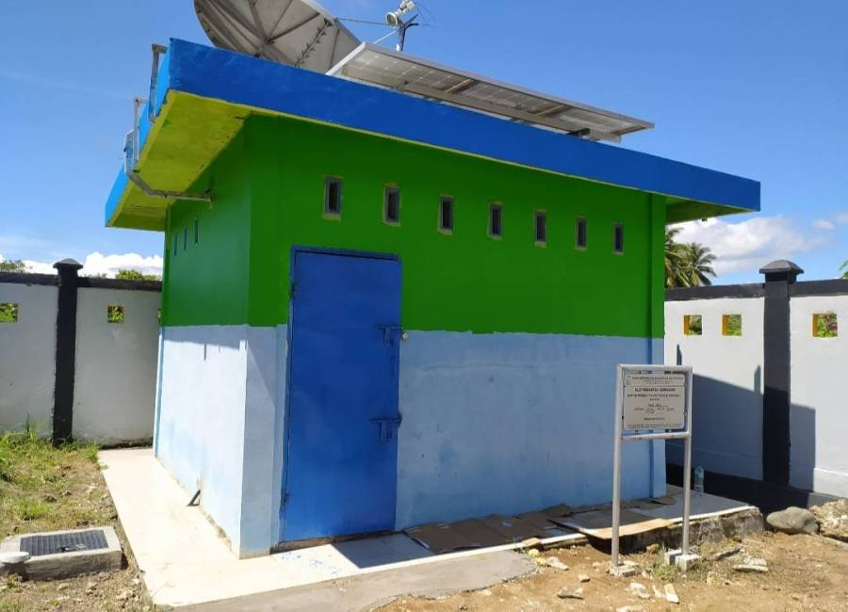
INTRODUCTION : Background
The Meteorology, Climatology, and Geophysics Agency (BMKG) have installed 669 accelerograph since 2010. The equipments consists of 405 collocated accelerographs and 264 non-collocated accelerograph. Therefore, BMKG used this data for generate shakemap and seismic hazard analysis.
Accelerograph Distribution on Indonesia Seismic Network
Data evaluation can be an important priority to maintain data accuracy. Power spectral density analysis of tool background noise is a reference in identifying problems and tool data quality. This equipment evaluation will be the basis for parts replacement or relocation.
Please do not use this space, a QR code will be automatically overlayed
Accelerograph Non Collocated
Accelerograph Collocated
P4.1-249

Slide 3
OBJECTIVES
Designing a machine learning-based Accelerograph data quality classification system.
Create a machine learning classification model architecture to obtain Accelerograph data quality index and identification instrument problems.
By implementing classification machine learning in processing Accelerograph data for analysis and classifying data quality quickly and with high accuracy, this research is very useful for monitoring earthquake and tsunami early warning system equipment at BMKG.
This evaluation system determines the input parameter features, which are in the form of pre-processing, data processing for each BMKG accelerograph station per component to obtain a dataset as input for machine learning. Dataset creation produces 12 feature parameters in the form rms, data availability, gaps, overlap, percentage of spectral noise above the Accelerometer High Noise Model (AHNM), percentage of spectral noise below the Accelerometer Low Noise Model (ALNM), PSD in each frequency range 0.01 - 0.1 Hz, 0.1 - 1 Hz, 1 - 5 Hz, 5 - 10 Hz, 10 - 20 Hz and 20 - 50 Hz.
Please do not use this space, a QR code will be automatically overlayed
P4.1-249

Slide 4
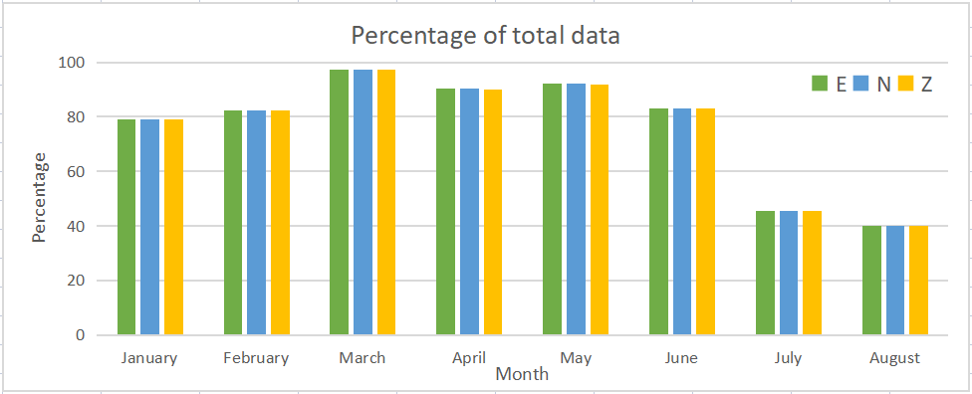
DATA
This evaluation system used 669 Accelerograph data from January to August 2021.
The data used is daily raw data for 3 components in MSEED format approximately 379.231 data. The availability data per month can be seen in the graph below.
Data pre-processing is done to extract features as input for the designed machine learning.
Please do not use this space, a QR code will be automatically overlayed
P4.1-249

Slide 5
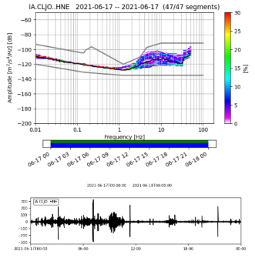
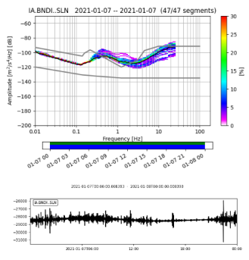
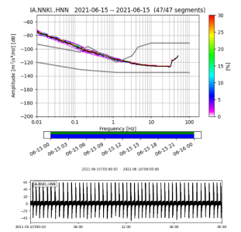
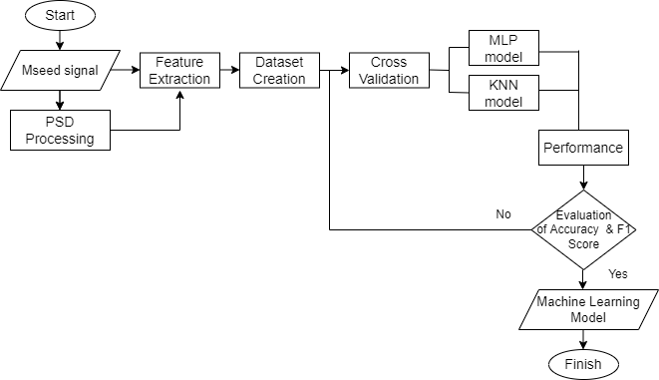
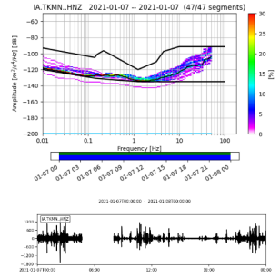
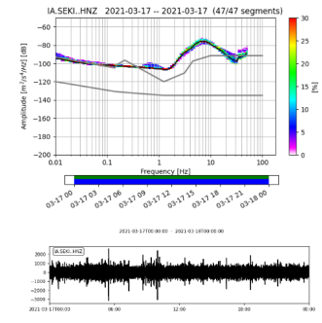
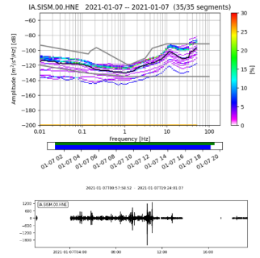
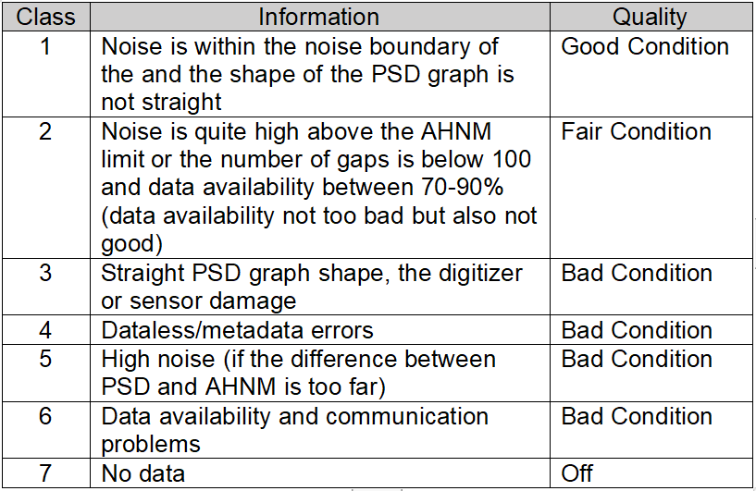
METHODS
Pre-processing and Labeling Data
Machine Learning Architecture
Class 1
Class 2
Class 3
Class 4
Class 5
Class 6
Validation
Confusion Matrix
Please do not use this space, a QR code will be automatically overlayed
Balanced Accuracy
P4.1-249

Slide 6
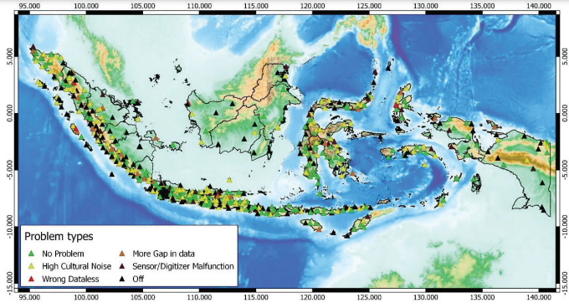
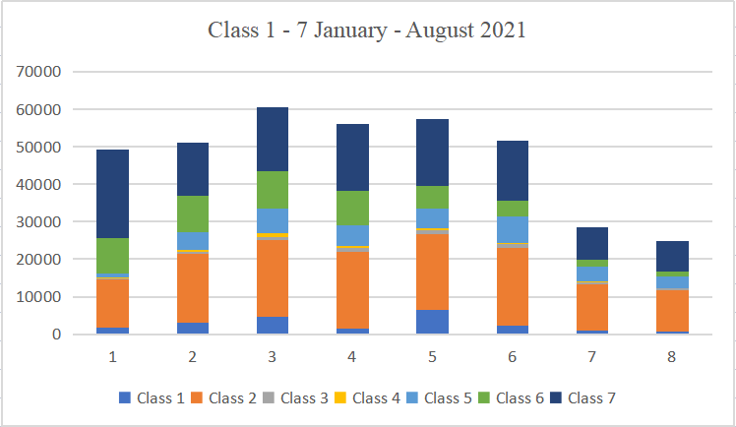
Pre-Processing and Evaluation Manually Results
Evaluation Result from Average Data Quality on 7 days data
Data quality index analysis obtained 21.197 good data, 136.274 fair data, 87.153 bad data, and 123.385 dead data.
The results of identifying problems throughout the location found that there were 37.123 problems with high cultural noise, 6.182 problems with sensors/digitizers, 3.244 metadata/cataless errors, and 51.826 experiencing gaps/lack of data availability.
Damage to digitizers/sensors that cannot record seismic vibrations and locations that have dataless errors will result in inaccurate readings of strong vibration values due to earthquakes. Many locations are off due to problems with the electricity and communication networks, another problem is that the sensors/digitizers hang/damage. The communication system currently used is the BMKG's VSAT and Telkomsel's M2M network via the BMKG's VPN, so this is highly dependent on the strength of the network signal at the location for sites using Telkomsel's M2M network and the quality of the BMKG's VSAT crospol and pointing.
Please do not use this space, a QR code will be automatically overlayed
P4.1-249

Slide 7
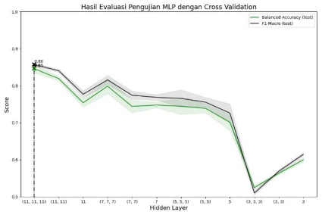
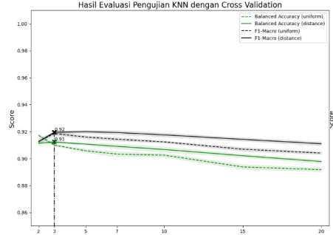
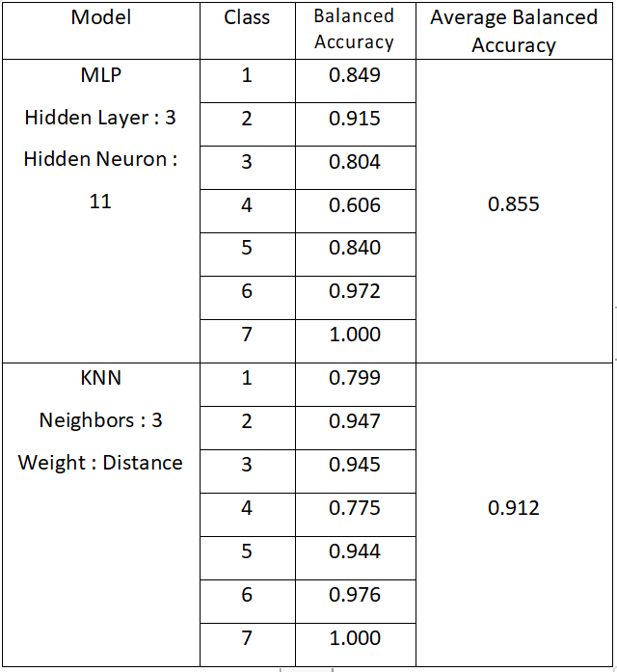
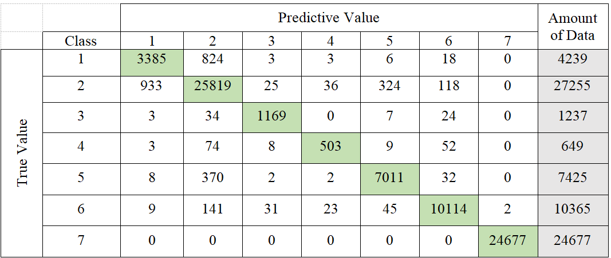
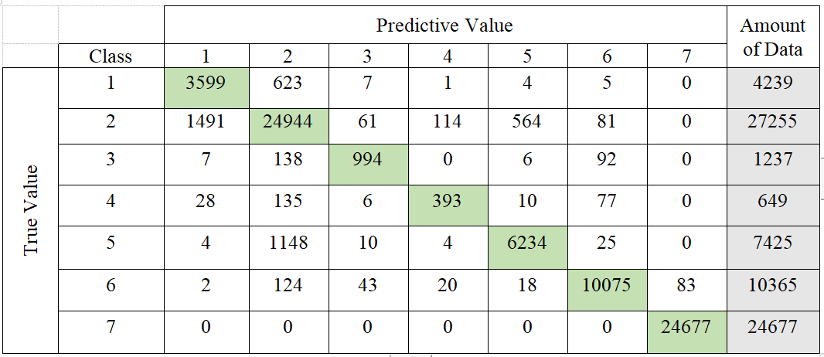
RESULTS
Machine Learning Best Model
MLP (Multi Layer Percepton)
kNN (k-Nearest Neighbor)
Comparison
Confusion Matrix
Please do not use this space, a QR code will be automatically overlayed
P4.1-249

Slide 8
CONCLUSION
An accelerograph data quality classification system has been designed using machine learning with MLP having a balanced accurancy of 85.5% and KNN having a higher balanced accurancy of 91.2%.
A machine learning classification model architecture has been created to obtain accelerograph data quality values with the best model MLP-11-11-11. The best KNN model is the KNN-3-2 model.
The performance of the machine learning model based on reading the results of the accelerograph data quality analysis, obtained in MLP from the test results at the output of 7 classes, namely the best ba 84.6% and f-1 0.857. In the KNN model, it was obtained from the test results at the output of 7 classes, namely the best ba of 91.2% and f-1score 0.919.
From the results of system design with machine learning models MLP and KNN can classify accelerograph data quality, the average performance results are above 80% so that the model can be used for the evaluation stage of accelerograph data quality at BMKG.
Please do not use this space, a QR code will be automatically overlayed
P4.1-249

Slide 9
References
Anderson, J. G. (2010). Source and Site Characteristics of Earthquakes That Have Caused Exceptional Ground Accelerations and Velocities. Bulletin of the Seismological Society of America, 1–36, https://doi.org/10.1785/0120080375.
Aur, K. A., Bobeck, J., Alberti, A., & Kay, P. (2021). Pycheron: A Python-Based Seismic Waveform Data Quality Control Software Package. Seismol. Res. Lett. 92, 3165–3178. doi: 10.1785/0220200418.
Avelita, B. (2013). A._Klasifikasi_K-Nearest_Neighbor. https://www.academia.edu/9131959/A._Klasifikasi_K Nearest_Neighbor.
Bendat, J. S., & Piersol, A. G. (1971). Random Data: Analysis and Measurement Procedures, 4th Edition. New York: Wiley, New York, 407 pp.
Berger, J., Davis, P., & Ekstrom, G. (2004). Ambient earth noise:A survey ofthe Global Seismographic Network. Journal of Geophysical Research 109, B11–B11307. DOI: 10.1029/2004JB003408.
Boore, D. M. (2005a). Long-period ground motions from digital acceleration recordings: a new era in engineering seismology, in Directions in Strong-Motion Instrumentation. Springer, Dordrecht, The Netherlands, 322 pp.
Brune, J. N., & Oliver, J. (1959). The seismic noise of the earth’s surface. Bulletin of the Seismological Society of America, 49, 349–353. https://doi.org/10.1785/BSSA0490040349.
Budiharto, W. (2015). Machine Learning and Computational Intelligence. Yogyakarta: Andi Offset Publisher Yogyakarta.
Burst, J. O. (2019). Macro F1 and Macro F1. arXiv: 1911.03347 [cs.LG].
Cauzzi, C., & Clinton, J. (2013). A High- and Low-Noise Model for High-Quality Strong-Motion Accelerometer Stations. Earthquake Spectra 29(1), 85-102. https://doi.org/10.1193/1.4000107.
Clinton, J. F., & Heaton, T. H. (2002). Potential Advantages of a Strong-motion Velocity Meter over a Strong-motion Accelerometer. Seismological Research Letters, 332-342. https://doi.org/10.1785/gssrl.73.3.332.
Cooley, J. W., & Tukey, J. W. (1965). An Algorithm for the Machine Calculation of Complex Fourier Series. Mathematics of Computation, Vol. 19, No. 90, pp. 297-301.
Please do not use this space, a QR code will be automatically overlayed
P4.1-249

