Slide 1
CLFMiner: An Artificial Intelligence, Temporal Data Mining and Modelling Approach for Monitoring, Exploring and Analysing Continuous Data, Timeliness, Data Availability and Distribution Process
Shaban LABAN and Alexander Sudakov
CTBTO Preparatory Commission.
Continuous Data (CD) distribution processes generate hundred thousands of records called Concise List of Frames (CLF) in a daily basis. Processing such data is very difficult using traditional interval relationships techniques.
Use AI (expert system and suitable inference engine), implementing modelling approach (RISMA) and applying data/stream mining algorithms
to process/analyze the CLF files and records
Using proposed tool can assist us to derive valuable information, calculate KPIs and discover hidden patterns
AI, modeling and data mining can help us to effectively monitor and understand the CD distribution process
Please do not use this space, a QR code will be automatically overlayed
P4.1-598

Slide 2
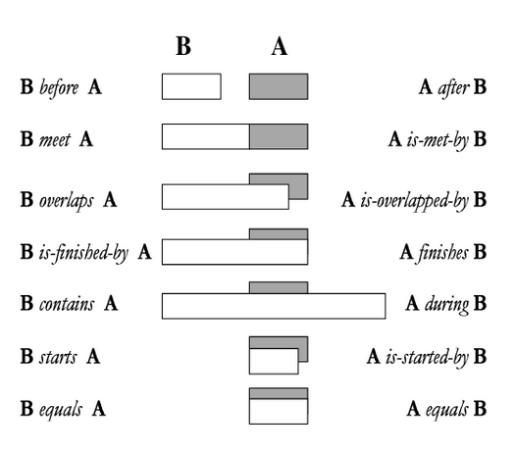
Introduction
Continuous Data (CD) distribution processes generate hundred thousands of records called Concise List of Frames (CLF) in a daily basis.
Processing and analyzing such data is very difficult using traditional interval relationships techniques.
We need to calculate 13 relationships between 2 intervals (Allen's interval relationships).
This becomes more complex if we are receiving hundred thousands of CLF intervals daily.
P4.1-598
Please do not use this space, a QR code will be automatically overlayed
Allen's interval relationships.

Slide 3
Objectives
To help us in effectively process/analyze the CLF files and records and monitor the CD distribution process
Can we use?
AI (expert system and suitable inference engine).
Modelling system (RISMA) to simplify complexity of intervals relationships
Applying data/stream mining algorithms
One programming language
Implement Dashboards
Store the different types of results into searchable schemaless database (NoSQL)
CLF line/record structure
Frame number
File name extension
Offset in file (number of bytes)
Frame size (number of bytes)
Direction indicator (incoming >, outgoing <)
Frame reception time
Nominal time if Data Frame
Frame parsing code
Receive or sent span time
Channel mask (0,1 or ?)
Frame time length in milliseconds
P4.1-598
2
4
6
8
10
Please do not use this space, a QR code will be automatically overlayed
WRA/0/1671020159966884 11bin 98228 5232 >d 1672531334.732652 1672531270.000000 0x0 0.314337 |0001000000000000011101111010010000000000| 10000
1
3
5
7
9
11

Slide 4
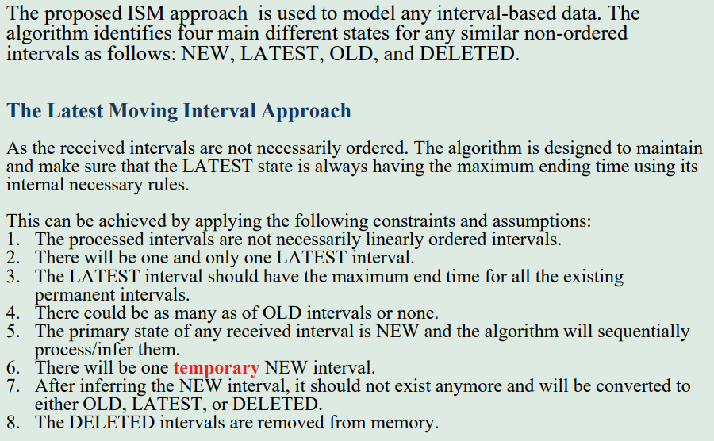
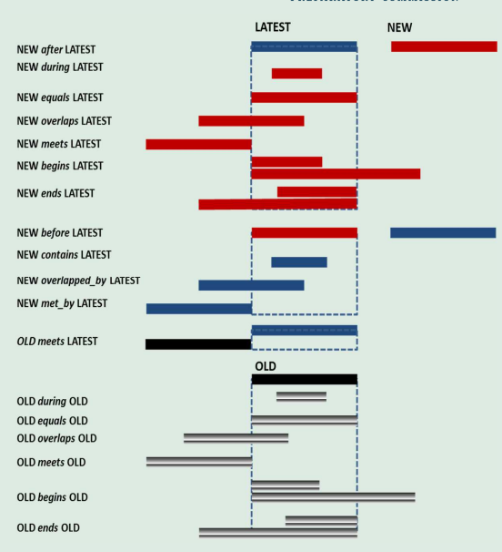
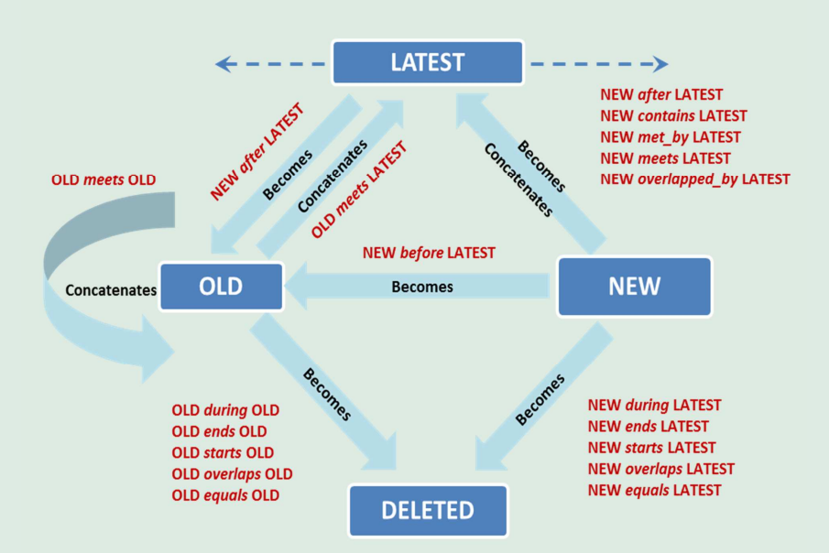
Methods/Data
Use AI (expert system and suitable inference engine), implementing modelling approach (RISMA) and applying data/stream mining algorithms to process/analyze the CLF files and records
RISMA Interval State Machine (ISM)
RISMA rules
RISMA states and rules relationships
P4.1-598
Expert System (clipspy)
Please do not use this space, a QR code will be automatically overlayed
Knowledge-based objects and rules
Discover patterns
Store results
Data/
Stream Mining
CLF
records
Parser and modelling
Build results, metrics
Explore
Inference Engine
Fired
Rules

Slide 5
Results
List of information/metrics/patterns that are calculated, derived and can be monitored/explored.
Channel
Data Availability (DA)
Timeliness
Distribution Process Indicator (DPI)
Number of Channels Sub Frames (CSF)
Number of OLD CSF
Fired rules/events/patterns
Rules/events/patterns association
Rules /events/patterns sequence
Data frames sequence
Duplicated frames
CD Binary data records status/information
Number of timely Frames
Minimum data begin time
Maximum data end time
Minimum time of backfilled data
Maximum time of backfilled data
Number of gaps
Number of gaps filled
Closed Frequent Itemset Table
Station
Average Data Availability (DA)
Average Timeliness
Average Distribution Process Indicator (DPI)
Average number of Channels Sub Frames (CSF) received
Channels count
Sequence of frame IDs
Duplicated frames
All types of frames received/sent
Frame span time
Data received time difference to begin of interval
Interval begin time
Interval end time
Channels statistics (see channel information)
P4.1-598
Please do not use this space, a QR code will be automatically overlayed
Information/metrics are calculated every 10 minutes, hourly, daily and monthly basis and stored into the NoSQL database.

Slide 6
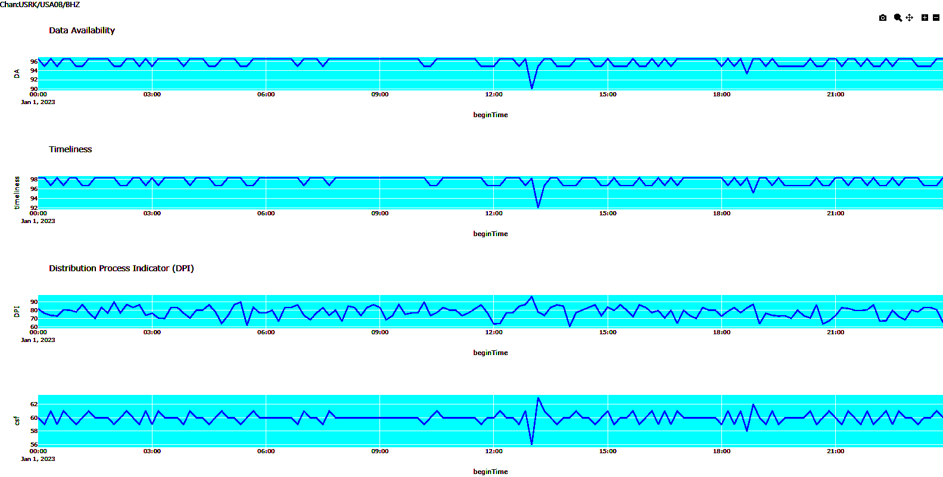
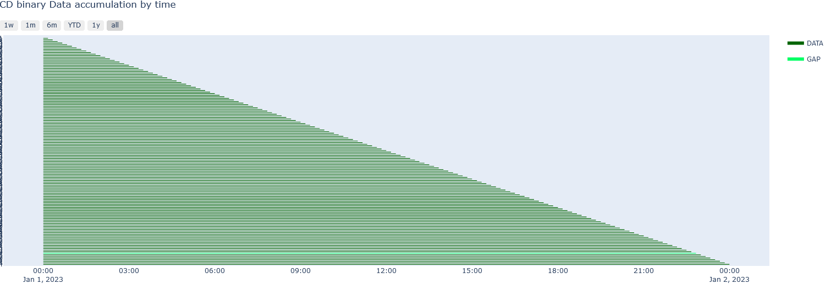
Results, continued…
Many metrics, performance indicators and results have been produced as well as different operation patterns were discovered.
WRA
Different types of distribution patterns
Some metrics,10 minutes calculations for one day.
TXAR
USRK
FINES
P4.1-598
Please do not use this space, a QR code will be automatically overlayed
Gap

Slide 7
Conclusion
AI, modeling and data mining can help us to effectively monitor and understand the CD distribution process.
As results are stored in NOSQL databases, we can have more information and results by directly query the databases for different patterns as well as make correlations with different stations and sites
Retrieve and explore generated and stored results using Dashboards.
Also, results can be fed to Elastic Search engines
Interactive analysis and data science activities can be done using Jupiter Notebooks
P4.1-598
Please do not use this space, a QR code will be automatically overlayed

Slide 8
References [Optional slide - Font: Arial Regular Size 20]
Laban, Shaban, and Aly El-Desouky. "RISMA: A rule-based interval state machine algorithm for alerts generation, performance analysis and monitoring real-time data processing." EGU General Assembly Conference Abstracts. 2013.
Yen, Show-Jane, et al. "An efficient algorithm for maintaining frequent closed itemsets over data stream." Next-Generation Applied Intelligence: 22nd International Conference on Industrial, Engineering and Other Applications of Applied Intelligent Systems, IEA/AIE 2009, Tainan, Taiwan, June 24-27, 2009. Proceedings 22. Springer Berlin Heidelberg, 2009
CDtools User Guide, “CTBTO Preparatory Commission.” 2023. Ctbto.org. 2023. https://www.ctbto.org/.
“Clips Python Bindings.” CLIPS Python Bindings - Clipspy 1.0.1 Documentation, clipspy.readthedocs.io/en/latest/. Accessed 25 May 2023.
Riley, Gary. "Clips: An expert system building tool." Proceedings Second National Technology Transfer Conference and Exposition. Vol. 2. 1991.
Plotly. “Plotly/Dash: Data Apps & Dashboards for Python. No Javascript Required.” GitHub, github.com/plotly/dash. Accessed 25 May 2023.
Kluyver, Thomas, et al. Jupiter Notebooks-a publishing format for reproducible computational workflows. Vol. 2016. 2016.
Quast, Radim Rehurek, Victor R. Escobar, Andrey Usov, Prasanna Swaminathan, Jeff. n.d. “Sqlitedict: Persistent Dict in Python, Backed up by Sqlite3 and Pickle, Multithread-Safe.” PyPI. Accessed June 9, 2023. https://pypi.org/project/sqlitedict/.
Px.x-xxx
Please do not use this space, a QR code will be automatically overlayed

