Slide 1
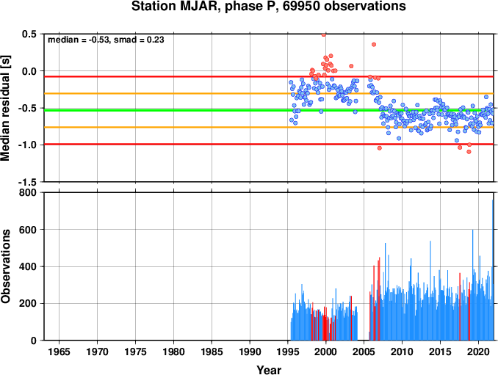
International Monitoring System Station Performance Over Time Using Reported Parametric Data from the International Seismological Centre Bulletin
R. Gallacher, D. A. Storchak, N. Poiata, T. Garth
International Seismological Centre
IMS stations have phases reported to the ISC. These phases can be used to track station performance over time.
IMS station polarity can be checked by by comparing the goodness of fit of reported first motion picked polarities from the ISC Bulletin with reported earthquake mechanism solutions
All station performance tools can be accessed through the ISC website
(www.isc.ac.uk) and the CTBTO-ISC Link website
Please do not use this space, a QR code will be automatically overlayed
P4.1-240

Slide 2
Introduction
The IMS seismic network is made up of 50 primary and 120 auxiliary stations
Many stations have been operational for more than 20 years
Through the Reviewed Event Bulletin, phases for these stations are included in the ISC Bulletin
Metrics tracked include:
average monthly travel time residuals
evaluation of travel time residuals by distance
evaluation of travel time residuals by hypocentre location
New station polarity checker tool available through CTBTO Link to ISC Database
Please do not use this space, a QR code will be automatically overlayed
P4.1-240

Slide 3
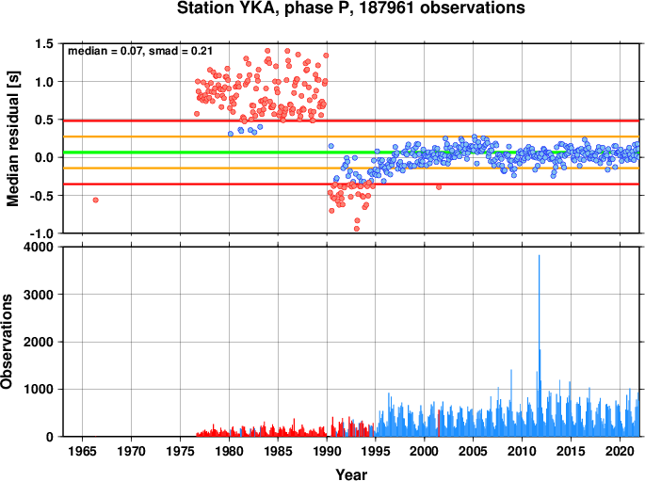
Station Performance Check
Tracking changes in station performance over 20+ years can prove challenging
Particularly where multiple agencies report phases at each station (i.e. NEIC, IDC etc.)
Some information (i.e. phase polarity) may only be reported by an agency which is not responsible for the station
ISC has reported phases for IMS stations for 30+ years
The example shows the monthly mean residual on reported P phases for station YKA (PS09)
Continuous data shows changes in the operation of station YKA over time
Please do not use this space, a QR code will be automatically overlayed
P4.1-240

Slide 4
Polarity Checker
The detection of systematic phase reversals at seismic stations can highlight problematic stations
This is achieved by comparing the goodness of fit of reported first motion picked polarities from the ISC Bulletin with reported earthquake mechanism solutions (Lentas, K. Indications of seismic station phase reversals detected from parametric data in the ISC bulletin. J Seismol 25, 1–23, 2021)
The example below shows predicted polarity for station SNAA (AS035) using reported polarities from the reporters AWI, MOS and PRE
Please do not use this space, a QR code will be automatically overlayed
P4.1-240

Slide 5
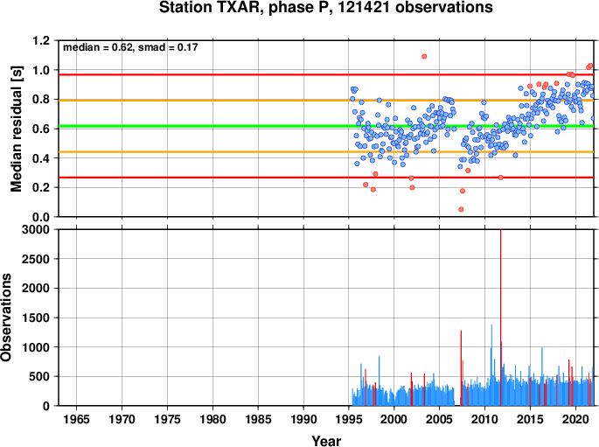
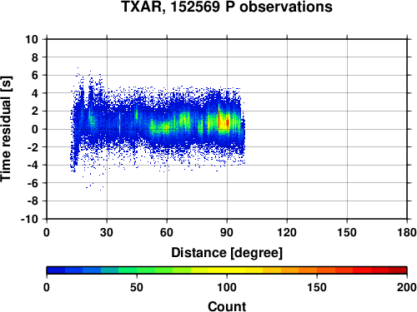
Station: Lajitas, USA (TXAR/PS46)
Station TXAR (PS46) shows trends in monthly mean residual
Multiple agencies reports are included in the plots, however duplicated phase reports are removed
Please do not use this space, a QR code will be automatically overlayed
P4.1-240

Slide 6
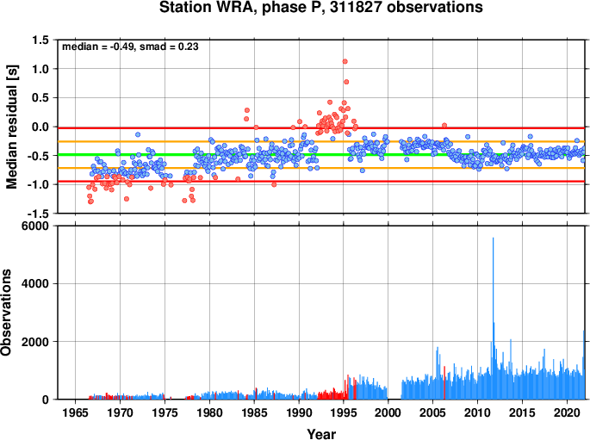
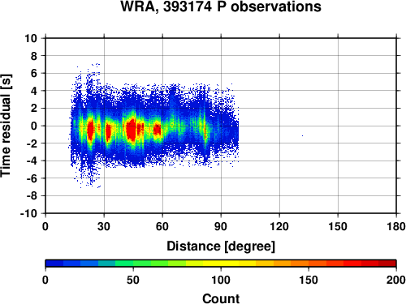
Station: Warramunga, Australia (WRA/PS02)
Station WRA (PS02) shows a historical spike in monthly mean residual from 1992-1995
Modern operation of the station shows a consistently small mean residual
Please do not use this space, a QR code will be automatically overlayed
P4.1-240

Slide 7
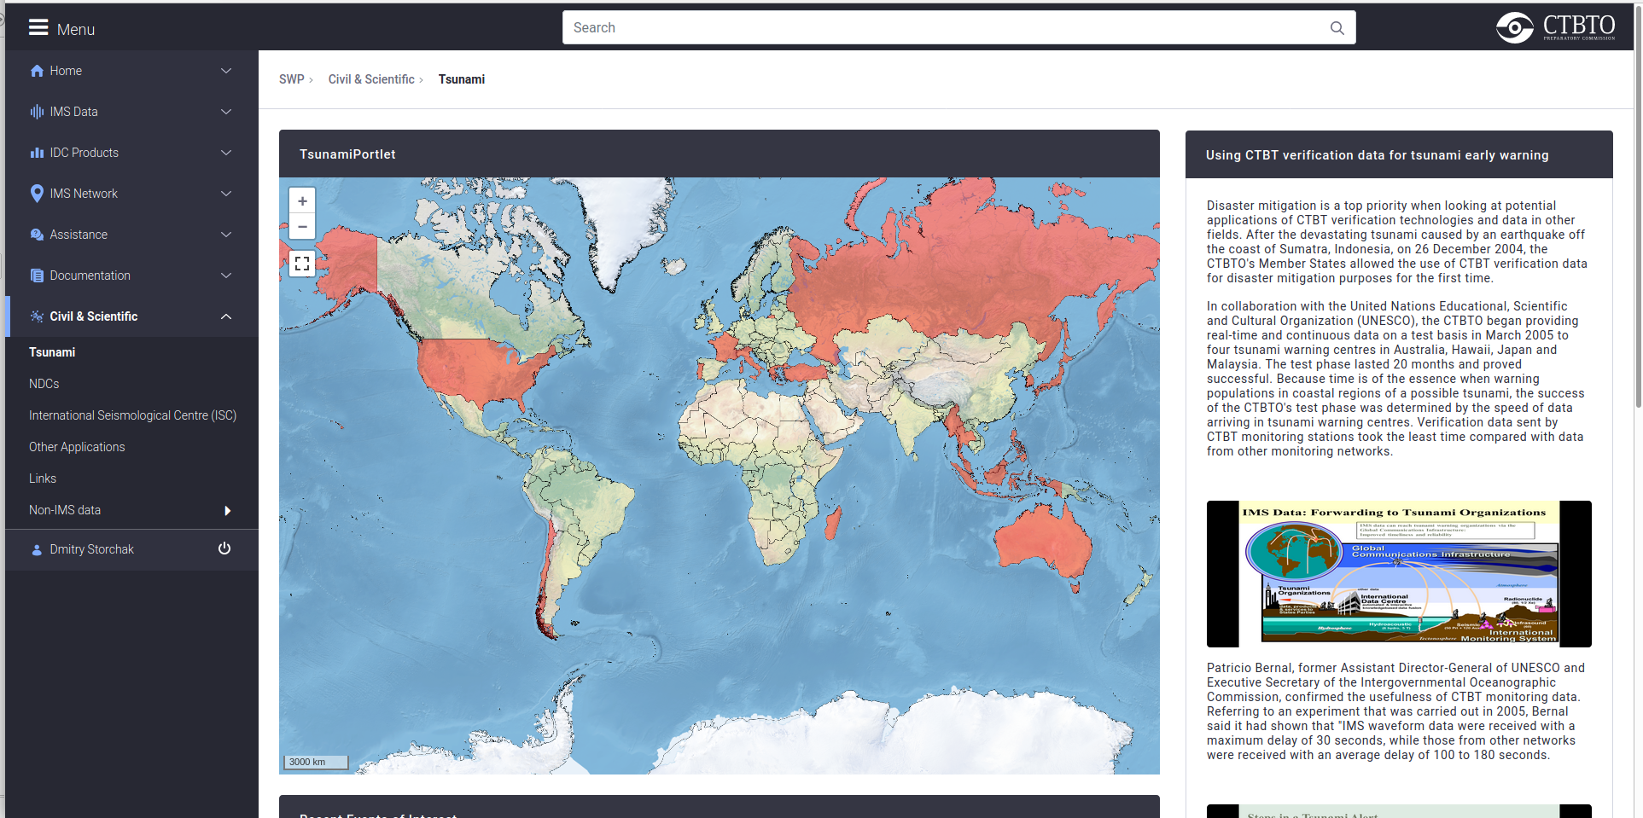
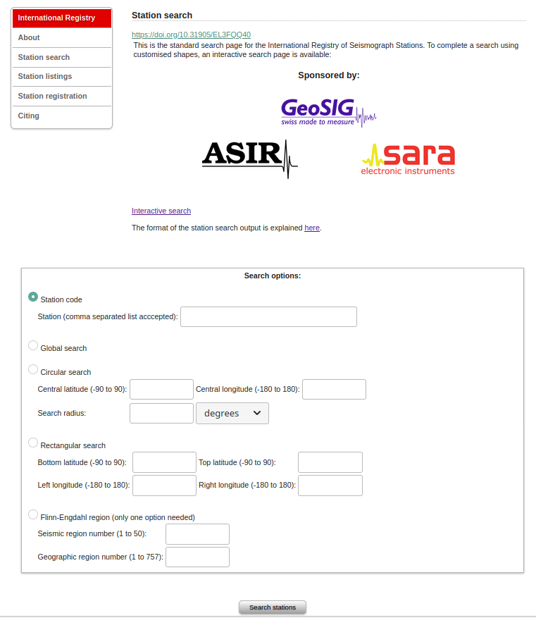
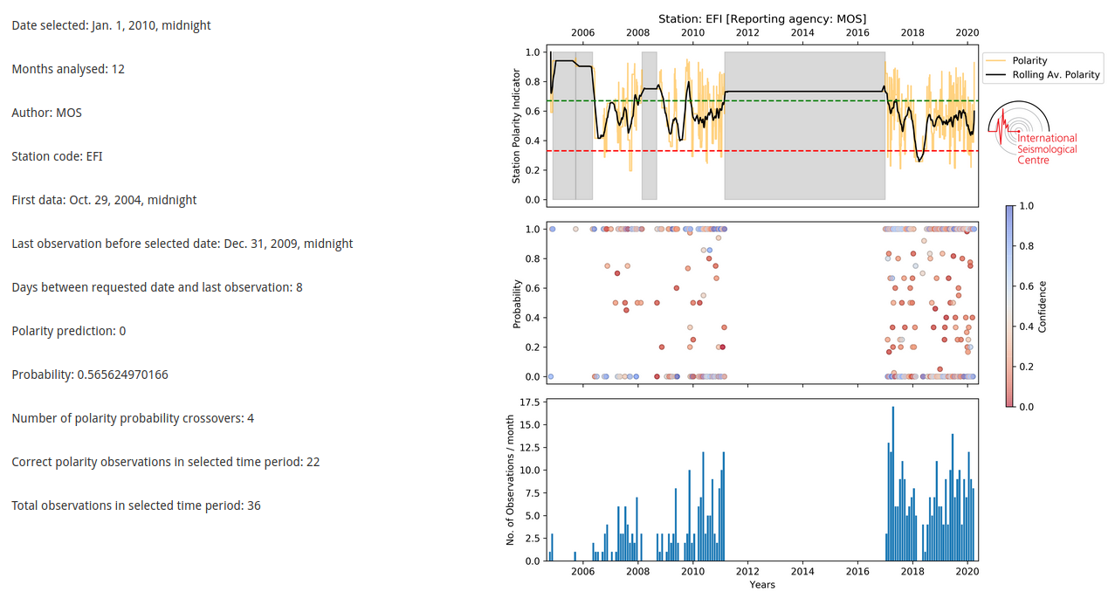
How to Access ISC Station Check Tools?
Access to the station performance is available through the station pages on both the ISC website (www.isc.ac.uk/registries/search/) and the CTBTO-ISC Link website
Access to the station polarity check is available through the CTBTO-ISC Link website
Please do not use this space, a QR code will be automatically overlayed
P4.1-240

