Slide 1
Enhance data quality control with interactive station monitoring tools in the OPS centre.
Parithusta., R.A, Ketata., I, and IDC OPS-MFO
CTBTO Preparatory Commission
The requirement for data availability emphasizes the significance of data quality monitoring. In conjunction with other PTS monitoring tools, the Multi-Technology Integration Portal was developed to support PTS monitor data quality at the station and network levels in a more systematic, timely, reliable, and accurate approach. As well as supporting other technical routine activities to ensure station performance meets the IMS Operational Manual requirements. This assists the OPS Centre, especially when dealing with incidents, in monitoring data quality at the station and network levels..
The method entails integrating/aggregating existing PTS monitoring tools and displaying them on a single portal. The Multi-Technology Integration portal has been developed to provide an informative view of data quality that allows the user to obtain a concise summary of the station status. Data is gathered from the station Information (DOTS), SOH-Grafana, PRTools, IRS-ITS reporting system, PSD/PDF, residual, calibration (CAMT- CalxPy), station configuration, and other sources.
The results show that using these methods led to a significant improvement in data quality monitoring in the OPS Centre.
This enhances data accuracy and identifies incident sources, allowing more reliable troubleshooting.
This approach supports identifying and informing OPS of potential incidents at an early stage by continuously monitoring station data quality.
Efficient in terms of time and operational efficiency when dealing with incidents.
Maintain the IMS network's high performance.
In dealing with station incidents and monitoring IMS networks, the use of Multi-Technology Integration Portal along with other PTS monitoring tools has resulted in significant enhancements in OPS data quality monitoring.
These benefits contribute to the overall reliability of IMS network performance.
Please do not use this space, a QR code will be automatically overlayed
P4.1-670

Slide 2
Introduction
The International Monitoring System (IMS) is a globally distributed network of monitoring facilities using sensors from seismic, hydroacoustic, infrasound, and radionuclide technologies. The need for data availability increased the significance of data quality monitoring. This task is addressed through the creation of a platform for the fast and easy identification of data acquisition problems, as well as regular activities to ensure that station characteristics meet the requirements of the IMS draft Operational Manuals.
In terms of data quality, what does OPS monitor?
Data Integrity
(Data Availability and Mission Capability performance)
Noise & spike identification
Instrument Calibration
Gaps & Constant Values
Data Consistency & Coherency
Data Surety
The Provisional Technical Secretariat (PTS) has developed a Multi-Technology Integration Portal internal platform with a variety of monitoring tools to facilitate data quality monitoring. This portal has been developed to support Internal/PTS on the daily IMS station – network monitoring.
The accurate and reliable data in PTS context is facilitates efficient troubleshooting at any level, enables informed decision-making in any type of incidents, supports predictive analysis, and drives continuous improvement on the station performance. It provides the necessary foundation for Station Operator and PTS to optimize their operations, improve data transmission quality, and achieve desired outcomes that meet the requirement. (Data Availability and Mission Capability performance).
P4.1-670
Please do not use this space, a QR code will be automatically overlayed
Compliance with Standards it involves verifying that the acquired data meets the specified requirements, such as sampling rate, amplitude range, frequency response, and other relevant parameters.
Notes:
Briefly introduce the topic of data quality control in the OPS centre.
Explain the importance of accurate and reliable data in operational decision-making.
MuTIP provides information such as station summary (PSD/PDF, Residual, and Calibration). MuTIP has also interfaced with Grafana (SOH), PRTools, JIRA instances (IRS, ITS, SHD), CAMT, DOTS, and International Data Centre databases. MuTIP provides good support for data quality monitoring in terms of troubleshooting (reliability, efficiency, accuracy, and timeliness) to maintain good station/IMS network performance in daily OPS data monitoring. Ensuring that the station is operating properly, especially in meeting data (availability, surety, and quality) requirements.

Slide 3
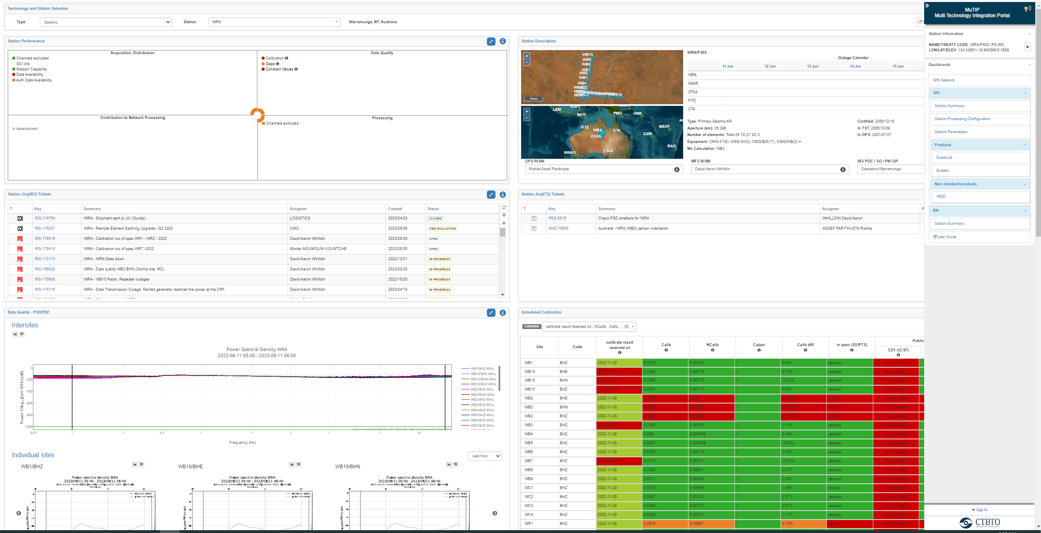
How OPS improves data quality monitoring ?
OPS's approaches to handling incidents and improving data quality monitoring are as follows:
OPS is primarily based on real-time monitoring and alerts for incident management.
OPS validates and verifies data by utilizing OPS Tools (SOH, PRTools, Geootools, and others) as well as existing databases.
Data quality control evaluated the overall quality of monitored station data using defined Data Quality Metrics and Indicators as specified in the Station O&M. Multi-Technology Integration Portal is particularly supported at this stage to ensure OPS can have more reliable data quality monitoring.
Continuously evaluate and improve on data quality based on the feedback, analysing data quality reports and process.
This approaches is also used to review Station Performance on a monthly (Monthly Report) or yearly (SSR's) basis.
SOH-Grafana
Geotools
IDC databases
DOTS
PRTools
Alert(s)
Incident reported by SO/PTS
IRS-ITS ticketing system
Monthly Report
Common challenges faced in maintained data quality in OPS Center
Data Accuracy
Data Integration
Data Consistency
Data Completeness
Data Timeliness
Data Security and Privacy
Multi-Technology Integration Portal
P4.1-670
Please do not use this space, a QR code will be automatically overlayed
The dedicated portal gathered information from various OPS tools and database(s) and visualized station data/information on a dedicated page for preliminary/summary/detail analysis.
Using the provided indicator, this tool can detect anomalies, outliers, and inconsistencies in data.
Notes:
Overview of Data Quality Control
Define data quality control and its significance.
Discuss common challenges faced in maintaining data quality.
Highlight the impact of poor data quality on operational efficiency.
Introduction to Interactive Station Monitoring Tools
Explain what interactive station monitoring tools are.
Discuss the benefits of using such tools for data quality control.
Emphasize the role of interactive station monitoring tools in enhancing operational processes.

Slide 4
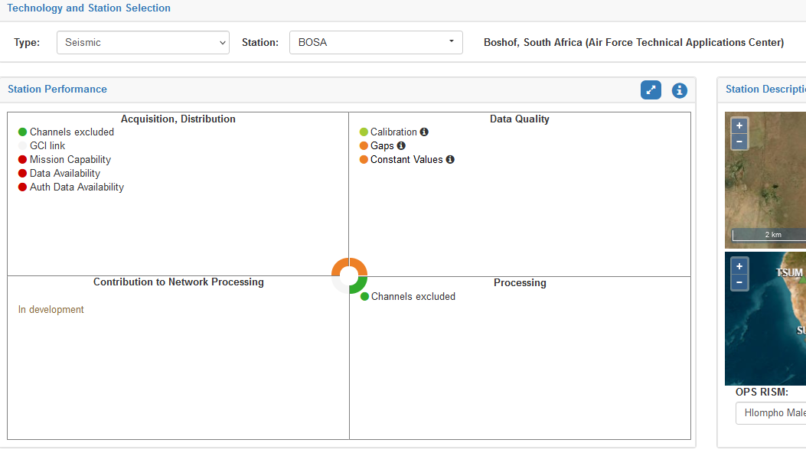
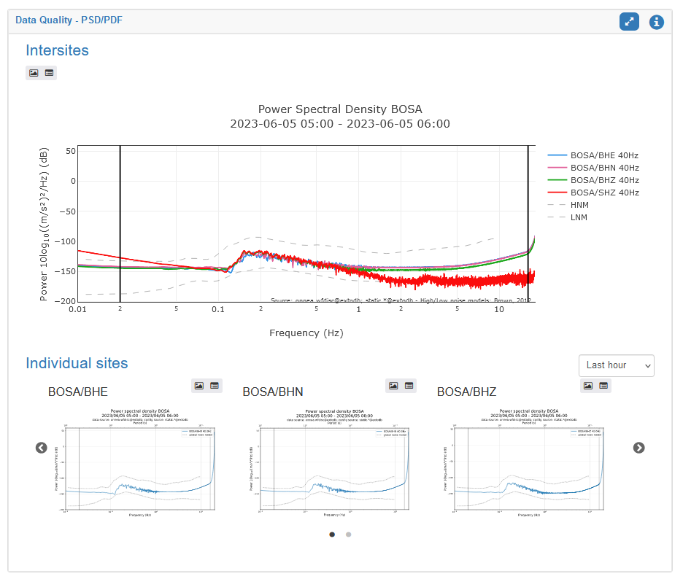
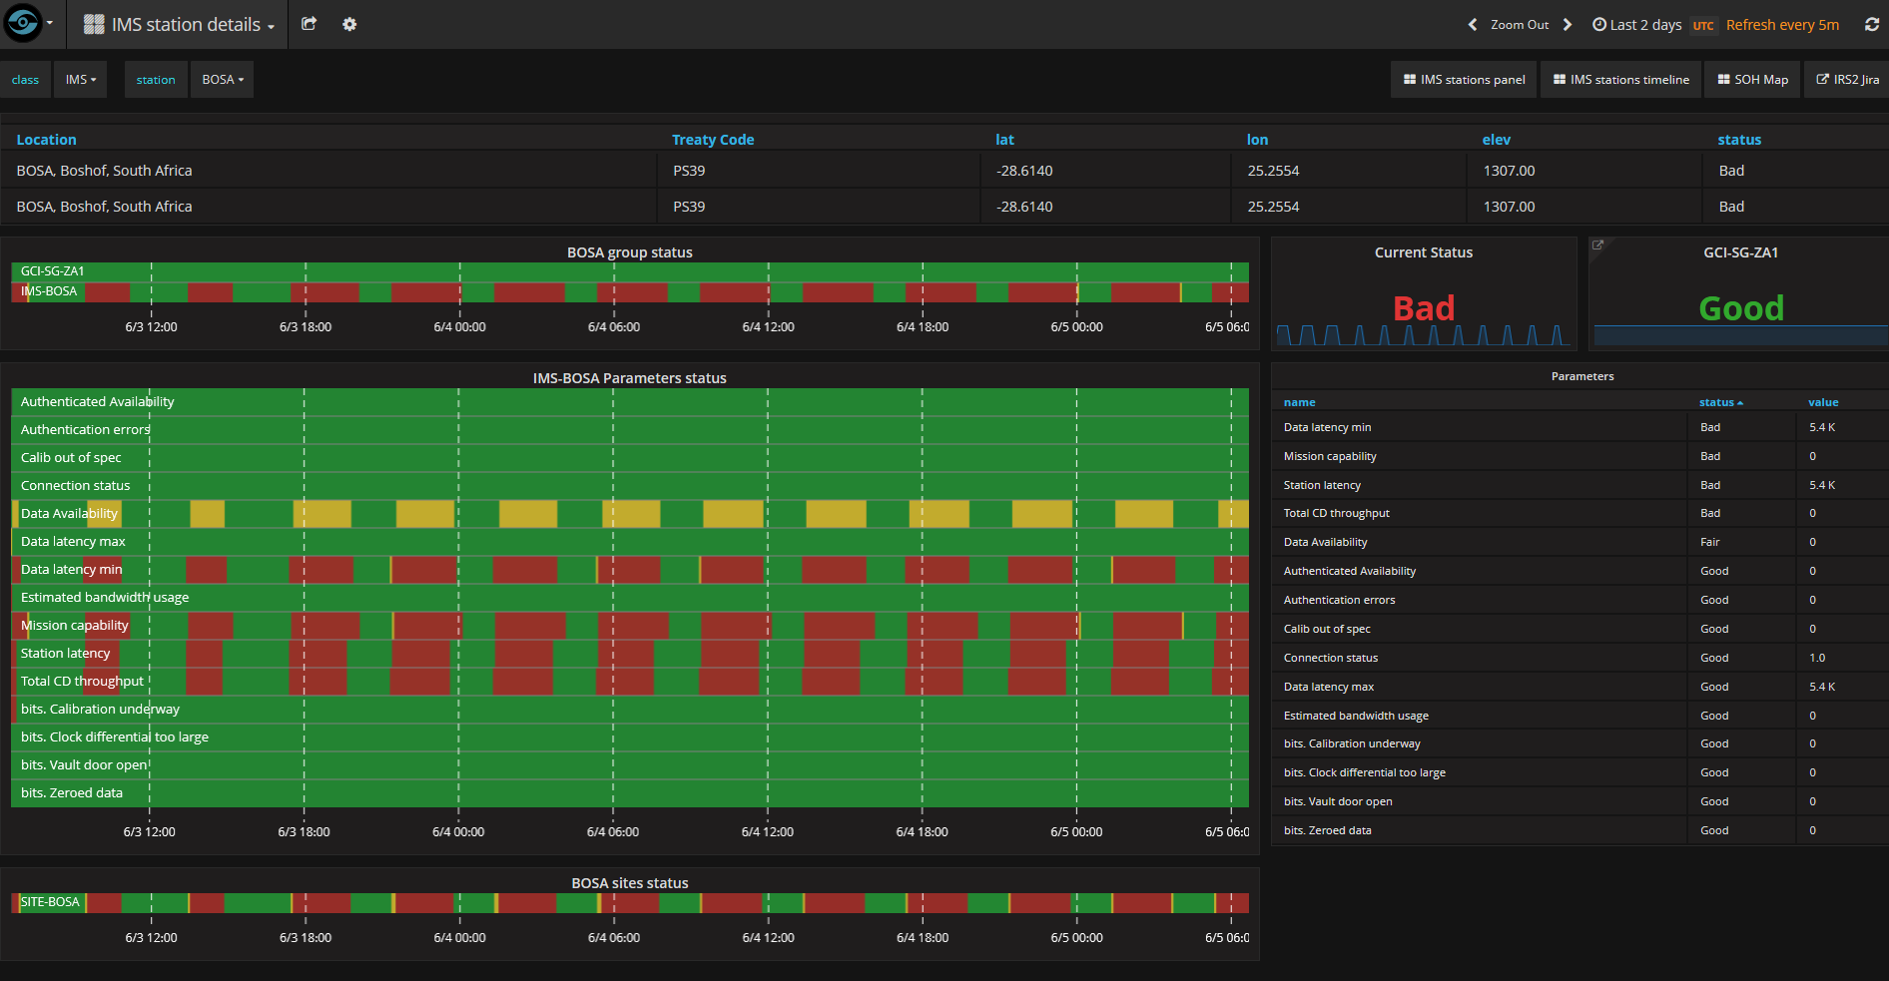
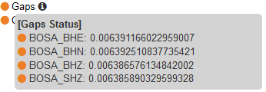
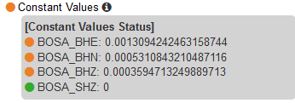
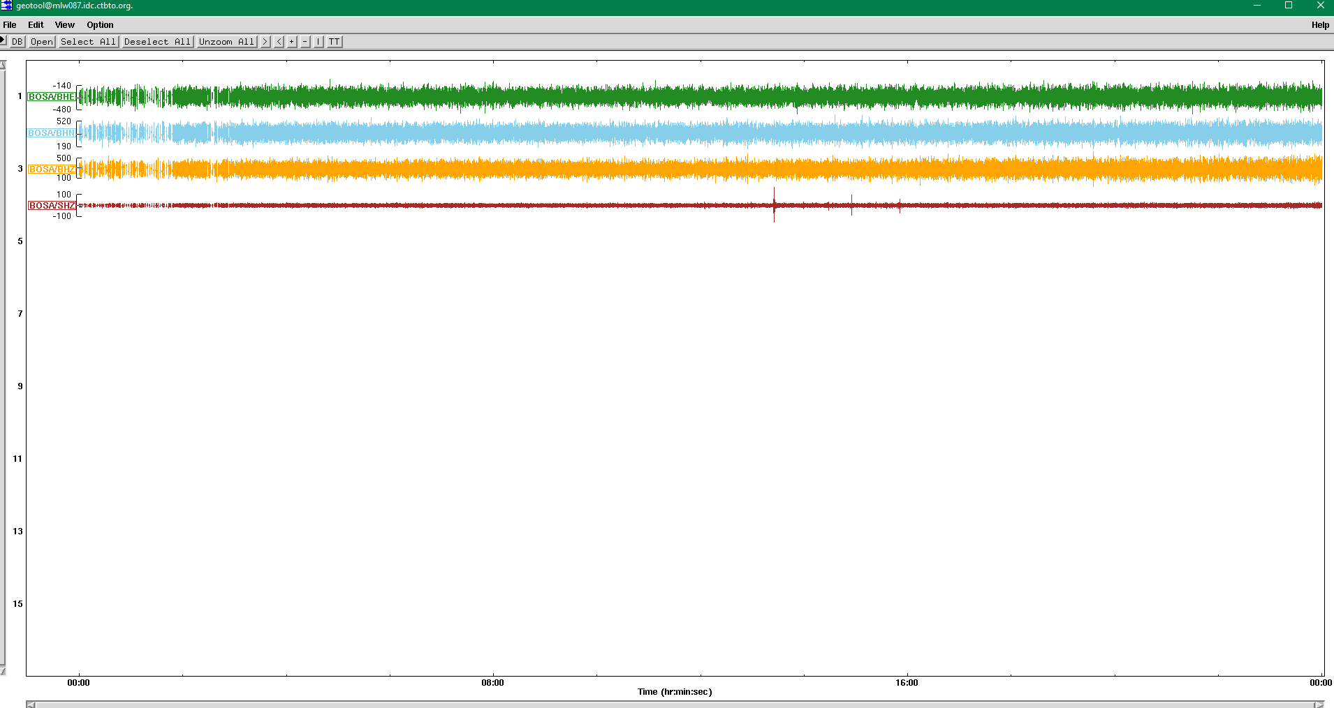
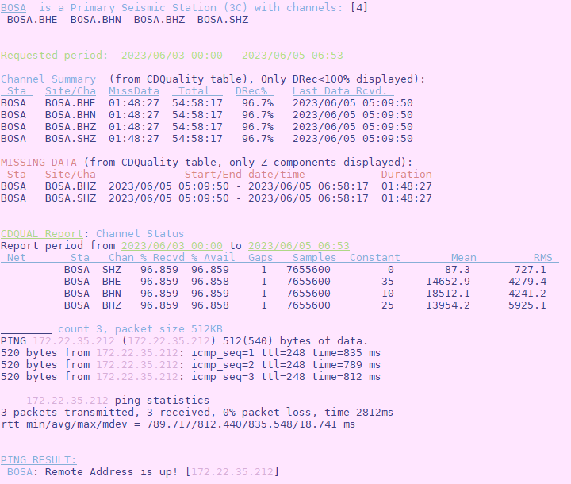
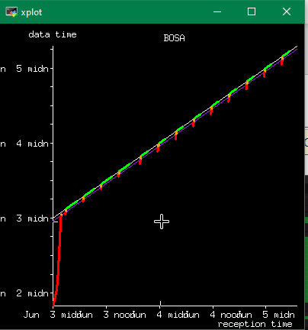
Use Case(s) in the PTS - OPS Center
Handling Incident - Alert
Station Performance
PSD/PDF
SOH
Geotool
The incident handling procedure in OPS includes an assessment on the data quality.
Alert is Active (SOH) (or Alert has ended-outage >1 hour)
The Station Performance indicator confirms that the alert is active due to lost DAU, MCU, gaps and Authentication DA.
Check the SOH-Grafana for more information on the parameter that caused the BAD status.
Geotool can provide information on waveform data.
Check KPI performance with PRTools.
The Station Summary section is used to validate the data quality (PSD/PDF, residuals, and configuration current status).
Establish communication with the Station Operator/PTS via IRS-JIRA for troubleshooting.
PRTools
P4.1-670
Please do not use this space, a QR code will be automatically overlayed
IRS
Notes:
Use Cases and Examples
Provide specific examples of how interactive station monitoring tools have been used in OPS centres.
Highlight successful implementations and the resulting improvements in data quality control.
Showcase before-and-after scenarios to demonstrate the effectiveness of these tools.
Integration and Implementation
Discuss the process of integrating interactive station monitoring tools into existing OPS centre systems.
Address potential challenges and considerations during implementation.
Explain the benefits of integrating these tools with other data management systems.
Best Practices for Data Quality Control
Share best practices for ensuring data quality control using interactive station monitoring tools.
Highlight the importance of data validation, data cleansing, and regular monitoring.
Discuss the role of training and ongoing support for OPS centre staff.

Slide 5
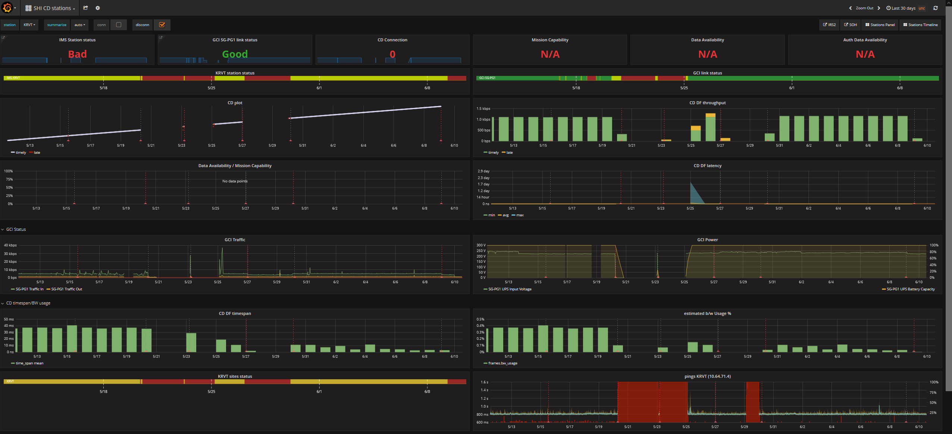
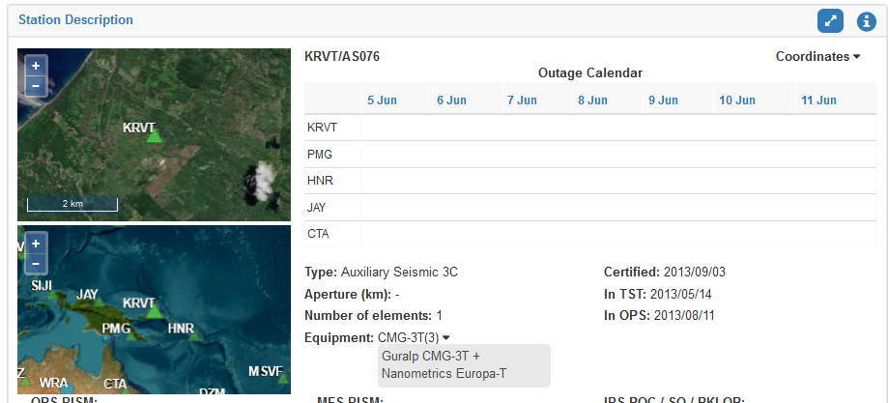
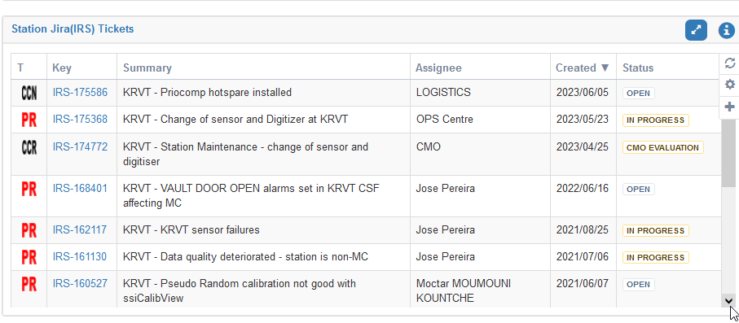
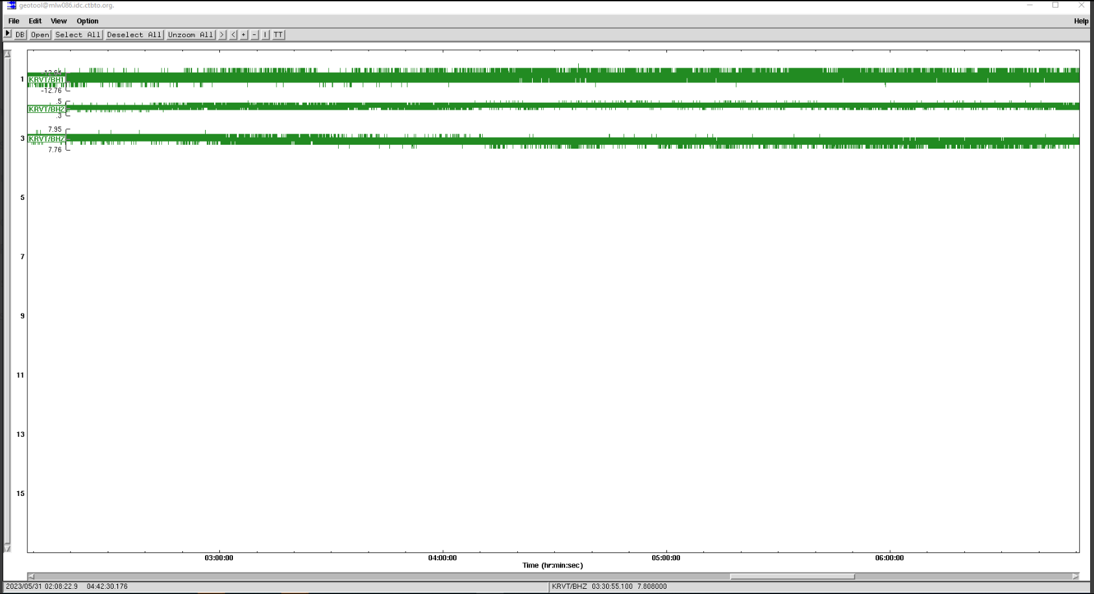
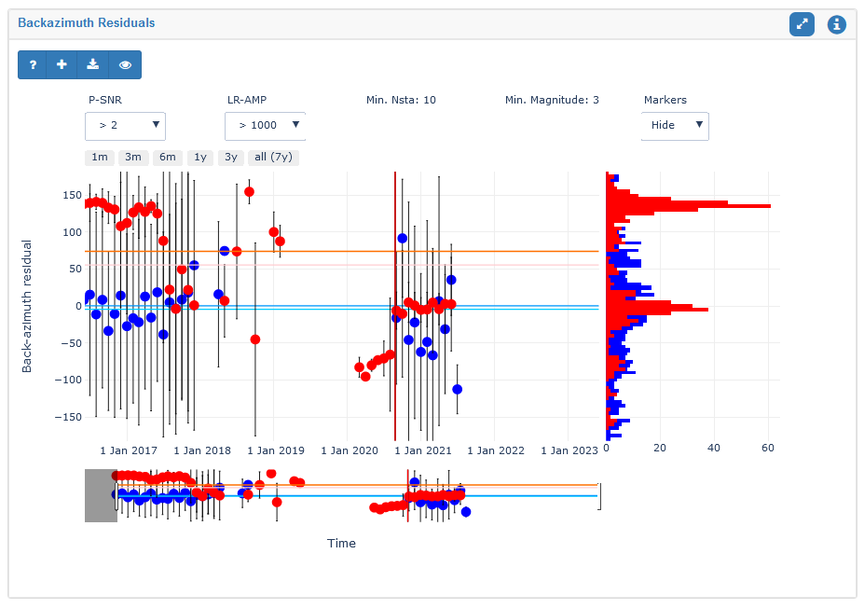
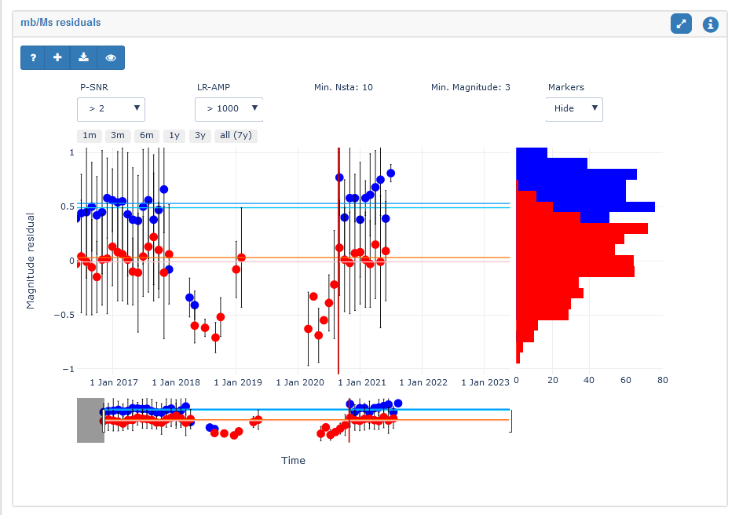
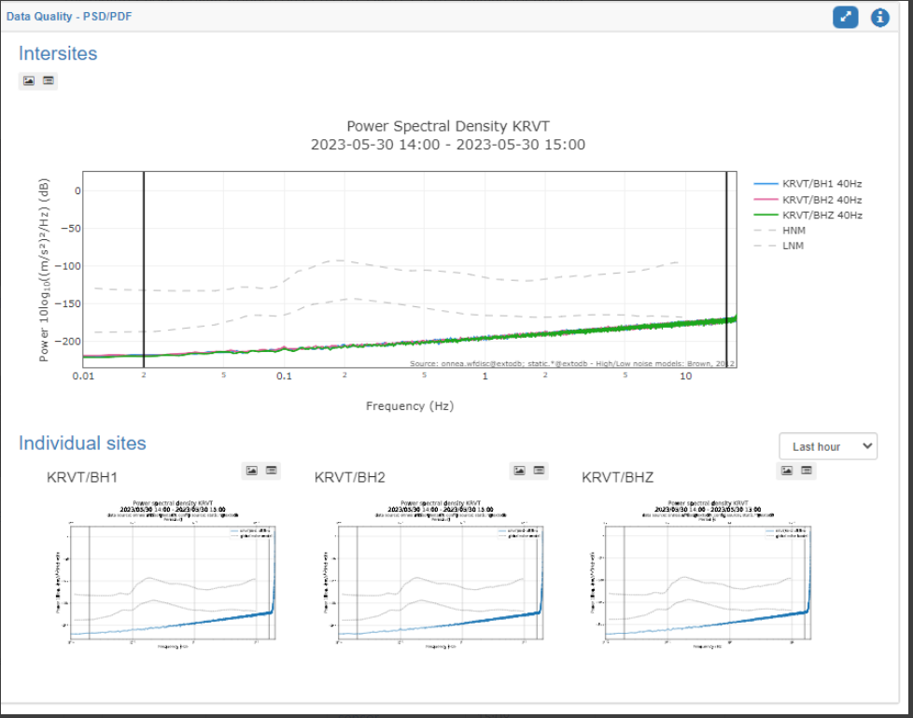
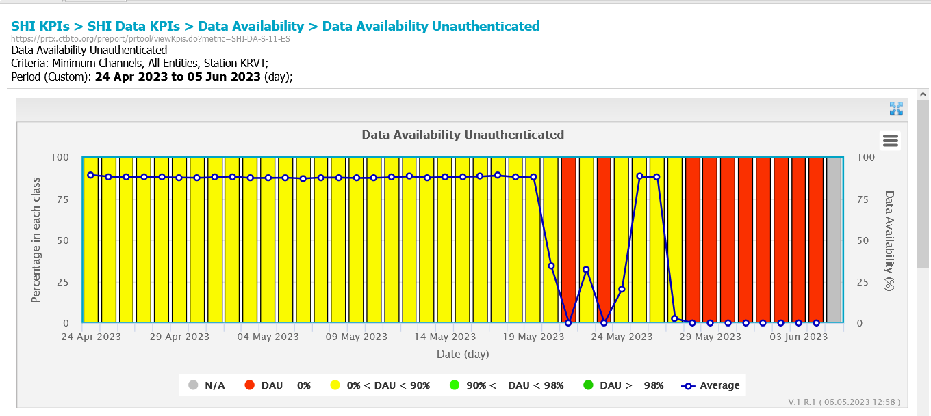
Use Case(s) in the PTS OPS Center
Equipment changed required due data quality deteriorated
SOH
Station Description
IRS
Residuals
PSD/PDF
Geotool
The quality of the data transmission has deteriorated:
DAU/MCU degraded; PRTools was used to assess station KPI performance.
Geotool confirmed that the station is only transmiting digitizer noise.
More information about the Station Performance can be found on the SOH-Grafana.
The Station Summary section is where the data quality issue (PSD/PDF, residuals, and current configuration status) is validated. PSD/PDF and residuals plots provided information on the anomaly that could result in equipment failure.
Verified the existing reports for more information and communicate with the Station Operator/PTS via IRS-JIRA for troubleshooting.
P4.1-670
PRTools
Please do not use this space, a QR code will be automatically overlayed
Notes:
Use Cases and Examples
Provide specific examples of how interactive station monitoring tools have been used in OPS centres.
Highlight successful implementations and the resulting improvements in data quality control.
Showcase before-and-after scenarios to demonstrate the effectiveness of these tools.
Integration and Implementation
Discuss the process of integrating interactive station monitoring tools into existing OPS centre systems.
Address potential challenges and considerations during implementation.
Explain the benefits of integrating these tools with other data management systems.
Best Practices for Data Quality Control
Share best practices for ensuring data quality control using interactive station monitoring tools.
Highlight the importance of data validation, data cleansing, and regular monitoring.
Discuss the role of training and ongoing support for OPS centre staff.

Slide 6
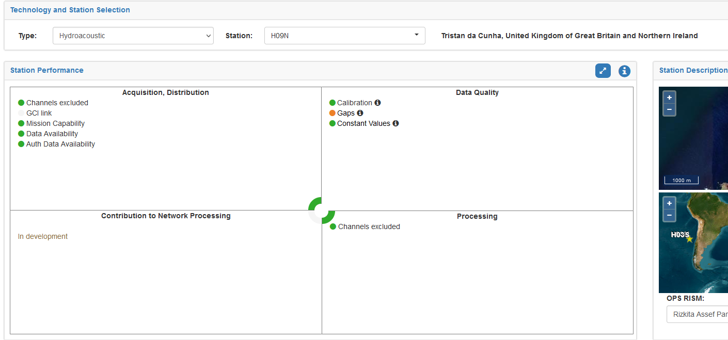
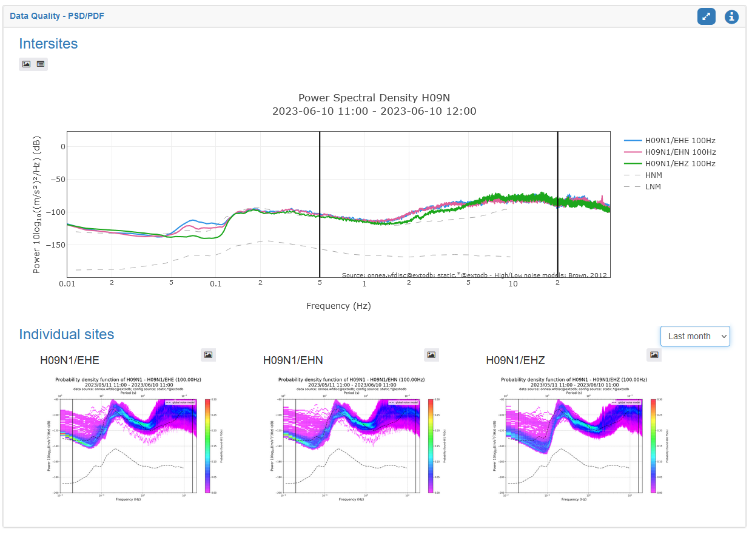
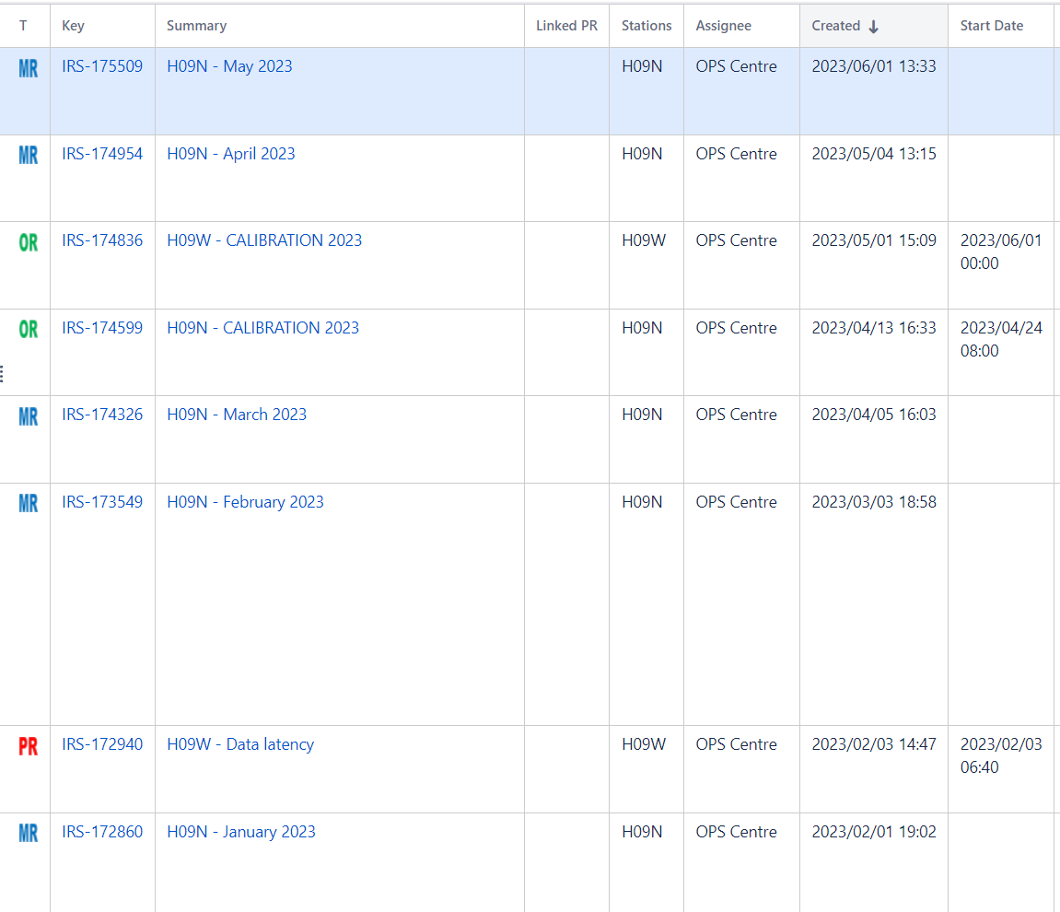
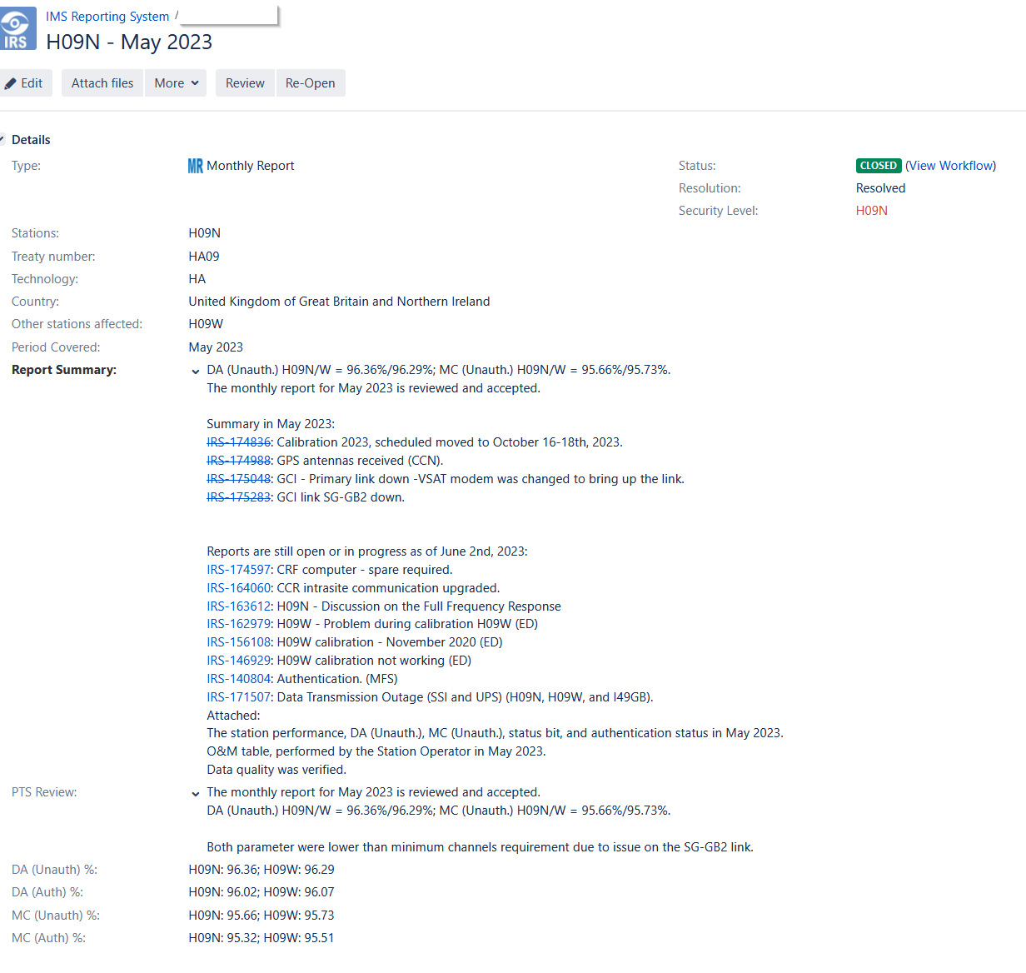
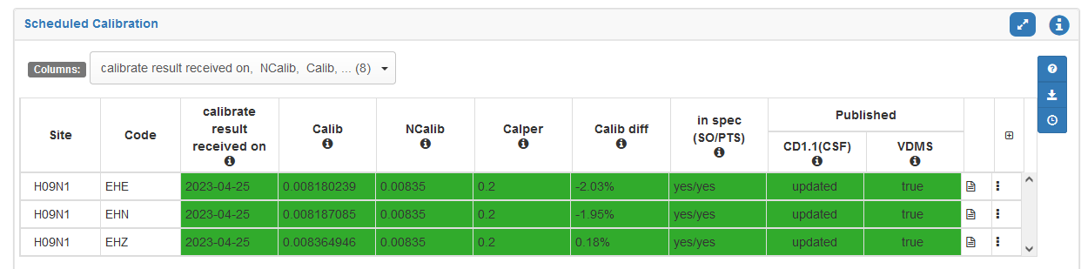
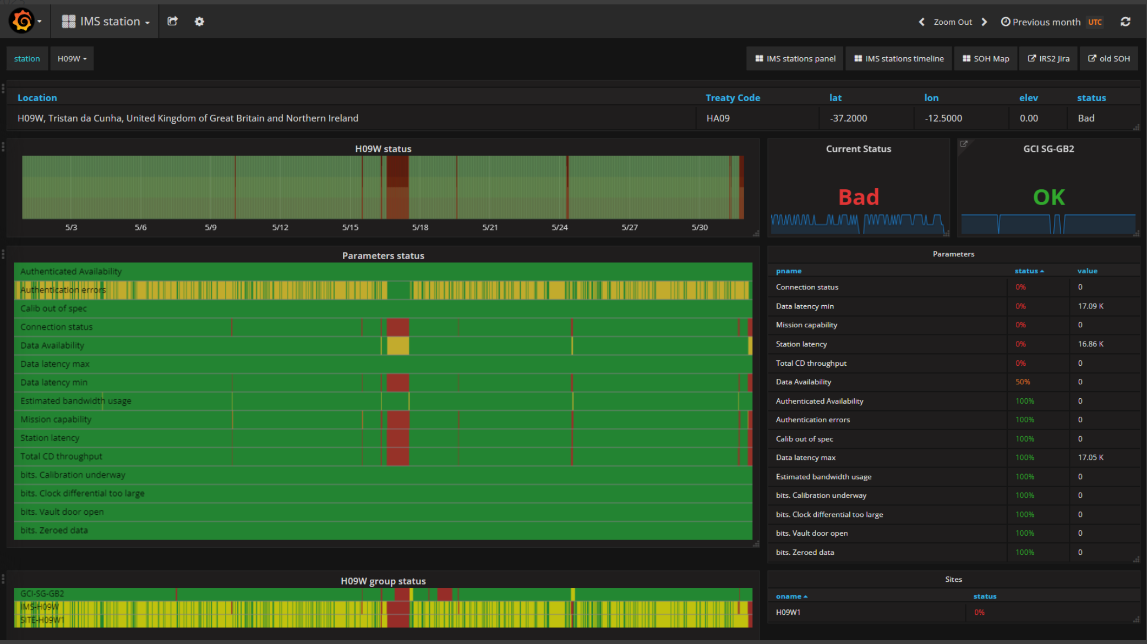
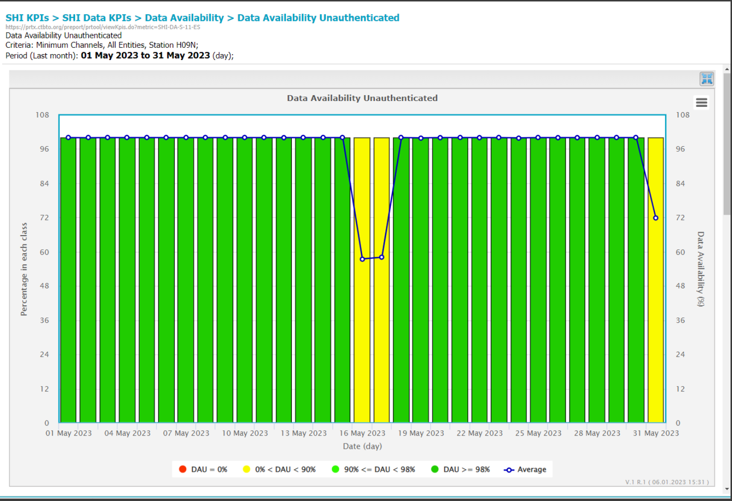
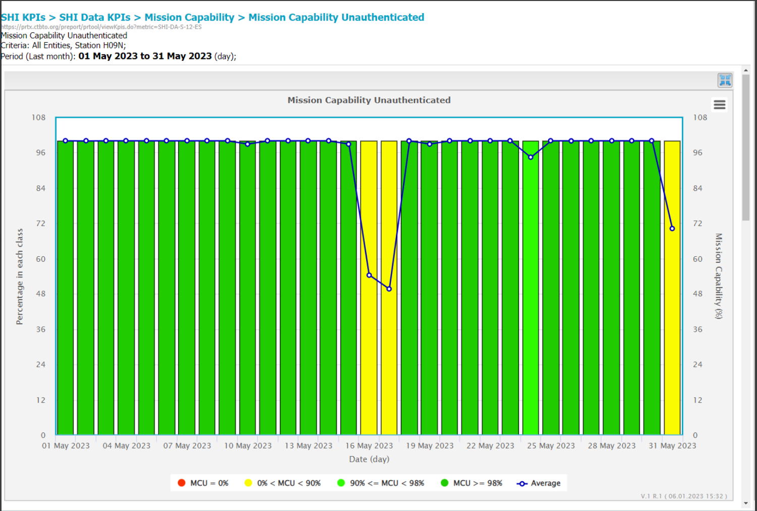
Reviewing the Station Performance
Monthly Report review
Station Summary
IRS
SOH
PRTools
Monthly report review:
PRTools is used to verify KPI station performance.
Review and verify the station O&M Activity (Status Bit) on the SOH-grafana.
SOH-grafana confirmed the station's performance and authenticity.
Geotool to confirmed the data quality of the waveform.
In the Station Summary section, PTS can analyze data quality station performance (PSD/PDF, residuals, calibration, and configuration status).
P4.1-670
Please do not use this space, a QR code will be automatically overlayed
Notes:
Use Cases and Examples
Provide specific examples of how interactive station monitoring tools have been used in OPS centres.
Highlight successful implementations and the resulting improvements in data quality control.
Showcase before-and-after scenarios to demonstrate the effectiveness of these tools.
Integration and Implementation
Discuss the process of integrating interactive station monitoring tools into existing OPS centre systems.
Address potential challenges and considerations during implementation.
Explain the benefits of integrating these tools with other data management systems.
Best Practices for Data Quality Control
Share best practices for ensuring data quality control using interactive station monitoring tools.
Highlight the importance of data validation, data cleansing, and regular monitoring.
Discuss the role of training and ongoing support for OPS centre staff.

Slide 7
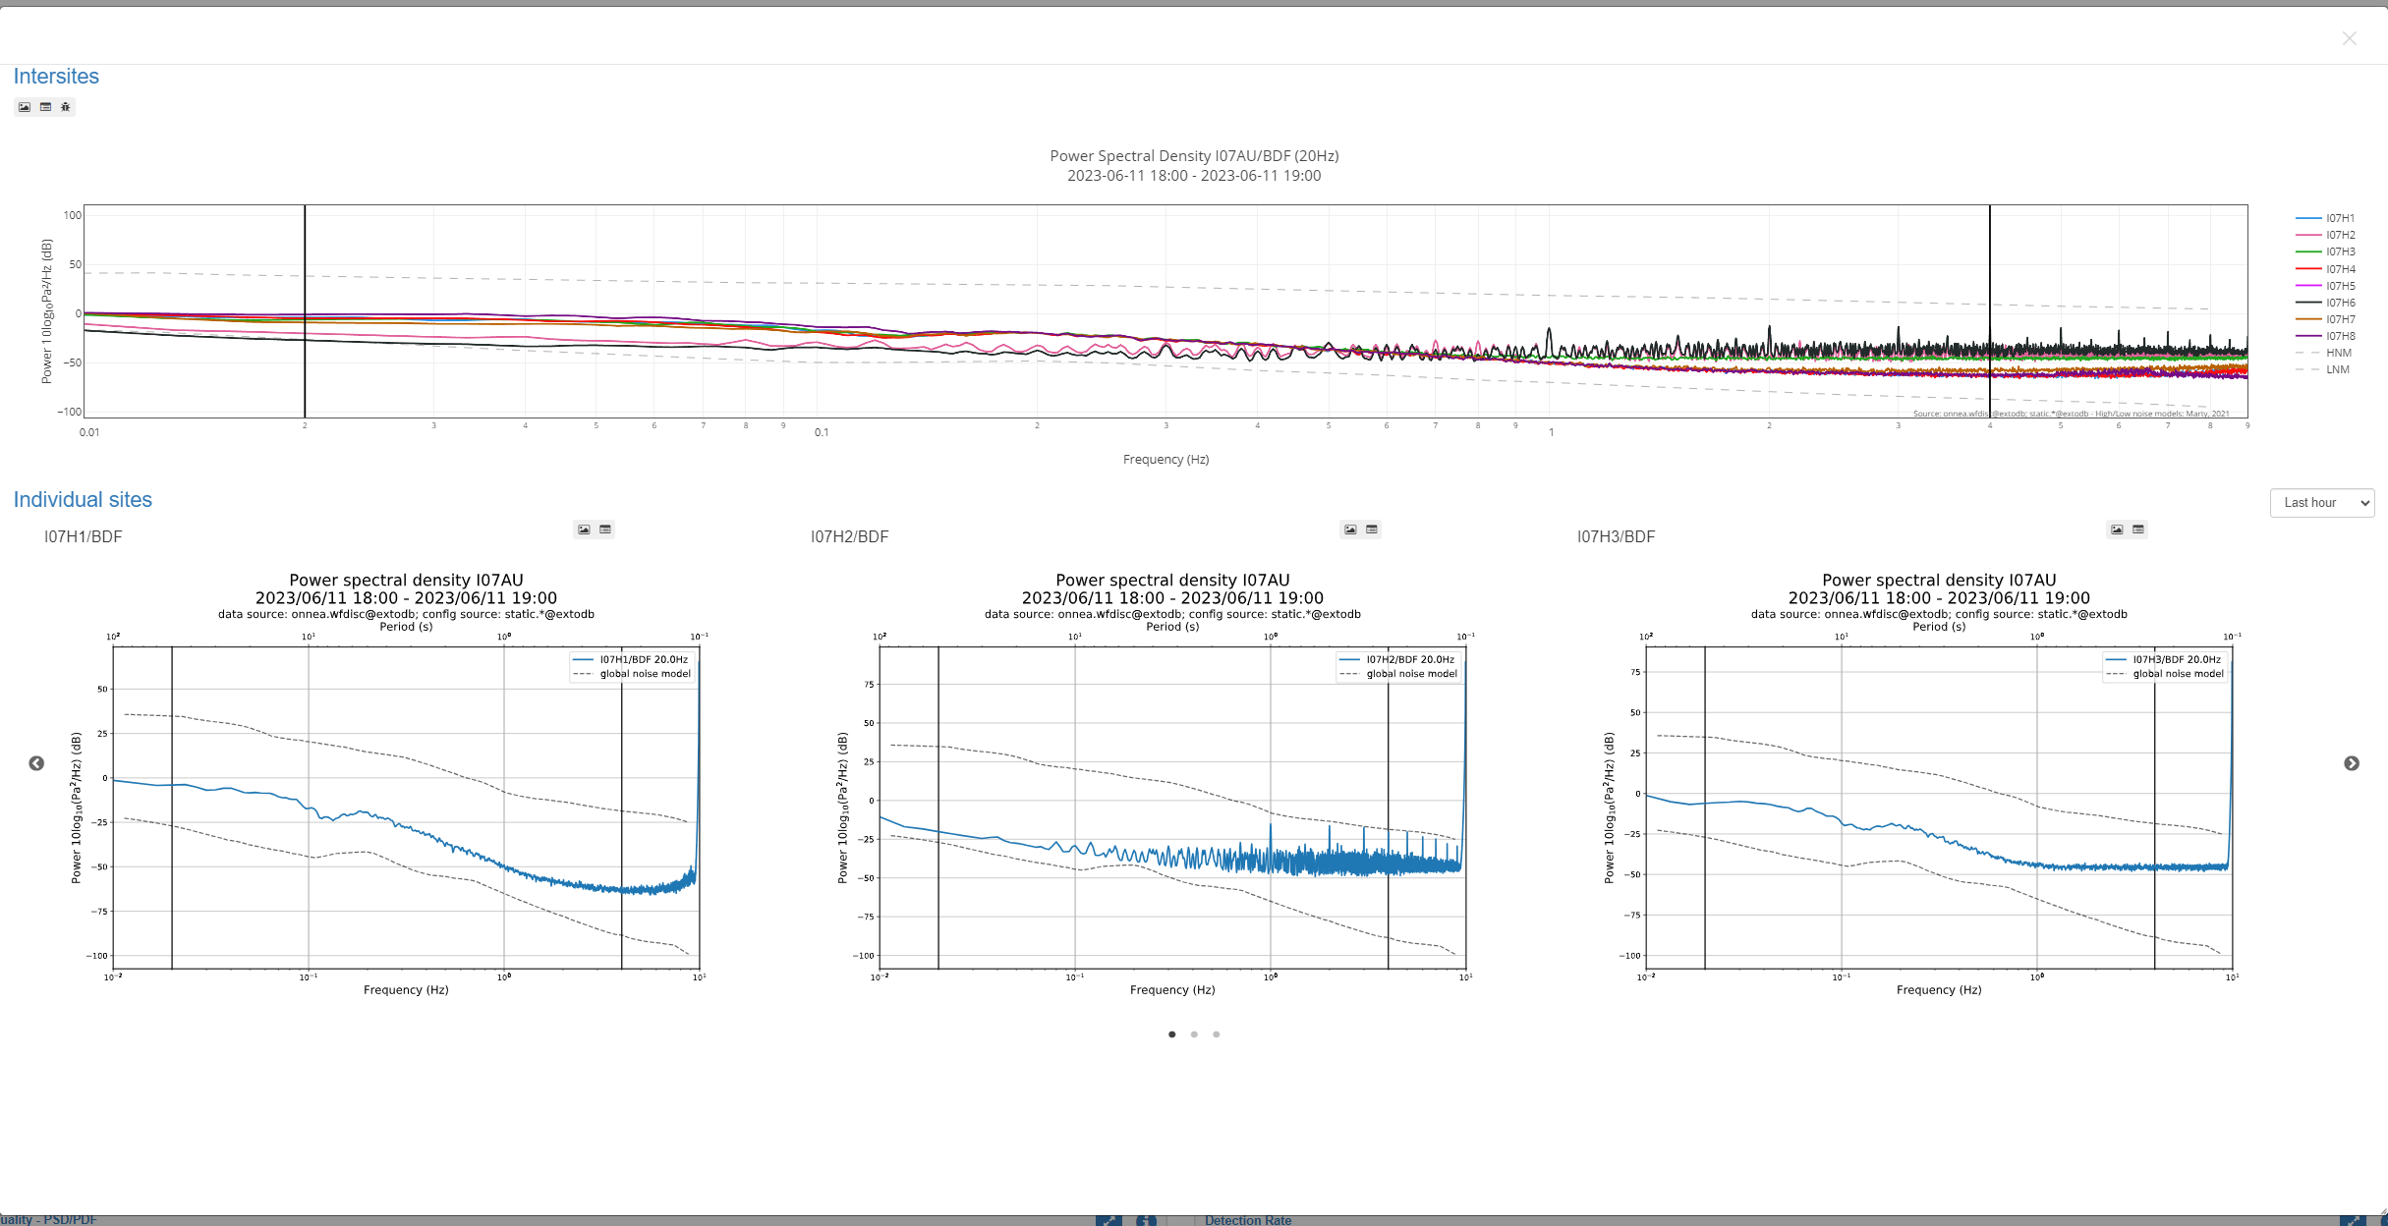
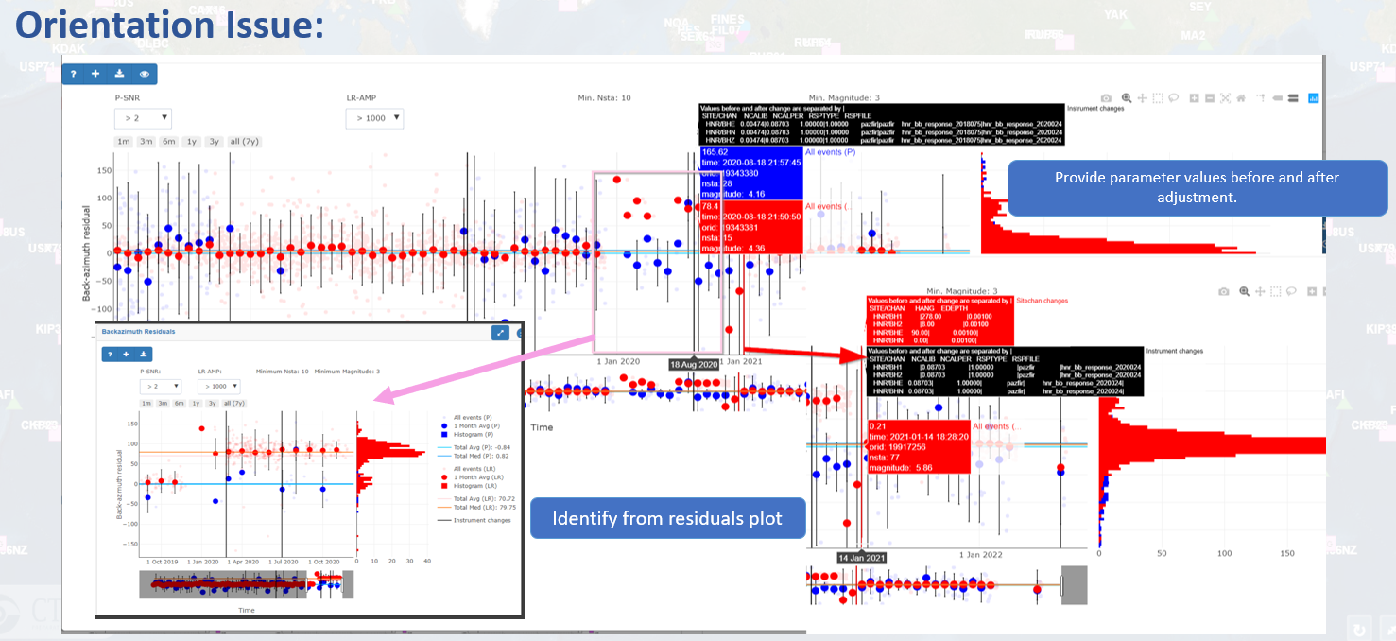
Other use case(s) in OPS Center
Support on the station Parameter Update process.
Identify the Orientation Issue at Station.
Identify the discrepancies among internal database(s).
Data quality problem caused by environmental disturbance.
P4.1-670
Please do not use this space, a QR code will be automatically overlayed
Notes:
Use Cases and Examples
Provide specific examples of how interactive station monitoring tools have been used in OPS centres.
Highlight successful implementations and the resulting improvements in data quality control.
Showcase before-and-after scenarios to demonstrate the effectiveness of these tools.
Integration and Implementation
Discuss the process of integrating interactive station monitoring tools into existing OPS centre systems.
Address potential challenges and considerations during implementation.
Explain the benefits of integrating these tools with other data management systems.
Best Practices for Data Quality Control
Share best practices for ensuring data quality control using interactive station monitoring tools.
Highlight the importance of data validation, data cleansing, and regular monitoring.
Discuss the role of training and ongoing support for OPS centre staff.

Slide 8
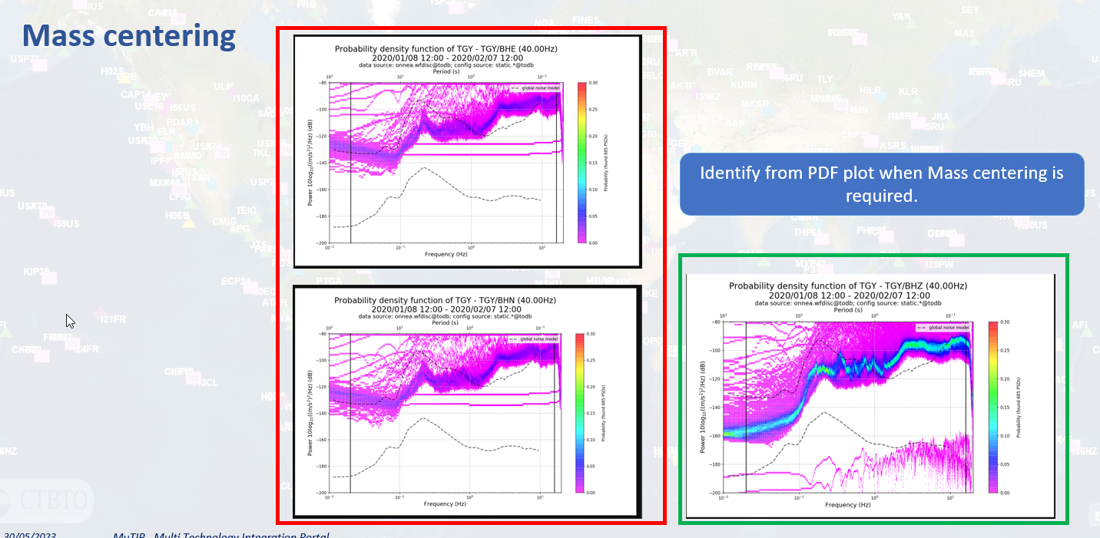
Other use case(s) in OPS Center
Identify the equipment failure (ex: the equipment only providing noise/spike).
Identify Mass Centering is required.
Identify the gaps and constant value.
Mass Centering is required
Advantages from data quality monitoring with Multi-Technology Integration Portal: Enhances operational processes by providing real-time visibility, enabling proactive issue detection, improving decision-making, fostering collaboration between Station Operator and PTS, facilitating predictive maintenance, and driving continuous process improvement. These benefits contribute to increased efficiency, reduced downtime, an optimized troubleshooting escalation process, and improved overall station operational performance.
P4.1-670
Please do not use this space, a QR code will be automatically overlayed
Notes:
Use Cases and Examples
Provide specific examples of how interactive station monitoring tools have been used in OPS centres.
Highlight successful implementations and the resulting improvements in data quality control.
Showcase before-and-after scenarios to demonstrate the effectiveness of these tools.
Integration and Implementation
Discuss the process of integrating interactive station monitoring tools into existing OPS centre systems.
Address potential challenges and considerations during implementation.
Explain the benefits of integrating these tools with other data management systems.
Best Practices for Data Quality Control
Share best practices for ensuring data quality control using interactive station monitoring tools.
Highlight the importance of data validation, data cleansing, and regular monitoring.
Discuss the role of training and ongoing support for OPS centre staff.

Slide 9
Conclusion
The objective of seismic data quality monitoring is to ensure that the acquired seismic data is accurate, reliable, and of high quality. By implementing a systematic monitoring process and reliable platform/tools, potential issues can be detected and addressed early on, leading to improved interpretations, better decision-making, and more robust data transmission.
The Multi-Technology Integration Portal was developed as a result of a cross-divisional project to support PTS with data quality monitoring and other technical routine activities to ensure that station performance meets the requirements of the IMS Operational Manual.
Using a Multi-Technology Integration portal in conjunction with other PTS monitoring tools is an excellent way to enhance data quality monitoring in the OPS Center.
These benefits contribute to the overall reliability of IMS network performance.
Px.x-xxx
Please do not use this space, a QR code will be automatically overlayed
Notes:
Conclusion
Recap the key points discussed in the presentation.
Emphasize the value of using interactive station monitoring tools for enhancing data quality control in the OPS centre.
Encourage further exploration and adoption of these tools.

Slide 10
Please visit other interesting posters for other tools that are integrated
in the Multi-Technology Integration Portal and future development.
CalxPy: A Software for Calibration Against a Reference
P3.1-578
Evaluation of the International Monitoring System Seismic, Hydroacoustic and Infrasound Network Performance with NetMOD
P4.1-469
Px.x-xxx
Please do not use this space, a QR code will be automatically overlayed
Notes:
Conclusion
Recap the key points discussed in the presentation.
Emphasize the value of using interactive station monitoring tools for enhancing data quality control in the OPS centre.
Encourage further exploration and adoption of these tools.

Slide 11
References
IMS Reporting System (https://irs.ctbto.org/)
SOH-Grafana (https:// soh.ops.ctbto.org)
PRTools (https://prtx.ctbto.org/)
Geotools
Draft Operational Manual for SHI monitoring (CTBT/WGB/TL-11,17/15/Rev.7)
Internal documentation
P4.1-670
Please do not use this space, a QR code will be automatically overlayed

