Slide 1
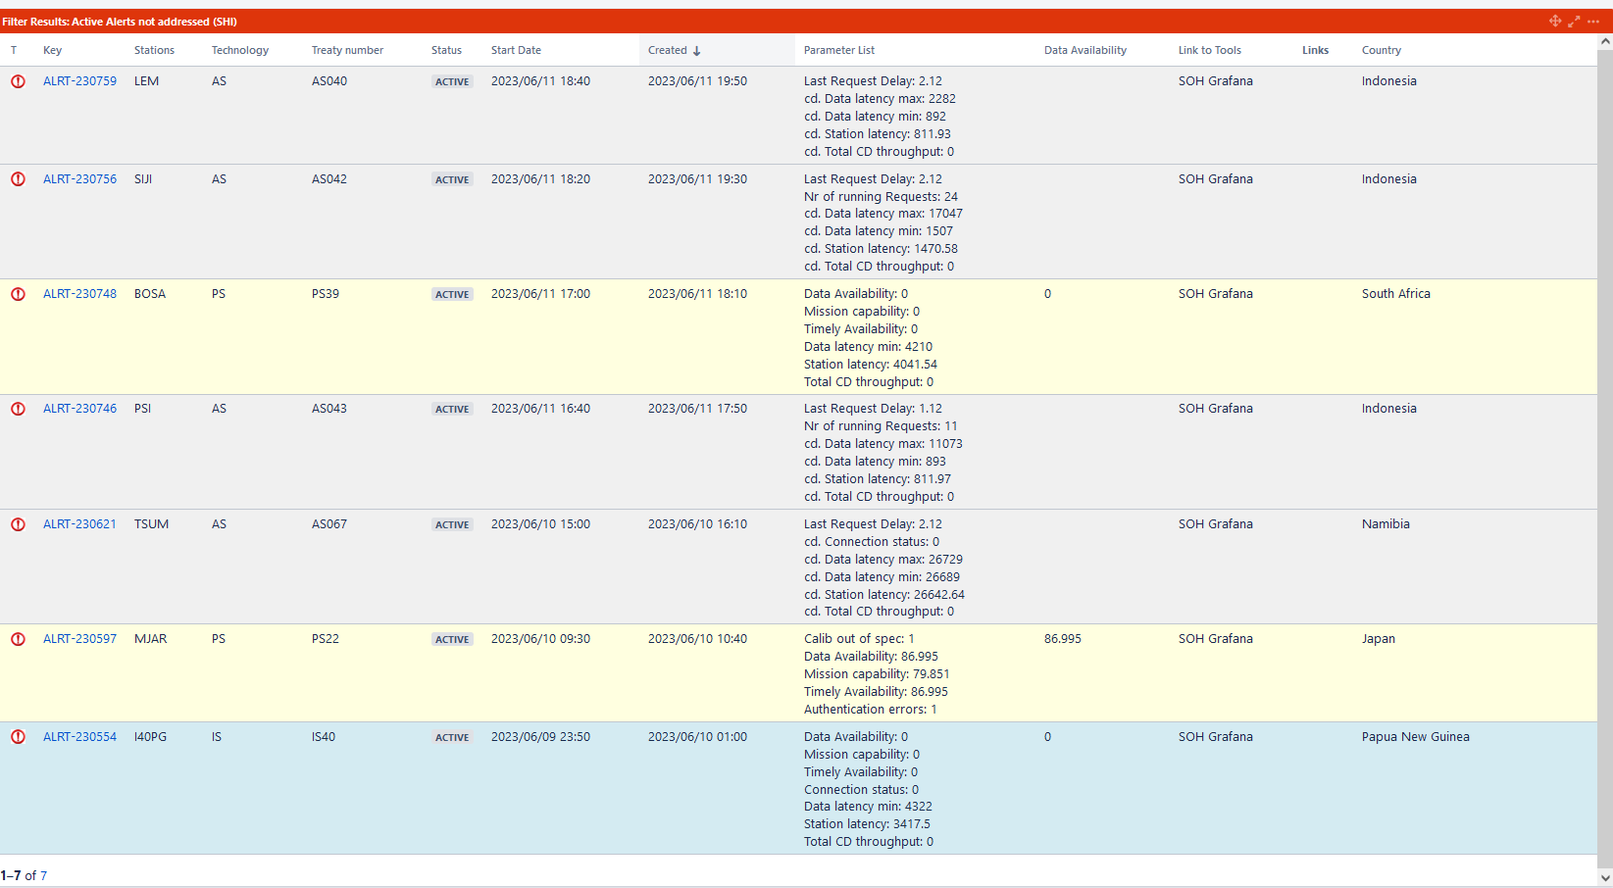
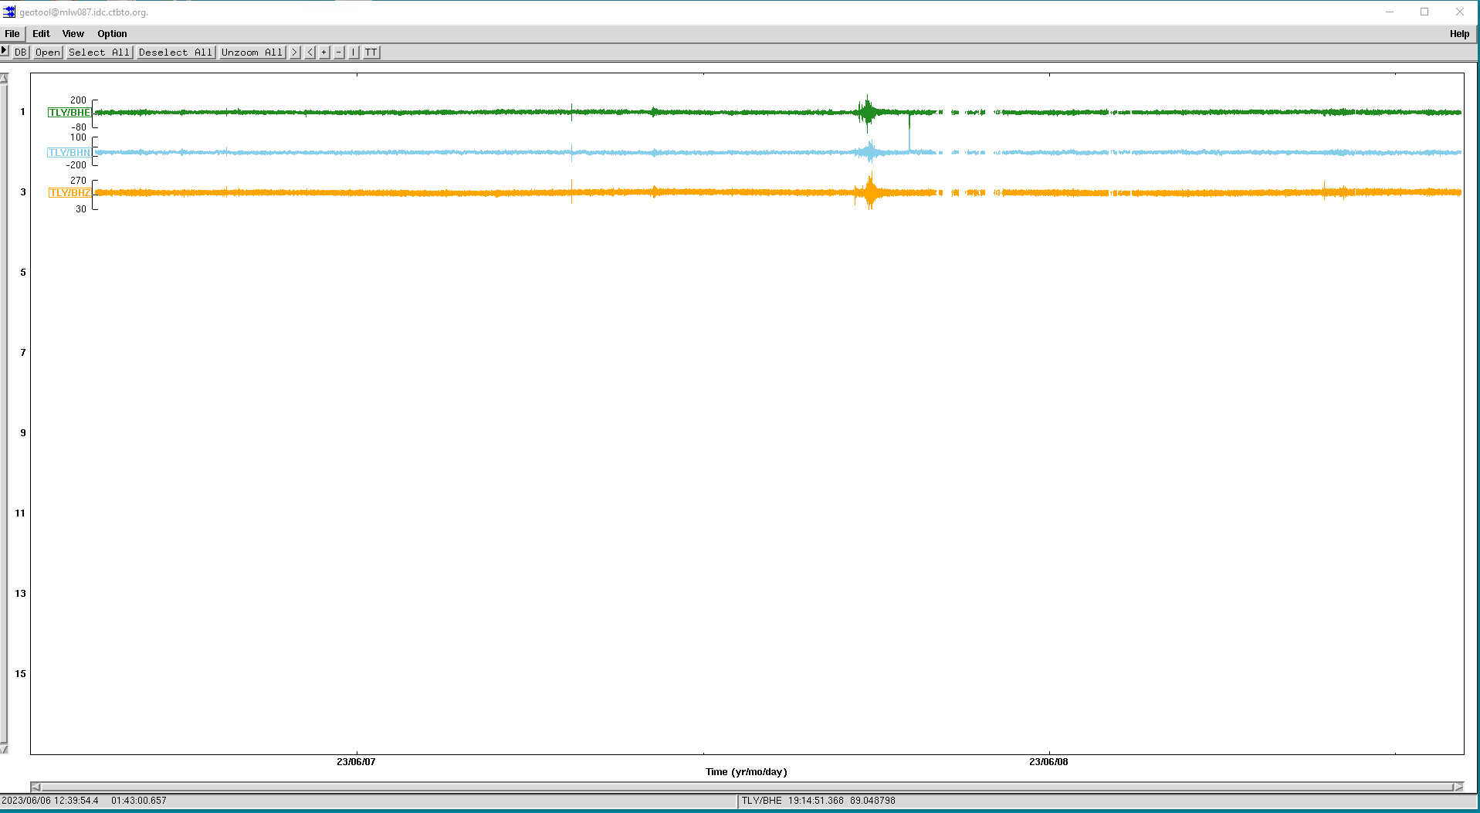
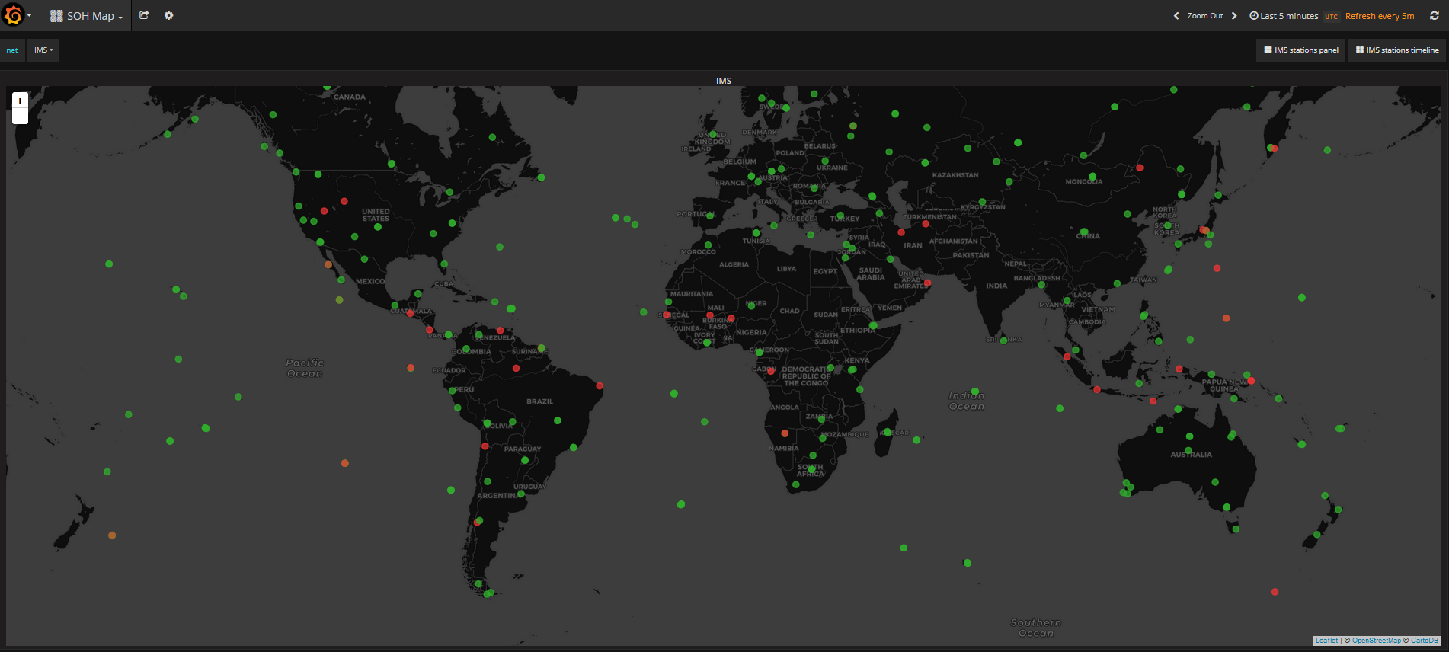
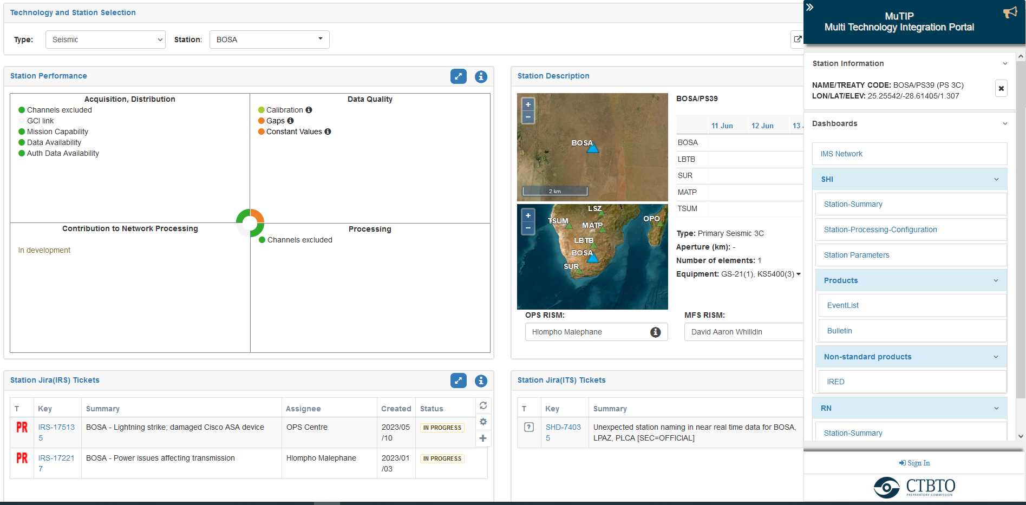
Enhance data quality control with interactive station monitoring tools in
the OPS centre.
Parithusta., R.A, Ketata., I, and IDC OPS-MFO
CTBTO Preparatory Commission
P4.1-670
The objective of seismic data quality monitoring is to ensure that the acquired seismic data is accurate, reliable, and of high quality, to ensure that station characteristics meet the requirements of the IMS draft Operational Manuals.
How does PTS (OPS) address the need to enhance data quality monitoring and optimize the use of all PTS tools?
By implementing a systematic monitoring process and reliable platform/tools, potential issues can be detected and addressed early on, leading to improved interpretations, better decision-making, and more robust data transmission from station and maintain the IMS network in high performance.
P4.1-670

