Slide 1
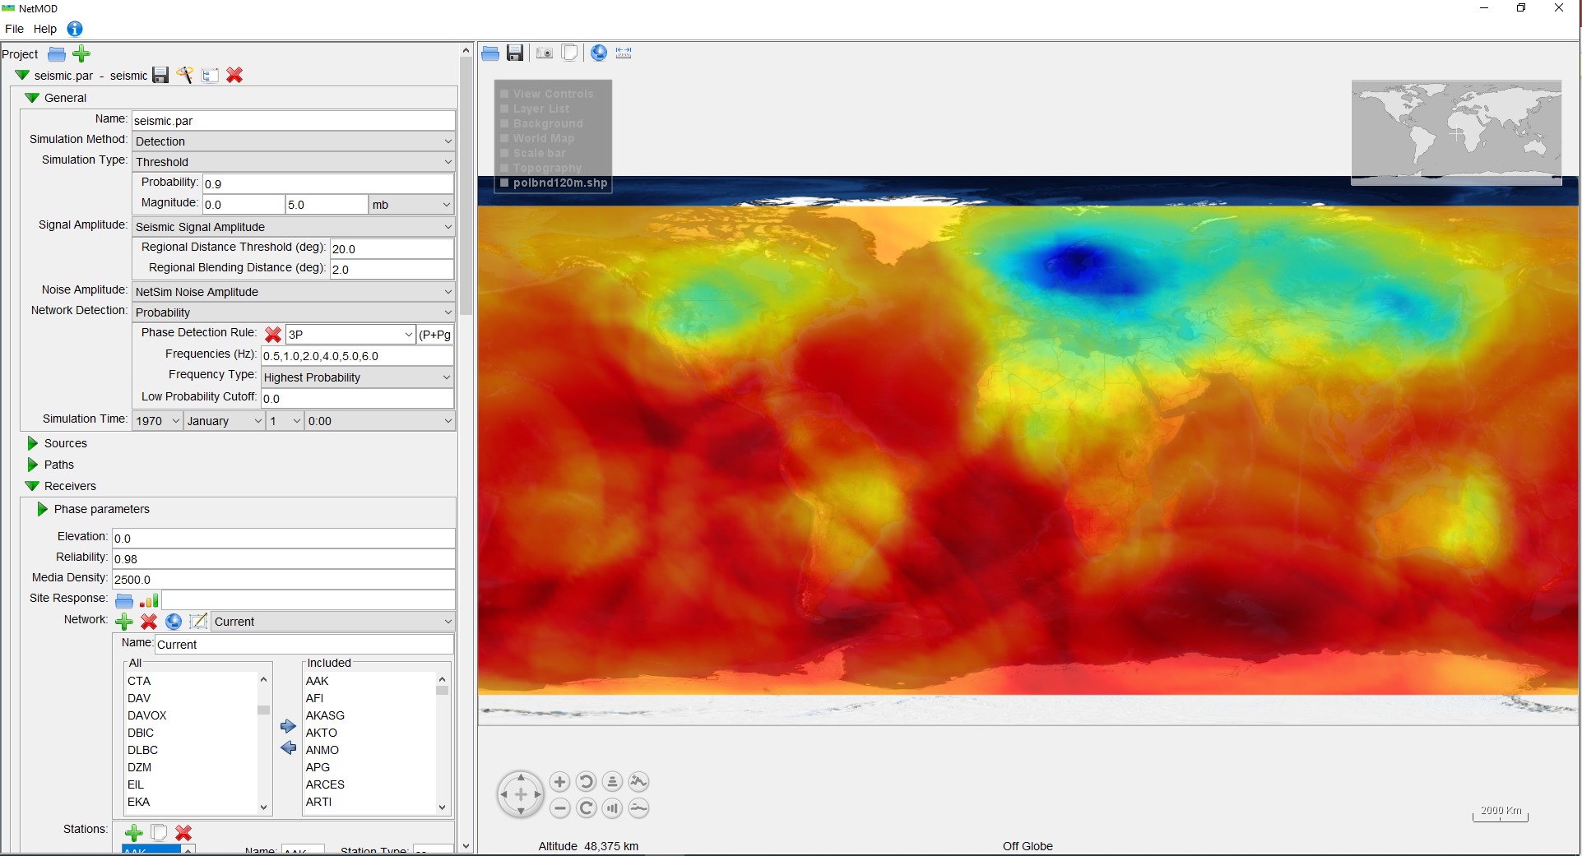
Evaluation of the International Monitoring System Seismic, Hydroacoustic and Infrasound Network Performance with NetMOD
Ichrak Ketata¹, Pierrick Mialle¹, Benoit Doury¹, B. John Merchant²
¹CTBTO Preparatory Commission, ²Sandia National Laboratories
P4.1-469
Evaluating and assessing the Network Performance by simulating and analyzing detection capabilities can contribute to the enhancement of the treaty’s verification regime and its capabilities
Network Monitoring for Optimal Detection (NetMOD) Java-Tool is tested with the provided parameter set and models. For each selected date, the receiver config is updated to reflect IMS status at that time and the noise data is computed using archived waveforms
Using NetMOD simulation results, it was possible to show the variation of the detection capability over the time when new stations get installed and certified, as well as the network resilience to a station outage or failure
Multiple metrics can be defined to assist in assessing the quality of processing results and bulletin production, and in estimating the impact of a station undergoing maintenance or failing for not only Seismic network but also for Hydroacoustic and Infrasound

