Slide 1
Evaluation of the International Monitoring System Seismic, Hydroacoustic and Infrasound Network Performance with NetMOD
Ichrak Ketata¹, Pierrick Mialle¹, Benoit Doury¹, B. John Merchant²
¹CTBTO Preparatory Commission
²Sandia National Laboratories
How is IMS network detection capability affect by changes to the network?
Evaluating and assessing the Network Performance by simulating and analyzing detection capabilities can contribute to the enhancement of the treaty’s verification regime and its capabilities
Network Monitoring for Optimal Detection (NetMOD) Java-Tool is tested with the provided parameter set and models. For each selected date, the receiver configuration is updated to reflect IMS status at that time and the noise data is computed using archived waveforms
Using NetMOD simulation results, it was possible to show the variation of detection capability over time as new stations got installed and certified, as well as the network resilience to a station outage or failure
Multiple metrics can be defined to assist in assessing the quality of processing results and bulletin production, and in estimating the impact of a station undergoing maintenance or failing for not only Seismic network but also for Hydroacoustic and Infrasound
Please do not use this space, a QR code will be automatically overlayed
P4.1-469

Slide 2
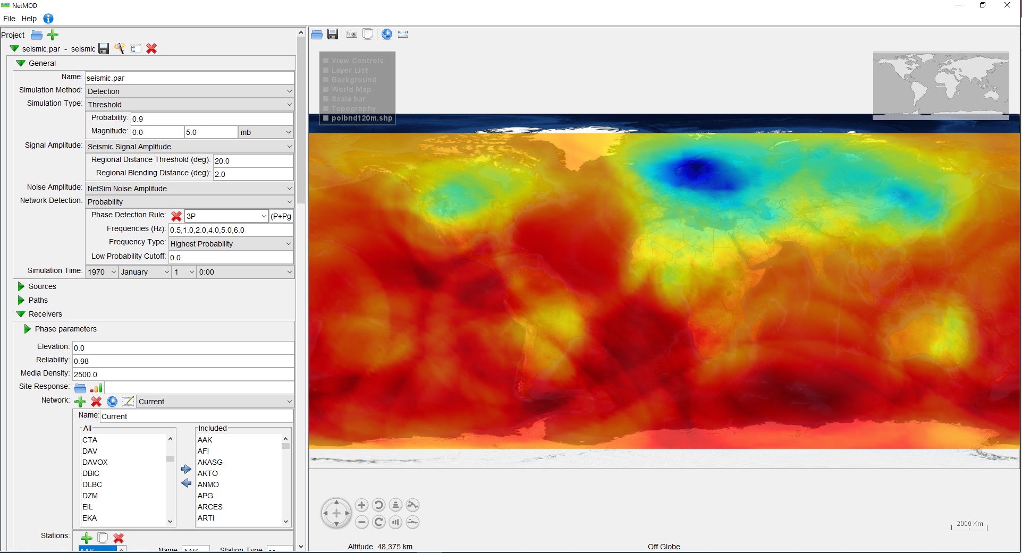
Introduction
To assess and evaluate the performance of the International Monitoring System (IMS) to detect events, one method is to simulate the network and monitor the minimum detectable source strength over time.
Simulating and analysing the detection capabilities of the Seismic, Hydroacoustic and Infrasound (SHI) networks of the IMS can contribute to the enhancement of the Treaty’s verification regime and its capabilities.
Network Monitoring for Optimal Detection (NetMOD) is a Java-based network simulation tool to predict network detection thresholds for SHI and assess the networks’ detection capability.
NetMOD is developed by Sandia National Laboratories and is provided to the Provisional Technical Secretariat as a voluntary contribution from the United States to be evaluated for its integration into the operational pipeline
The geophysical models used by NetMOD determine:
Source characteristics
Signal attenuation along the path
Performance and noise properties of the station.
The geophysical models are combined to simulate the Signal-to-Noise Ratios (SNR) at each of the stations. From there, the probability of detection can be computed given a detection threshold.
P4.1-469
Please do not use this space, a QR code will be automatically overlayed

Slide 3
Objectives
Assessing the Network
Assist the International Data Centre (IDC) in continuously monitoring, assessing, and reporting on the operational status of the overall IMS Network.
Quantify the variations in detection capability over time and study the impact of several parameters on the network coverage (e.g. installation and certification of new stations, seasonal variation, weather conditions, station noise levels, outage of key stations, period of large events).
Assisting in processing
Present an opportunity to define metrics to assist in assessing the quality of processing results and bulletin production
Evaluate the resilience of the network in homogeneously monitoring the globe and assist in analysing events of interest
Assessing the importance of a station installation on the overall performance of the network during the planning of station deployments
Input to the IMS Activities
Station outage: Assessing the Station Contribution to the Network and study the network resilience to its failure
Identifying importance of certain stations of the network as an input for sustainment planning or needs for timely maintenance activity
P4.1-469
Please do not use this space, a QR code will be automatically overlayed

Slide 4
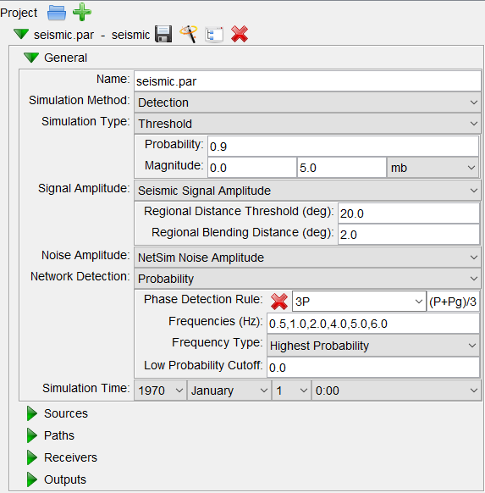
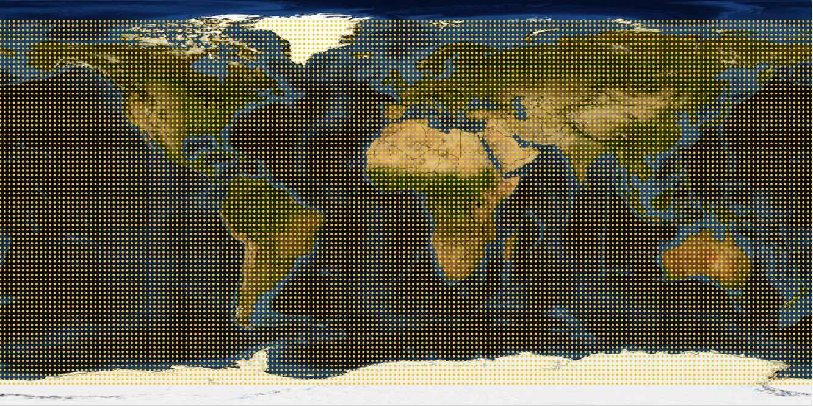
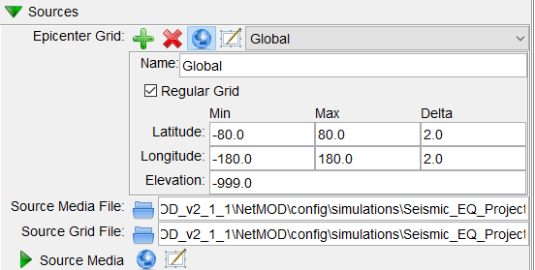
Methods/Data
NetMOD General Configuration
NetMOD 2.1.1 is evaluated
NetMOD was provided with a baseline parameter set for each of the SHI Network. This includes among others, the source models and attenuation models
A comparison tool is provided with NetMOD, which allows for assessing differences between simulations. To be able to compare results, the same set of parameter files was used, except for the receiver par file
The type of the simulation chosen is “Threshold”. It is configured to determine the magnitude at each source location that results in 0.9 probability of detection for the network
The Epicenter Grid defines the locations of the sources that are to be simulated. An epicenter grid that is regularly spaced in latitude and longitude was configured for all simulations
The simulations were executed from:
Graphical User Interface of NetMOD
Command-line mode for batch execution
P4.1-469
Please do not use this space, a QR code will be automatically overlayed

Slide 5
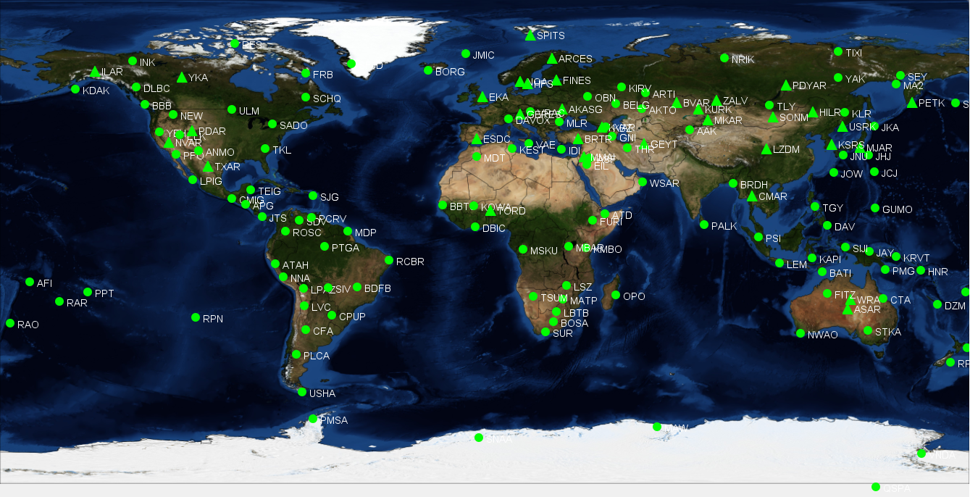
Methods/Data
Receiver Configuration
Evaluation of the Seismic Network based on two case studies:
Case Study 1: Quantify the variations in detection capability over time (New Stations)
Case Study 2: Station outage and assessing its contribution to the network. Scope: North America / Selected Station NVAR
NetMOD integrated Map: visualize configured stations
2017
88.82% Seismic Network
2019
89.41 % Seismic Network
2022
90% Seismic Network
Green stations used in Simulation
Red stations excluded from Simulation
P4.1-469
Please do not use this space, a QR code will be automatically overlayed

Slide 6
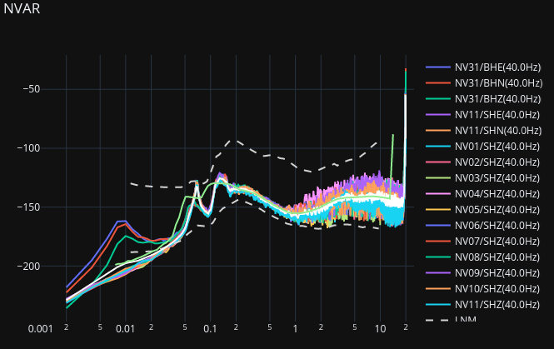
Methods/Data
Site Noise Configuration
NetMOD accepts different files formats for the Site Noise Configuration. For this evaluation, the NOI text file is chosen. This file stores the site noise represented as a logPSD across a range of frequencies
For each date/hour, for each site/channel of a station, Power Spectral Density (PSD) values are computed:
Uses archived IMS waveform data
Uses operational software to compute PDSs for each site/channel (measure of ambient noise as a function of frequency)
PSD calculation at IDC is based on Welch's algorithm (Welch, 1967) and its implementation follows Heinzl et. al., (2002), validated by Brown et al. (2012)
PSDs of all site/channels of a station are averaged (white line shown in the figure).
Save resulted values for each station to *.noi file
A script was used to generate and automate the computation and the generation of the noise files
P4.1-469
Please do not use this space, a QR code will be automatically overlayed

Slide 7
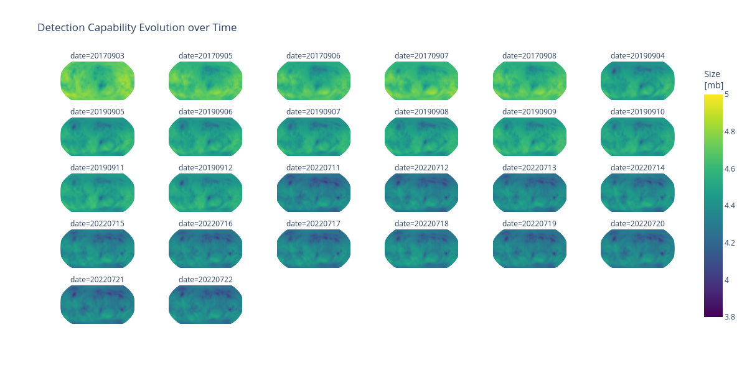
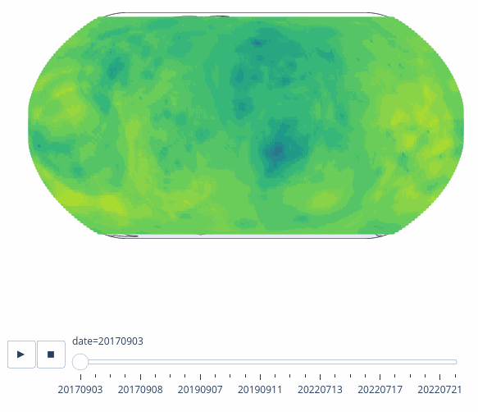
Case Study 1: NetMOD Simulation Results
2017
2019
2022
P4.1-469
Please do not use this space, a QR code will be automatically overlayed

Slide 8
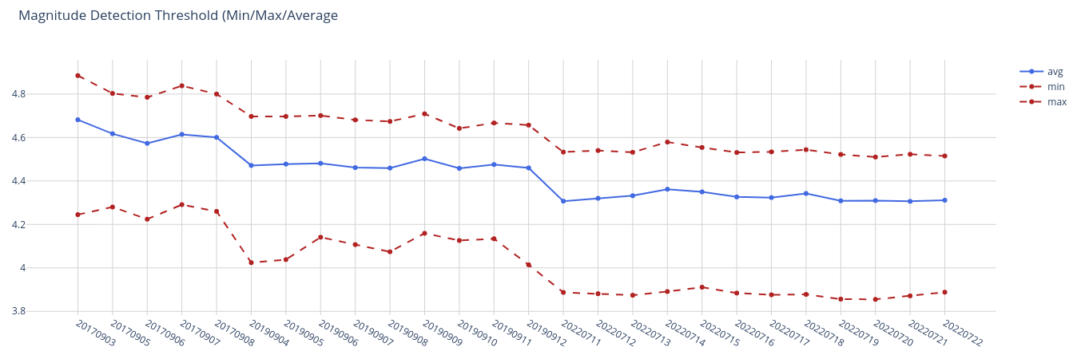
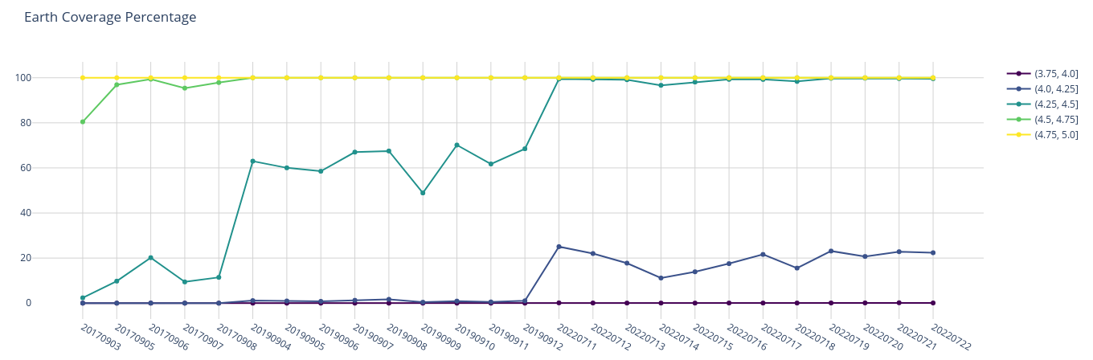
Case Study 1: Quantify Variation
2017
2019
2022
P4.1-469
Please do not use this space, a QR code will be automatically overlayed

Slide 9
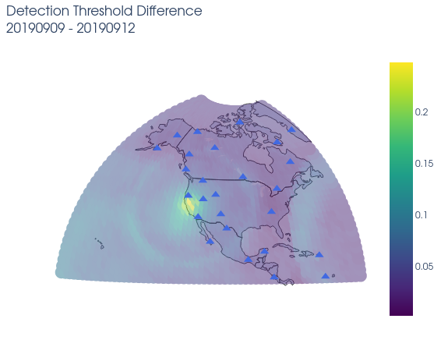
Case Study 2: Network Resilience to Station Outage (NVAR case)
Comparison Tool
P4.1-469
Please do not use this space, a QR code will be automatically overlayed

Slide 10
Conclusion and Outlook
Multiple metrics can be defined to assist in assessing the quality of processing results and bulletin production, and in estimating the impact of a station undergoing maintenance or failing for not only Seismic network but also for Hydroacoustic and Infrasound
Outlook
Continue the evaluation of other case studies for seismic network
Extend the evaluation to the other monitoring technologies: Infrasound and hydroacoustic
Prototype the integration for in-house concept validation
Define a baseline configurations and a well-validated default parameter set for the SHI networks
Automate the integration of NetMOD with IDC noise computation
Integrate NetMOD with IDC atmospheric specifications – IDC ECMWF datasets (high-resolution atmospheric specifications
Aggregate and display of results on IDC platform
P4.1-469
Please do not use this space, a QR code will be automatically overlayed

Slide 11
References
B. John Merchant, Eric P. Chael, Christopher J. Young, Benjamin R. Hamlet, Stephen L. Heck, William R. Walter, Dale N. Anderson. A New Network Modeling Tool for the ground-Based Nuclear Explosion Monitoring Community: Science and Technology Conference (2013)
B. John Merchant. NetMOD Version 2.1 User Manual
Heinzel, Gerhard, Albrecht Rüdiger, and Roland Schilling. Spectrum and spectral density estimation by the Discrete Fourier transform (DFT), including a comprehensive list of window functions and some new at-top windows. (2002).
Welch, Peter. The use of fast Fourier transform for the estimation of power spectra: a method based on time averaging over short, modied periodograms. IEEE Transactions on audio and electroacoustics 15.2 (1967): 70-73.
Brown, David, et al. The IDC seismic, hydroacoustic and infrasound global low and high noise models. Pure and Applied Geophysics 171.3-5 (2012): 361-375.
P4.1-469
Please do not use this space, a QR code will be automatically overlayed

