Slide 1
SENDING SMS ALERT TO I33MG STATION OPERATORS
Mamiharijao Rambolamanana, Ralay Tiana Razafiarisera, Fanomezana Randrianarinosy, Tahina Rakotoarisoa
Institute and Observatory of Geophysics of Antananarivo P.O. Box 3843 101 – Antananarivo, Madagascar
This alert system purpose is to minimize IMS station downtime during any eventual outage. It also confirm the end of any outage.
The system consists of a Raspberry pi 2 and a SIM800L module. It processes logs from monitoring server.
Local station operators receive SMS showing the date and time of any outage and the return into normal state of the station
REPLACE THIS TEXT
With your
Conclusions
DO NOT CHANGE or RESIZE the Text or the Textbox
Please do not use this space, a QR code will be automatically overlayed
P4.1-079

Slide 2
Introduction
In order to increase the data availability, the system produced by Madagascar NDC team minimize downtime during an eventual outage.
In case of an outage, the system send SMS to the local operator and all team, confirm the end of any outage.
Please do not use this space, a QR code will be automatically overlayed
P4.1-079

Slide 3
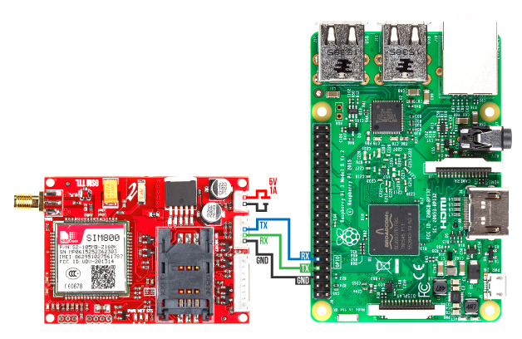
Objectives
How to minimize the downtime and to comfirm
The end of any outage?
Raspberry pi 2
SIM800L
Please do not use this space, a QR code will be automatically overlayed
P4.1-079

Slide 4
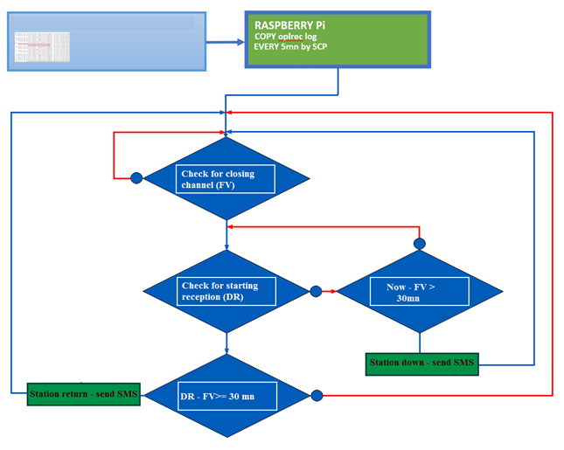
Methods/data
Monitoring server
Station down
NO SMS
Please do not use this space, a QR code will be automatically overlayed
Station return
P4.1-079

Slide 5
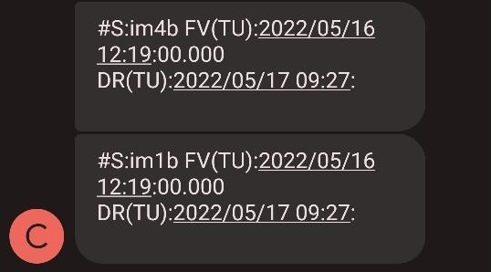
Results
OUTAGE ON 2022/05/16
After test
Please do not use this space, a QR code will be automatically overlayed
P4.1-079

Slide 6
Conclusion
The system is very helpfull for the local operator in case of an outage
It Informs in time (everytime) and everywhere the station status
It allows to the team to intervene in a short time
Please do not use this space, a QR code will be automatically overlayed
P4.1-079

