Slide 1
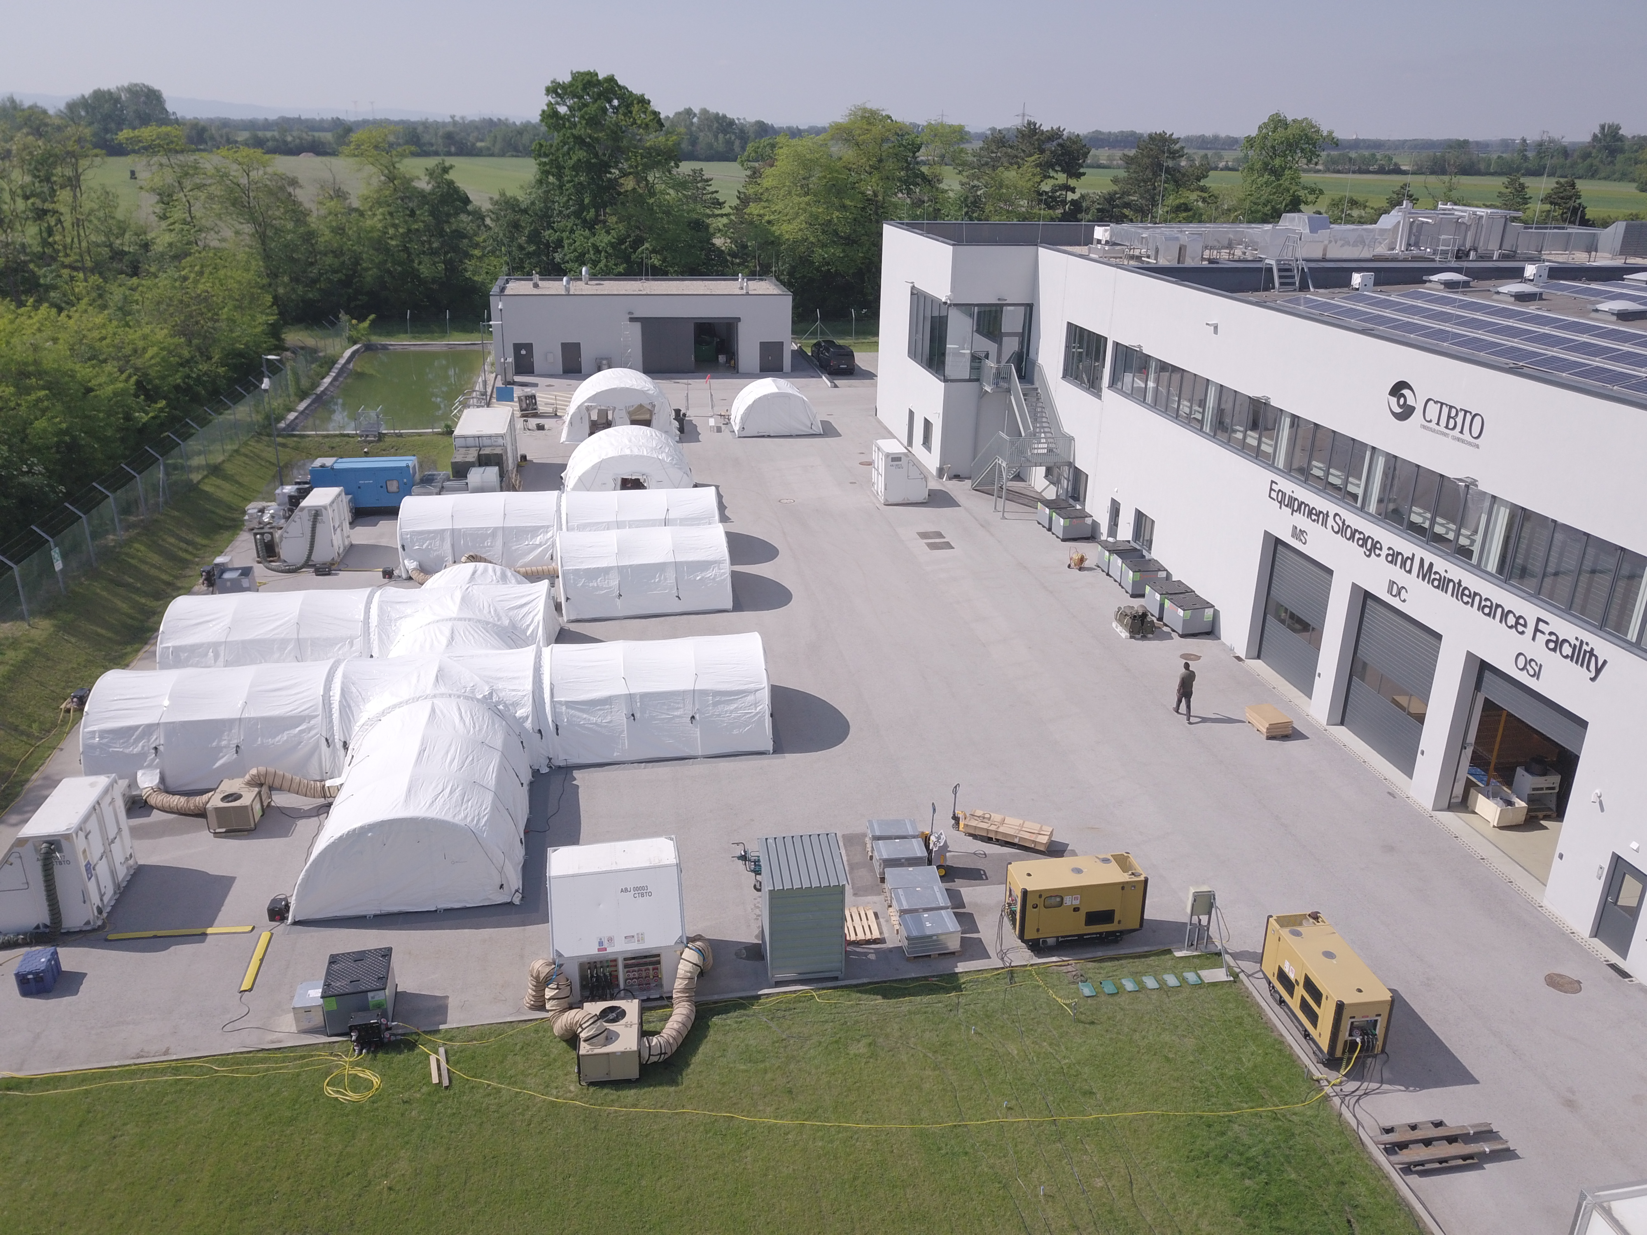
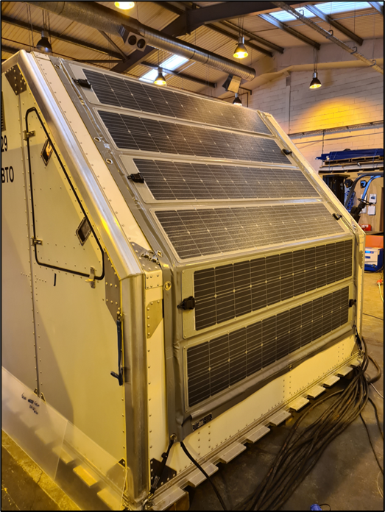
Power Generation and Distribution Systems at the Base of Operations for On-Site Inspection
Samuel Toon and Alana Harmati
CTBTO OSI/EP
P4.2-261
The Base of Operations during an On-Site Inspection may be in a remote area. It is vital that the power generation and distribution systems are robust to ensure that inspection activities can take place without interruption.
The current components of the power system for an OSI include
diesel generators,
Uninterruptable Power Supply (UPS) and
hybrid power systems.
The UPS system allows for quiet time without the diesel generators also reducing fuel usage and CO2 production.
The system is designed to be resilient and flexible and has management software to switch power sources depending on the power consumption at any point in time.
The BOO systems are also supplemented by field deployable power banks and solar panels for powering technical equipment such as the SAMS mini arrays and noble gas samplers in remote locations.

