Slide 1
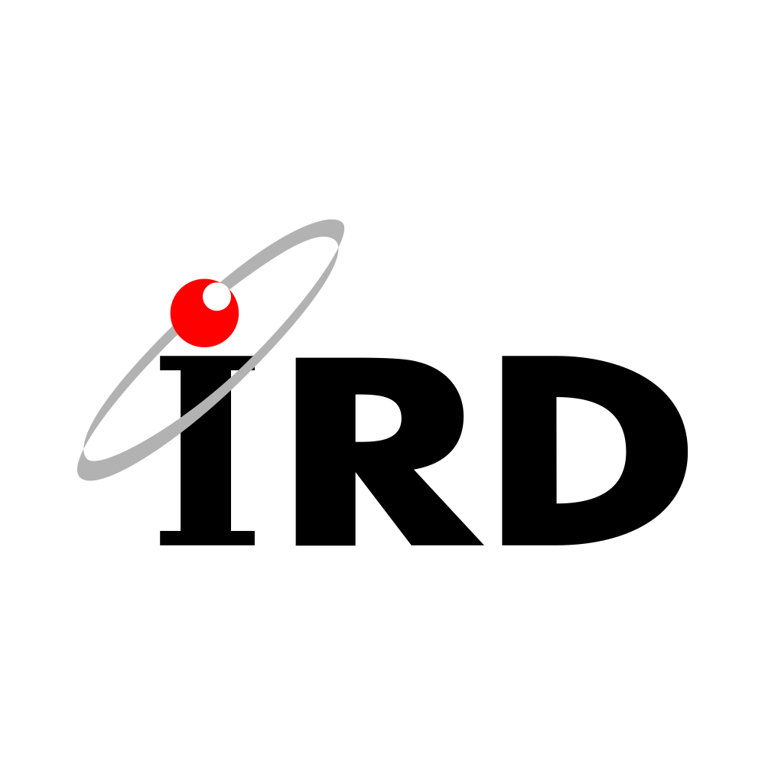
Management of na International Monitoring System Station in Brazil
Mr. Rócio Reis
Institute of Radiation Protection and Dosimetry
REPLACE THIS TEXT
With your
Short Introduction
DO NOT CHANGE or RESIZE the Text or the Textbox
REPLACE THIS TEXT
With your
Methods/Data
DO NOT CHANGE or RESIZE the Text or the Textbox
REPLACE THIS TEXT
With your
Results
DO NOT CHANGE or RESIZE the Text or the Textbox
REPLACE THIS TEXT
With your
Conclusions
DO NOT CHANGE or RESIZE the Text or the Textbox
Please do not use this space, a QR code will be automatically overlayed
P4.2-474

Slide 2
Introduction: Management of na International Monitoring System Station in Brazil
Brazil participates in the CTBTO in several ways, as it has an institution, the National Center for Monitoring and Alerts of Natural Disasters (CEMADEN), which became responsible for the implementation of the Brazilian National Data Center (NDC). The country also has a radionuclide laboratory, RL4, which is in the certification process. In addition to operating an infrasound station, IS9, and a primary seismic station, both in the city of Brasília, we have two seismic auxiliaries , AS10 and AS11. We also have a radionuclide station in planning, RN12, and another in operation and certified, RN11. RN11 is operated by the Institute of Radiation Protection and Dosimetry (IRD) and the experience gained over the years is presented, emphasizing good practices, maintenance, training and lessons learned, facing the health crisis (COVID-19), management, obtaining and using equipment and spares. And the legal limitations and human resources will also be presented to share the experience acquired in the management of RN11.
Please do not use this space, a QR code will be automatically overlayed
P4.2-474

Slide 3
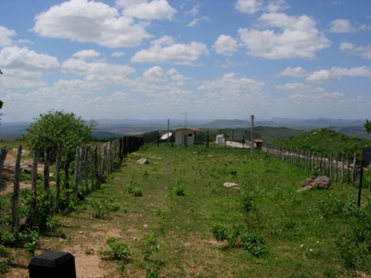
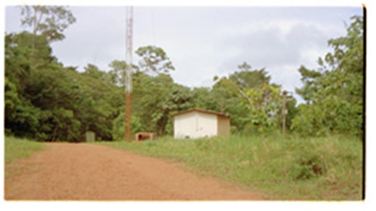
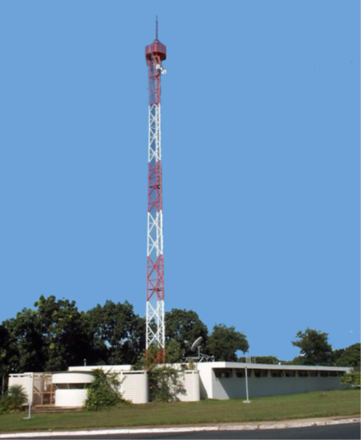
Management of an International Monitoring System Station in Brazil
Brazil participates in the CTBT in several ways, as it has some institutions that contribute to various activities relevant to the treaty.
The country participates in the CTBTO's International Monitoring System (IMS) with seismic monitoring technology through the primary seismic station PS07, in Brasília. And also the auxiliary seismic station AS011-RGNB, in addition to the auxiliary seismic station AS010-PTGA.
One of these institutions is the National Center for Monitoring and Alerts on Natural Disasters (CEMADEN), of the Ministry of Science, Technology and Innovation (MCTI), which will house the future National Data Center in Brazil. CEMADEN was assigned to this task because it has experience and capacity in receiving, processing, storing and disseminating environmental data.
AS011
AS010
Please do not use this space, a QR code will be automatically overlayed
And using infrasound technology we have the IS09 station, belonging to the University of Brasília.
P4.2.474

Slide 4
Management of an International Monitoring System Station in Brazil
The National Nuclear Energy Commission (CNEN) is the institution in Brazil that maintains the Institute of Radiation Protection and Dosimetry (IRD) which acts as responsible for the operation and maintenance of the radionuclide monitoring station RN11 and also the laboratory RL4. There are plans to build the RN12 station in the near future.
The RN11 monitoring station has two pieces of equipment with different measurement technologies. One of the technologies is represented by the equipment of North American origin, supplied by the company General Dynamics Advanced Information Systems, whose objective is to determine the radiation and radionuclides present in atmospheric particulate material. The equipment is known as a Radionuclide Aerosol Sampler/Analyzer (RASA).
Another technology is represented by the Swedish Automatic Unit for Noble Gas Acquisition (SAUNA), which is produced by the Swedish company Scienta Sensor Systems AB. SAUNA determines the presence of radioactive noble gas isotopes in the atmosphere.
Please do not use this space, a QR code will be automatically overlayed
P4.2.474

Slide 5
Objectives :Management of na International Monitoring System Station in Brazil
The RN11 radionuclide monitoring station has the following main challenges:
- Keep the flow of shipments between the IRD and the CTBTO in operation, as it is vital for the maintenance of equipment, quality control of measurements and storage of samples generated by RASA in Austria. As we do not have a post-certification activity (PCA) contracts due to legal impossibilities, careful monitoring of all import or export steps must be maintained as a priority to prevent anything from interrupting or delaying the flow of shipments. In the past we were unable to maintain this flow for some periods and that is why we realized how important it is. It is our opinion that the provision of replacement items and new equipment by the CTBTO proactively should be maintained and, if possible, improved.
- Over the past decade, the team that works and manages the RN11 has shrunk to a single member. So one of the main objectives is to recruit and train new members to compose the staff. That's why we believe that the CTBTO's offer of training will help a lot in the preparation of future new members of our team.
- The country was greatly affected during the pandemic and there were several difficulties during that period. However, one of the main lessons learned during that time was to expand and perfect the forms of communication. Also for the exchange of ideas and suggestions that allowed the continuity of the activities of the RN11 station at a time when technical visits and shipments stopped taking place. Thus, we suggest that the CTBTO maintain the remote access options created during the pandemic and, if possible, improve them.
Please do not use this space, a QR code will be automatically overlayed
P4.2-474

