Slide 1
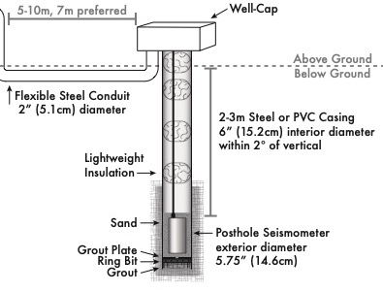
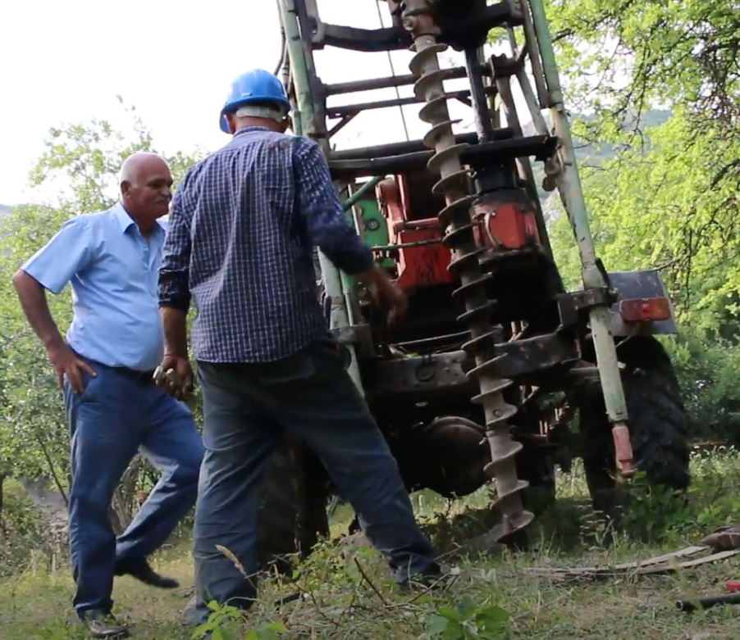
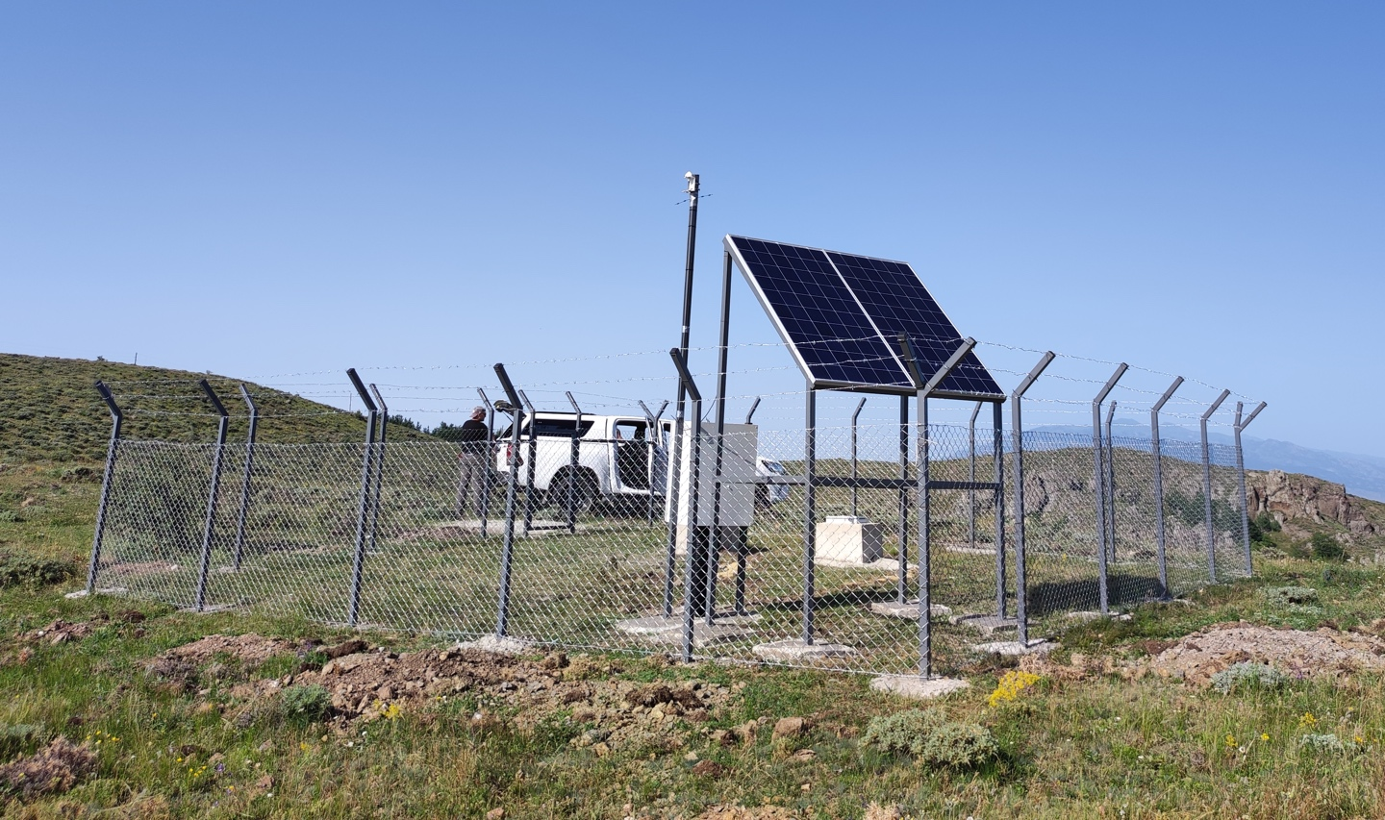
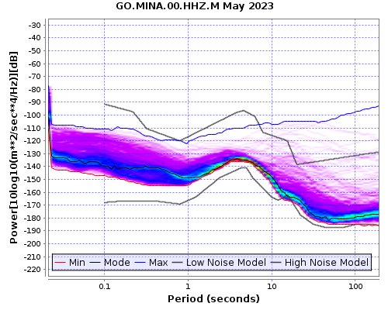
High-Performance Broadband Seismic Station Installations in the Caucasus and Central Asia
K. Aderhold, R. Woodward, M. Staats, K. Hafner, R. Busby, A. Chiang, R. Gök, T. Godoladze, A. Berezina, A. Aguiar, K. Mackey, D. Burk, J. Stachnik, H. Babayan, G. Babayan, G. Yetirmishli, N. Mikhailova, B. Ashirov, S. Negmatullaev
P4.2-181
Collaboration with national seismic networks in Armenia, Azerbaijan, Georgia, Kazakhstan, Kyrgyzstan, and Tajikistan through LLNL and ISTC/STCU
Practices based predominantly on extensive National Science Foundation sponsored deployment of >2000 broadband USArray stations
Posthole design for high-performance and low-noise station – robust, durable, and secure on a budget
Variety of drilling techniques used depending on in-country resources
80% of stations complete and transmitting open data
Azerbaijan AZ.ZRNV Construction
Georgia – GO.MINA Station and PDF
Gök and Chiang’s work was performed under the auspices of the U.S. Department of Energy by Lawrence Livermore National Laboratory under Contract DE-AC52-07NA27344

