Slide 1
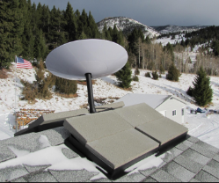
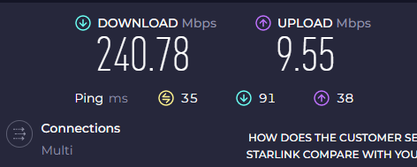
Next Generations of the Global Communications Infrastructure: The Role of Low Earth Orbit Satellites (LEOs)
Fernando Araujo
IEEE
P4.2-029
Global broadband access and low latency are enabled by the increasing availability of low earth orbit satellites. This service could benefit locations where the International Monitoring System stations are installed.
Broadband availability could enhance the data transmission performance and the user experience for station operators in remote regions by maximizing data availability, simplifying complex infrastructure -typically associated with the deployment of VSATs- and providing innovative services and applications.
DISCLAIMER: The views expressed on these slides are those of the author and do not necessarily reflect the view of the IEEE

