Slide 1
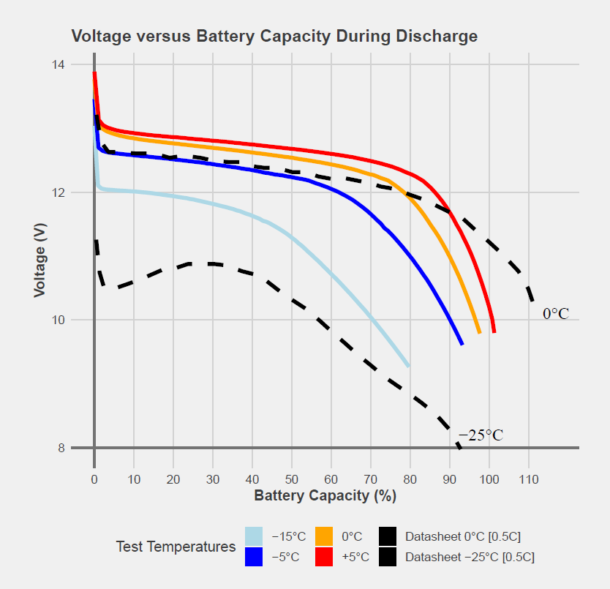
The use of LiFeYPO₄ Batteries as a Back Up Power Source for Extreme Environments and Considerations of the Power Supply Design for Such Locations
Gregory Brenn¹, Pavel Martysevich¹, James Robertson¹, Georg Rausch²
¹IMS/ED, CTBTO, Vienna, Austria; ²Ing. Ludwig Rausch Ges.m.b.H., Langenzersdorf, AT
P4.2-706
The Engineering/Development Section of the IMS is exploring new battery technologies that can be adapted for stations located in extreme environments.
This poster investigates the charge and discharge characteristics of LiFeYPO₄ batteries at cold temperatures from +5C to -15 °C. We present both charge and discharge curves to characterize overall battery performance with respect to cold temperatures.
This poster also presents preliminary temperature and solar charge controller observations at PDYAR (PS35) in Peleduy, Russian Federation, to better characterize the behavior of the current power system design and infrastructure through the cold winter months.
If you want to learn more about these battery tests, come see our e-poster during session T4.2: Systems Engineering for International Monitoring System and On-Site Inspection.

