Slide 1
The use of LiFeYPO₄ Batteries as a Back Up Power Source for Extreme Environments and Considerations of the Power Supply Design for Such Locations
Gregory Brenn¹, Pavel Martysevich¹, James Robertson¹, Georg Rausch²
IMS/ED, CTBTO, Vienna, Austria¹, Ing. Ludwig Rausch Ges.m.b.H., Langenzersdorf, AT²
The IMS is exploring new battery technologies that can be adapted for stations located in extreme environments. This poster presents:
Charge and discharge characteristics of LiFeYPO₄ batteries at cold temperatures
Winter temperature statistics for PDYAR/PS35 and assess feasibility of LiFeYPO₄ for similar environments
Batteries: Winston LYP100AHA LiFeYPO₄
Record Voltage, Current, and Battery Capacity at -15°C, -5°C, 0°C, +5°C
Discharge to Low-Voltage Disconnect
Charge to end-current of 0.5A
At -15°C, 25% reduction in charge capacity compared to +5°C
At -5°C, only a 10% reduction in overall battery capacity
No Constant-Current charging phase at -15°C and -5°C
At -15°C, discharge time reduced by 3.6 hours compared to +5°C
LiFeYPO₄ battery performance during charging and discharging significantly degrades at -15°C
With appropriate insulation and temperature management, LiFeYPO₄ batteries could be applied to IMS stations in extreme environments.
Please do not use this space, a QR code will be automatically overlayed
P4.2-706

Slide 2
Introduction and Objectives
Motivation
~20% of IMS Primary and Auxiliary Seismic, and Infrasound Stations are located at high latitudes, where temperature strongly influences the design of the power system.
Datasheets do not always provide enough information about the performance of batteries and charge controllers at colder temperatures. Additional testing is required to fully characterize battery and charge controller performance/integration.
Introduction
PTS is responsible for the design, standardization, and deployment of IMS power systems at IMS SHI stations.
To ensure reliability and robustness of these power systems, IMS/ED is exploring new battery technologies that can be adapted for stations located in extreme environments.
Objectives
Examine the charge and discharge characteristics of LiFeYPO₄ batteries at colder temperatures.
Analyze recent PDYAR (PS35) temperature observations and charging status from Winter 2022/23 and compare to LiFeYPO₄ battery testing results to assess viability of implementing this battery technology in this type of extreme environment.
P4.2-706
Please do not use this space, a QR code will be automatically overlayed

Slide 3
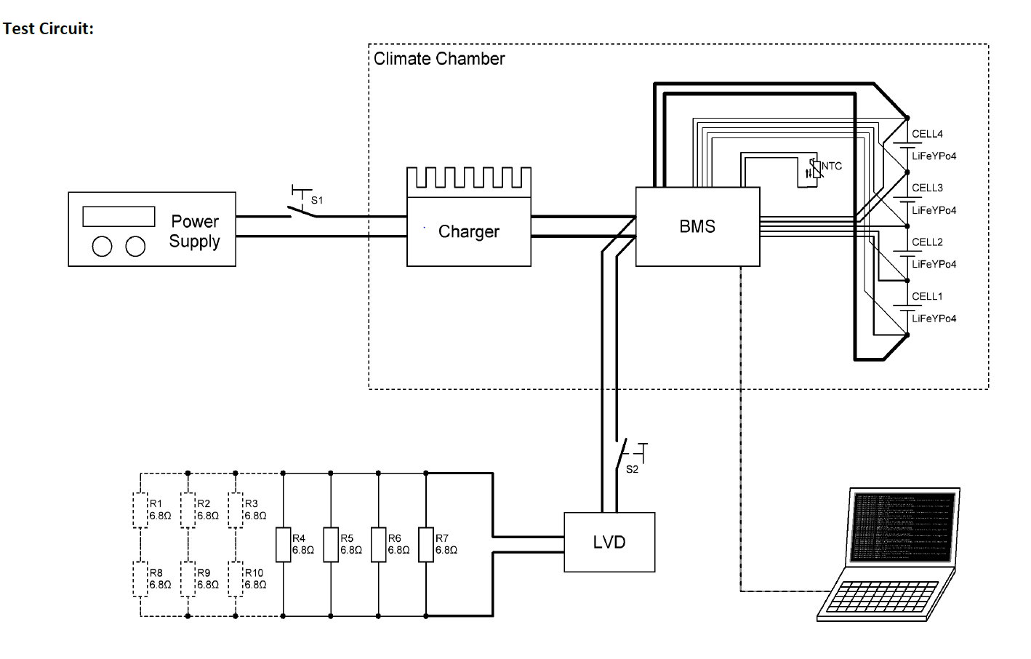
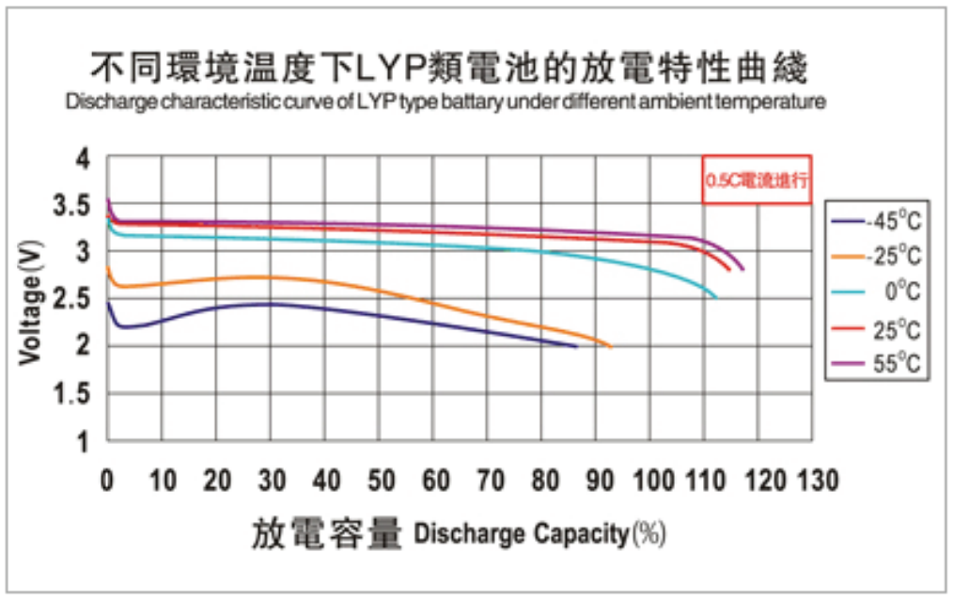
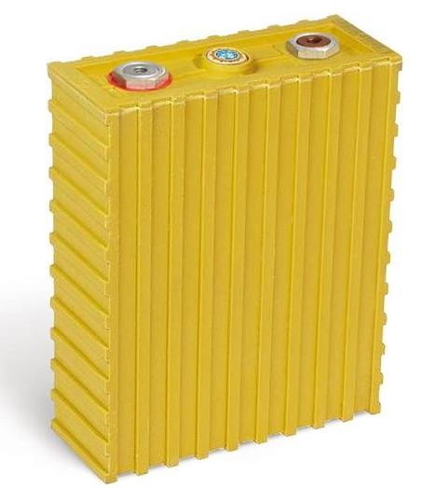
LiFeYPO₄ Thermal Testing Battery Setup
Battery Technical Information
Battery Type | Winston LYP100AHA LiFeYPO₄ [3.3V | 100Ah]
Battery Configuration | 4 Connected in Series (Nominal 12V system)
Datasheet Operating Temperature | -45°C to + 85°C
Datasheet Recommended Charging Voltage | 3.65 V
Datasheet Min. Voltage Datasheet Max. Voltage | 2.8V 3.8V
Thermal Testing Environment
Temperature Control | Weisstechnick ClimeEvent C/1000/70/3 Climate Chamber
Charging Power Supply | 32V constant voltage Bench Power supplied to 90V input 25A output CC/CV MPPT Charger
Charge Settings | Max 14.4V | 20A
Battery Management System | Custom 75A 4S LiFeYPO₄ with active balancing
Charging/Discharging Test Parameters
Charging | 14.4V | 20A Max Output End-of-Charge: Below 0.5A
Discharging | Avg. Load of 90-100W @ 0.08C-rating
Low-Voltage Disconnect | Varies by Temp 9.8V @ +5°C and 0 °C 9.6V @ -5°C 9.2V @ -15°C
Procedure | First test: Discharge Second Test: Charge
Schematic Test Circuit
Manufacturer Discharge Curves
Battery under test
P4.2-706
Please do not use this space, a QR code will be automatically overlayed

Slide 4
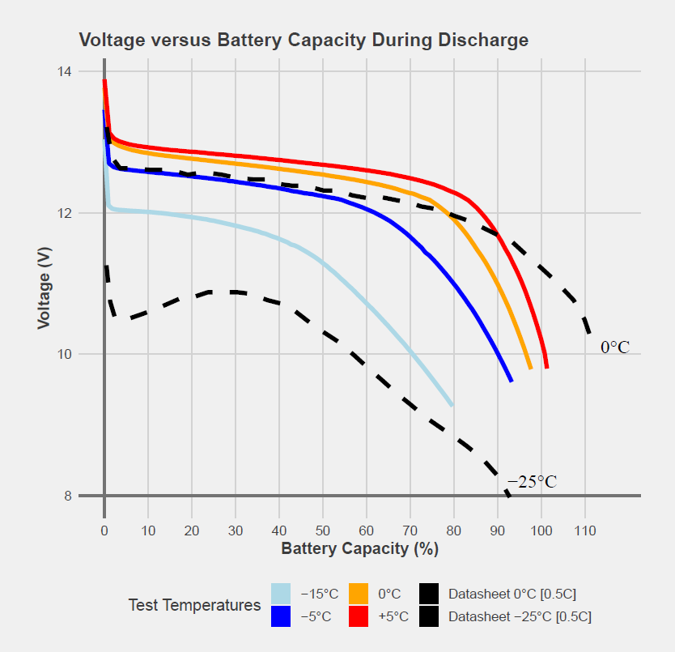
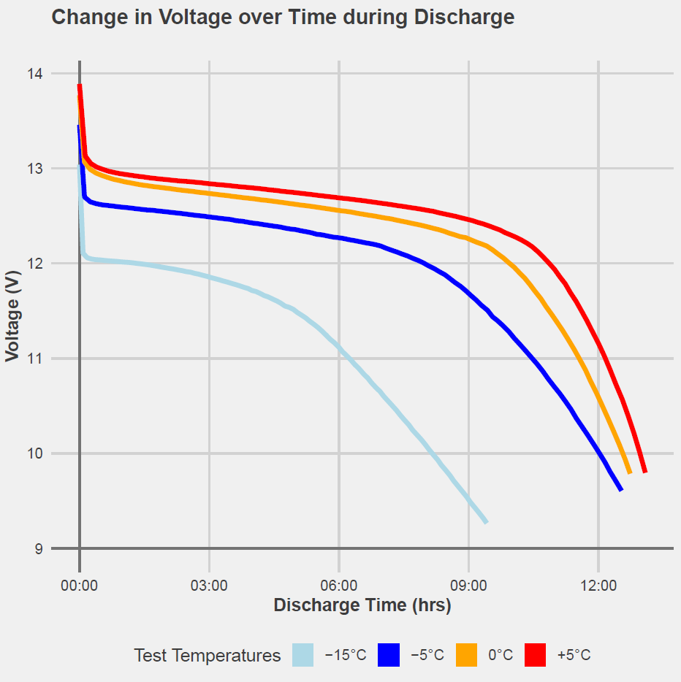
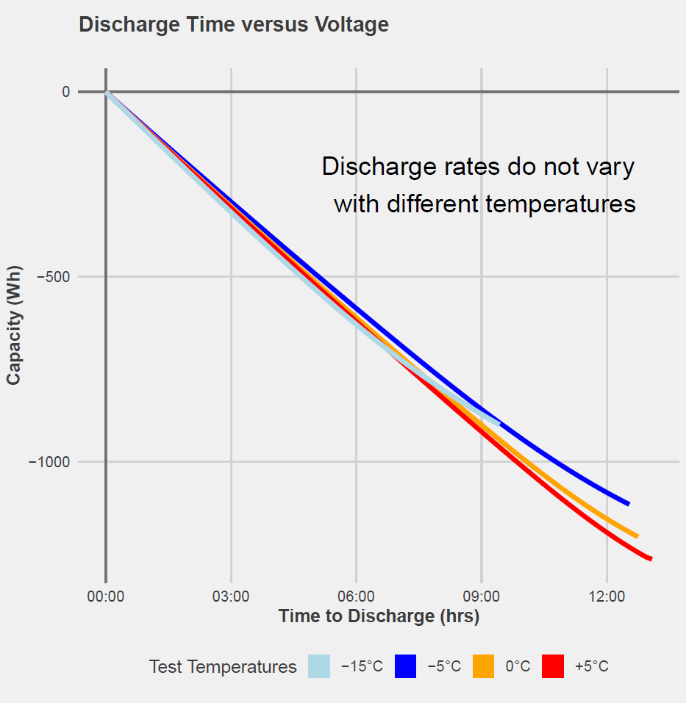
LiFeYPO₄ Discharge Test Results
Reduction in Battery Capacity (Wh) Compared to | +5°C | 0°C | -5°C
0°C | ~ 5%
-5 °C | ~12% | ~7%
-15°C | ~30% | ~25% | ~19%
Reduced Discharge Time to LVD compared to | +5°C
0°C | 0.28 hr
-5 °C | 0.55 hr
-15°C | 3.6 hr
Main Observation
At -15°C, Low-Voltage Disconnect (LVD) (9.2V) triggered after only 9hr of Discharging.
Main Observation
Discharge rate (capacity/time) is not affected by temperature, because load wattage does not vary significantly during discharge.
P4.2-706
Please do not use this space, a QR code will be automatically overlayed

Slide 5
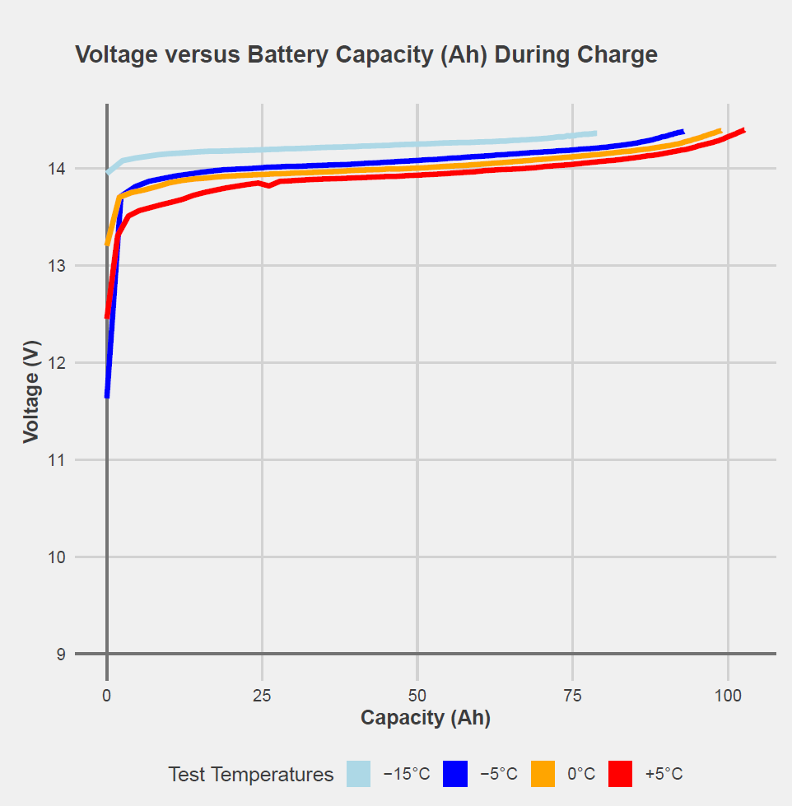
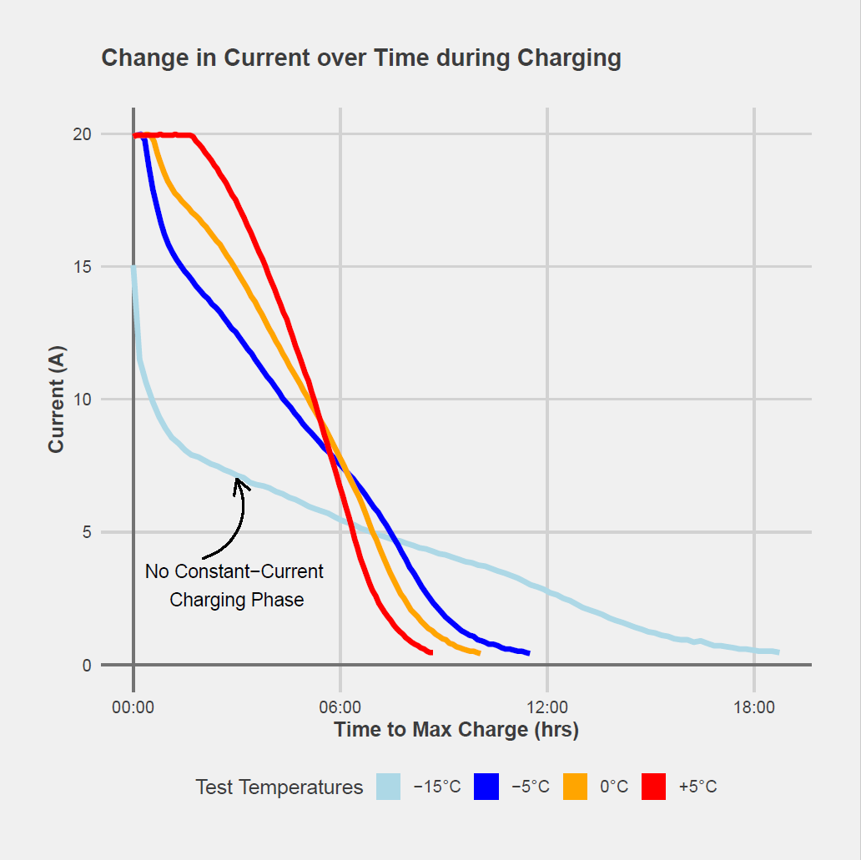
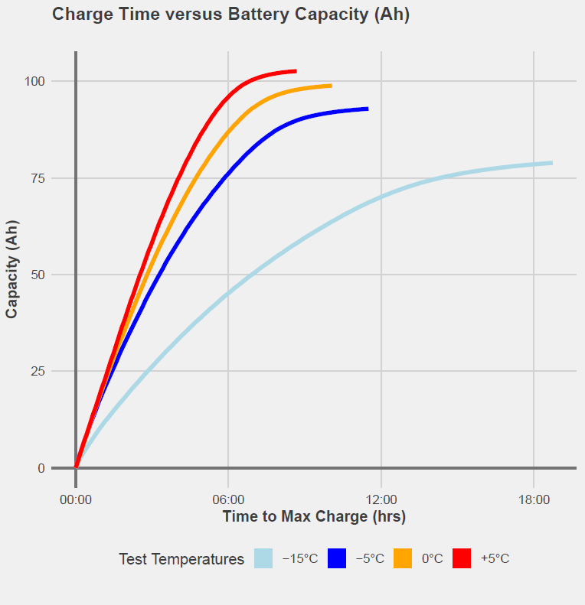
LiFeYPO₄ Charge Test Results
Increase in Charge Time to End-of-Charge compared to | +5°C
0°C | 1.4 hr
-5 °C | 2.8 hr
-15°C | 10 hr
Main Observations
Reduction in Charge Capacity (Ah) Compared to | +5°C | 0°C | -5°C
0°C | 4%
-5 °C | 10% | ~6%
-15°C | 25% | 20% | 15%
Main Observation
No Constant-Current (CC) charging phase at -15°C and -5°C
Battery voltage at -15°C and -5°C instantly reaches end-of-charge voltage (14.4V)
At -15°C, it takes 18.65 hours to reach full charge (End-of-Charge Current of 0.5A) with an 20% reduction of overall capacity
At -5°C, it takes ~7 hours less time to reach full charge with only a 10% reduction to overall capacity
P4.2-706
Please do not use this space, a QR code will be automatically overlayed

Slide 6
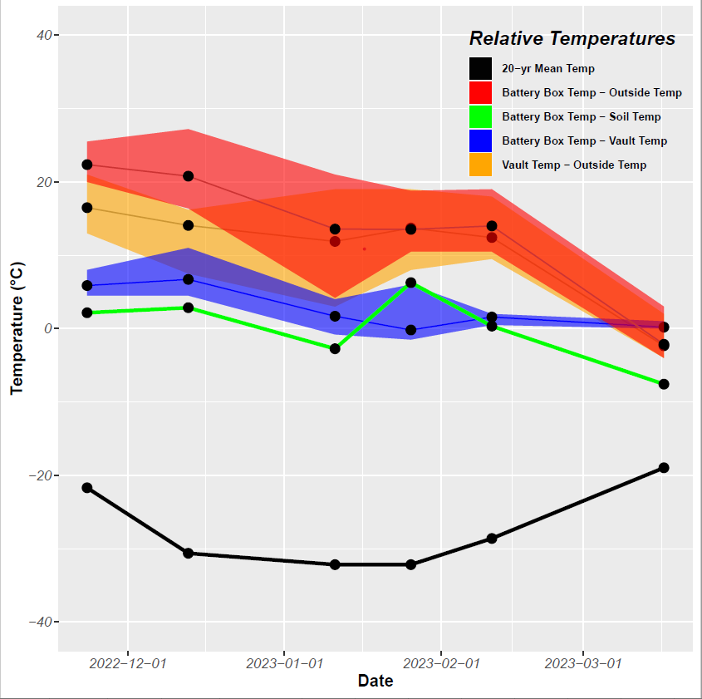
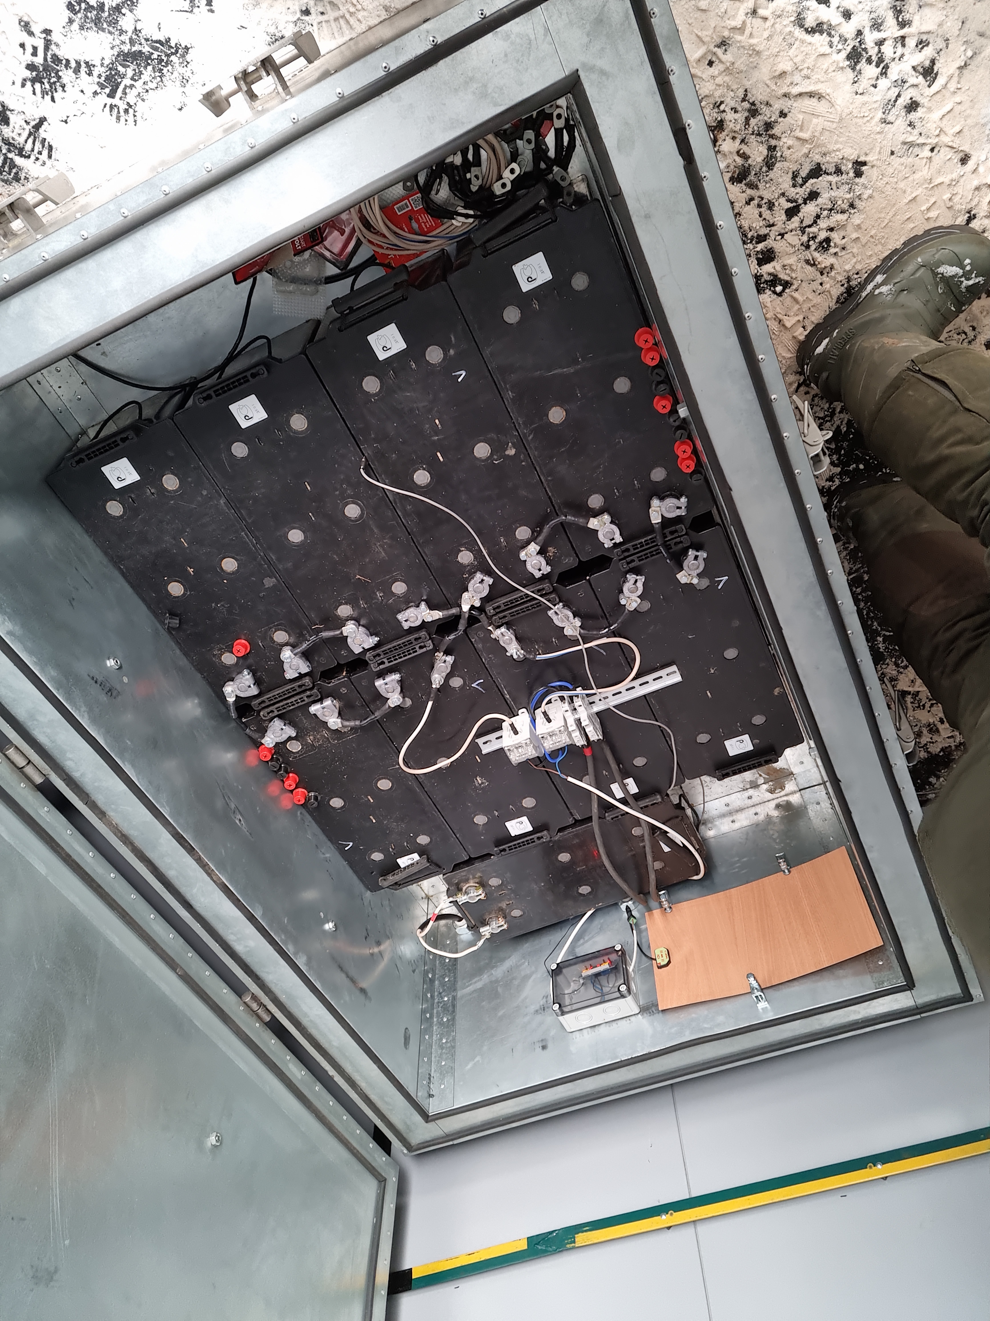
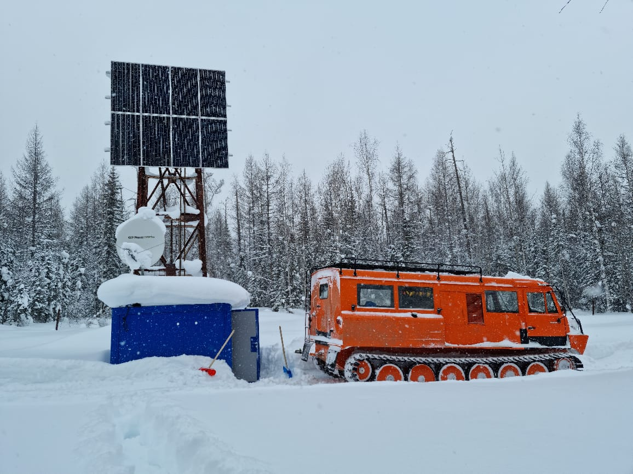
Preliminary Results of Temperature Observations at PDYAR (PS35)
In Peleduy, Russian Federation [59.6N 112.6E]
Background
Six Maintenance Visits to 9 PDYAR/PS35 elements in Winter 2022/23 were conducted to ensure sustainable operation of the station through the cold winter months.
Temperature measurements performed at each visit for:
Outside Temperature
Vault Temperature
Battery Box Temperature
At present, neither additional insulation nor external heating is installed within the battery box.
Temperatures for this area can exceed -30°C during the Winter months
20-yr mean temperatures were taken ~25km south in Vitim, Russian Federation
Black dots represent Average temperatures across the 9 sites for each visit
Shaded regions represent maximum and minimum temperatures for each relative temperature pair
Increase in Battery Box Temperature recorded on 2023-01-10 associated with anomalously warm site visit
P4.2-706
Main Observations
Battery Box Temperature relative to Outside Temperature on average >15°C warmer
Vault Temperature relative to Outside Temperature on average 15°C warmer
Battery Box Temp relative to Vault Temp on average 5°C warmer but strong correlation in March
There exists strong relationship between soil temperatures and temperatures observed in battery box
Please do not use this space, a QR code will be automatically overlayed
Battery Box
PS35 Site: March 2022

Slide 7
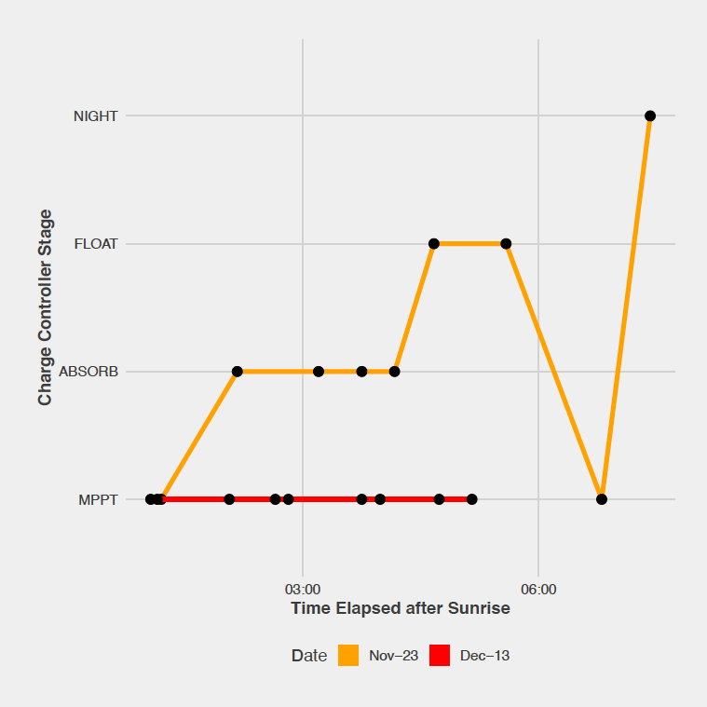
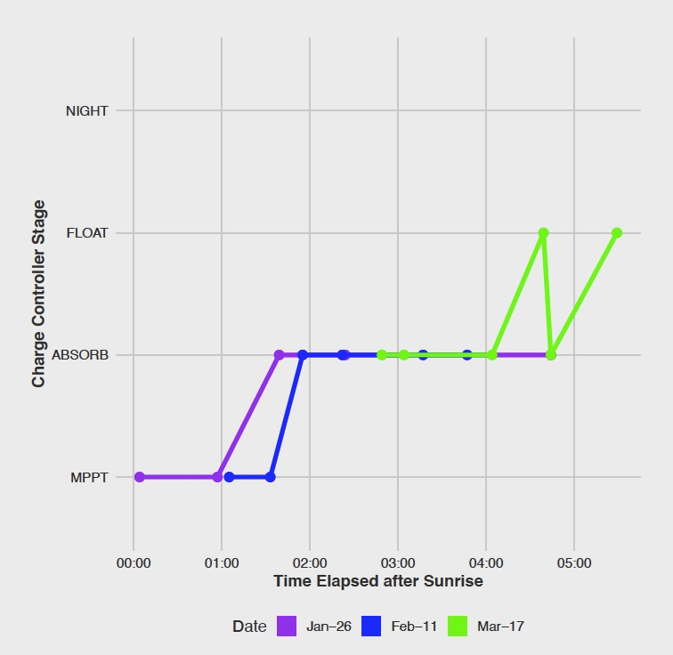
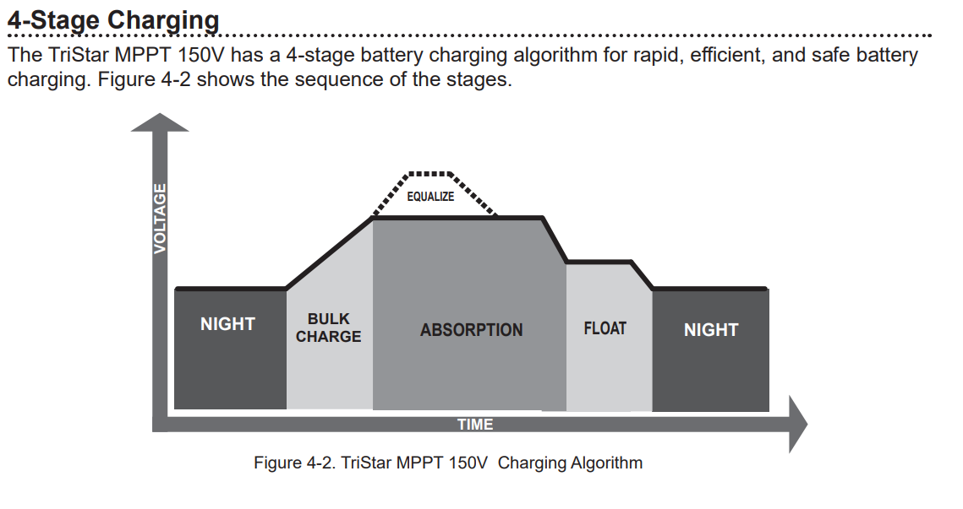
Solar Charge Controller Observations at PDYAR (PS35)
In Peleduy, Russian Federation [59.6N 112.6E]
Background
During the Six Maintenance Visits to the PDYAR/PS35 elements in Winter 2022/23, charge controller (CC) status was recorded once at each station after sunrise.
Bulk/MPPT Stage: Battery not at 100% charge and battery voltage has not yet reached pre-set Absorption Voltage. MPPT stage charges to ~80-90% SOC.
Absorb Stage: Once Absorption Voltage reached, constant voltage is supplied to battery to reach full state-of-charge.
Float Stage: Occurs after Absorption stage, CC reduces charging current, and keeps battery at maximum state of charge.
Night Stage: When no solar power is available.
Observation Date | Weather
Nov. 23, 2022 | Clear Sky
Dec. 13, 2022 | Overcast
Observation Date | Weather
Jan. 26, 2023 | Overcast
Feb. 11, 2023 | Clear Sky
Mar. 17, 2023 | Overcast
Main Observations
No ABSORB stage observed for December visit – only MPPT/BULK. 6.2 hrs of daylight combined with overcast weather could have reduced PV power generation.
Even during overcast weather and extreme temperatures (-25°C to -30°C), batteries were able to reach ~80-90% State of Charge (Absorb stage).
FLOAT stage observed during early winter and early spring visits, potentially associated with more available sunlight.
These observations will be combined with spring/summer observations in 2023 to better understand charge controller characteristics at PDYAR.
P4.2-706
Please do not use this space, a QR code will be automatically overlayed

Slide 8
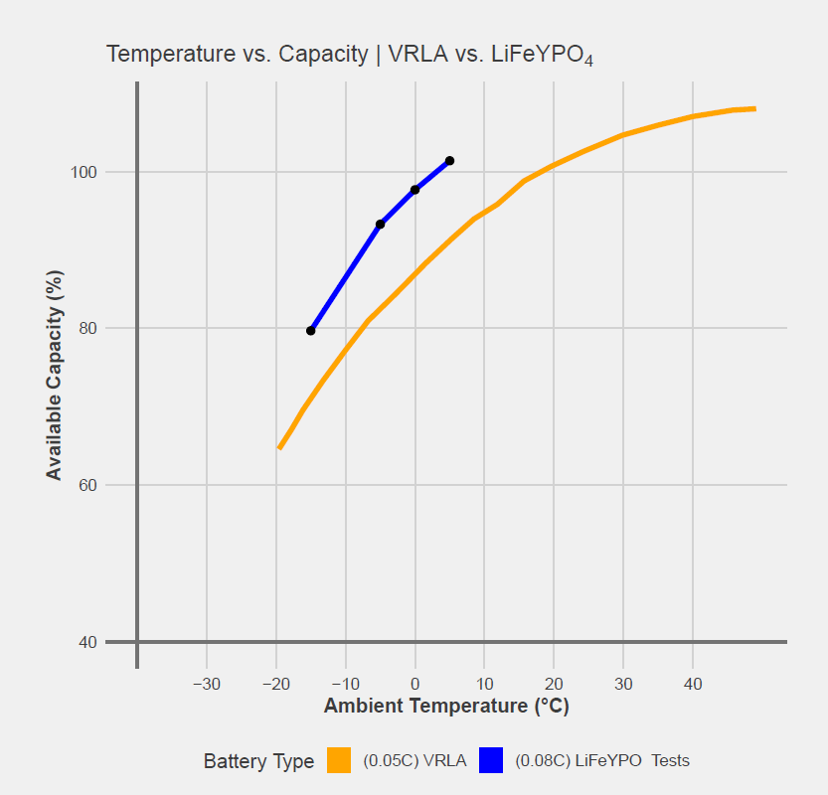
Conclusions
Main Conclusion: LiFeYPO₄ battery performance significantly degrades below -5°C.
Discharge
Tested LiFeYPO₄ battery capacity during discharge at -15C decreases by 30% relative to tested battery capacity at +5°C and an 18% decrease in capacity compared to -5C.
Discharge times at -15°C decreases by >3 hours relative to tested discharge times at +5°C
Discharge rates calculated as Capacity (Wh) with respect to time do not vary with temperature.
Charge
Charging LiFeYPO₄ batteries at -15°C decreases the available capacity of the battery bank by ~25% relative to battery capacity at +5°C.
Charge times at -15°C take ~10 hours longer to only reach 80% capacity compared to 100% available capacity charge times at +5°C.
Charge times at -15°C also take ~7 hours longer when compared with charge times at -5°C.
PDYAR (PS35) Temperature Observations
Strong correlation between soil temperatures and battery boxes inside a vault structure with limited insulation.
Preliminary comparison suggests that LiFeYPO₄ batteries could be deployed in cold environments with appropriate insulation from ambient temperatures above -5°C.
Battery capacity vs. temperature curves for the 0.08C-rate (8 Amps / 100 Ah) LiFePO₄ batteries tested in this analysis, plotted together with 0.05C-rate Valve-Regulated Lead-Acid (VRLA) battery curve [from Victron Energy].
Increased capacity for LiFeYPO₄ batteries compared to VRLA batteries within the -15°C to +5°C range. Further temperature testing at different C-ratings required for a complete characterization.
P4.2-706
Please do not use this space, a QR code will be automatically overlayed

