Slide 1
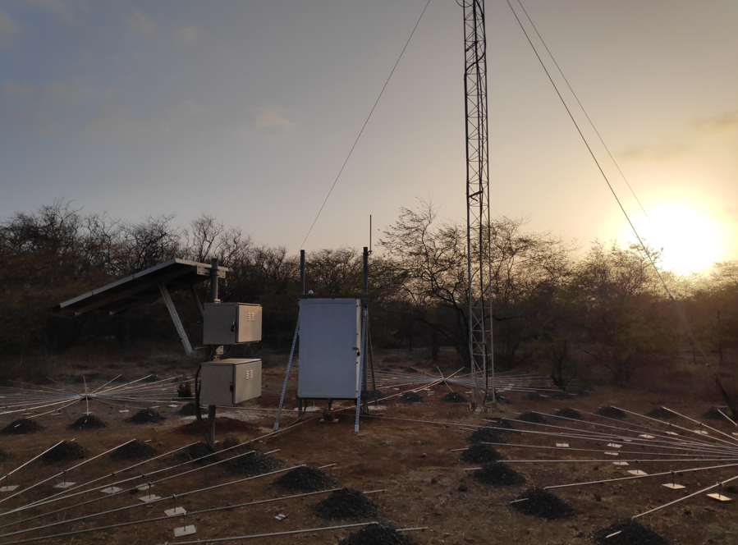
Backup Cellular Communication System for Infrasound Monitoring Stations
Maxime Grillandini
Enviroearth
P4.2-241
In collaboration with PTS, Enviroearth developed a cellular communication solution for intra-site communication of Infrasound Monitoring Stations.
Global system overview:
Dedicated to work as a backup to existing intra-site communication at all Infrasound stations
➔ allowing continuous data availability
Fully designed to comply to PTS specification
Includes VPN architecture for secure data management
Implementation and testing of the system:
Set up of a bench test at Enviroearth facilities for preliminary testing
Deployment of the system at one of the infrasound station on the IMS network, IS11 Cabo Verde.
Testing of the system on-site in real conditions
IS11, Cabo Verde station

