Slide 1
Backup Cellular Communication System for Infrasound Monitoring Stations
Maxime Grillandini
Enviroearth
Development of a Backup Cellular system for the intra-site communication of infrasound monitoring stations in collaboration with PTS
System design:
Understanding of IMS network specifities
Hardware development
Data management with VPN tunnel establishment
Global system overview
Implementation and testing of the system at our facilities and at an Infrasound station (IS11- Cabo Verde)
A promising backup intra-site communication system for Infrasound Monitoring Station
Please do not use this space, a QR code will be automatically overlayed
P4.2-241

Slide 2
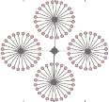
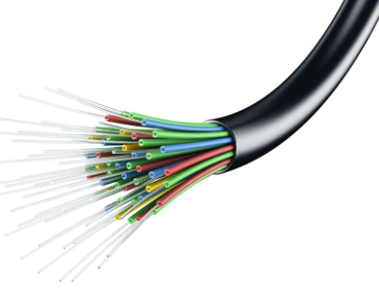
Introduction - Using cellular communication as a backup system for intra-site communication
Intra-site communication of all infrasound stations over the network is primordial to ensure direct transmission of information from remote elements to local Central Recording Facilities (CRF):
Remote Element side
CRF
20 km
Ethernet
Radio
Fiber optic
VSAT - Satellite
Existing intra-site communication system
In collaboration with PTS, Enviroearth has developed a cellular communication system for intra-site communication.
Diagram of an infrasound station with 4 remote elements.
Provide a low power consumption, ergonomic, reliable, secure and continuous data transmission system between the remote elements and the CRF in case of main communication failure and/or outage.
➔ This solution is meant to work as a backup system to the Existing communication system in place at all stations.
Please do not use this space, a QR code will be automatically overlayed
P4.2-241

Slide 3
Objective - Comply to PTS specification
Developing a system conform to PTS specification
NETWORKING
ENVIRONMENTAL
Mobile Technologies: 2G, 3G and 4G
I/O protocols 10BaseT/100BaseT Ethernet;
Cell radius: up to 50 km
Bandwidth: not less than 8 Mbps;
Continuous stream of data: 112kbps 24/7
Working in a private network
Temperature range:
-40°C to +50°C (for the remote Elements),
0° to +40° (for the CRF);
IP rating:
IP66 or better (for the remote Elements),
IP20 or better (for the CRF indoor equipment);
POWER
Operating voltage:
12/24 VDC at the remote Elements,
110/230 VAC (default) or 24 (optional) VDC at the CRF;
Power consumption:
less than 10 W for the remote Elements,
less than 30 W for the CRF
Please do not use this space, a QR code will be automatically overlayed
P4.2-241

Slide 4
Method - Overall system operation
Remote elements
Sensor
Cellular system main components:
Cellular receiver modem (for the CRF)
Cellular transmitter modem (for the remote elements)
Cellular antenna
Coaxial cable
Surge protection device (SPD)
ISP network (2G/3G/4G)
Digitizer
VPN tunnel communication via ISP network
Ethernet Hub
Cellular modem
(Transmitter) + antenna
Cellular modem Characteristic:
Built-in Failover mode: allow automatic switch in case of existing intra-site communication outage
Theorical peak consumption of 5W
1x SIM card slot
-25°C/+60°C
VPN server management
Backup cellular communication
Existing intra-site communication
CRF
Cellular modem
(receiver) + antenna
VPN tunnel communication via ISP network
Network :
VPN tunnel management
Cellular system running within a pre-established cellular network (2G/3G/4G)
Ethernet Hub
Please do not use this space, a QR code will be automatically overlayed
ISP network (2G/3G/4G)
Satellite communication to VIC
PC
P4.2-241

Slide 5
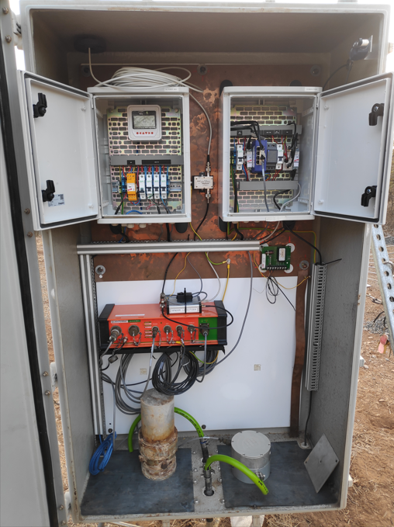
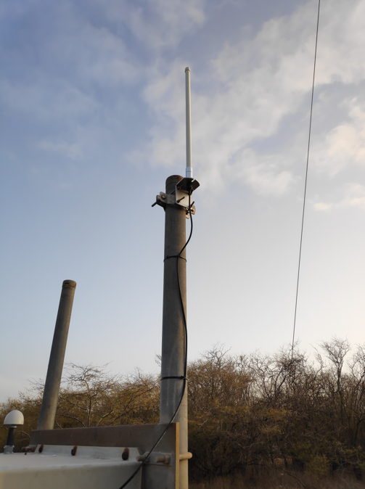
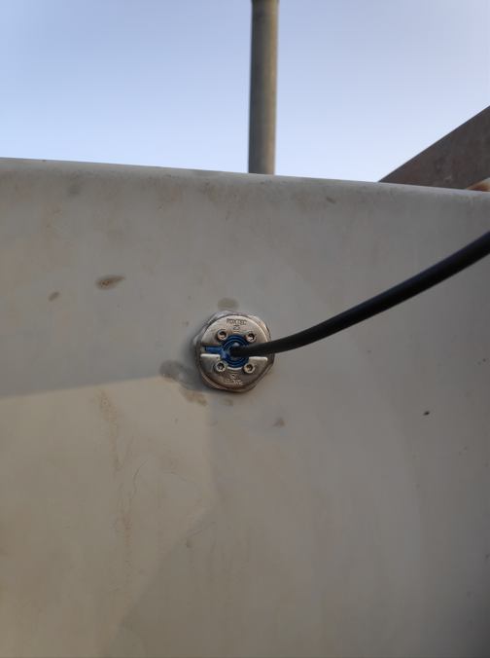
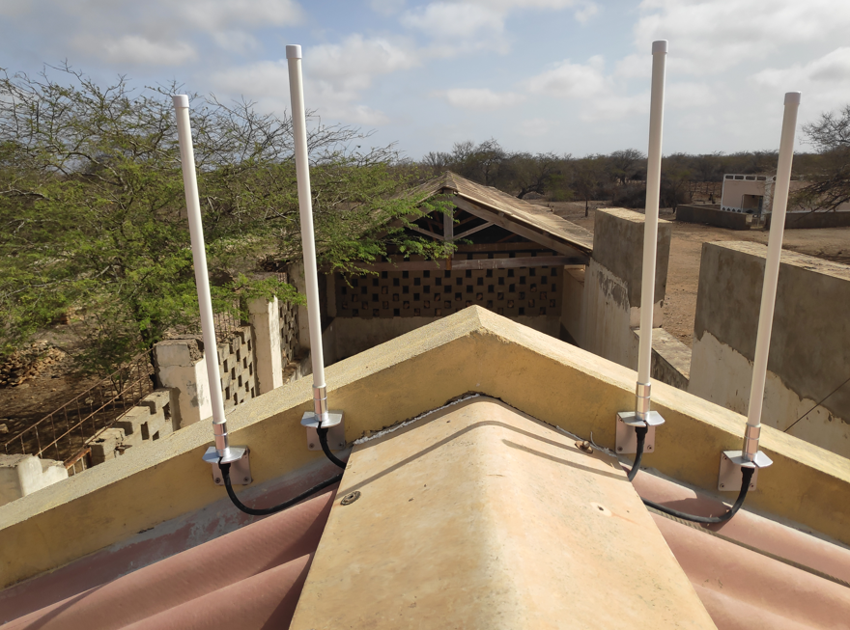
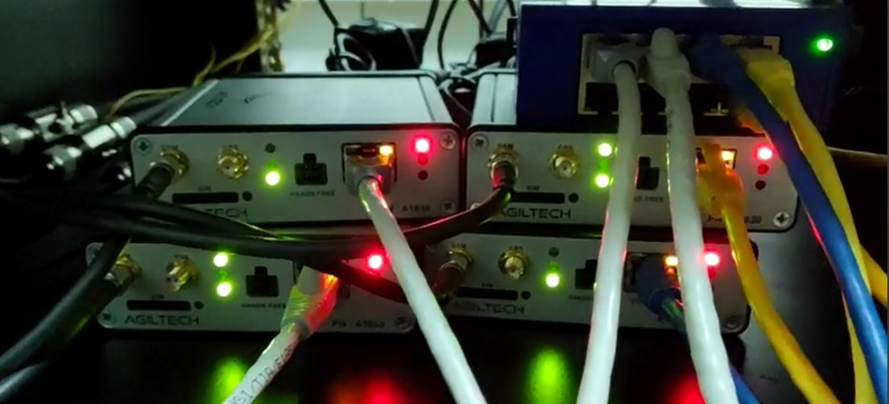
Results - System implementation at IS11, Cabo Verde station
IS11 characteristics:
1 CRF
8 remote elements
Intra-site communication through Radio
Solar panel power system at the remote elements – 12VDC
a)
b)
Vault entrance
Ethernet Hub connection
Antenna installation (a) and cable entrance in the vault at a remote element (b)
Cellular modem
SPD
Ground connection
Please do not use this space, a QR code will be automatically overlayed
Cellular antennas installation at the CRF
Cellular modems installation at the CRF
Old sensor
Installation of the cellular system inside a vault at a remote element
P4.2-241

Slide 6
Test results and conclusion
Testing the failover operation of the system
Test: Simulation of a communication outage of the intra-site link (radio) at the CRF.
Procedure: Disconnection of the radio ethernet cable from the CRF main ethernet Hub.
Observation:
Success of the failover operation of the cellular system that brought up data after the intra-site communication outage.
Proper functioning of the VPN tunnel
Too long failover duration which took almost 4 hours – assuming to be cause by the poor signal quality at every remote elements
Timetable of failover duration for each site (this table gives a rough estimation of the time)
Grafana tool – graphic showing the failover duration for each site
IN CONCLUSION
General aspects of the system:
Very easy on-site installation
Very low power consumption – 0.35A, 12V ~4W
Data secured management with VPN tunnel
System adapted for every Infrasound station over the network
Performance limited by the quality of the local Internet network
A promising backup intra-site communication system adapted for Infrasound Monitoring Station.
Please do not use this space, a QR code will be automatically overlayed
P4.2-241

