Slide 1
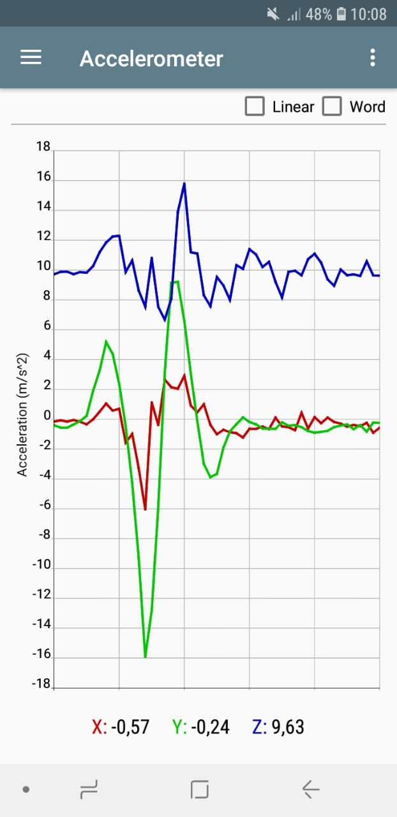
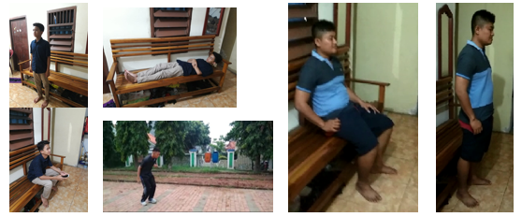
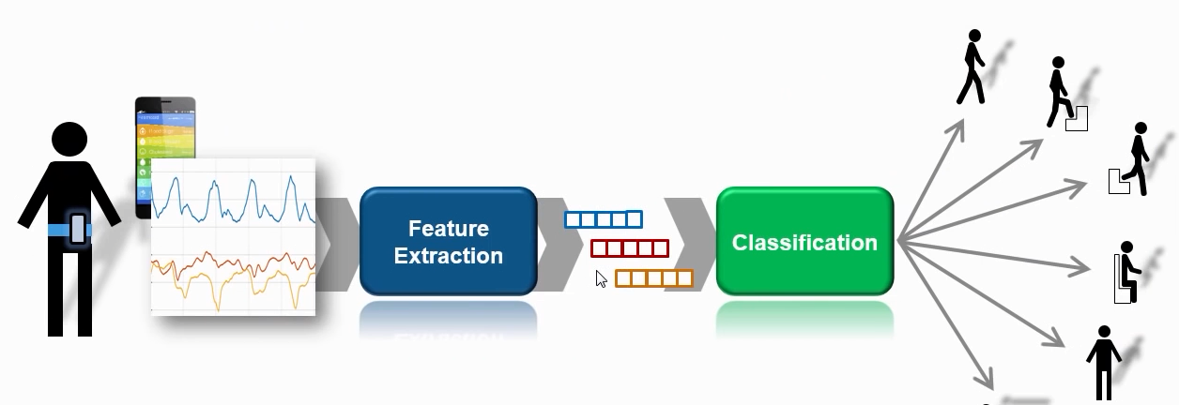
Design of Human Activity Recognizer as Android Smartphone Digital Filter
for Earthquake Signal Processing
Haryas Subyantara Wicaksana, Hapsoro Agung Nugroho
Bandung Institute of Technology, Indonesia Agency for Meteorological Climatological and Geophysical (BMKG)
P4.3-568
HAR comprises several design stages, namely:
Data collection (8 subjects)
Feature extraction
Activity data classification
Determining the Butterwoth type filter design based on activity data.
Human activities include sitting, standing, lying down, walking and running. The Butterworth type digital filter is designed based on the dominant frequency of the human activity acceleration signal. This filter is installed in server program and then tested against activity signals carried out in the Central BMKG earthquake simulator.

Slide 2
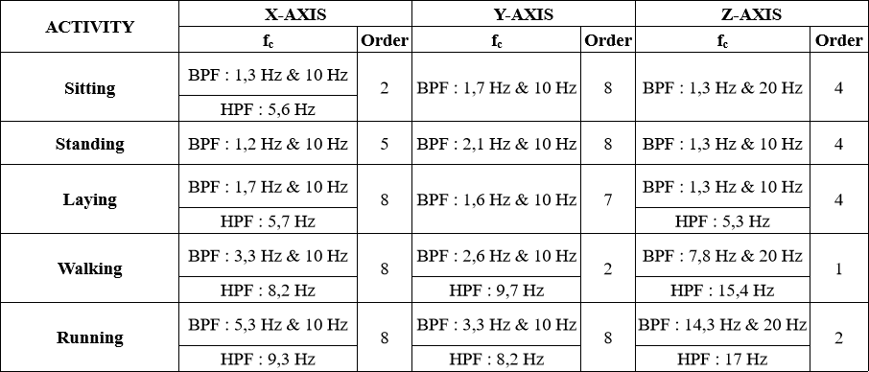
Design of Human Activity Recognizer as Android Smartphone Digital Filter
for Earthquake Signal Processing
Haryas Subyantara Wicaksana, Hapsoro Agung Nugroho
Bandung Institute of Technology, Indonesia Agency for Meteorological Climatological and Geophysical (BMKG)
P4.3-568
The test results show an increase in the percentage of earthquake signals from 3.87% to 64.61% and a decrease in the percentage of human activity signals from 96.13% to 35.39%.

