Slide 1
Design of Human Activity Recognizer as Android Smartphone Digital Filter for Earthquake Signal Processing
Haryas Subyantara Wicaksana, Hapsoro Agung Nugroho
Indonesia Agency for Meteorological Climatological and Geophysical (BMKG), School of Meteorology, Climatology and Geophysics (STMKG)
Smartphone accelerometer signal on smartphone
Data collection
Feature extraction
Activity data classification
Determining the Butterwoth type filter design based on activity data.
The test results show an increase in the percentage of earthquake signals from 3.87% to 64.61% and a decrease in the percentage of human activity signals from 96.13% to 35.39%.
Please do not use this space, a QR code will be automatically overlayed
P4.3-568

Slide 2
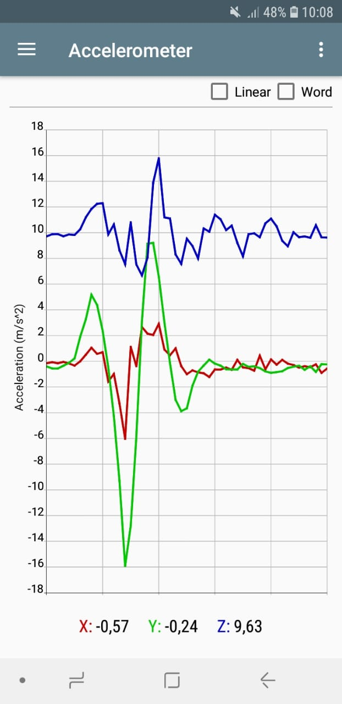
INTRODUCTION
Threat of earthquake hazard is interspersed in almost all zones of Indonesian archipelago. A total of 3,846 earthquakes have occurred in Indonesia with a magnitude of more than 6.0 Richter scale in the period 1976-2006.
Smartphone accelerometer can be utilized as a seismic parameters sensor. This idea has limitations regard to noise. Human activity produces significant noise on accelerometer seismic data on smartphones.
Human Activity Recognizer (HAR) is very possible to be implemented as a noise filter. Research on HAR has been carried out several times. However, HAR has not been applied in field of disaster mitigation, especially earthquakes.
Please do not use this space, a QR code will be automatically overlayed
P4.3-568

Slide 3
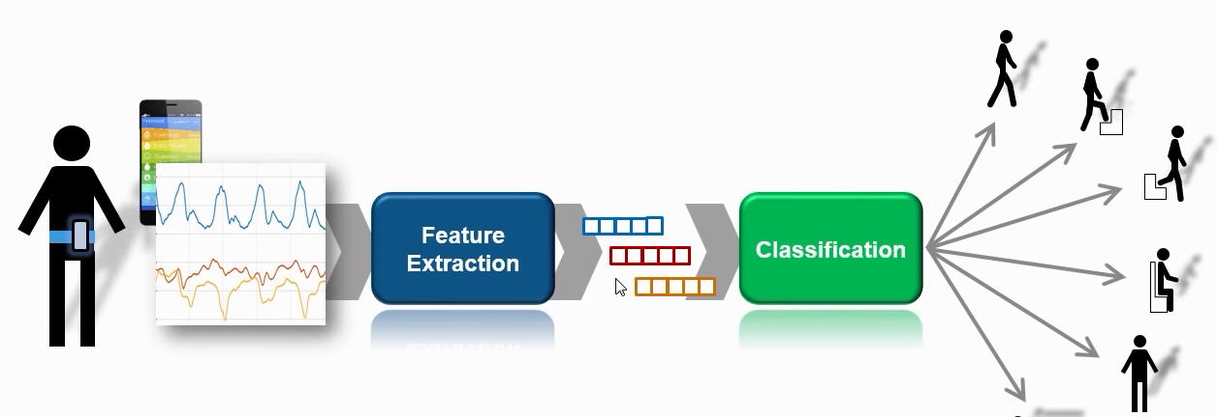
OBJECTIVES
This study discusses implementation of HAR as a digital accelerometer filter for smartphones. It is expected to improve post-earthquake data quality from smartphone. This study aims to reduce linear acceleration signal caused by human activity on smartphone accelerometer.
Please do not use this space, a QR code will be automatically overlayed
P4.3-568

Slide 4
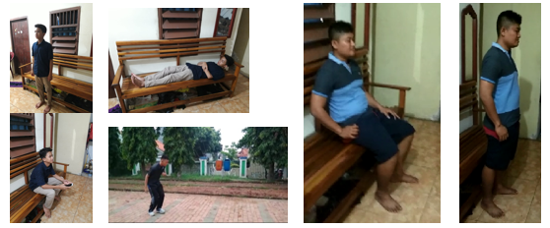
METHODS
HAR comprises several design stages, namely:
Data collection (8 subjects)
Feature extraction
Activity data classification
Determining the Butterwoth type filter design based on activity data.
Human activities include sitting, standing, lying down, walking and running. The Butterworth type digital filter is designed based on the dominant frequency of the human activity acceleration signal. This filter is installed in server program and then tested against activity signals carried out in the Central BMKG earthquake simulator.
Please do not use this space, a QR code will be automatically overlayed
P4.3-568

Slide 5
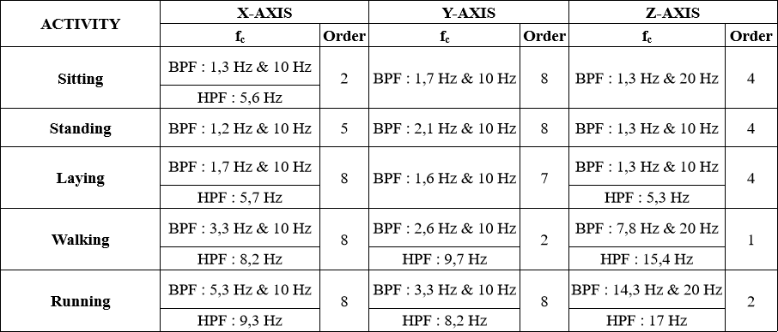
RESULTS
Please do not use this space, a QR code will be automatically overlayed
P4.3-568

Slide 6
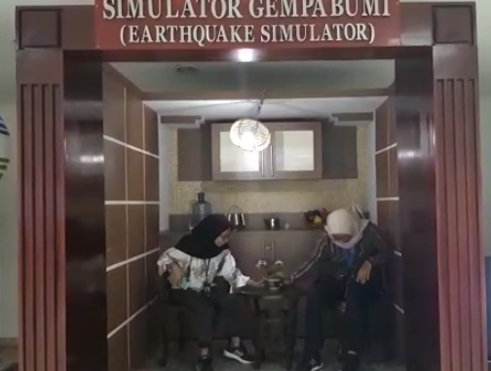
CONCLUSION
HAR-based smartphone digital accelerometer filter perform well in terms of output signal classification. The test results show an increase in the percentage of earthquake signals from 3.87% to 64.61% and a decrease in the percentage of human activity signals from 96.13% to 35.39%.
Please do not use this space, a QR code will be automatically overlayed
P4.3-568

