Slide 1
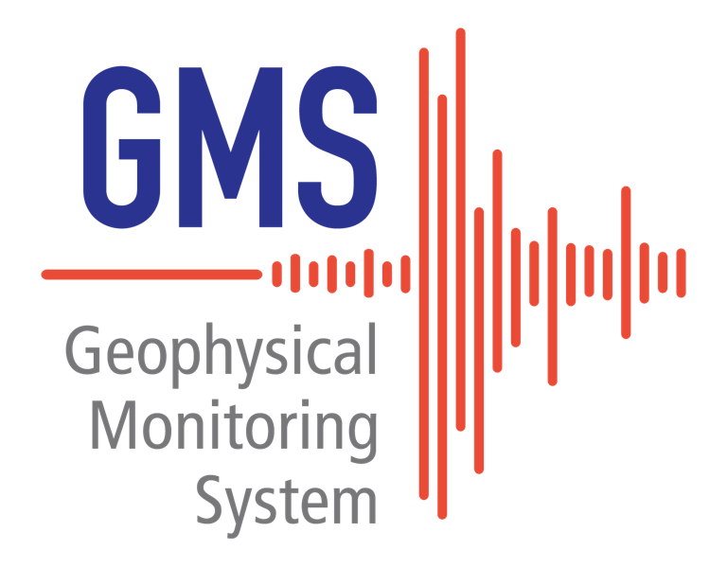
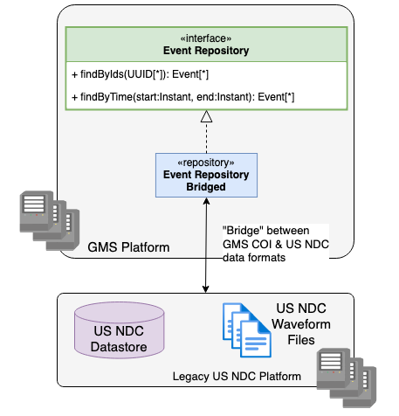
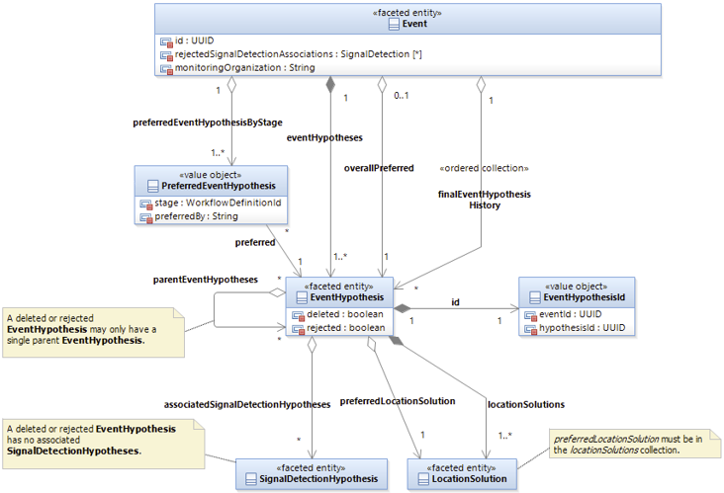
Data Model and Data Access Architecture in the Geophysical Monitoring System
Ben Hamlet and Mark Harris
Sandia National Laboratories
SAND2023-04909D
P4.3-375
Sandia National Laboratories is developing the Geophysical Monitoring System (GMS) to modernize the United States National Data Center (USNDC) waveform processing system. The United States is providing the common architecture and processing components of GMS as a contribution-in-kind to accelerate progress on International Data Centre (IDC) Re-engineering.
The legacy US NDC system lacks separation between the application data model and physical database schema, which has impeded cost-effective system maintenance and extension.
The GMS architecture avoids this problem through the Common Object Interface (COI).
The GMS COI defines application-level components, a Data Model and Access API, for interacting with persistent data objects. These are agnostic to the underlying persistent data storage implementations.
The GMS project is currently prioritizing development of the Interactive Analysis (IAN) user interface tools used by Analysts. Since the GMS data acquisition and automatic processing components can not yet support these tools, GMS temporarily includes the Legacy Data Bridge to provide the tools access to the legacy US NDC database and waveform file storage.
The Legacy Data Bridge provides one COI implementation.
Sandia National Laboratories is a multimission laboratory managed and operated by National Technology & Engineering Solutions of Sandia, LLC, a wholly owned subsidiary of Honeywell International Inc., for the U.S. Department of Energy’s National Nuclear Security Administration under contract DE-NA0003525.

