Slide 1
GCI support for a Virtual National Data Centre
Marius Popa
CTBTO
In a constant evolving digital world, there is a need for flexible way to secure the CTBTO data and products sent over the Internet.
High levels of flexibility can be achieved by implementing programable, intelligent, VPN systems that can be deployed without the need for dedicated physical hardware.
This system of secure communications can be deployed in as a software implementation, eliminating the need for physical network infrastructure, either on premises or in a platform as a service environment.
There is only one requirement: Internet access. VPN HUBs offer a highly flexible design model:
hardware or software or a mix of both - the entire VPN system can be recovered in a short time with a high level of automation.
Please do not use this space, a QR code will be automatically overlayed
P4.3-165

Slide 2
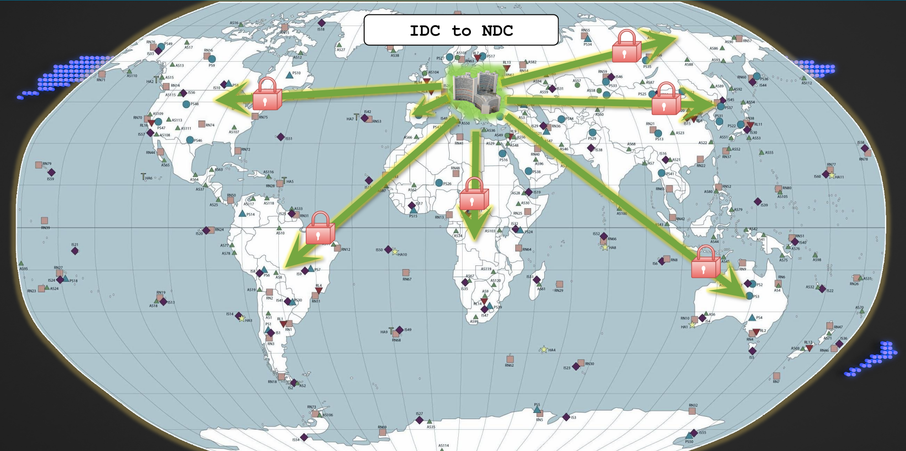
GCI support for a Virtual National Data Centrer
P4.3-165
Please do not use this space, a QR code will be automatically overlayed

Slide 3
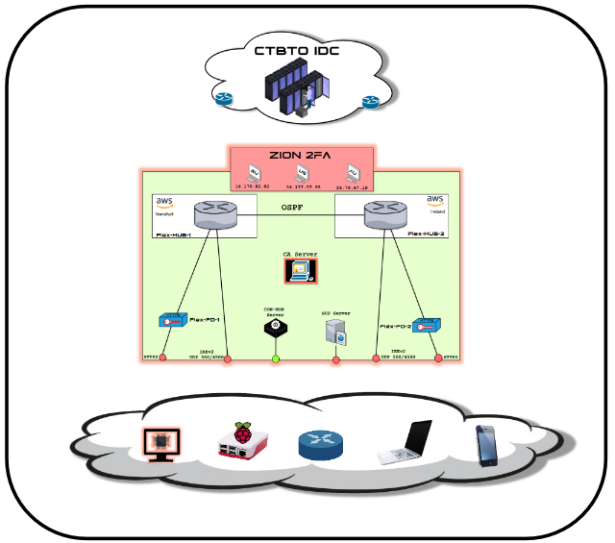
GCI support for a Virtual National Data Centrer
P4.3-165
Please do not use this space, a QR code will be automatically overlayed

Slide 4
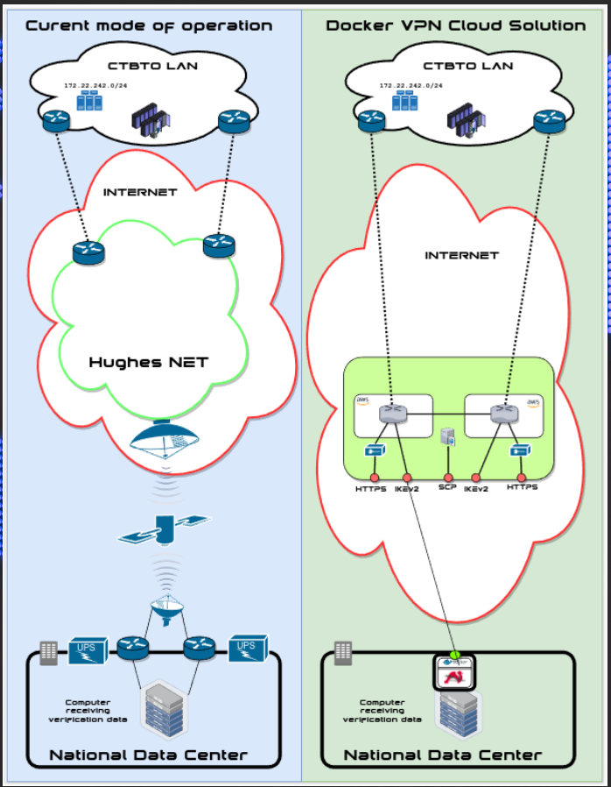
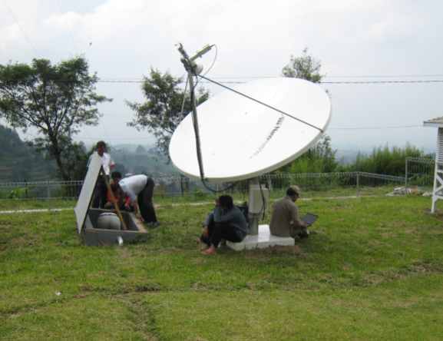
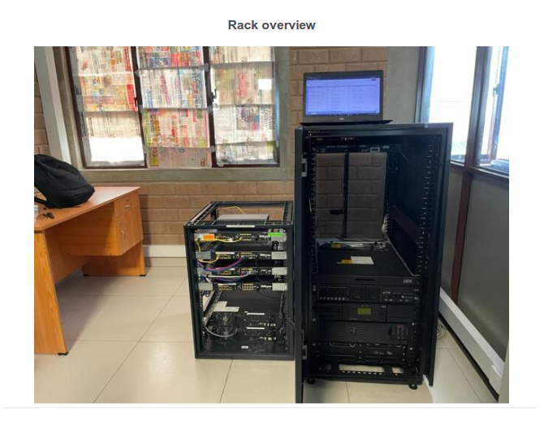
GCI support for a Virtual National Data Centrer
P4.3-165
Please do not use this space, a QR code will be automatically overlayed

Slide 5
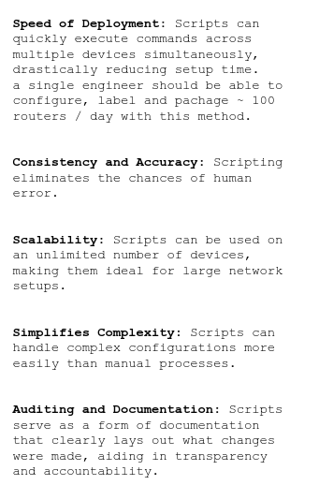
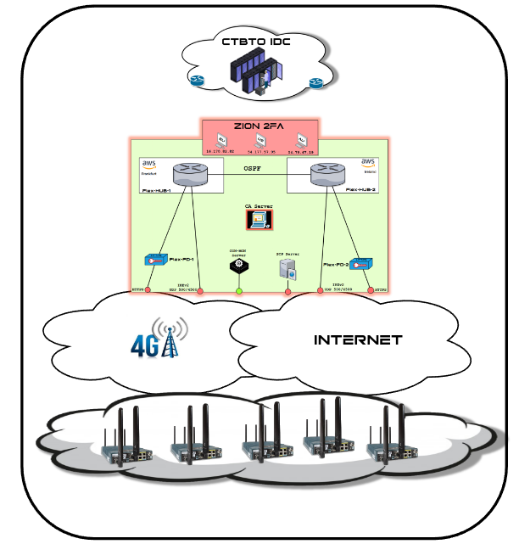
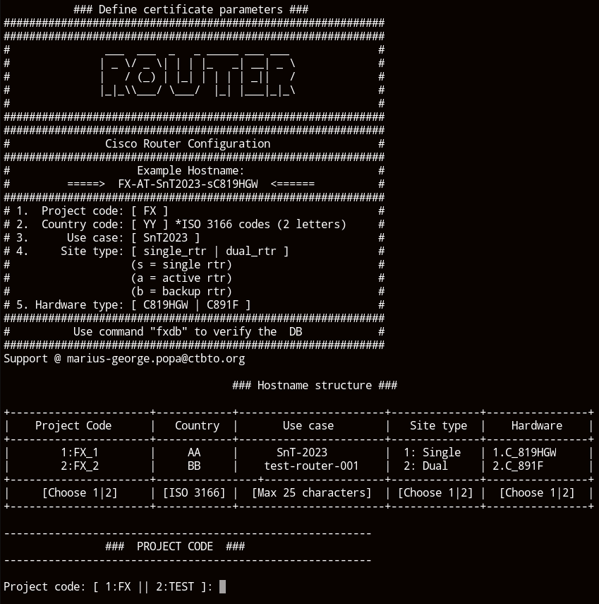
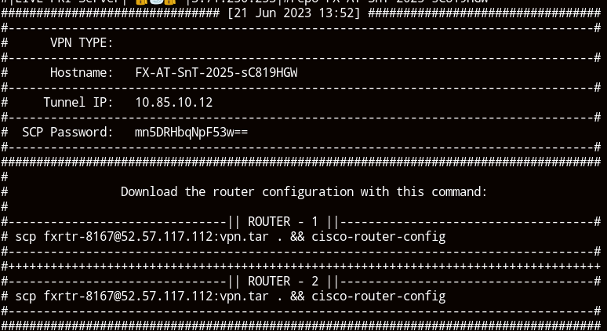
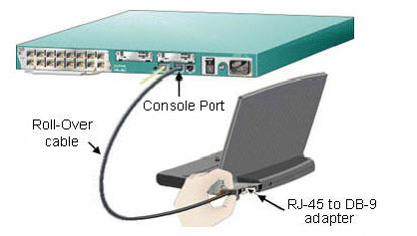
GCI support for a Virtual National Data Centrer
P4.3-165
Please do not use this space, a QR code will be automatically overlayed

Slide 6
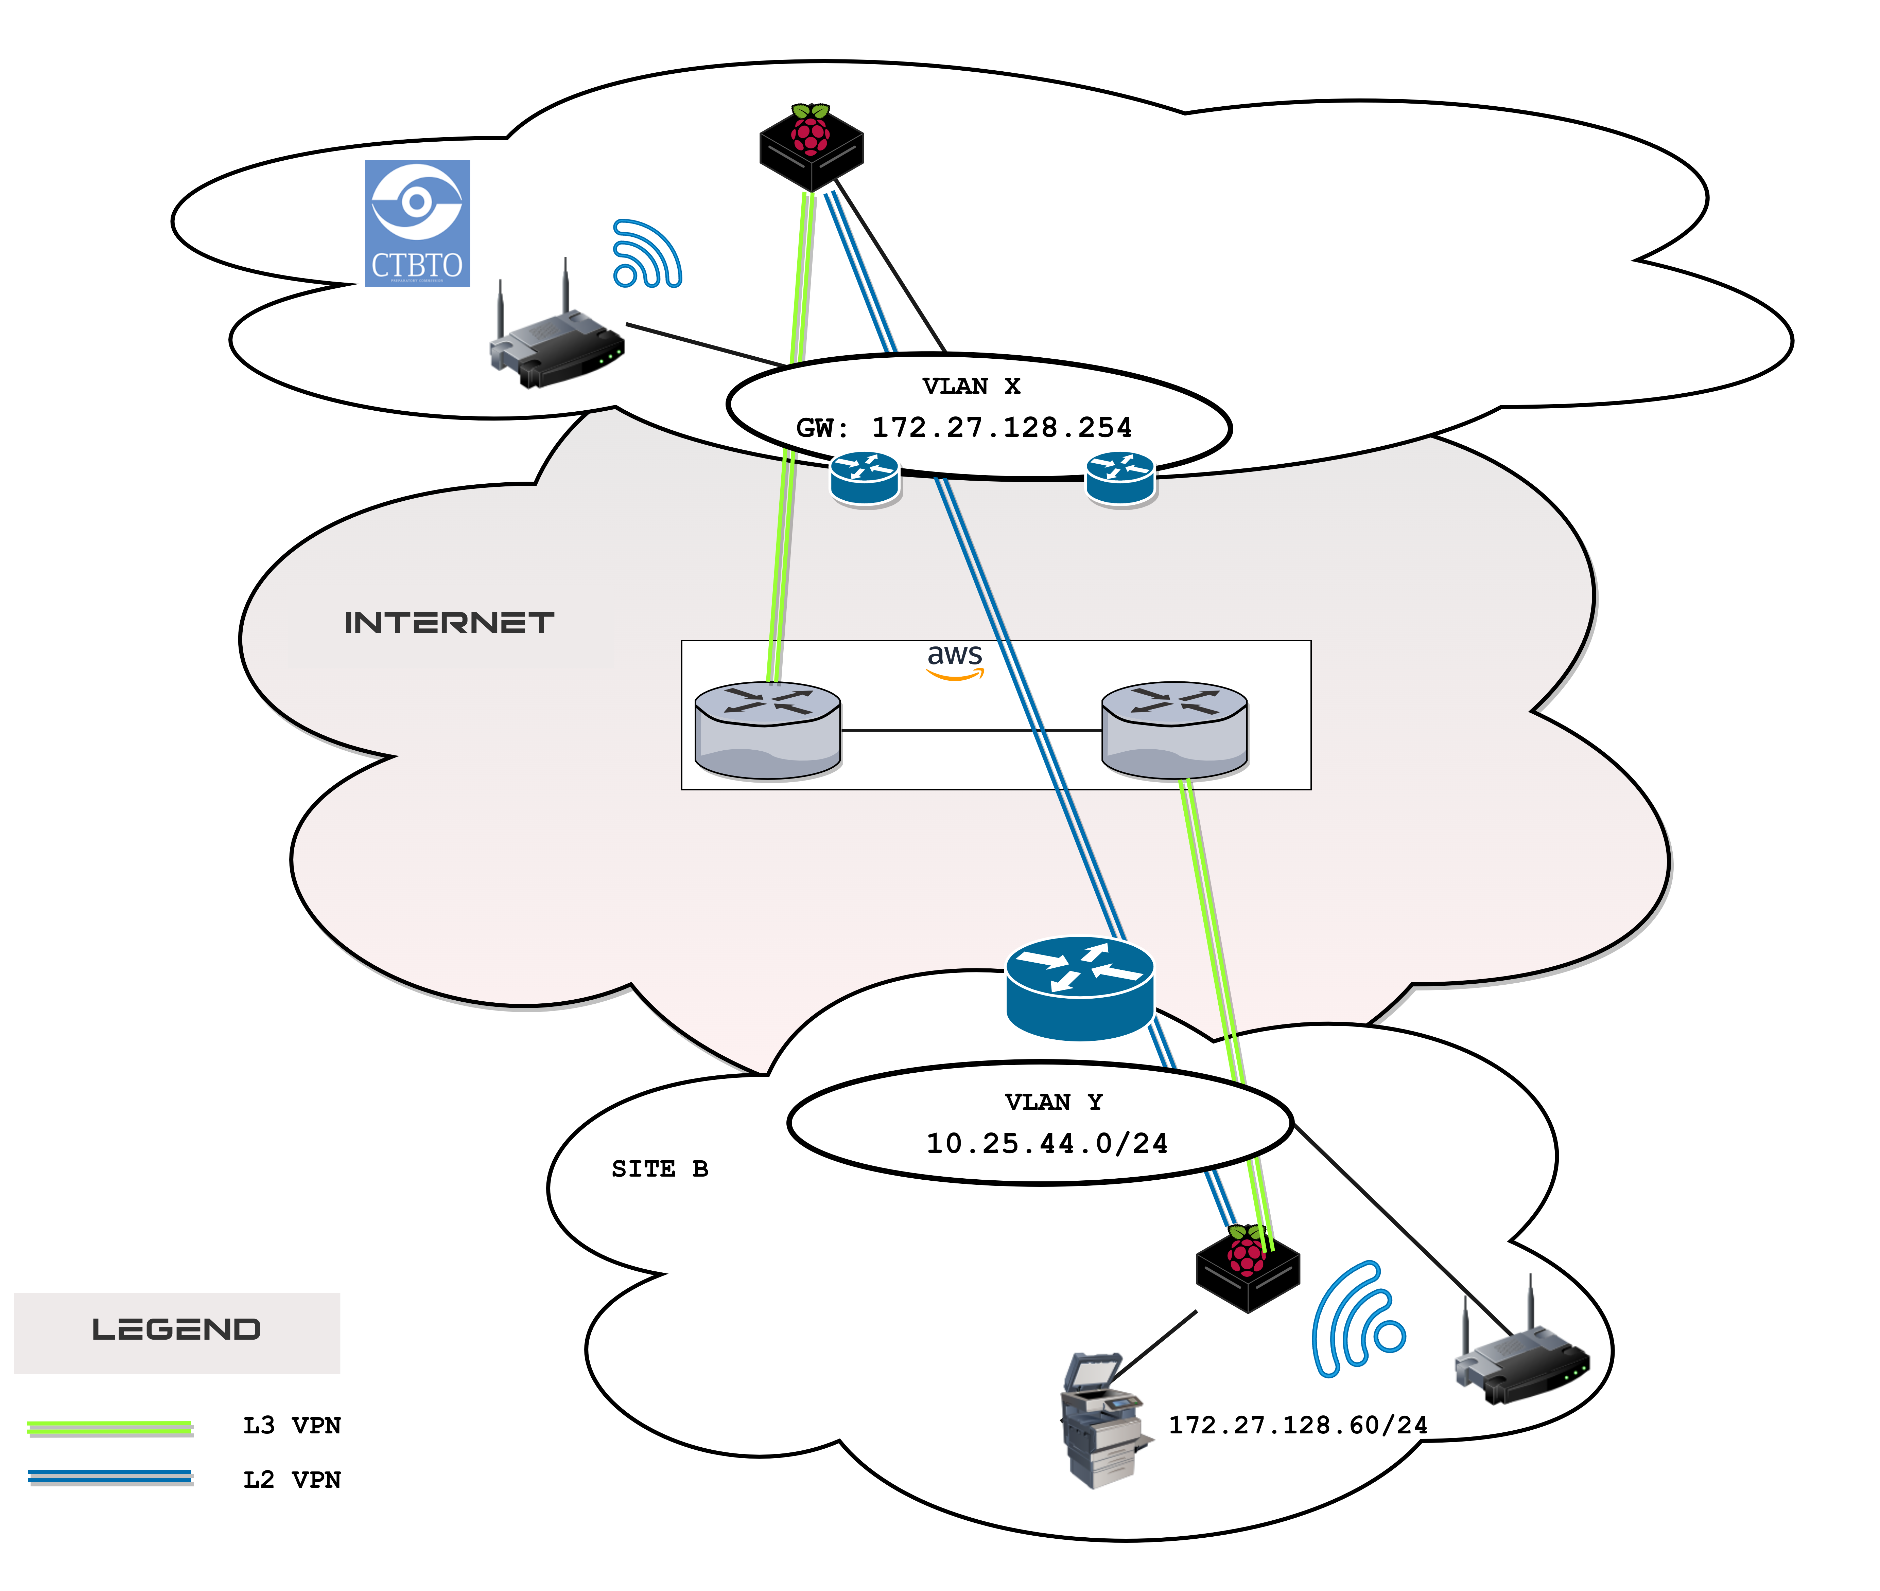
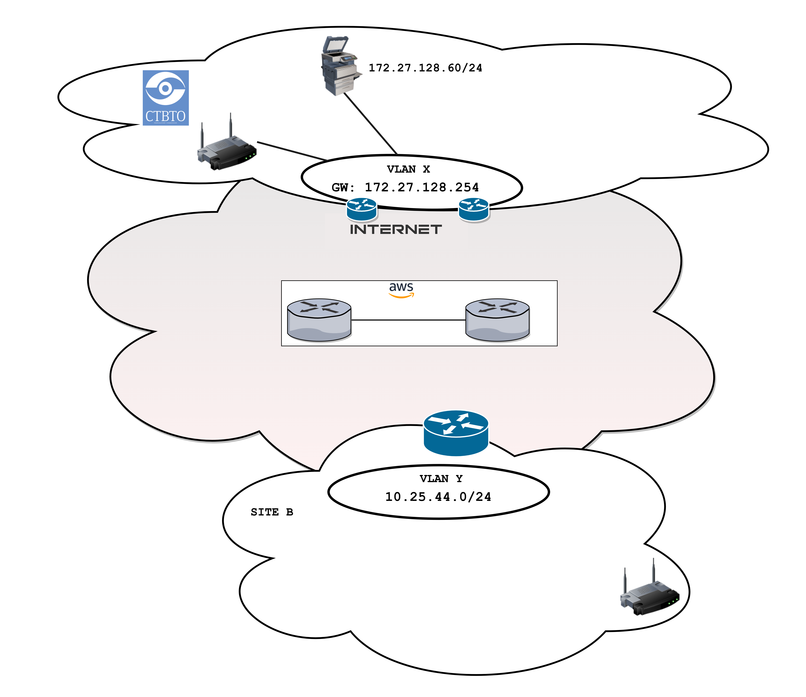
GCI support for a Virtual National Data Centrer
P4.3-165
Please do not use this space, a QR code will be automatically overlayed

Slide 7
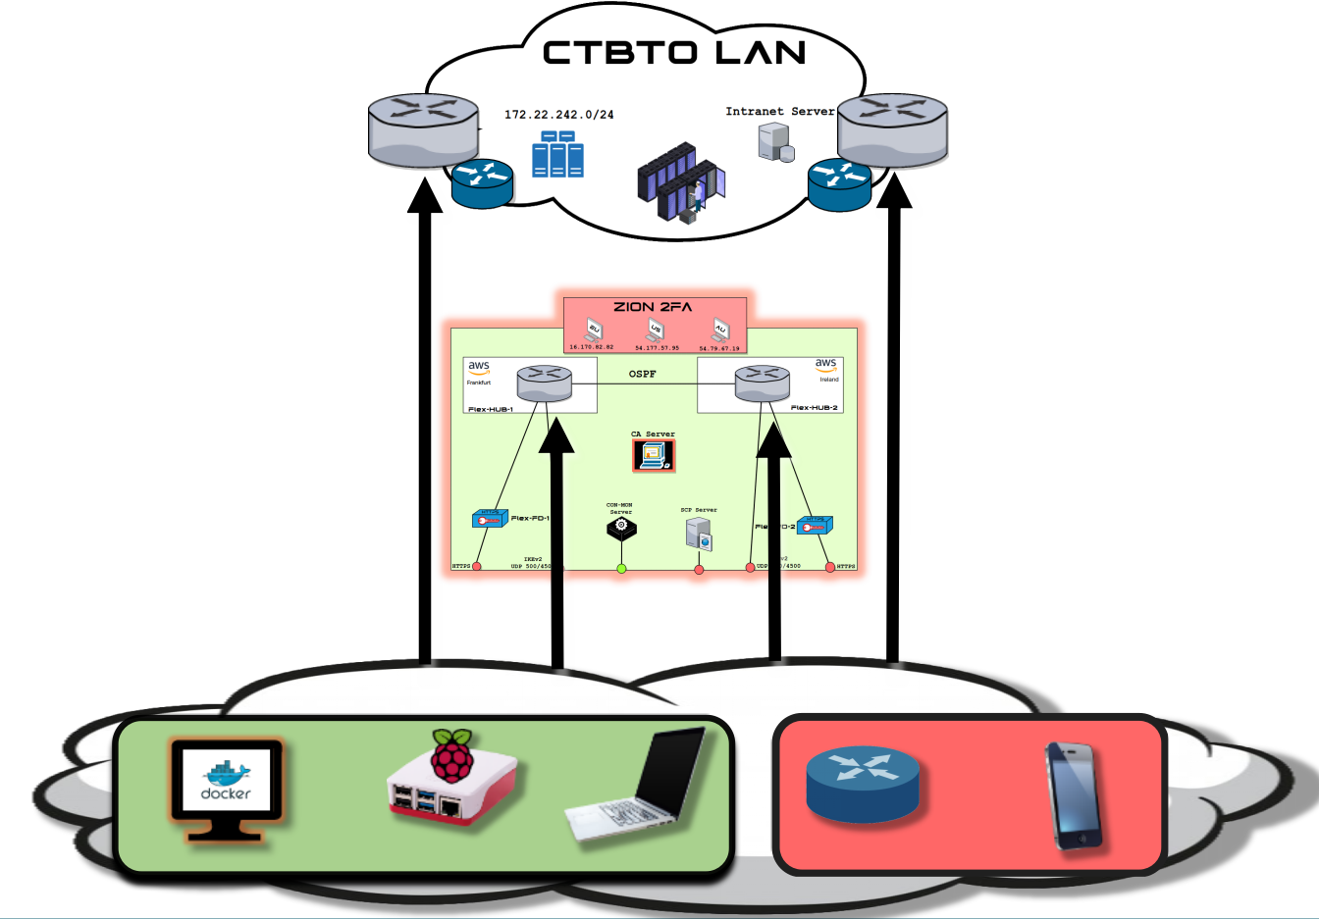
GCI support for a Virtual National Data Centrer
P4.3-165
Please do not use this space, a QR code will be automatically overlayed

Slide 8
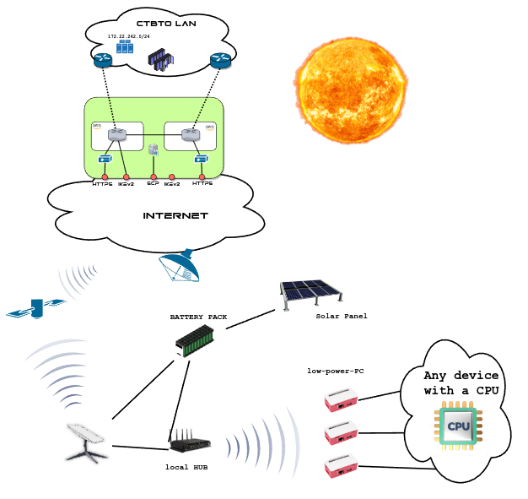
GCI support for a Virtual National Data Centrer
P4.3-165
Please do not use this space, a QR code will be automatically overlayed

