Slide 1
The Meteorology, Climatology and Geophysics Agency VSAT Network Disaster Recovery Plan as Efforts to Optimize Data and Sending Information for Meteorology, Climatology and Geophysics
Reza Aria Nugraha, S.Tr & Leo Gumalto Butarbutar, S.Tr
Indonesian Agency for Meteorological, Climatological and Geophysics (BMKG)
The BMKG VSAT communication network is a system that connects all systems within the integrated BMKG environment and requires a real time data exchange process.
DISASTER RECOVERY PLAN for the dissemination of weather information and disaster events Data Backup
The results of this study are DRP documents that are adjusted to the BMKG duties and functions. The document contains the roles and responsibilities of personnel as well as steps to back up services and recover assets
The dissemination of weather information and disaster events for the community is not disrupted
Please do not use this space, a QR code will be automatically overlayed
P4.3-734

Slide 2
Introduction : Background
The BMKG VSAT communication network is a system that connects all systems within the BMKG environment which are integrated and carry out the process of exchanging data information on weather and natural disasters in real time. The paralysis of the VSAT communication network in the BMKG environment is critical because it can cause communication paralysis both internally and externally at BMKG.As an institution that plays a role in collecting, processing and disseminating weather and natural disaster information, of course the BMKG VSAT communication network manager must be active and innovative in providing and creating data access services that can help the user community to reduce the impact caused by disasters.With the importance of BMKG information to the public, the BMKG communication line must not go down and must have disaster recovery because of the urgency of information to the public. For example, information on an earthquake, a maximum of five minutes, must be sent and disseminated quickly, especially for information relating to potential tsunami warnings.Therefore, in building disaster recovery, it is necessary to have a backup plan for the main data center at the Central BMKG and recovery if a disaster occurs at the data center or the network infrastructure that supports the data center. Data backup must be in a different location from the main data center to anticipate a major disaster.
Please do not use this space, a QR code will be automatically overlayed
P4.3-734

Slide 3
Introduction : Identification of Problems
How does the BMKG VSAT network system work
What is the risk of damage to the BMKG VSAT network when a disaster occurs?
How is the implementation of the BMKG VSAT network Disaster Recovery Planning design?
How to design a data center as a backup location for BMKG VSAT network data services?
Please do not use this space, a QR code will be automatically overlayed
P4.3-734

Slide 4
Introduction : Formulation of The Problems
Based on the background previously described, we can formulate the problems that occur in the BMKG VSAT network in the fishbone diagram as shown in the picture above.
Please do not use this space, a QR code will be automatically overlayed
P4.3-734

Slide 5
Objectives
The purpose of this research is to find out how the recovery system on the BMKG VSAT network is implemented in an effort to optimize data transmission and information on Meteorology, Climatology and Geophysics when a disaster occurs.
The Benefits of Writing
For Writers
Able to compile scientific papers as provision in writing the final project and add insight and skills in the field of communication networks at BMKG.
For Readers
This Poster is expected to be material in enriching knowledge regarding the application of disaster recovery on networks and provide an opportunity to learn more about it.
For Society
The author made the place for the implementation of the Disaster Recovery Plan, where the DRP process was carried out by implementing backups to maintain the continuity of up to date information services for the public to access.
Please do not use this space, a QR code will be automatically overlayed
P4.3-734

Slide 6
Methods
Study of Literature
The Method is carried out by searching and studying various literature in the form of books (textbooks), journals and scientific articles, as well as websites related to data centers.
Discussion and Interview
This method complements the literature study method to determine the extent of understanding gained from the results of the literature study and becomes a forum for exchanging ideas for all parties involved in this study.
Running System Analysis
The analysis is carried out on various data center design criteria covering all existing aspects so that the data is determined which criteria must be implemented in data center design.
Designing a Disaster Recovery Plan (DRP)
The design is the stage of determining the location of the DRP, making the design and infrastructure requirements for the Disaster Recovery Plan (DRP) and the network topology that is created.
Please do not use this space, a QR code will be automatically overlayed
P4.3-734

Slide 7
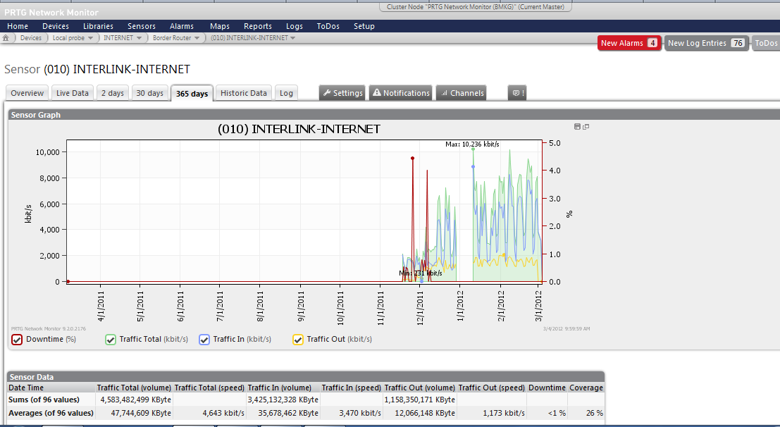
Results : Risk Analysis of Damage to the BMKG VSAT Network
The picture above explains that the graph in red is when the ISP Interlink link is down. While the blue graph is traffic in to the BMKG network which describes the graph of user access from outside (the public) to the BMKG system. And the yellow graph is traffic out related to data requests and data transmission from BMKG's sensor sites throughout Indonesia to be processed into useful information for the community. With the ISP link down, automatically for a while the communication system both internal and external to the BMKG will also be down. The expectation is that when viewed from the level of importance of BMKG information, the BMKG system should not go down, even if it's only for one second. Because information delivery must be carried out quickly and accurately in real time, not only to the public but also to related institutions, such as BNPB, LAPAN, BATAN etc. BMKG has very important data.
Please do not use this space, a QR code will be automatically overlayed
P4.3-734

Slide 8
Results : Need Analysis of BMKG Data Center Conditions
The following is a map of the conditional needs of the BMKG data center, described below:
Continuous Power Supply
Physical Security
Network Connectivity (internet)
Helpdesk and Disaster Management Procedures
Please do not use this space, a QR code will be automatically overlayed
P4.3-734

Slide 9
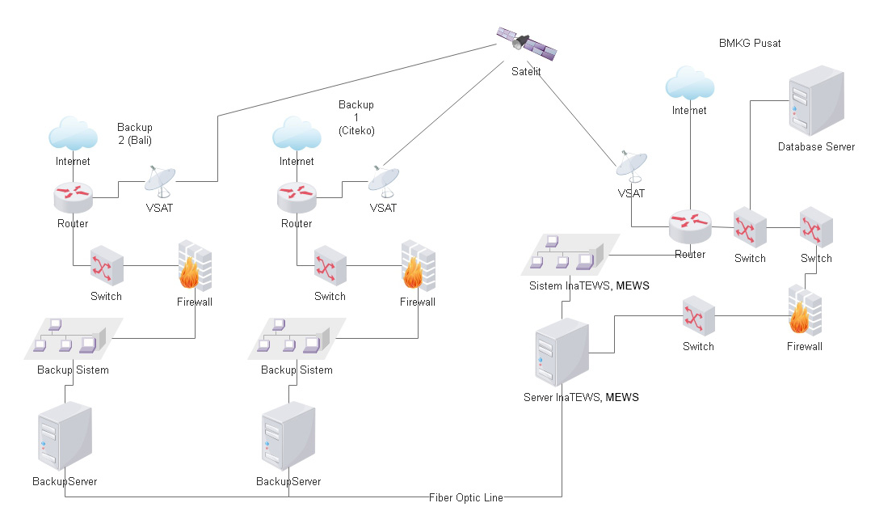
Results : Disaster Recovery Plan Concept
In Building disaster recovery requires a backup plan for the main data center at the Central BMKG and recovery if a disaster occurs on the BMKG VSAT network infrastructure that supports the data center. Data backup must be in a different location from the main data center to anticipate a major disasterwill be utilized for the operation of the BMKG VSAT network must be able to be maintained working 24 hours a day, which functions as a backup of all systems
The DRP system applied is the Fail Over System. The Fail Over system is one way to overcome pressing situations, if an event occurs that causes the main system to go down, the backup system will automatically replace the role of the main system.
Please do not use this space, a QR code will be automatically overlayed
P4.3-734

Slide 10
Results : Disaster Recovery Plan Concept
In Building disaster recovery requires a backup plan for the main data center at the Central BMKG and recovery if a disaster occurs on the BMKG VSAT network infrastructure that supports the data center. Data backup must be in a different location from the main data center to anticipate a major disasterwill be utilized for the operation of the BMKG VSAT network must be able to be maintained working 24 hours a day, which functions as a backup of all systems
The DRP system applied is the Fail Over System. The Fail Over system is one way to overcome pressing situations, if an event occurs that causes the main system to go down, the backup system will automatically replace the role of the main system.
Please do not use this space, a QR code will be automatically overlayed
P4.3-734

Slide 11
Results : Disaster Recovery Plan Location Design
The selection of locations that we chose in implementing the Disaster Recovery Plan (DRP) were Citeko and Bali. The selection of the selected location for the data center design will be based on:
Related to the redundancy aspect
The distance between the central BMKG server and the backup site is more than 100 km from the Central BMKG in Jakarta, Kemayoran. The placement of the location aims to mitigate the risk of natural disaster threats that are the same as those that threaten the Central BMKG, such as floods, earthquakes, tsunamis and so on.
Protection from harm
Protection from natural disasters such as floods and earthquakes, pollution, electromagnetic interference, vibrations and political atmospheres.
Ease of access
Close distance, easy access via the toll road, location close to the city center. The location is relatively close to police stations, fire stations, hospitals, military agencies and markets/malls.
Fulfilling all key design strategies
The availability of fiber optic cable lines. Reliable for connectivity, modular, flexible and standard. Use a complete network with sufficient bandwidth (<10 Gbps).
Associating with energy sources
Adequate power source to be able to reach the location, not far from the city center. Safe from power cut. There is an adequate generator and UPS.
Please do not use this space, a QR code will be automatically overlayed
P4.3-734

Slide 12
Results : Disaster Recovery Plan Testing
Testing of the disaster recovery plan is very important (a tape backup system cannot be declared working until restoration/repair tests have been carried out), so a disaster recovery plan has many elements that are only theoretical until these elements are tested and recognized in practice. Tests against the plan must be created and trials must be carried out sequentially, and in a standardized form. DRP testing uses the checklist test method.
No. | Control Objects | Procedure | Status
1 | Backup Procedure | By conducting an experiment, if at the central BMKG all servers, networks and electricity are turned off, the fiber optic line will immediately send data to the server before the server goes down to the backup server at the Backup Site. | OK
2 | Backup Settings | Backup Consists of the BMKG Mandiri VSAT and is connected to a backup server and backup data is processed on the backup system. Process on the backup site: o Automatically transfers data on the downed InaTEWS and MEWS servers to the backup server on the backup site. o System Backup processes the backup data for can be displayed.o Backup data can be published as processed data from earthquake and weather measurements.o Backup data on Backup Site 1 server can be sent to backup server on Backup Site 2 | OK
3 | Distance to Backup Site | Distance affects the data transfer process from the central BMKG to the Backup Site | OK
4 | Backup Site Data | Data from the central BMKG has been backed up on the Backup Site and stored on the backup server which is processed on the backup system and can be displayed as weather and earthquake information | OK
Please do not use this space, a QR code will be automatically overlayed
P4.3-734

Slide 13
Conclusion
BMKG has the task of providing services and providing information in the fields of Meteorology, Climatology, Air Quality, and Geophysics (MKKuG) in Indonesia requiring a Disaster Recovery Plan (DRP) as a place/area for storing and processing data and information in the event of a disaster resulting in a VSAT network. BMKG experiences temporary disruption or even total damage. The DRP locations we designed are in Citeko, Bogor and Denpasar, Bali.
The design of the Disaster Recovery Plan (DRP) uses as much as possible what the BMKG already has (for space, technology, human resources, and other assets that may be needed) including the design of locations and infrastructure for the establishment of a BMKG data center.
Please do not use this space, a QR code will be automatically overlayed
P4.3-734

Slide 14
References
Afif, Mohammad Faruq & Suryono, Tito. 2013. Implementasi Disaster Recovery Plan Dengan Sistem Fail Over Menggunakan DBRD dan Heartbet pada Data Center FKIP UNS. Surakarta
INDOSAT. 2008. Disaster Recovery Center. Jakarta
Manurung, Yunita Caroline & Surendro, Kridanto. Pengembangan Rencana Penanggulangan Bencana (Disaster Recovery Planning) untuk Data Center ITB. Bandung
Maral, Gerald. 2003. VSAT NETWORK (Second Edition). England
Saputro, Udi Mulyanto. 2016. Implementasi Disaster Recovery Plan Server System dengan Metode Failover dan Mirroring Co-location Server Berbasis Linux di Fakultas Kedokteran Unissula. Semarang.
Setiyaji, Andri. 2012. Disaster Recovery Center (Pusat Pemulihan Bencana) Sistem Informasi/Teknologi Informasi (SI/TI). BMKG:Jakarta
Suherman, Yusuf Hamdani. 2015. Perancangan Disaster Recovery Center (DRC) Berdasarkan ISO 24762. Bandung.
Yulianti, Eka Diah & Nanda, Hafida Bayu. 2008. Best Practice Perancangan Fasilitas Data Center. Jakarta
Please do not use this space, a QR code will be automatically overlayed
P4.3-734

