Slide 1
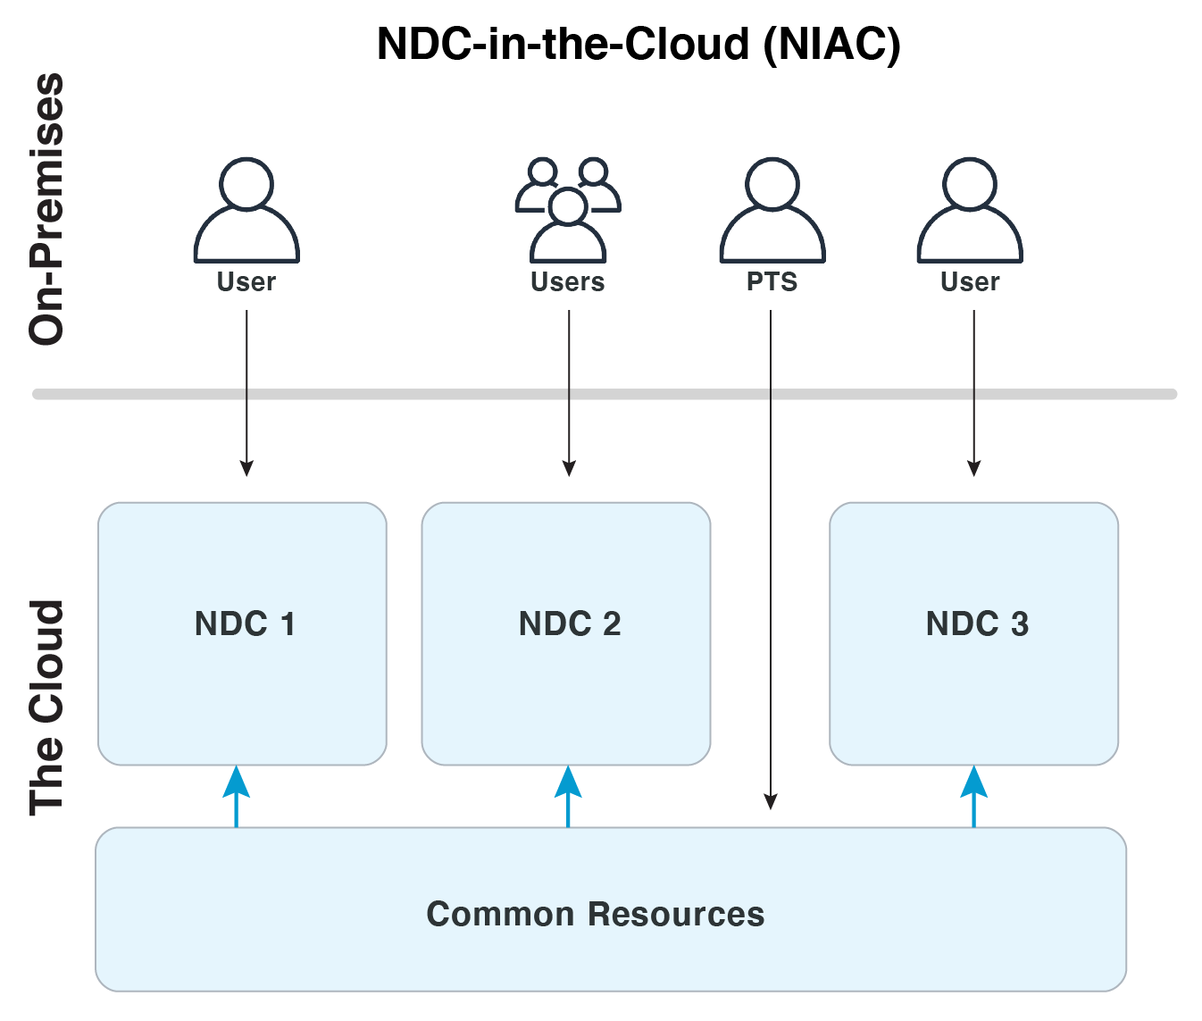
NDC-in-the-Cloud: Flexible and Reliable Cloud Resources for NDCs
Jonathan MacCarthy¹,Gordon MacLeod (PI)¹, Omar Marcillo²
¹Los Alamos National Laboratory, ²Oak Ridge National Laboratory
P4.3-894
NDC-in-the-Cloud
Potential NDC Benefits
Reduced data transfer
Increased data utilization
Increased NDC (and PTS) flexibility, scalability
Reduced risk due of local infrastructure outages
LA-UR-22-26024

