Slide 1
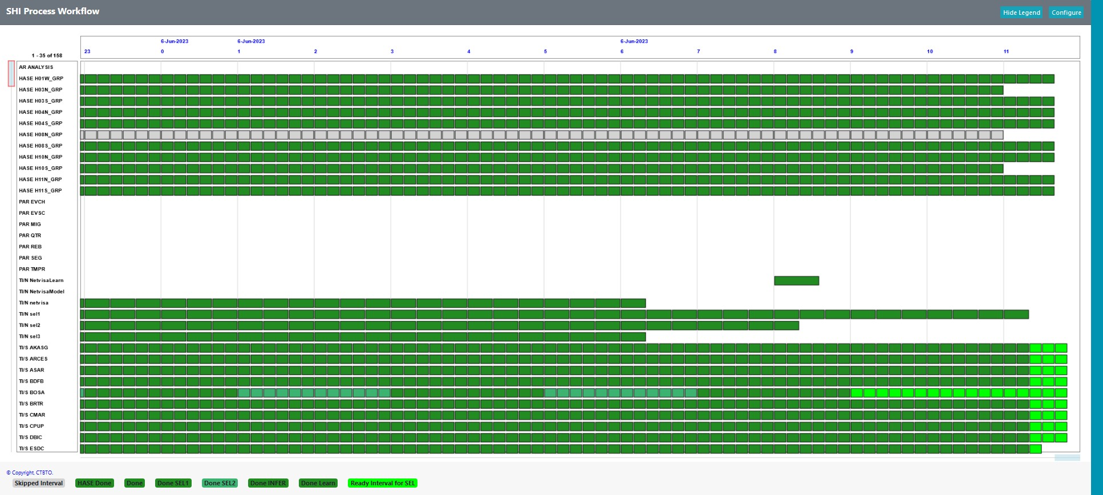
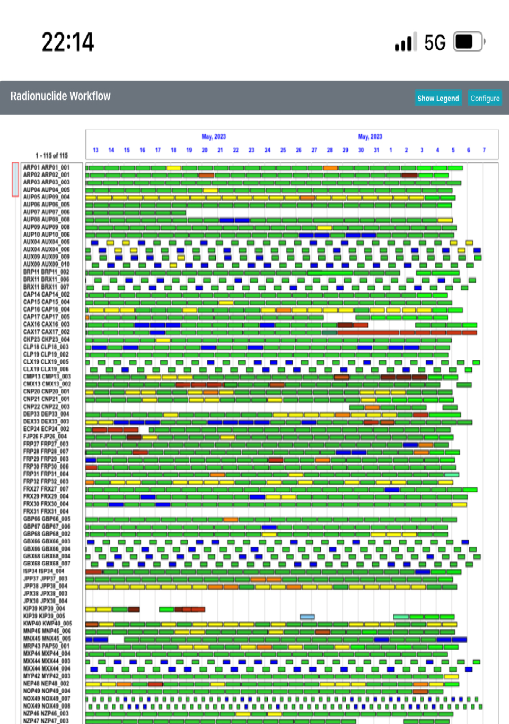
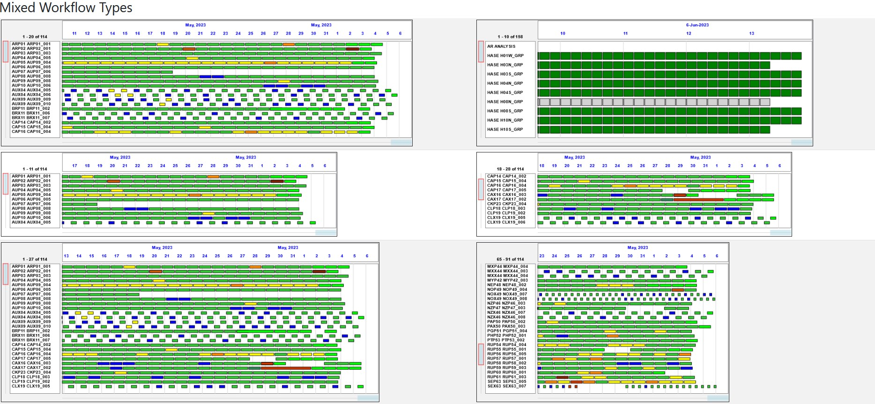
WFaaS: A New Modern, Embedded, Web Based, Configurable and Portable Monitoring Service for Monitoring International Data Centre Different Processes
Shaban Laban, Alexander Sudakov, Dongmei Han, Thomas Ludwig Hoffmann and Leonid Kolesnykov
CTBTO Preparatory Commission.
P4.3-674
Legacy workflow monitoring tools (Linux-based or Java dependency)
Hard to configure/use with different operating systems
Prototype a new modern web-based workflow monitoring service
User friendly and no dependencies
Configurable
Embedded widget that can be externally used with any HTML5 page or web-server
Different HTML5 templates
Different object models for different technologies (SHI, RN or other processes)
Ability to upload monitored information and use it offline
More mobile capabilities

