Slide 1
WFaaS: A New Modern, Embedded, Web Based, Configurable and Portable Monitoring Service for Monitoring International Data Centre Different Processes
Shaban Laban, Alexander Sudakov, Dongmei Han, Thomas Ludwig Hoffmann and Leonid Kolesnykov
CTBTO Preparatory Commission.
Legacy workflow monitoring tools (Linux-based or Java dependency)
The front end is based on latest Hypertext Markup Language (HTML5) specifications and JavaScript.
The back end is implemented in Python and uses Tornado web framework
A prototype version to proof the concept has been implemented that overcomes the limitations of the current legacy tools
Simple, configurable, portable, embedded and user-friendly tool
More mobile capabilities
Will be ready soon for beta testing
Please do not use this space, a QR code will be automatically overlayed
P4.3-674

Slide 2
Introduction
Legacy workflow monitoring tools (Linux-based or Java dependency)
Hard to maintain/use with different OS systems (e.g. Windows, etc.)
Limited capabilities
Intensive resources utilization
Fixed configuration
Not suitable for mobile usage
Not modular
P4.3-674
Please do not use this space, a QR code will be automatically overlayed

Slide 3
Objectives
Build a new modern workflow monitoring service:
Web-based monitoring interface
User friendly and no dependencies
Configurable
Embedded widget that can be externally used with any HTML5 page or web-server
Different HTML5 templates
Different object models for different technologies (SHI, RN or other processes)
Ability to upload monitored information and use it offline
Uses the mobile capabilities
P4.3-674
Please do not use this space, a QR code will be automatically overlayed

Slide 4
Proposed Implementation
The front end is based on latest Hypertext Markup Language (HTML5) specifications and JavaScript.
The back end is implemented in Python and uses Tornado web framework.
Different HTML5 templates
Different object models for different technologies (SHI, RN or other processes)
Scheduled monitoring programs to periodically fetch changed information from IDC data sources
Cache the monitored information in local small databases
Provide and share the monitored information for web connections
P4.3-674
Please do not use this space, a QR code will be automatically overlayed

Slide 5
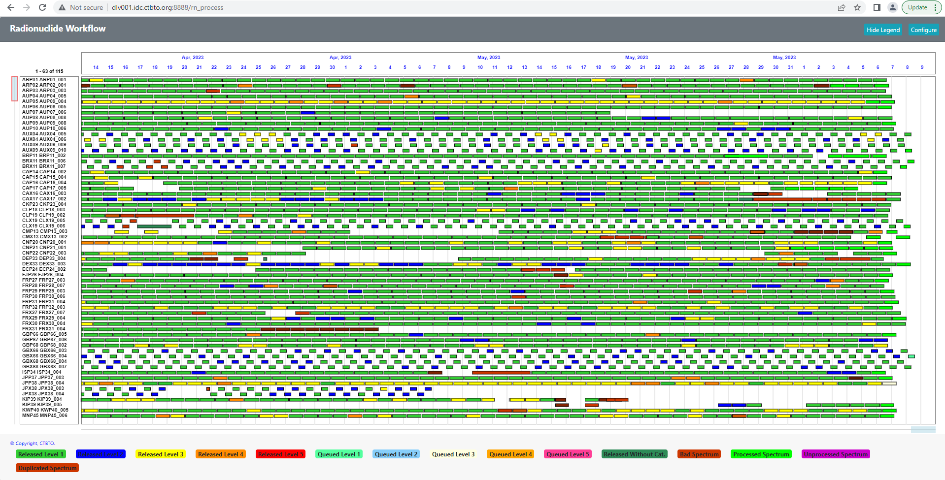
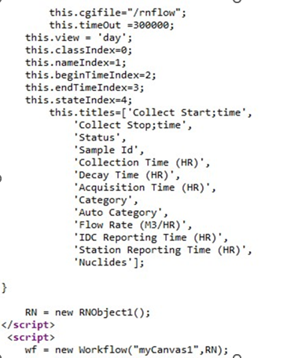
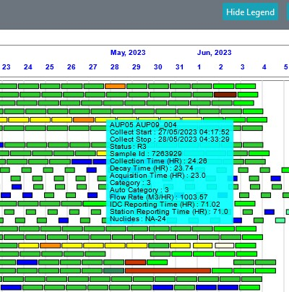
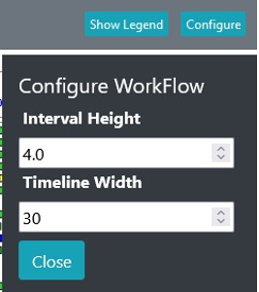
Results
Example of RN Workflow template
Example of RN monitoring object
Example of configuring graph objects
Excerpt of RN monitoring data used (concise and complete)
P4.3-674
Please do not use this space, a QR code will be automatically overlayed

