Slide 1


Feedback on SPALAX NG operation
Axelle Gourgues, Sylvain Topin, Thomas Philippe, Gabriel Couchaux, Florian Philippe, Frédéric Tribet, Henri Chevreul
CEGELEC Défense & CEA
CTBTO Acceptance
Prerequisite for installation (site requirements, environment, utilities)
Operation and Maintenance Training
Performance of the system
Please do not use this space, a QR code will be automatically overlayed
P4.4-736

Slide 2
SPALAX NG Acceptance
The new generation of the system has been successfully developed by the CEA and CEGELEC Défense. CEGELEC commissioned several Spalax NG at CEA premises. These have been evaluated in France for several months before moving to operations. It is reliable and good results have been observed. New people have been trained on the system and can now operate it. CEGELEC will describe latest evolutions to the system following users lessons learned and provide feedback on the system operation.
The system has been fully tested and the acceptance by the CTBTO has been completed on July 14th 2021.
CTBTO Acceptance process
Phase 1
From Oct. 1st, 2018 → March 31st, 2019
DA = 99.3 %
Good consistency with certified laboratory reanalysis (GBL15 & ATL03)
Phase 2
Dec. 20th, 2019 → June 19th, 2020
DA = 98.2 %
Good consistency with certified laboratory reanalysis (GBL15 & ATL03)
Phase 1&2
Valid spectra = 1081 delivered (1095 expected)
Overall Data Availability = 98.7 %
Valid operation time = 8648 h (8760 h expected)
Good agreement between station and IDC data analysis (see Calibration Validation Report established by IDC, Nov. 2020)
Please do not use this space, a QR code will be automatically overlayed
For more information Meet us on our booth #26 and read posters P2.4-459 and P3.2-233
P4.4-736

Slide 3
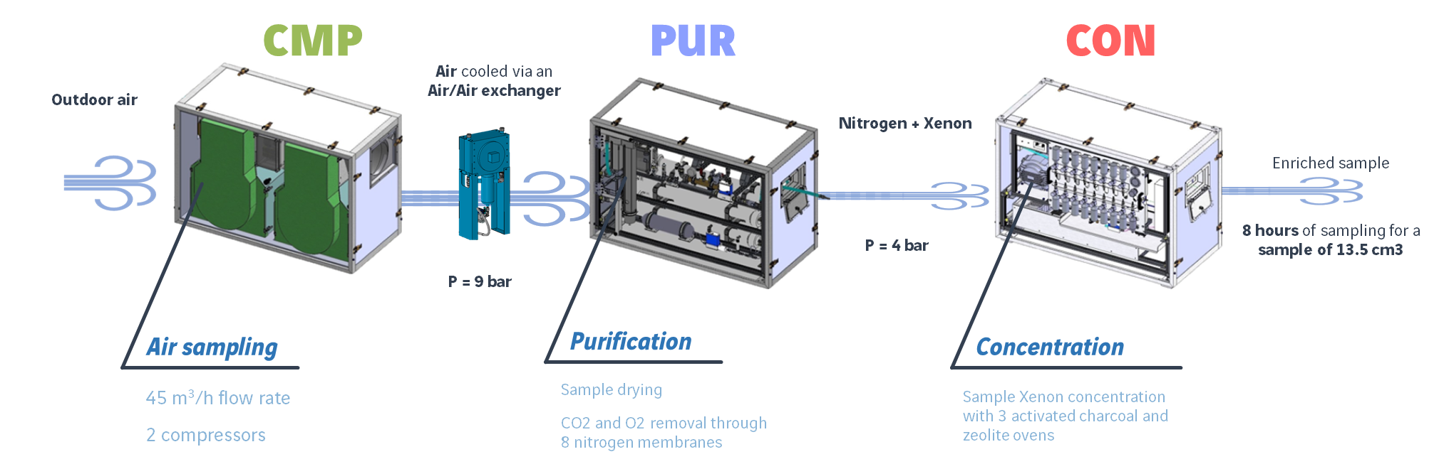
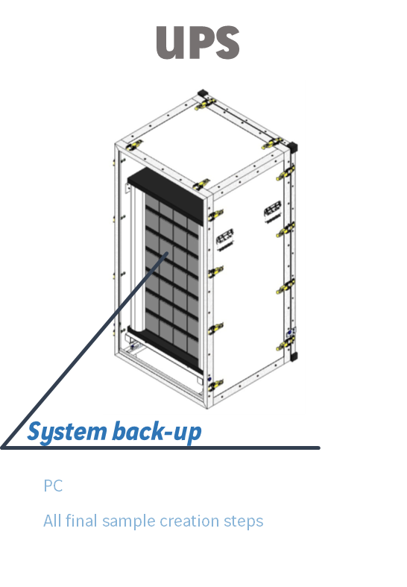
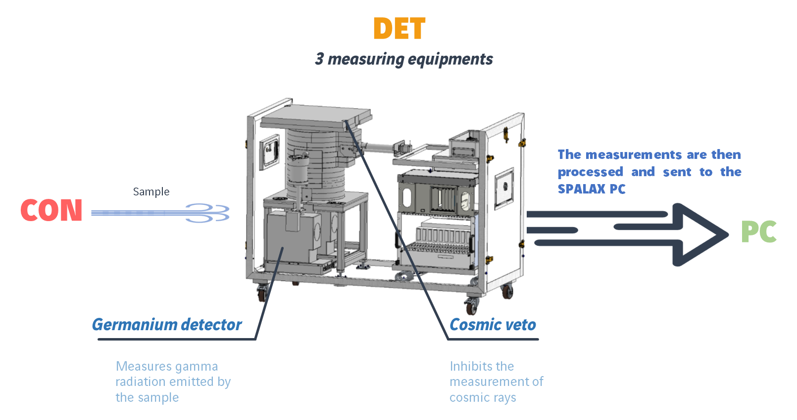
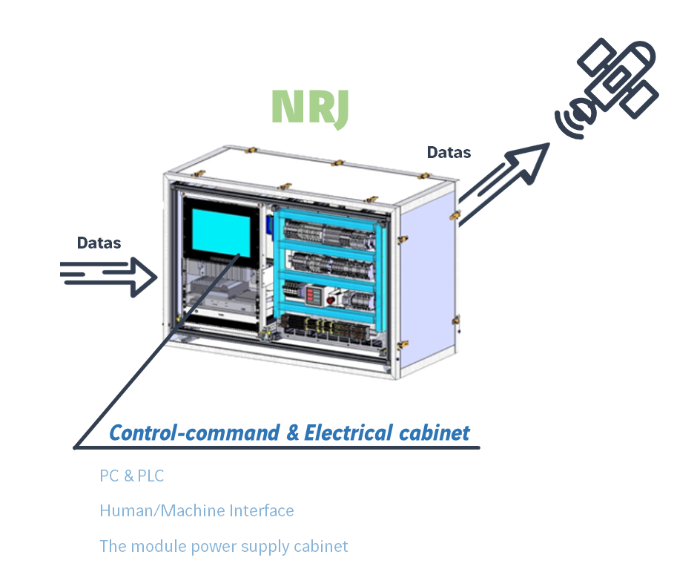
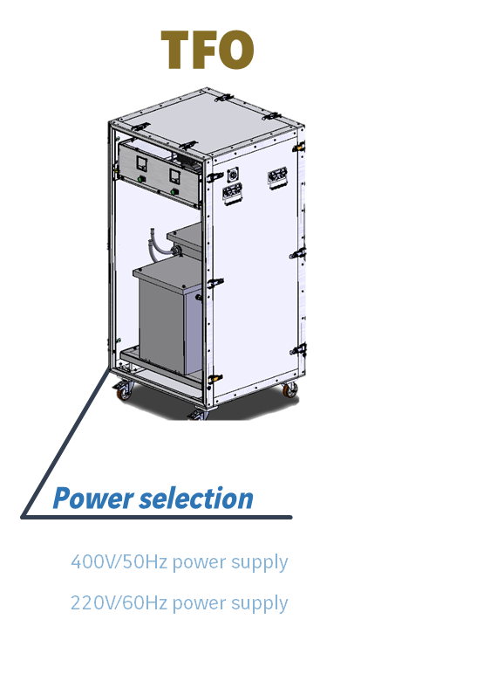
SPALAX NG PRESENTATION
Please do not use this space, a QR code will be automatically overlayed
For more information Meet us on our booth #26 and read posters P2.4-459 and P3.2-233
P4.4-736

Slide 4
SPALAX NG TRANSPORTATION AND DEPLOYEMENT
The system is conditionned in 6 or 7 units (transformers unit is optionnal depending on power onsite).
Full air transportability compliance
Please do not use this space, a QR code will be automatically overlayed
For more information Meet us on our booth #26 and read posters P2.4-459 and P3.2-233
P4.4-736

Slide 5
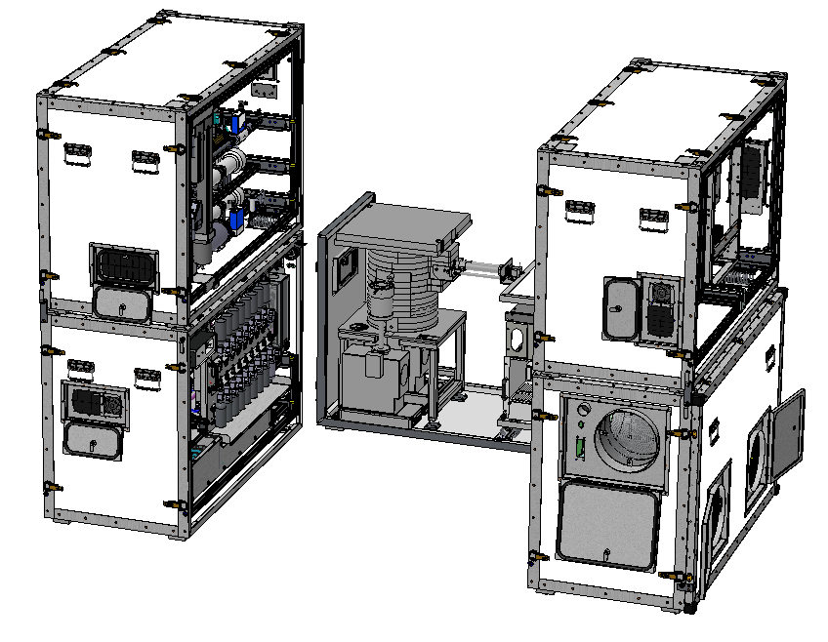
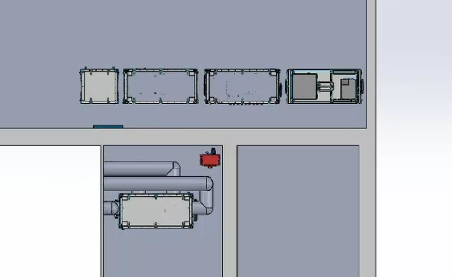
SPALAX NG TRANSPORTATION AND DEPLOYEMENT
Prerequisite for installation
Temperature range: 22-24°C
Air flow output: 45 m³/h without compressors
Power requirement depending on site and configuration (For 400V -> 40A three-phase, with ground no neutral)
Configuration can be adapted according to site requirements
With compressors inside the room
With compressors outside the room
Please do not use this space, a QR code will be automatically overlayed
COMPRESSORS
COMPRESSORS
For more information Meet us on our booth #26 and read posters P2.4-459 and P3.2-233
P4.4-736

Slide 6
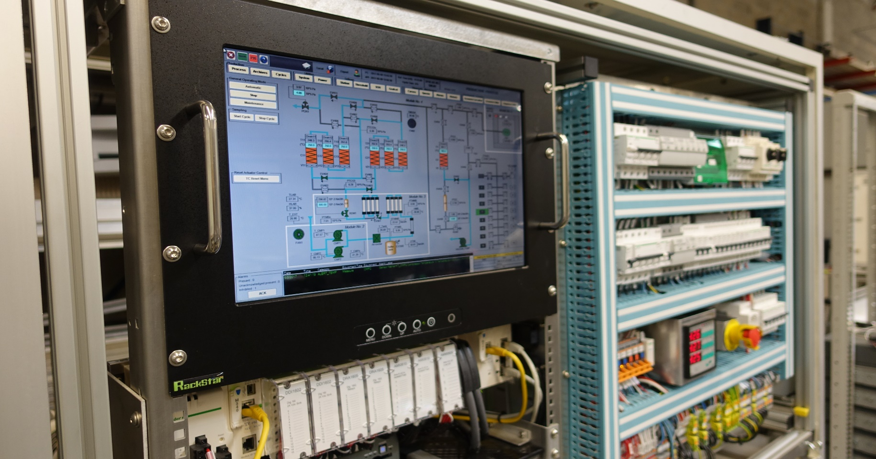
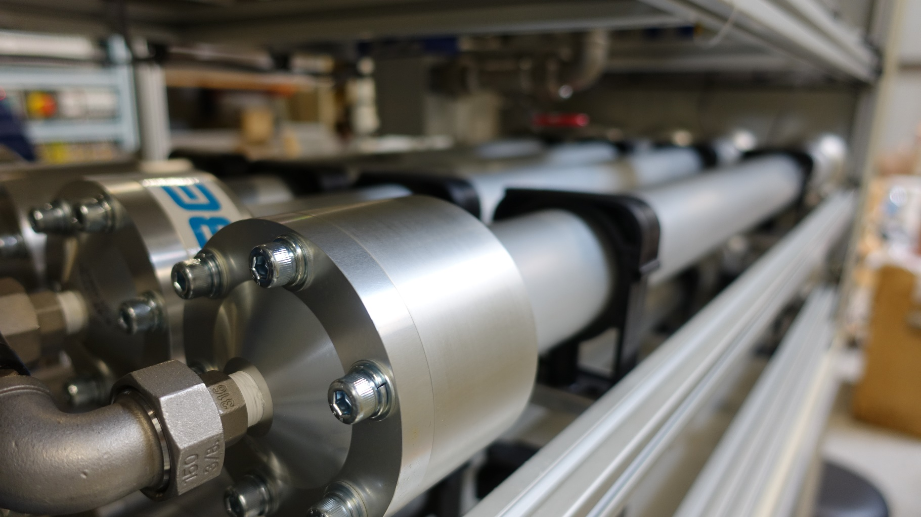
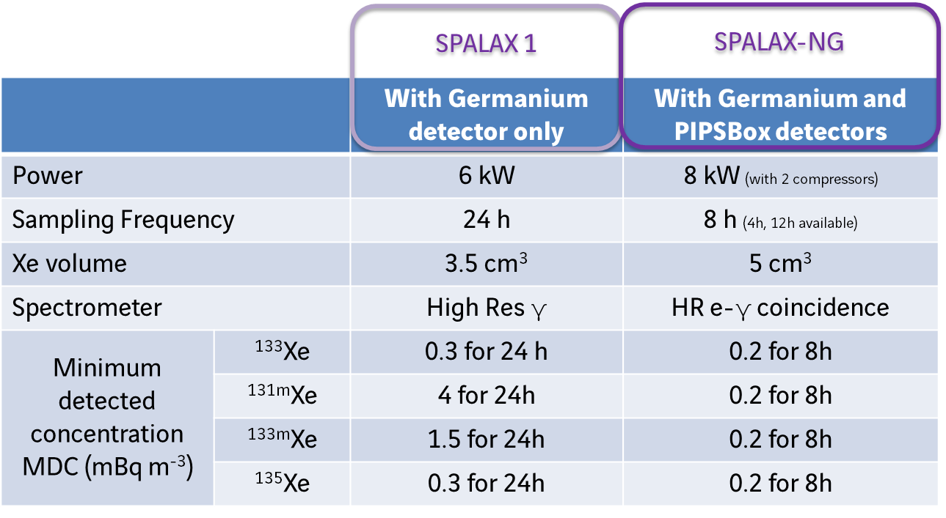
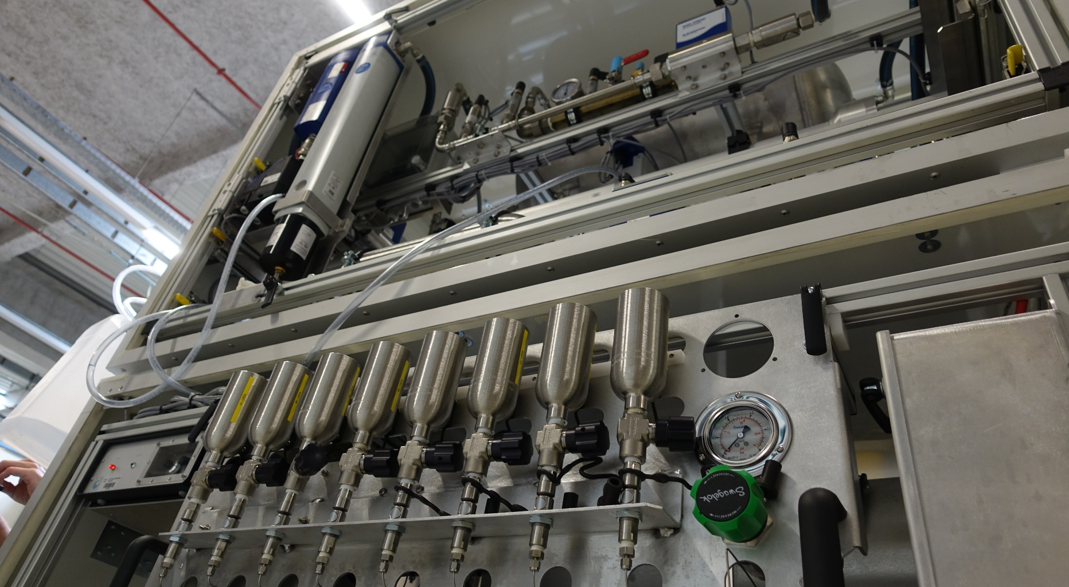
PERFORMANCE OF SPALAX NG
High sensitivity for the ^{133m}Xe and ^{131m}Xe detection: play a key role in an event discrimination
High spectral data quality / High resolution: simple analysis, low interference, reduced correction
High accuracy of source localisation: high sampling frequency
High reliability / Easy Operation & Maintenance: hard environmental condition taken into account
Please do not use this space, a QR code will be automatically overlayed
For more information Meet us on our booth #26 and read posters P2.4-459 and P3.2-233
P4.4-736

