Slide 1
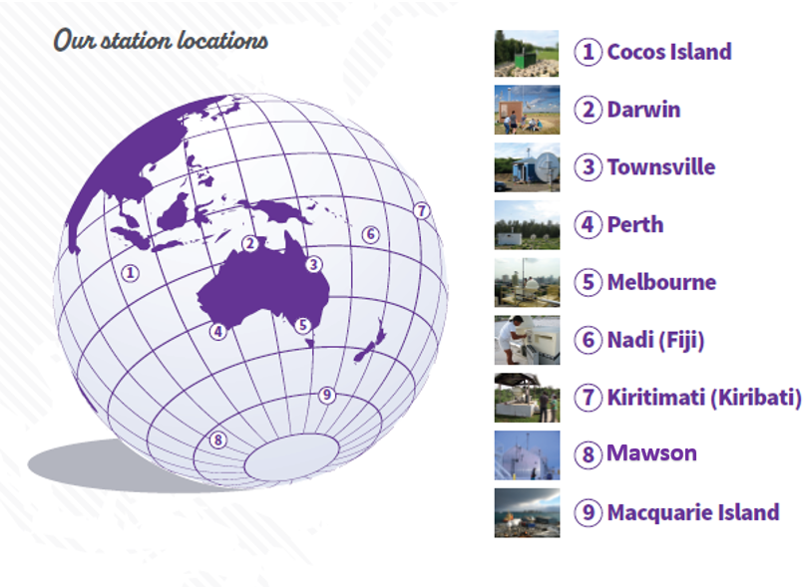
Australian Performance in IMS Radionuclide Stations – How can remote stations perform as well as those on the mainland?
Hardman, Hofman, McLeish, McWilliams, Gouin, Grzechnik*
Australian Radiation Protection and Nuclear Safety Agency (ARPANSA)
Px.x-xxx
Management of 9 particulate and 2 noble gas stations
COVID-19 travel restrictions & quarantine (nationally & internationally)
Innovative travel solutions
Enhanced relationships for remote management
Maintained over 95% data availability
Fully open May 2023!
Notes:
5 (Melb) to 1 (Cocos) (return) = 10,000km round trip (via 4; Perth)

