Slide 1
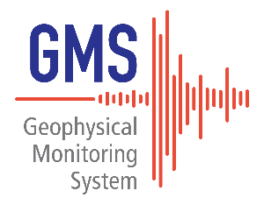
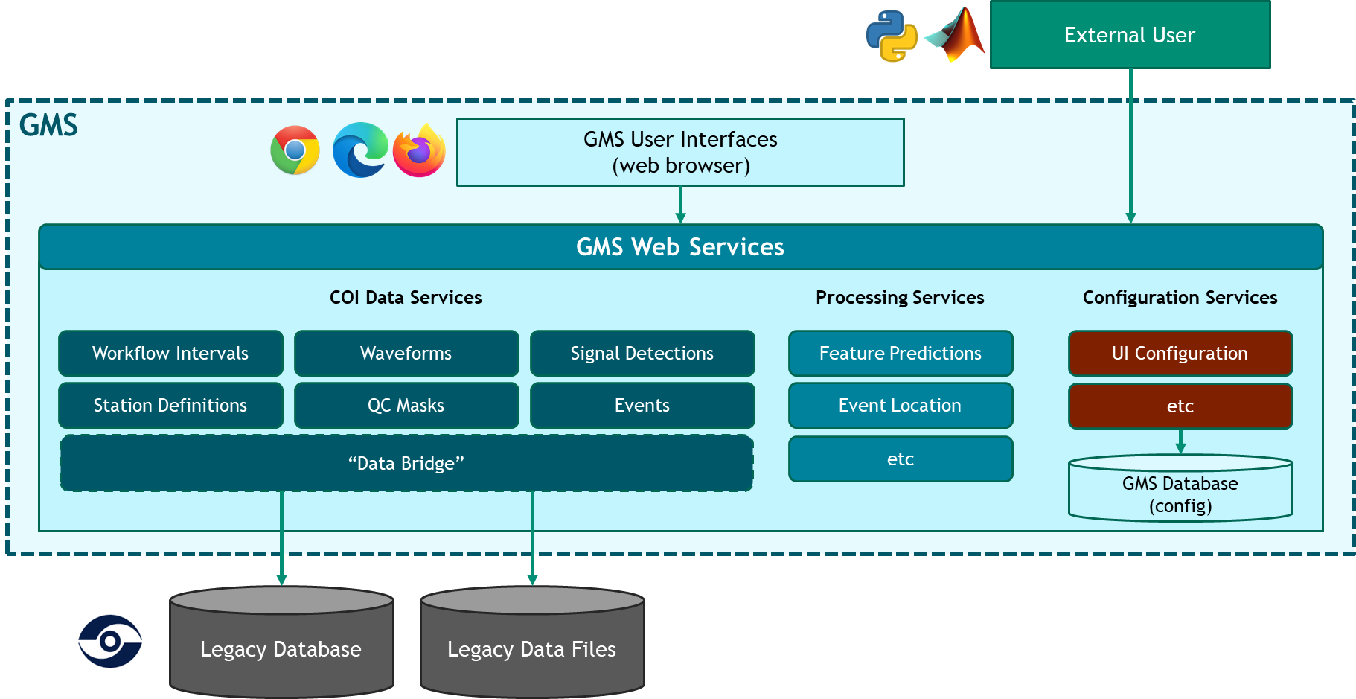
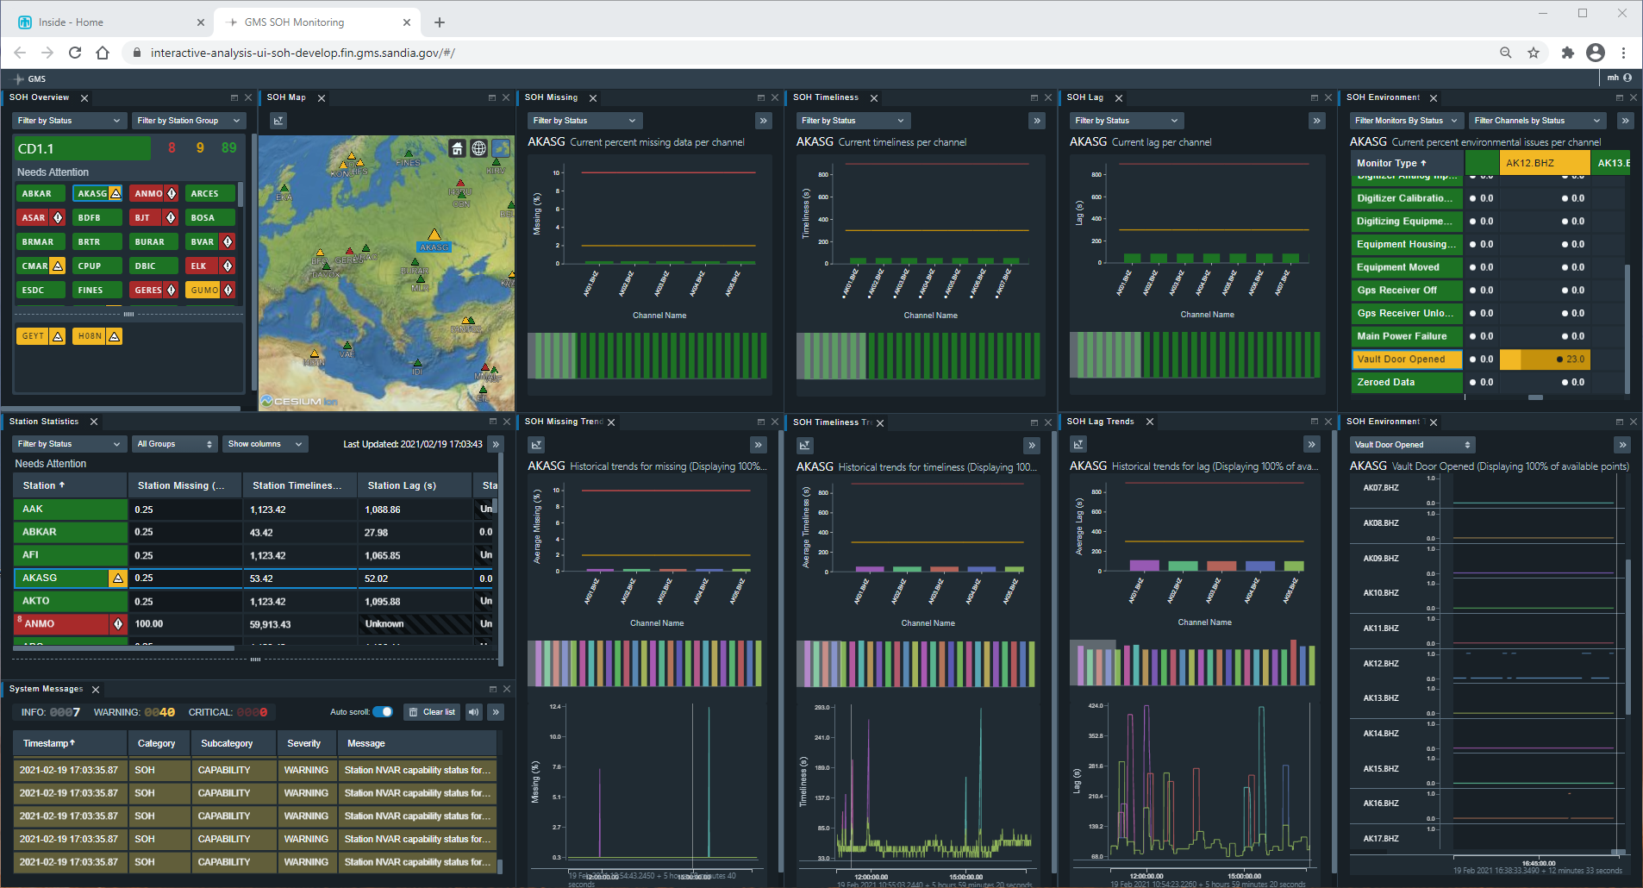
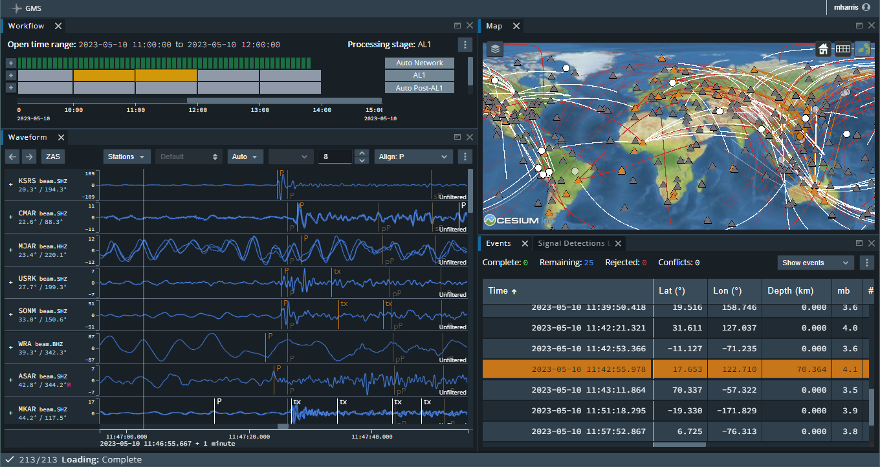
Geophysical Monitoring System (GMS) Interactive Analysis Capabilities
Mark Harris, Katherine Aur, Nicole McMahon, KJ Lechtenberg, Paul Wright
Sandia National Laboratories
P4.4-325
Sandia is developing the Geophysical Monitoring System (GMS) for modernization of the US NDC waveform processing system and releasing GMS on GitHub as open source to assist with IDC Re-engineering.
GMS is a service-oriented, distributed web application, using modern web technology accessed with a common web browser. GMS is cloud-ready, operational quality, and secure.
GMS includes data services that “bridge” the data from the legacy system to the GMS Common Object Interface (COI) format and makes this data available through web services.
Past development includes a mature Station State-of-Health (SOH) Monitoring capability to help system operators to recognize and address station availability and quality issues.
Development is now focused on Interactive Analysis tools (IAN) used by SHI analysts, with the goal to replace the Analyst Review Station (ARS) software with a modern, efficient, and extensible system.
SOH
IAN
Sandia National Laboratories is a multimission laboratory managed and operated by National Technology & Engineering Solutions of Sandia, LLC, a wholly owned subsidiary of Honeywell International Inc., for the U.S. Department of Energy’s National Nuclear Security Administration under contract DE-NA0003525.

