Slide 1

Geophysical Monitoring System (GMS)
Interactive Analysis Capabilities
Mark Harris, Katherine Aur, Nicole McMahon,
KJ Lechtenberg, Paul Wright
Sandia National Laboratories
Sandia National Laboratories is developing the Geophysical Monitoring System (GMS) for the US NDC, focused on Interactive Analysis tools, and releasing GMS as open source to assist IDC Re-engineering.
GMS is a large, agile software development project, using GitLab CI/CD development pipelines, deployed in a cloud-ready Kubernetes containerized platform.
GMS is a service-oriented, distributed web application. Interactive Analysis (IAN) includes displays for the base data types needed for SHI analysis. IAN uses modern web technology, accessed with a common web browser, with consistent, flexible, fully synchronized displays
SNL is developing GMS data access services and an Interactive Analysis application, planned to complete in 2026. GMS is cloud-ready, operational quality, and secure. We are releasing two GMS Open Source versions per year.
Please do not use this space, a QR code will be automatically overlayed
P4.4-325
Sandia National Laboratories is a multimission laboratory managed and operated by National Technology & Engineering Solutions of Sandia, LLC, a wholly owned subsidiary of Honeywell International Inc., for the U.S. Department of Energy’s National Nuclear Security Administration under contract DE-NA0003525.

Slide 2
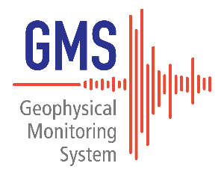
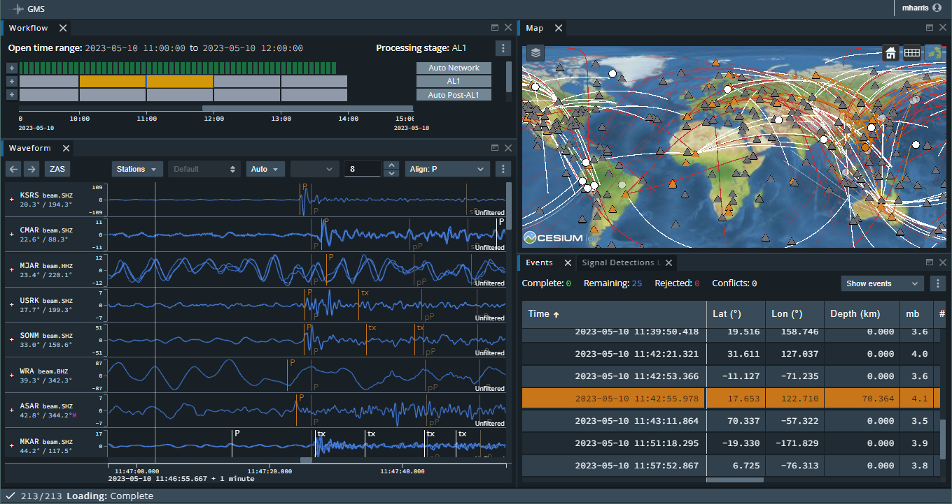
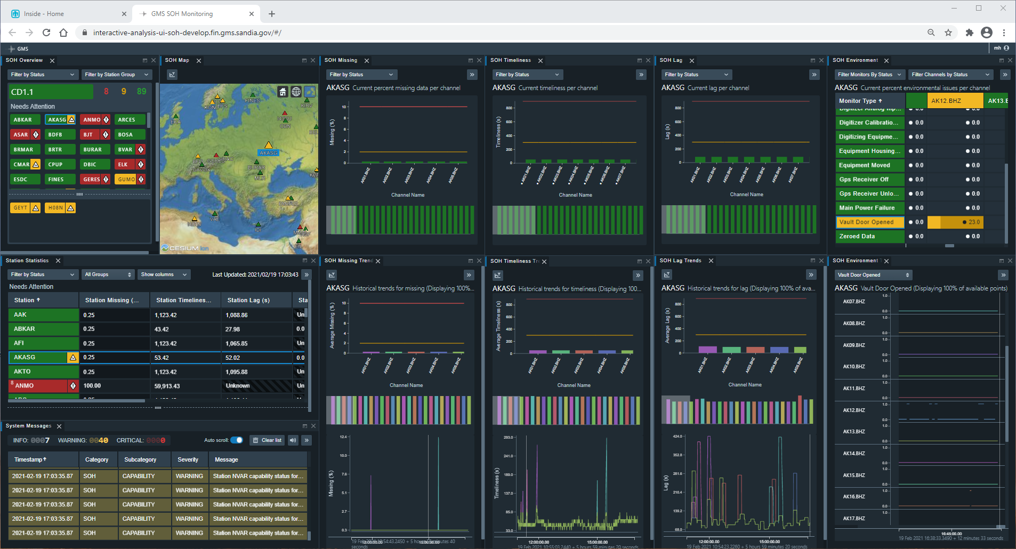
Introduction
Sandia National Laboratories (SNL) is developing the Geophysical Monitoring System (GMS) for modernization of the United States National Data Center (US NDC) waveform processing system.
The United States is providing the common architecture and processing components of GMS as a contribution-in-kind to accelerate progress on International Data Centre (IDC) Re-engineering.
Open source releases of GMS, available on GitHub, have been made annually since 2018.
Recently the GMS development effort is focused on interactive analysis capabilities, referred to as IAN. The 2022 GMS open source release includes capabilities to access and display station metadata, waveforms, QC masks, signal detections, and events. IAN uses modern web technology, accessed with a common web browser. All displays are fully synchronized with a consistent user experience.
The latest release also includes a mature, operational-quality Station State-of-Health (SOH) Monitoring capability for CD-1.1 protocol stations, to enhance the ability of system operators to quickly recognize and address station availability and quality issues.
GMS is deployed using a cloud-ready Kubernetes containerized platform, hardened for cyber security accreditation.
Please do not use this space, a QR code will be automatically overlayed
P4.4-325

Slide 3
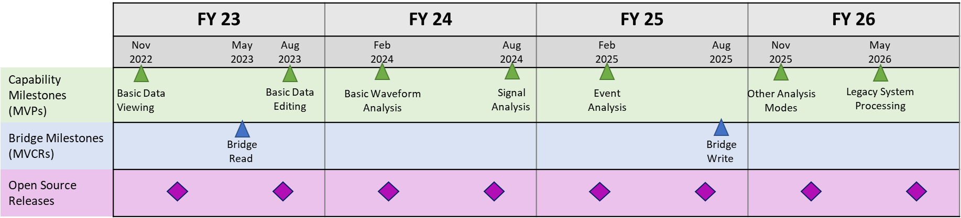
Objectives
The US NDC and IDC systems originated from 1990’s technology and over time have become difficult to maintain and enhance. Both systems are in need of modernization.
SNL has been working with the US NDC and IDC to establish requirements, design new software architectures, and develop modern processing and analysis software. A primary objective is to improve system qualities such as extensibility, maintainability, configurability, usability, and security.
GMS development is now focused on developing interactive analysis tools used by seismic, hydroacoustic, and infrasound analysts, with the goal to replace the Analyst Review Station (ARS) software with a modern, efficient, and extensible system.
This effort includes development of data services that “bridge” the data from the legacy system to the GMS Common Object Interface format and make this data available through web services to GMS applications and external users.
SNL is developing GMS for the US NDC modernization effort, and providing two open source software releases per year for use in IDC Re-engineering.
Interactive Analysis Development Milestones
Please do not use this space, a QR code will be automatically overlayed
P4.4-325

Slide 4
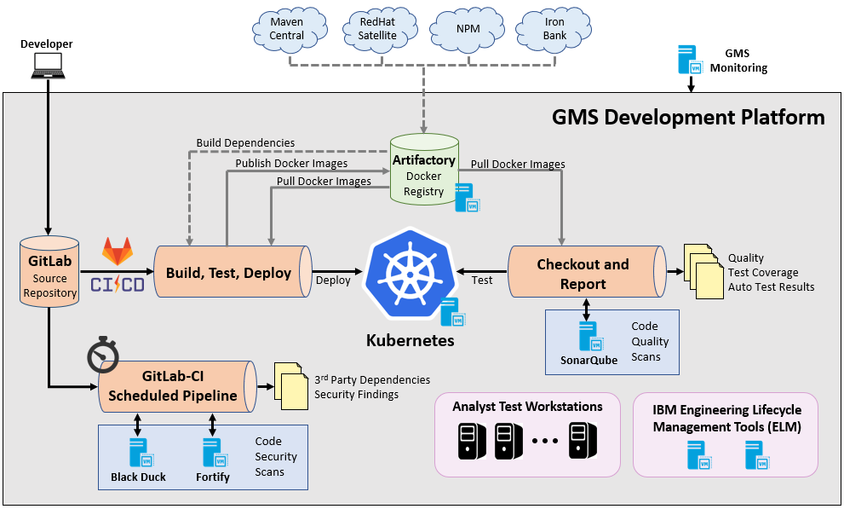
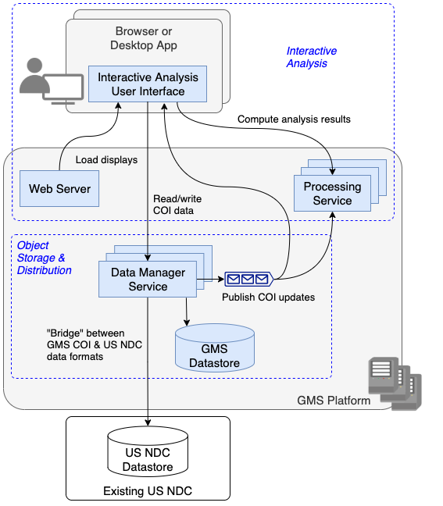
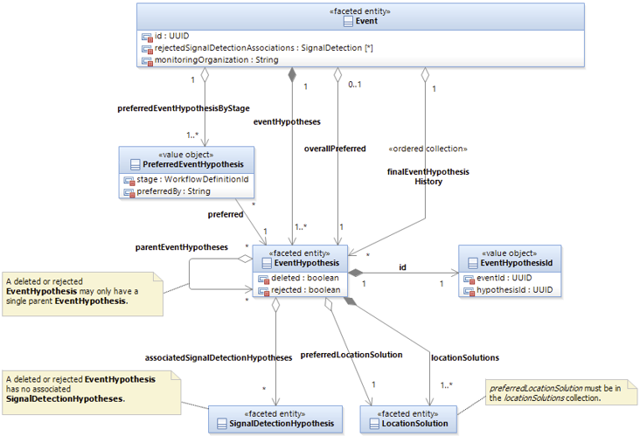
Methods
Product Design and Architecture
Development and Deployment
GMS is a large software development project with several development teams, plus architecture, geoscience, platform, and test teams.
Product Management defines and prioritizes a capability roadmap, and along with user experience and architecture develops product guidance for developers in the form of descriptions, storyboards, and architecture designs.
GMS uses agile development practices, working in two week iterations. GMS developers manage code and workflow in GitLab.
We use GitLab Continuous Integration / Continuous Deployment (CI/CD) to automate software build, test, and deployment pipelines.
GME is deployed using a cloud-ready Kubernetes containerized platform, hardened for cyber security accreditation.
Please do not use this space, a QR code will be automatically overlayed
P4.4-325

Slide 5
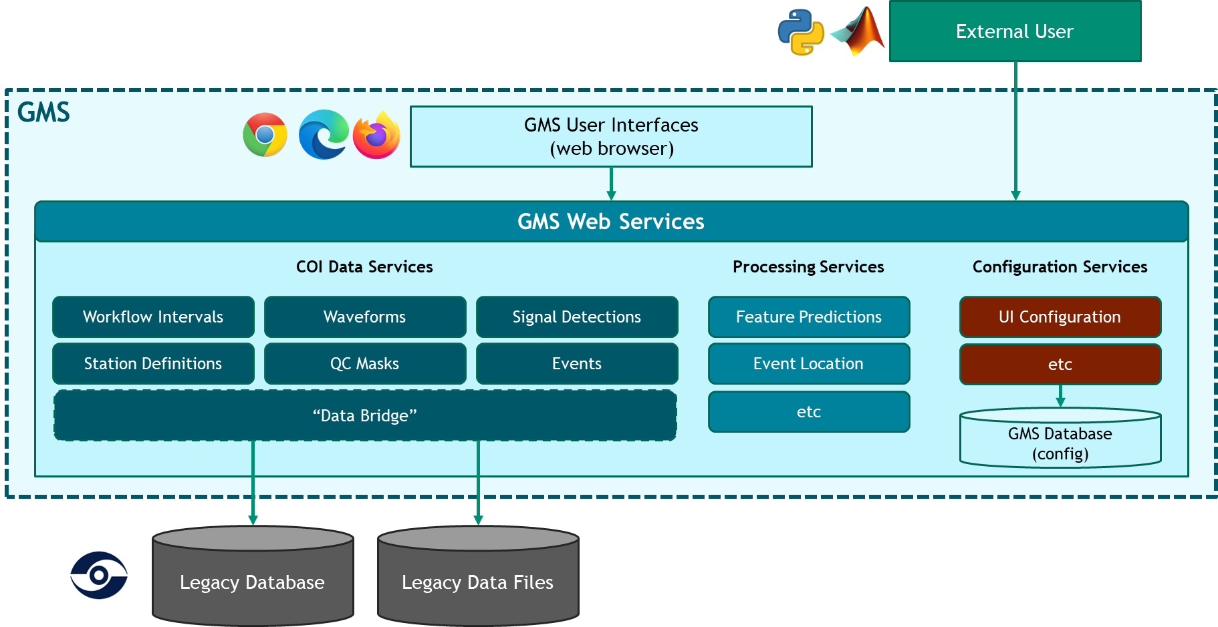
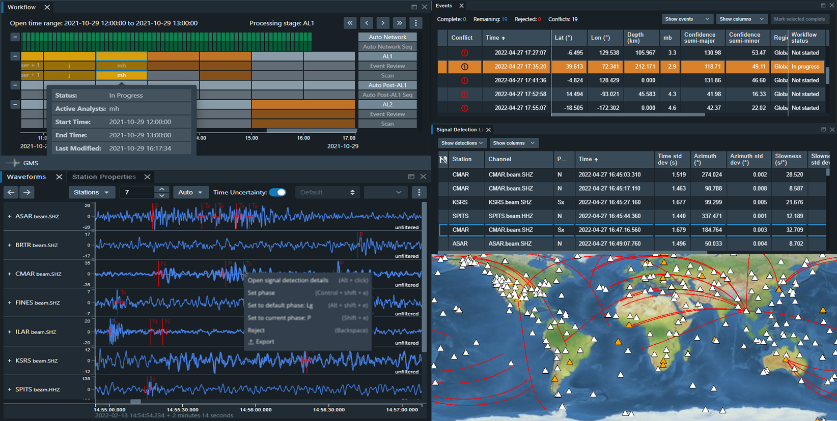
Results
Interactive Analysis (IAN)
GMS is a service-oriented, distributed web application. Data services provide access to stored data (in this case from the legacy database) to GMS applications like IAN. Processing and configuration services also support analysis operations. External users can also access these services.
IAN can currently display the base data types needed for SHI analysis. Displays include Workflow, Station Properties, Waveforms, Filters, Signal Detection List, Event List, Map, Undo/Redo. Capabilities to edit data and perform signal processing operations are underway.
IAN uses modern web technology, accessed with a common web browser. Display are flexible and customizable. Data and user operations are fully synchronized across all displays, with consistent user experience design.
Please do not use this space, a QR code will be automatically overlayed
P4.4-325

Slide 6
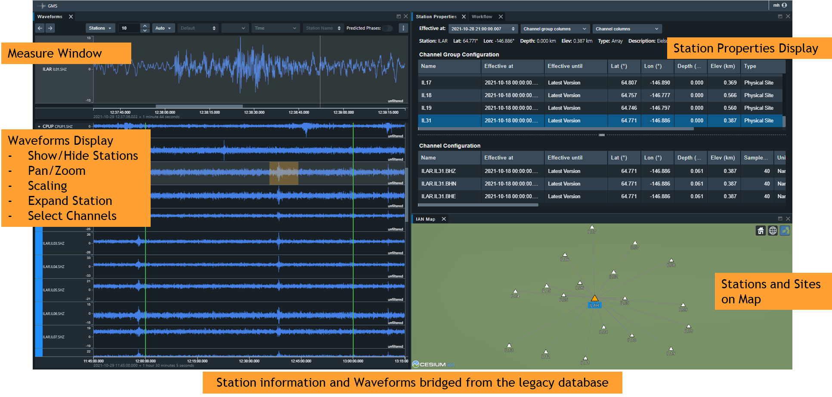
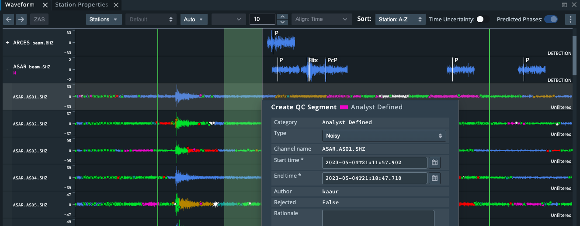
Results
Station and Waveform Analysis Features
Station Viewing
Map – station and site icons
Station Properties – text attributes for stations, site, channels
Waveform Display – show and hide stations
Waveform Viewing
Beams and Raw Waveforms
Zoom and pan
Amplitude scaling
Interactive QC masks
Measure Window (zoomed waveform segment)
Waveform Analysis (next release)
Edit QC masks
Waveform Filtering
Please do not use this space, a QR code will be automatically overlayed
QC Masks are color-coded on waveform segments
P4.4-325

Slide 7
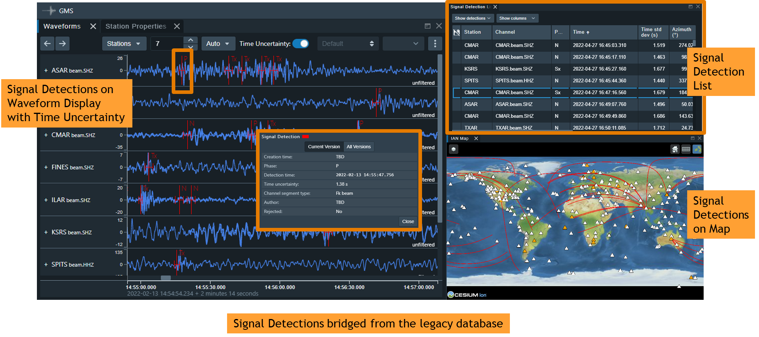
Results
Signal Detection Analysis Features
Signal Detection Viewing
Color-coded based on association status
Signal Detection List – text attributes
Waveform Display – phase marker, arrival time, uncertainty
Map – great circle path
Signal Detection Editing (next release)
Create and reject
Change arrival time (drag & drop)
Change time uncertainty
Change phase label
View signal detection association conflicts
Please do not use this space, a QR code will be automatically overlayed
P4.4-325

Slide 8
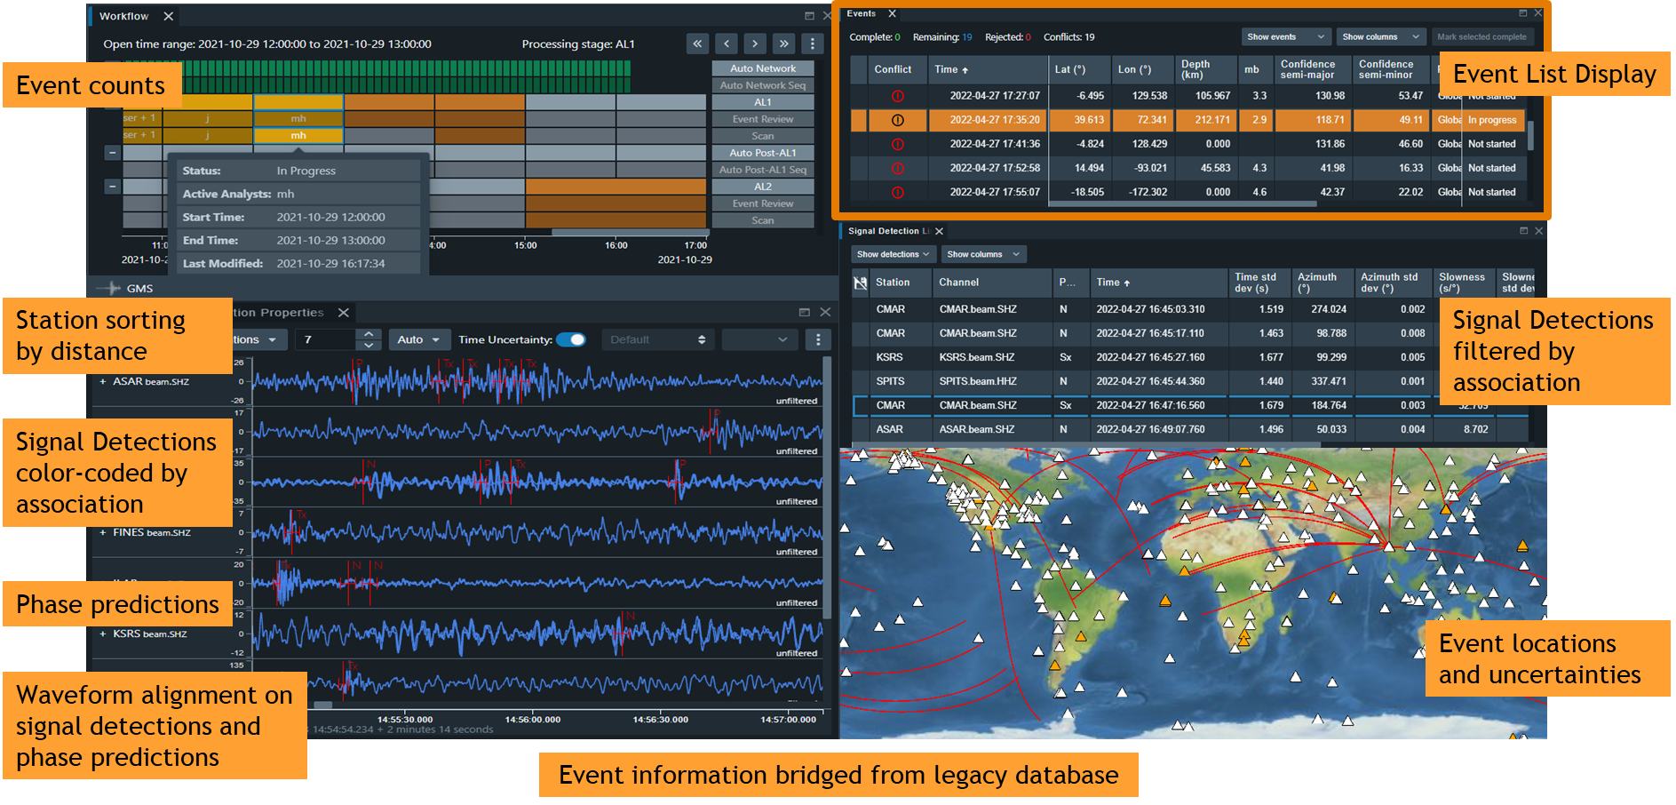
Results
Event Analysis Features
Event Viewing
Color-coded based on review status
Event List – text attributes, workflow progress
Map – location and uncertainty ellipse
Waveform Display – zoom/align/sort for open event
Waveform Display – travel time predictions
Event Editing (next release)
Create, duplicate, reject
Associate or disassociate Signal Detections
View event association conflicts
Please do not use this space, a QR code will be automatically overlayed
P4.4-325

Slide 9
Results
Station State-of-Health Monitoring
The latest GMS release also includes a mature, operational-quality Station State-of-Health (SOH) Monitoring capability for CD-1.1 protocol stations, to enhance the ability of system operators to quickly recognize and address station availability and quality issues.
The US NDC is now deploying this application operationally and the IDC is assessing its capabilities for their operations.
Please do not use this space, a QR code will be automatically overlayed
P4.4-325

Slide 10
Conclusion
SNL is developing the GMS for the US NDC, currently focusing on data access services and an Interactive Analysis application to replace ARS. This effort is planned to complete in 2026.
GMS is cloud-ready, operational quality, and secure.
The United States is providing two GMS Open Source software releases per year as a contribution-in-kind for use by IDC Re-engineering.
The current release is available on GitHub:
  https://github.com/SNL-GMS/GMS-PI21-OPEN
The next release should be available early fall 2023, including:
  Final Station SOH Monitoring application
  Significant bridged data access capability
  Early Event Analysis capability
Please do not use this space, a QR code will be automatically overlayed
P4.4-325

