Slide 1
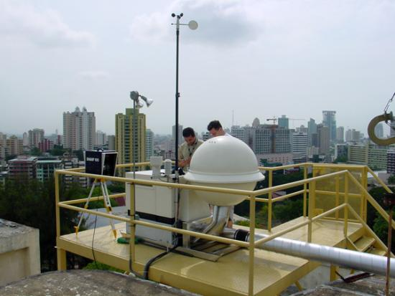
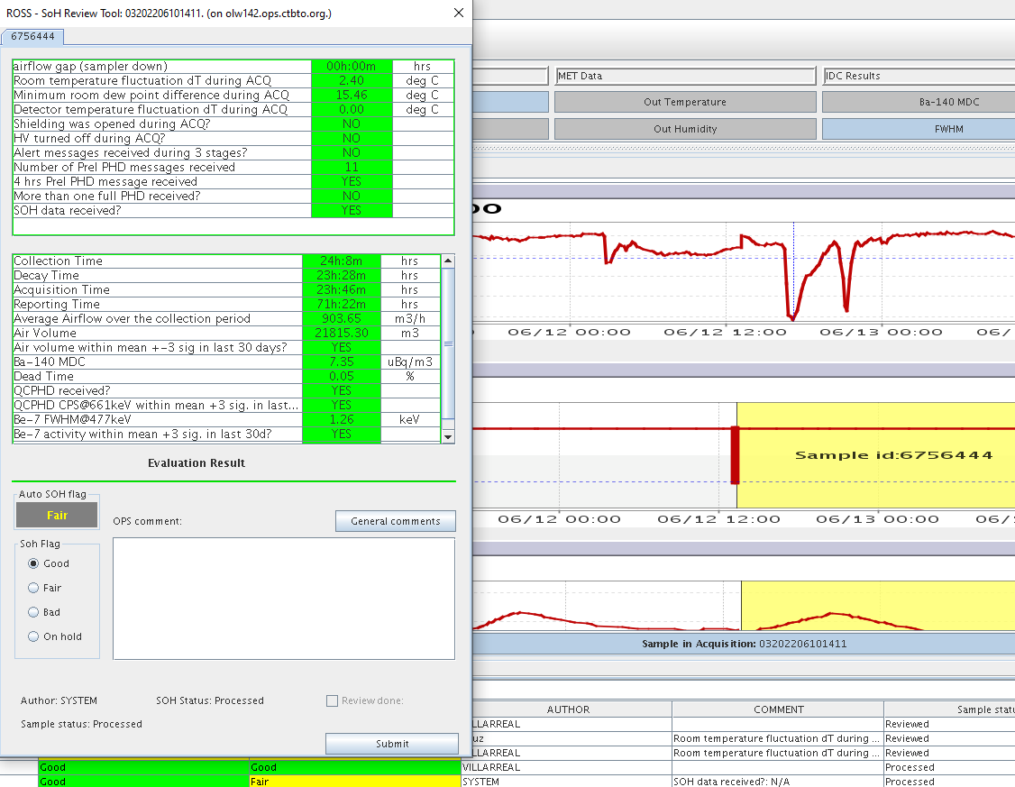
International Monitoring System Radionuclide Station State of Health Monitoring Using the Radionuclide Operations Support System
P. T. Cruz, R. E. Villarreal, M. Nizamska, P. Ekimov, M. Rozmaric, and D. Han
CTBTO Preparatory Commission
P4.4-759
Radionuclide Monitoring Stations under the IMS Network provide crucial evidence to confirm whether a detected explosion is relevant to a nuclear test.
Because of this importance to CTBT’s verification regime, it is important to maintain good operational status of IMS Radionuclide Monitoring Stations and ensure high Data Availability and good Data Quality
The Radionuclide Operations Support System (ROSS) provides a graphical interface for PTS users to display IMS station data and alert messages, assess current station performance based on SOH data, and notify various stakeholders of the critical issues that affect Key Performance Indicators (KPIs) of Radionuclide Stations in the International Monitoring System (IMS).
Learn more about the ROSS software through my e-poster during session 4.4 on this date or access it online on the SnT2023 Conference platform!

