Slide 1
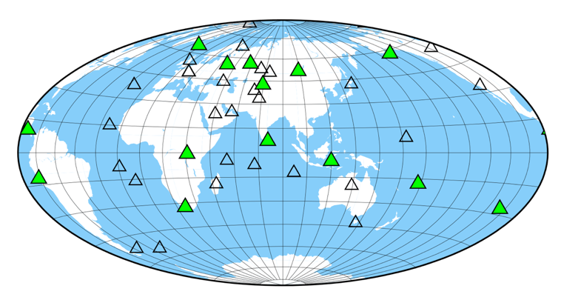
Decreasing operational costs by enhancing regional and local capabilities: a new paradigm for long term global network operations
Rob Mellors and the IDA staff
University of California, San Diego
[Author name goes here / Font: Arial Size: 18]
Affiliation / Organization / Company / Institute [if any / Font: Arial Size: 14]
P4.4-477
Problem:
Maintenance and operation of global seismic networks is costly
Travel restrictions during COVID demonstrated that an increased role by local station operators in diagnosis, repair, and upgrades led to multiple benefits.
Benefits:
Decrease travel costs (and CO₂ footprint)
Builds local capacity and knowledge
Quicker response => reduced data loss
Needs:
Improved remote training and documentation
More spare equipment on site
Good working relationship between field engineers and station operators
IDA station
IDA/IMS auxiliary station
The IDA network is a 40 station network that is part of the U.S. Global Seismic Network. 14 of the IDA stations serve as auxiliary IMS stations.

