Slide 1
Decreasing operational costs by enhancing regional and local capabilities: a new paradigm for long term global network operations
Rob Mellors, Carl Ebeling, Pete Davis, Jon Berger, Dan Auerbach, Scott Bargabus, Jim Conley, Don Elliott, William Hatfield, Erik Klimczak, Chris Sites, Sonya Wilson, and Heinz Wuhrmann
rmellors@ucsd.edu
Institute of Geophysics and Planetary Physics
Scripps Institution of Oceanography
University of California, San Diego
Maintenance and operation of global seismic networks is costly.
Travel restrictions imposed by COVID illustrated a new mode of operation and maintenance which increases the roles of the local operators.
Objective: Decrease maintenance and operation costs of a global seismic network
Solution: Increase reliance on local operators to maintain stations.
Benefits
Decreases travel costs (and CO₂ footprint)
Builds local capacity and knowledge
Quicker response means reduced data loss
Increased reliance on local operators provides significant benefits.
Please do not use this space, a QR code will be automatically overlayed
P4.4-477

Slide 2
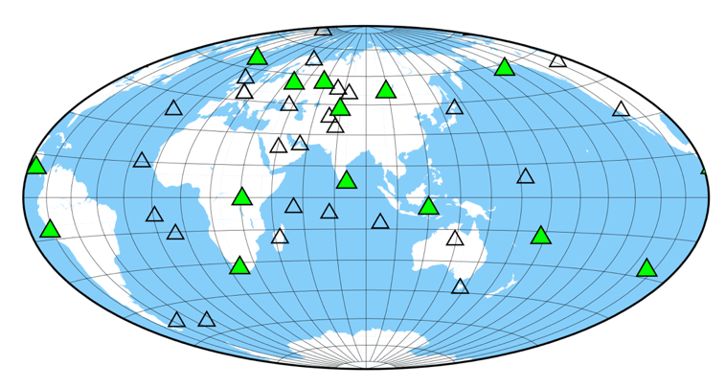
Introduction
Problem:
Maintenance and operation of global seismic networks is costly.
Costs:
Staff
Equipment
Travel
Shipping
Telecommunications
Travel restrictions imposed by COVID forced increased reliance on local operators to diagnose, repair, and upgrade stations in collaboration with field engineers in San Diego.
This turned out to have significant benefits.
IDA station
IDA/IMS auxiliary station
IDA network
41 open broad-band stations
Objectives: Science and monitoring
Supports 14 IMS auxiliary stations
Separate data flow
Same power and sensors
Funded by U.S. NSF, U.S. Geological Survey, and University of California, San Diego
Based in San Diego, California, USA
Please do not use this space, a QR code will be automatically overlayed
P4.4-477

Slide 3
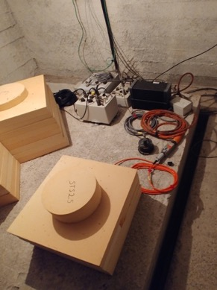
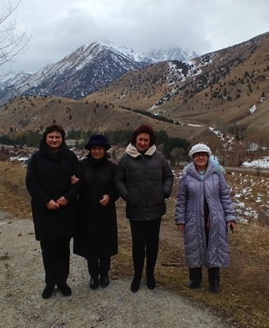
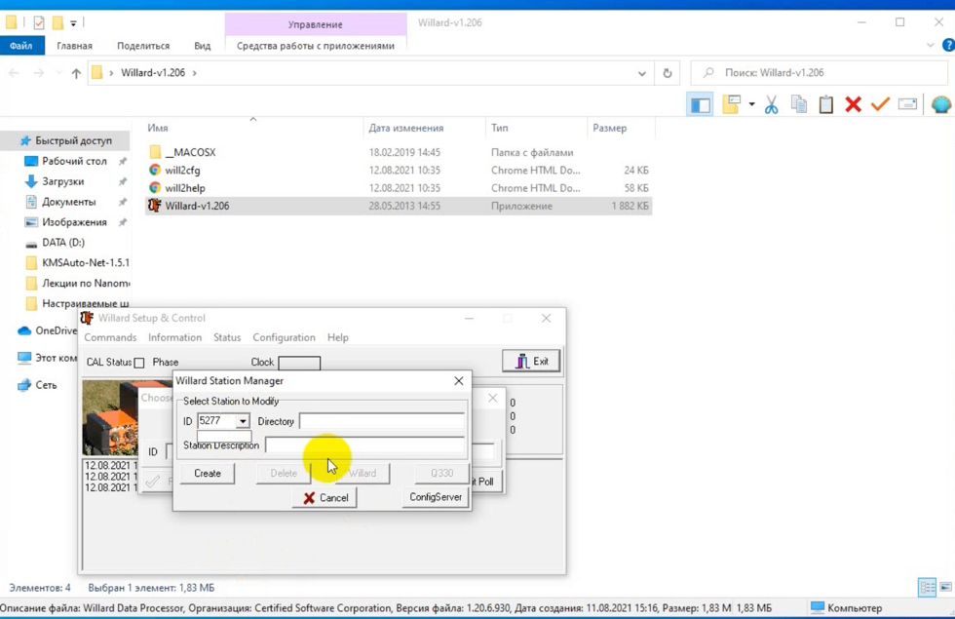
Objectives
AAK/AS030
Objective: Decrease maintenance and operation costs
of a global seismic network
Example: Travel of field engineers to diagnose, repair and
update
Travel costs (e.g., airfare, lodging)
Time spent traveling (multiple days or more
to some locations)
Delay in fixing problems
Solution: Increase reliance on local operators to maintain stations
Diagnosing problems (with guidance)
Installing spares
Replacing vault sensors
Electronics upgrades (e.g., firmware)
Please do not use this space, a QR code will be automatically overlayed
New STS2.5 installation and firmware upgrades performed by AAK station operators.
P4.4-477

Slide 4
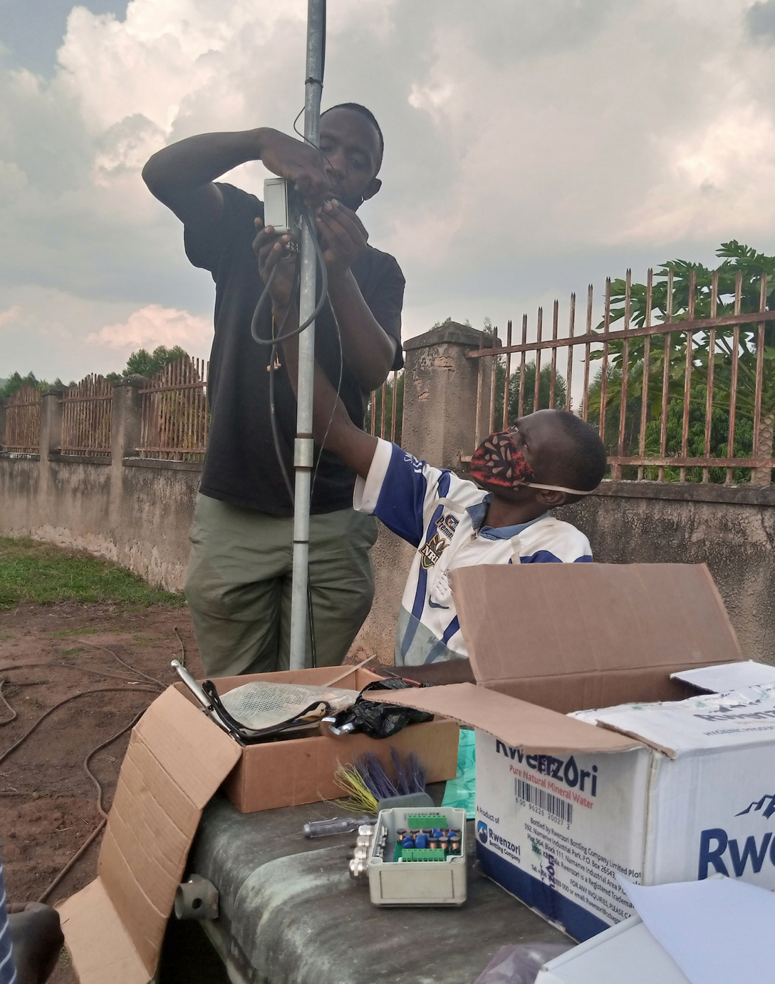
Methods - Benefits
Benefits:
Decreased travel costs (and CO₂ footprint)
Builds local capacity and knowledge
Quicker response => reduced data loss
Communication:
Off-site: email (documents, photos)
On-site: cell phone apps are very useful if coverage exists (WhatsApp, Telegram, Viber, Skype)
Send video of diagnostics (LED’s, voltage)
Photos and videos of completed work
MBAR/AS103
Overall:
Improved capabilities at local level
Lower overall costs
Consistent data return
Please do not use this space, a QR code will be automatically overlayed
P4.4-477

Slide 5
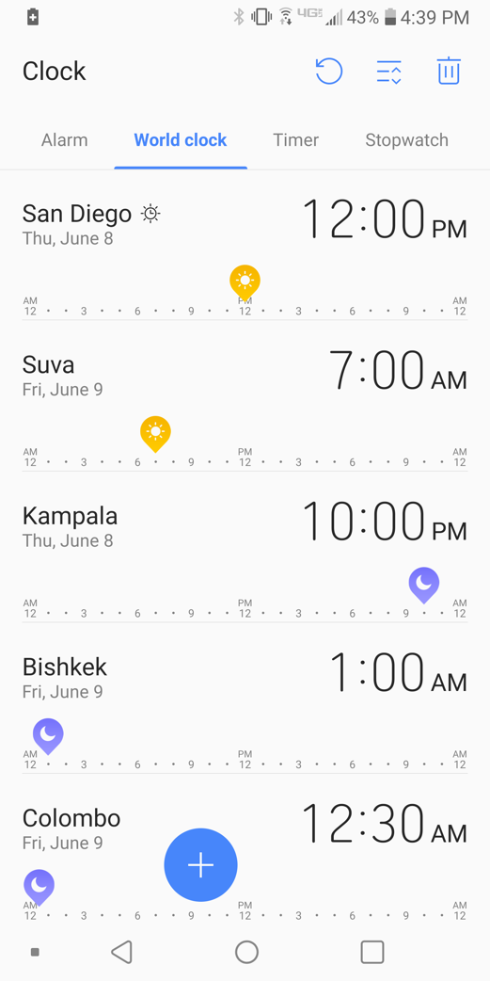
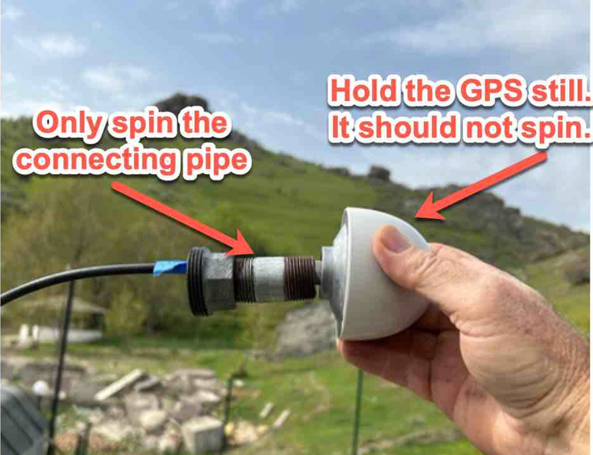
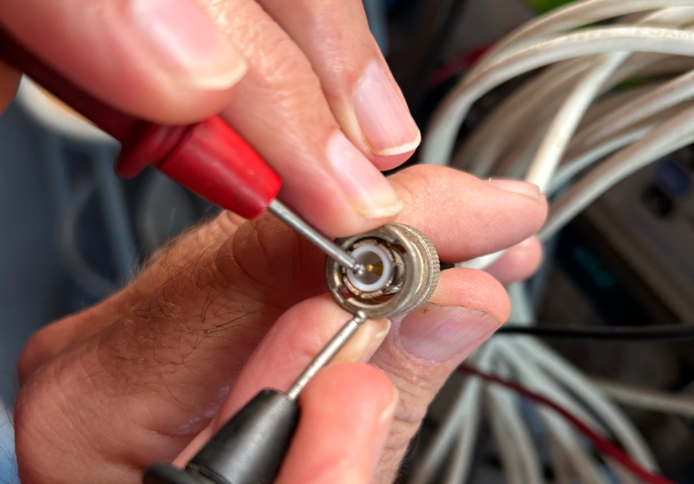
Methods - Needs
Needs:
Good relationships between field engineers and station operators
Improved remote training and documentation
Available spare equipment on site
As much remote diagnostics as possible
Quality check of completed work
Willingness of funding agencies to support international staff
Challenges:
California-based engineers are in significantly different time zones (lots of late-night phone calls)
Language and communication
Example of detailed GPS antenna replacement procedure
Please do not use this space, a QR code will be automatically overlayed
P4.4-477

Slide 6
Conclusion
Increase reliance on station operators and local contacts.
Benefits:
Decrease travel costs (and CO₂ footprint)
Builds local capacity and knowledge
Quicker response = reduced data loss
Needs:
Improved remote training and documentation
More spare equipment on site
Good working relationship between field engineers and station operators
A sincere thank you to all our host organizations!
Code | Name | Host
AS018 | RPN | CCHEN
AS025 | JTS | Observatorio Vulcanológico y Sismológico de Costa Rica
AS031 | MSVF | Mineral Resource Department/Fiji Electricity Authority
AS038 | BORG | Icelandic Meteorological Office
AS044 | KAPI | Badan Meteorologi, Klimatologi, dan Geofisika
AS060 | AAK | Institute of Seismology National Academy of Sciences Kyrgyz
AS078 | NNA | Instituto Geofisica del Peru
AS084 | OBN | Geophysical Survey of Russia Academy of Sciences
AS085 | ARTI | Geophysical Survey of Russia Academy of Sciences
AS087 | TLY | Geophysical Survey of Russia Academy of Sciences
AS099 | SUR | South African Astronomical Observatory/
AS100 | PALK | Geological Survey and Mines Bureau of Sri Lanka
AS103 | MBAR | Geological Survey and Mines Department
AS110 | KDAK | Univ. California, San Diego.
Please do not use this space, a QR code will be automatically overlayed
P4.4-477

