Slide 1
Impact on On-Site Inspection Efficiency
due to Lack of Team Building Opportunities
Nalin de Silva
Geological Survey and Mines Bureau
It is forecasted that OSI will function in uncompromising hostile environment as of the objective of the same and having a well coordinated and closely bounded team is a necessity for success. Such team building was disturbed by the COVID-19 pandemic situation
Hypothetical comparison of two different scenarios of team building; interactive training and remote training towards achieving OSI objective
IFE, the mock exercise of OSI, in 2008 and 2014, revealed that closely knitted in-person trained field teams managed to produce expected results. The performance of remote training is yet to be tested
IFE reveals the importance of closely-bounded team for its success and COVID-19 disturbed in building of such teams as remote training become inevitable. The OSI regime needs to device a cost-effective mechanism towards in-person training for team building.
Please do not use this space, a QR code will be automatically overlayed
P4.5-040

Slide 2
Introduction
OSI is the final verification regime that provides necessary information enabling to decide whether there is any possible violation
OSI demands to function in an uncompromised even hostile environment with unforeseen and unexpected scenarios which may not pre-determined
Having a closely knitted team with in-person relations is an advantage for the success of the inspection
COVID-19 demanded remote training for the surrogated inspectors with minimum of in-person interactions
Please do not use this space, a QR code will be automatically overlayed
P4.5-040

Slide 3
Objectives :
To evaluate the necessity of having in-person training over remote training options as of the complexity and unforeseen nature of an On-Site Inspection (OSI)
Please do not use this space, a QR code will be automatically overlayed
P4.5-040

Slide 4
Methods: Hypothetical comparison of two different approaches
OSI OBJECTIVE
Characters of an OSI
Inspected scenarios are not pre-defined
Operate in uncompromised hostile environment
Team composition is culturally diverse
Individual capabilities and expertise are wide-ranging
Time criticality
Isolated approach due to lack of team building
Collective approach via team-building
Please do not use this space, a QR code will be automatically overlayed
P4.5-040

Slide 5
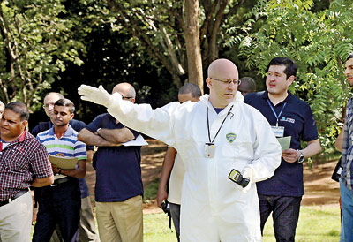
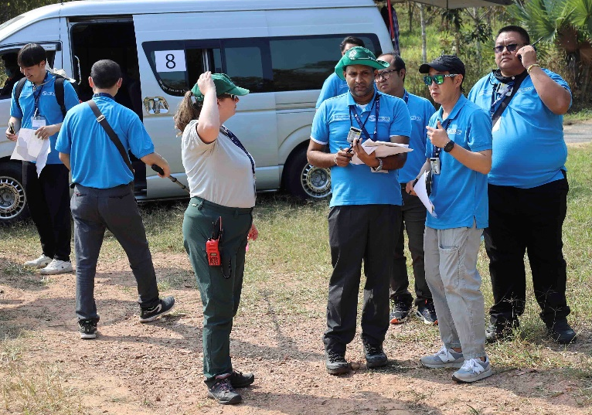
Result : IFE outcome
Please do not use this space, a QR code will be automatically overlayed
Fully interactive training
Semi-automated environment
P4.5-040

Slide 6
Conclusion
COVID-19 situation made remote training of OSI tools and procedures mandatory, driving the Inspectorate towards semi-automatic mode providing limited opportunities for team-building, while hardly having sufficient room for diversified sentiments.
Previous Integrated Field Exercises (IFE) reveals the importance of having well-coordinated closely-bounded team, with a space for constructive personal initiatives bringing into ever evolving on-field inspection progression.
The OSI regime shall implement process to assess the quality of remote training compared to in-house team-building and need to device a cost-effective mechanism filling the gaps, accordingly.
Please do not use this space, a QR code will be automatically overlayed
P4.5-040

Slide 7
References
Comprehensive Nuclear-Test- Ban Treaty
Model Text for the Draft OSI Operational Manual , 2013
On-Site Inspection Test Manual , CTBT/WGB/TL-18/30, 2006
Ranjana, M., (2016)., Leadership: Personal Effectiveness and Team Building, 2nd Edition.: Vikas Publishing House.,
Please do not use this space, a QR code will be automatically overlayed
P4.5-040

