Slide 1
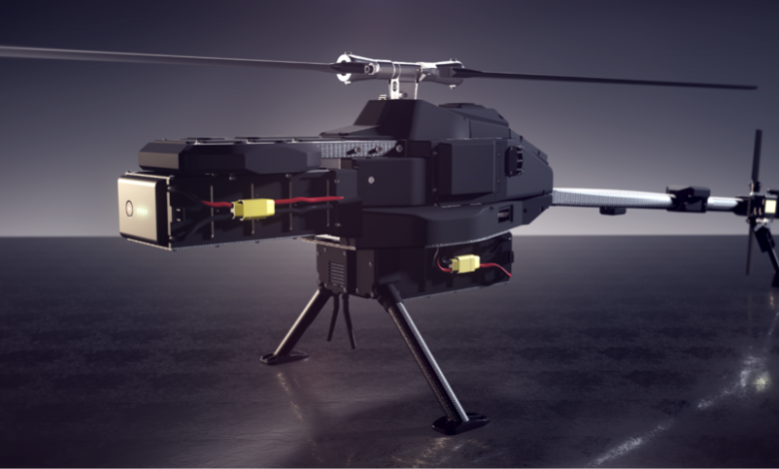
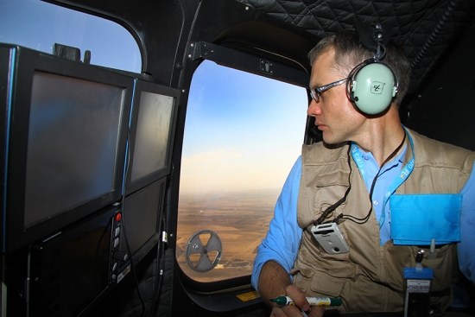
The Comprehensive Nuclear-Test-Ban Treaty Protocol: Possible Hindrance for On-Site Inspection Obligations
Nalin de SiIva
Geological Survey and Mines Bureau
P4.5-039
Considered the nature of the intrusiveness of an OSI having strict-code of conduct is an understandable phenomenon,
However, the tools and methods were listed in the Protocol was formulated at the time which the Treaty was negotiated ( almost 03-decades back)………
Field Glasses
Video Cameras
Still Cameras
+
Limited on board Inspectors
Aerial Drones in Mineral Exploration | Geology for Investors
Once the Treaty Entry Into Force, the verification system may need an updating??
In case if the tools and methods listed in the Protocol is fixed, with the advancement of science and technology, the same may become redundant…while the potential violator is not barred to use of any of the novel technologies

