Slide 1
The Comprehensive Nuclear-Test-Ban Treaty Protocol:
Possible Hindrance for On-Site Inspection Obligations
Nalin de Silva
Geological Survey and Mines Bureau
OSI has to be performed via the tools and methods that are listed in the Protocol. As time elapse these tools become outdated and achieving the OSI objectives with such stalled resources become a challenge in an environment where possible violator is having tolerance to choose.
Comparison of modern tools and equipment available with listed and allowed equipment in the Treaty-Protocol for an OSI inspection
It is transpired that modern techniques, which further developing, are having a great advantage towards OSI objectives compared with the techniques and tools listed in the Protocol.
Considered the nature of intrusiveness of OSI intent, in the perspective of national security, having a balance approach both on equipment and methods is an expected outcome, though the same hinders the progress of an effective OSI inspection.
Please do not use this space, a QR code will be automatically overlayed
P4.5-039

Slide 2
Introduction : OSI tools and methods
1. OSI is the final verification regime of the CTBT and the ambiguous event is assessed being on-site that is identified via IMS analysis and other National Technical Means (NTM).
2. The Protocol of the Treaty defines the allowed methods and tools that are to be deployed in the field, and reflect the tools that were available at the time of Treaty negotiations (?)
3. Other than the methods and tools listed, the Inspection Team could obtained information (?) via other National Technical Means (NTM), where such assistance is not well defined.
4. As time elapses, the listed methods and tools may become redundant considered the novel technological developments
Please do not use this space, a QR code will be automatically overlayed
P4.5-039

Slide 3
Objectives : Emphasizing the hindrance with stalled OSI tools
to assess whether the limitation of the Protocol is a hindrance towards successful On-Site Inspection
to identify possibilities in upgrading the tools and methods of OSI, as of the technological advancement
Please do not use this space, a QR code will be automatically overlayed
P4.5-039

Slide 4
Method: Comparison of allowed techniques/tools and available tools
OSI approved tools and methods | Improved Technology | Comparison
Over-flight with limited number of inspectors | Remotely controlled drones with high maneuverability | The new technology provide wider coverage compared to OSI approved equipment and techniques
VOB: Field Glasses Video Cameras Still-cameras | Automated image capturing tools Equipment that could penetrate canopies and obtain ground images etc….( developing further) | The VOB techniques listed in the Protocol may not work in low-visibility environments
Drilling only for radioactive samples | Bore-hole-logging (sonic, EM and etc…) | Bore-hole logging provides wider coverage and the foot-print would be larger
Other National Technical Means(NTM) | The Protocol is not specifying how the NTM works in an OSI. In the pre-planning stage NTM could incorporated, yet once the inspection is initiated, the assistance of NTM is not clear ( subject to ISP approval?)
Please do not use this space, a QR code will be automatically overlayed
P4.5-039

Slide 5
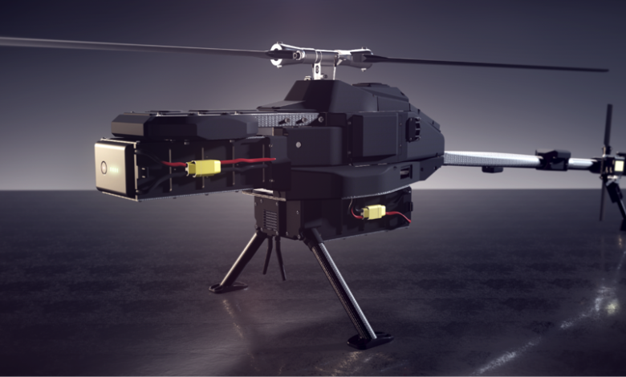
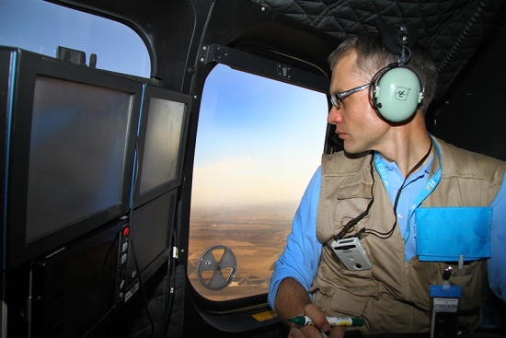
Results
It is transpired that modern techniques, which are further developing, are having a great advantage towards OSI objectives compared with the techniques and tools listed in the Protocol.
Aerial Drones in Mineral Exploration | Geology for Investors
Application of modern technics and tools would be producing far better results compared to what is approved in the Protocol…………..
Please do not use this space, a QR code will be automatically overlayed
P4.5-039

Slide 6
Conclusion / Recommendations
Considered the nature of the intrusiveness of an OSI having strict-code of conduct is an understandable phenomenon, however,
as the time elapses, novel technologies and tools will be developed with high capabilities that could reach OSI objectives with an ease, further
the potential violator is not bounded by technological-barriers and could develop “concealment tactics” in which the OSI (redundant) tools and method become futile,
In addition, the assistance of NTM during the inspection phase is not comfortably applicable (?)
With all difficulties, the IT required to deliver the outcome according to very strict “Time-Lines”
in such backdrop,
Once the Treaty Entry Into Force (EIF), the verification methods, tools an technologies needs to be upgraded in keeping par with the scientific and technological advancement.
Please do not use this space, a QR code will be automatically overlayed
P4.5-039

Slide 7
References
Comprehensive Nuclear-Test- Ban Treaty
Model Text for the Draft OSI Operational Manual , 2013
On-Site Inspection Test Manual , CTBT/WGB/TL-18/30, 2006
Please do not use this space, a QR code will be automatically overlayed
P4.5-039

