Slide 1
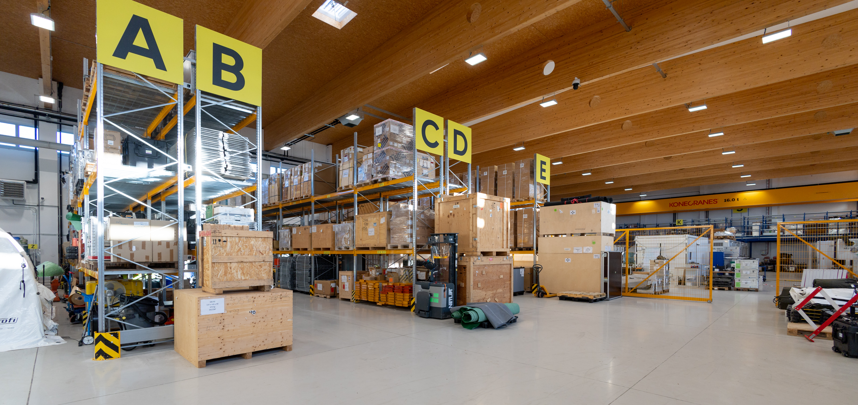
Update on Tools to Support On-Site Inspection Equipment Calibration, Maintenance and Protection
Remi Colbalchini, Aled Rowlands, Samuel Toon and Alana Harmati
CTBTO OSI/EP
P4.5-429
One stop repository with increasing number of functionalities, EIMO, physical protection devices, better outputs and capacity building = tools required at HQ and On-site for equipment management in line with the Treaty.
Tracking of movement with RFID Gate
2 factor authentication key cabinet
EIMO Use during Inspection with Equipment list
Spare storage management on EIMO
Generation of shipment paperwork from EIMO
Maintenance monitoring in EIMO

