Slide 1
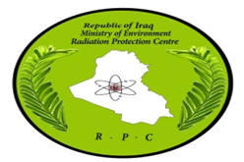
Potential Application of Wallet Card for Radiation Zones to Inspection Team Health and Safety Protection in Inspection Areas
[AL-SALHY SALWA ]
Radiation Protection Center (RPC) / Ministry Of Environment / Iraq
Radiation Protection Center (RPC) a regulatory body in Iraq : Rules and duties
Objective of wallet -card for radiation zones
Radiation measurements (µSv/hr)
for the health and safety of workers at the on-site inspection sites
Please do not use this space, a QR code will be automatically overlayed
P4.5-786

Slide 2

Radiation Protection Center (RPC) a regulatory body in Iraq : Rules and duties
The Radiation Protection Centre (RPC) is the national regulatory authority that is designated by the Iraqi Government for a specific purpose in connection with regulatory oversight of all ionizing radiation sources in Iraq. (RPC) is established according to the law of Ionizing Radiation No. 99 for the year 1980 “Protection from Ionizing Radiation”.
Law No. 99 of 1980 defined RPC’s infrastructure and its core functions and responsibilities.
RPC has a great experience in the field of regulatory control of all radiation sources and x-ray generator applications, protection of workers, Inspection, and granting authorization and licenses, for all facilities and activities. (RPC) responsible for :
1 - Monitoring radiation workers (This is done by providing them with personal dosimeter TLD, ED)
2 - Monitoring Iraqi environment (soil, water, air)
3 - And gamma radiation monitoring
Please do not use this space, a QR code will be automatically overlayed
RPC IT in IA
P4.5-786

Slide 3

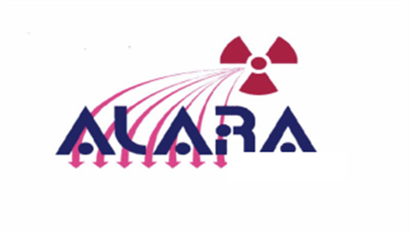
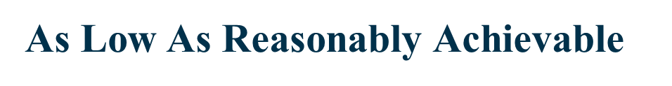
Objective of wallet -card for radiation zones
The wallet card for radiation zones prepared and designed for :
- Provide the inspection team with radiation protection Guidelines for an Onsite Inspection Work in Radiation Zones (Safe Zones , Low, Medium, High And Very High Radiation Zones )
The wallet card prepared and designed for inspection teams health and Safety to maintain the radiation doses of an inspection team on-site within ALARA principle to reduce the potential doses of radiation and radioactive Materials.
The wallet cards for radiation zones are designed by Radiation Protection Officer ( RPO) at a Regulatory body in IRAQ / Radiation protection center / Ministry of Environment for the health and safety of workers at the on-site inspection Sites are intended to deliver health and safety information and instruct.
The wallet cards for radiation zones supplied by RPC to inspectors in radiological emergencies as the RPC is a member of National Emergency Committee, in Iraq with other ministries which are MOST, Health, Defense, etc.
Please do not use this space, a QR code will be automatically overlayed
P4.5-786

Slide 4
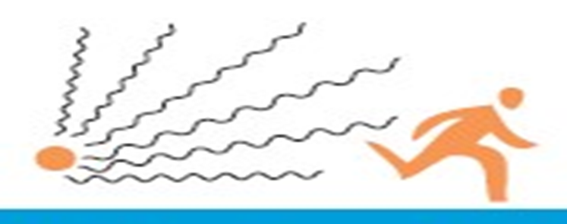

Radiation measurements (µSv/hr)
- All radiation measurement in the wallet -card for radiation zones according to the Instructions of The IAEA
- When the inspection teams enter the On- site, they use the Survey Meter to Determine the radiation dose rate (µSv/hr) .
Radiation measurement :
Background Zones(Bkg) : dose rate <0.2 µSv/hr ( safe Zone )
Safe Zones : Bkg dose rate <0.2 µSv/hr ( safe Zone )
Low Zones : >2 x Bkg <10 µSv/hr ( area where small amounts of radioactivity )
Medium Zones : >10 µSv/hr <1 mSv/hr (area where medium amounts of radioactivity )
High Zones : : >1< 10 mSv/hr (area where high amounts of radioactivity )
Very High Zones : >10 mSv/hr
Please do not use this space, a QR code will be automatically overlayed
P4.5-786

Slide 5
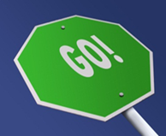
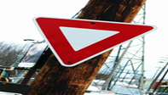
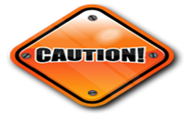
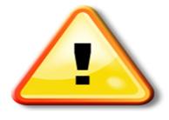

The Result / Potential Application of wallet card
Radiation Zones – wallet card
Zones | Notes | Radiation Field | Contamination | Controls
Background |  | <0.2 µSv/hr | none | none
Safe |  | <0.2 µSv/hr | none | none
Low |  | >2 x Bkg <10 µSv/hr | low | Pre-work planning; ALARA controls
Medium |  | >10 µSv/hr <1 mSv/hr | medium | Pre-work planning; ALARA controls; consult H&S team
High |  | >1<10 mSv/hr | high | Pre-work planning; ALARA controls, H&S team approval; written work plan
Very High |  | >10 mSv/hr | very high | Pre-work planning; ALARA controls; H&S team & IA TL approval: written work plan; DG authorization
Please do not use this space, a QR code will be automatically overlayed
P4.5-786

Slide 6
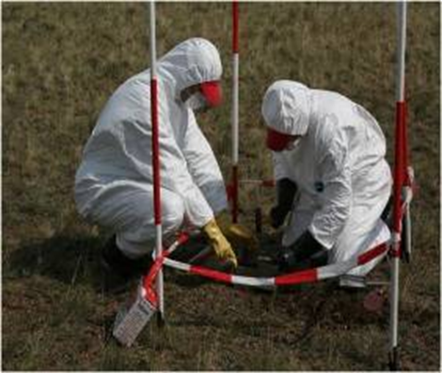
Conclusions
According to my work in my institution as a Radiation Protection Officer( RPO ) I designed my e- poster titled ( wallet cards for Radiation Zones ) according to IAEA instruction and CTBTO for the health and safety of workers at the on-site inspection sites are intended to deliver health and safety information and instruct.
The Inspection teams must comply the instructions for entering Radiation Zones , and applying the ALARA principle while working in radioactive areas,
and reducing the number of workers to the lowest possible number to carry out their work in the IA.
must be qualifying inspection teams within the awareness and safety culture programs include advance planning and good management in dealing with radiation sources and to learn about and how to lower it according to ALARA principle
Please do not use this space, a QR code will be automatically overlayed
P4.5-786

Slide 7

References
IAEA / International Basic Safety standard GSR part 3 / GSG-7
CTBTO website .
Iraqi Radiation Law No. 99 of 1980 .
Please do not use this space, a QR code will be automatically overlayed
P4.5-786

